Slide 1


Child of Change
"It starts with a kiss, it ends with a baby.“
Quebec proverb
Maickery Bozor
July 23, 2020
Ayiti Analytics final project

Slide 2
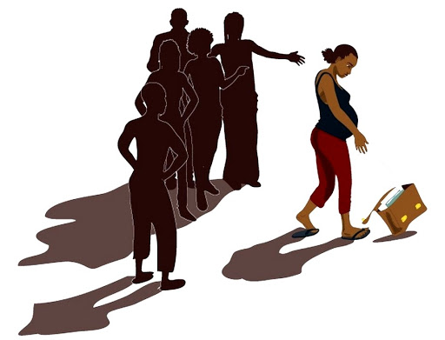
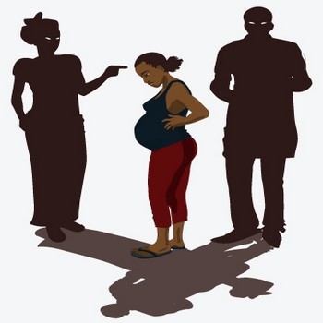
Introduction

Slide 3
Causes

Slide 4
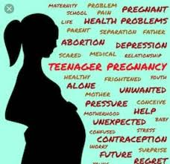
Consequences
Consequences

