Slide 1


Child of One
"It starts with a kiss, it ends with a baby.“
Quebec proverb
It’s important to sexually educating our children
Maickery Bozor
July 23, 2020
Ayiti Analytics final project

Slide 2
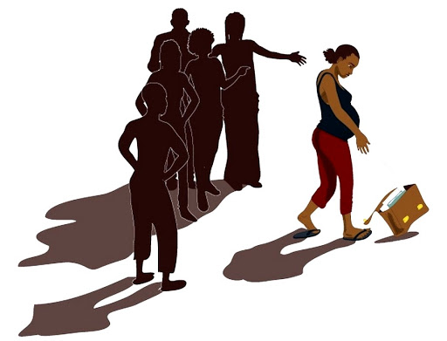
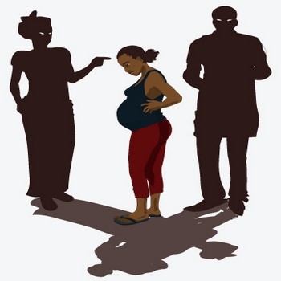
Introduction

Slide 3
Causes

Slide 4
- only 12% of sexual information is provided by family and 29% by friends;
- only 16% of the progenitors are adolescents and 47% are over 28 years of age;
- 93% of adolescent girls do not use condoms or use them only sometimes;
- 90% do not know about family planning methods and how they work;
- 92% do not know their menstrual cycle and 88% do not know their fertile period"

Slide 5

Consequences
Consequences

