Slide 1
Overview of ArithMagic
Software Engineering COMP 4110
University of Massachusetts Lowell
Fall 2019
Team members:
Project Manager: Lily Byan
Facilitator: Justin Dom
Customer Liason: Michael Santana
Configuration Manager: Michael Batbouta
Customer: Elementary School Teachers
Instructor: Professor James Daly*
*Please direct all inquiries to the instructor.

Slide 2
Project Overview
What is ArithMagic?
Educational game
Valuable learning tool
[picture to be inserted]
Notes:
JUSTIN
Motivation from project description - educational game
Decision to create game to teach arithmetic operations
Introduce technical terms

Slide 3
Project Overview
Why ArithMagic?
Practice is necessary
Practice is also boring
[memey picture to be inserted]
Notes:
JUSTIN
Motivation from project description - educational game
Decision to create game to teach arithmetic operations
Introduce technical terms

Slide 4
[insert example of why practice is important]

Slide 5
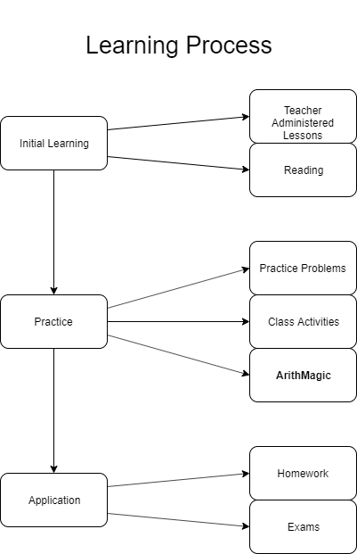
Project Overview
Purpose
Supplements learning
Promotes study
Makes learning fun

Slide 6
Project Overview
How?
Asks math problems in the form of a game
Incentivizes learning

Slide 7
Overview of Features
Levels - adjust difficulty
Questions - varied types
Tutorial - teaching aspect
Score - promotes competition
Timer - provides motivation
Notes:
MICHAEL B
Feature: Levels - sequence of questions
Variable question structure
Feature: Tutorial - basis for teaching operations
Feature: Score - creates competitive aspect
Feature: Timer - helps create competitive aspect

Slide 8
Domain Research
Notes:
Project constraints:
Mass DoE frameworks for math knowledge of students

Slide 9
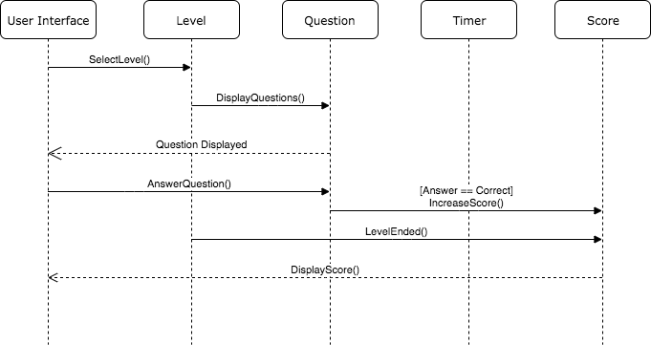
Model-Based View of System
Notes:
LILY
Sequence diagram - best explains interaction and novelty
Explain objects at the top
Select the level
Begin displaying questions
Receive answer
Check answer and possibly increase score
End level after all the questions have been answered
Display score to user
Doesn’t include tutorial aspect

Slide 10
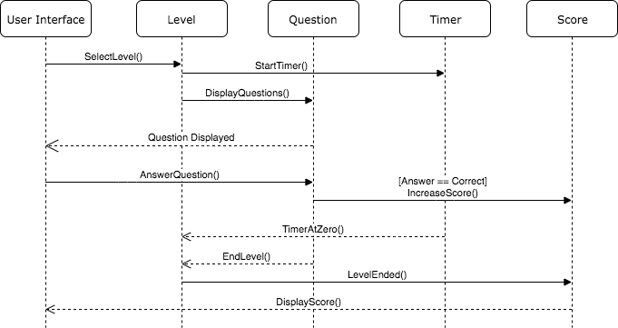
Model-Based View of System
Notes:
LILY
Timer aspect
Begins when level starts
Set amount of time to complete level
If timer reaches zero - send signal to end level
Display score
Bonus score if completed within time limit

Slide 11
Demonstration
Notes:
MICHAEL S
Sample scenarios

Slide 12
Further Development
● Keeping an online profile of each individual user
● Saving the progress of a user
● Allowing the teacher to adjust default difficulties
● Allowing the teacher to add in their own questions
● Allowing the teacher to monitor the progress of the user

Slide 13
Acknowledgements

