Slide 1
Revolutionizing Image Quality: An In-depth Investigation into Super-Resolution via Generative Adversarial Networks
Farjana Alam(20101022)
Maidul Islam(20101309)
Course Code: CSE424
Section: 01
Team: 31
ST: Farah Binta Haque
RA: Md Sabbir Hossain

Slide 2
Objectives
Introduce a novel GAN architecture with a detail-enhancing generator for super-resolution tasks.
Incorporate a VGG19-powered discriminator to effectively distinguish between real and generated high-resolution images.
Leverage the perceptual expertise of VGG19 to ensure fidelity and enhance visual appeal in the reconstructed images.
Demonstrate significant improvements over existing methods, showcasing the potential of the data-driven approach in unlocking latent information within low-resolution images across diverse domains.
01

Slide 3

Introduction
In the realm of image processing, the challenge of dealing with low-resolution (LR) images has persisted, impeding the extraction of valuable information and limiting their utility across various fields. Traditional interpolation methods, though commonly employed, often fall short in overcoming the inherent limitations of LR images, introducing artifacts and failing to accurately reconstruct crucial details. Considering this issue, this paper introduces a pioneering data-driven approach to super-resolution utilizing Generative Adversarial Networks (GANs) guided by the perceptual loss of a pre-trained VGG19 model.
02

Slide 4
Related Works
The study presents MISNet, an ultralight-weight super-resolution network that makes use of residual framework feature interpolation at the multi-resolution level. When tested on benchmark datasets, such as Urban100, the network performs better than current cutting-edge networks. MISNet improves image quality by combining residual and interpolated features,which makes it appropriate for low-power and storage-capableapplications. When compared to existing ultralight-weight networks, the suggested network performs better at retrieving high-frequency features and edges, especially in the Urban100 dataset.
This research resents a Deep Spiking Neural Network(SNN) based Progressive Tandem Learning (PTL) framework for pattern identification. Using the MNIST, Cifar-10, and ImageNet-12 datasets, the authors validate their method and obtain competitive classification accuracy. The technique uses an adaptive training scheduler for layer-wise learning and spike counts for network conversion. The results showcase the efficacy and efficiency of the proposed PTL framework for SNN-based pattern recognition, showing state-of-the-art performance in tasks such as object identification, time-domain voice separation, and image reconstruction.
03

Slide 5
Dataset
Human face images from Kaggle.
3500 high-resolution + 3500 low-resolution images (paired) for training
1000 high-resolution + 1000 low-resolution images (paired) for testing
04

Slide 6
Pre-processing
Combined training and testing datasets due to small size (4497 images)
Used 33% for testing and 67% for training
Resized training images: 510x510 -> 128x128 (high-resolution) and 32x32 (low-resolution)
05

Slide 7
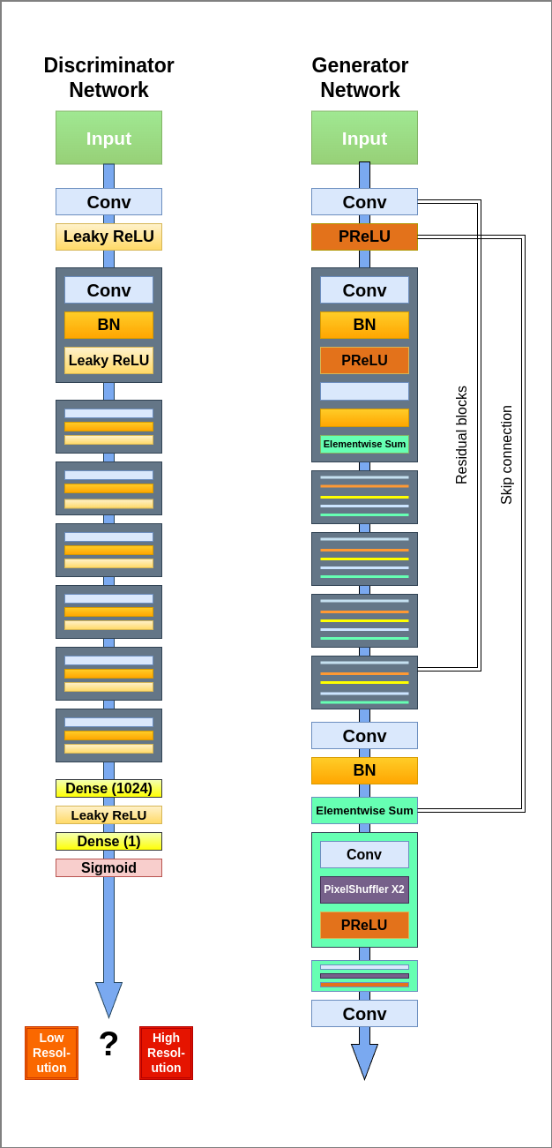
Methodology
Implemented algorithms
Super Resolution GAN.
Detail-enhancing generator: progressively refines features and increases resolution.
VGG19-powered discriminator: extracts perceptual features from real HR images for accurate feedback.
06

Slide 8
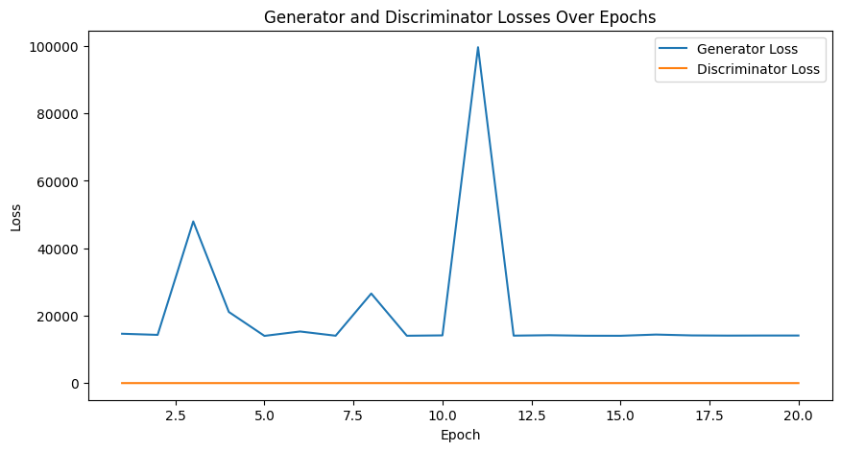
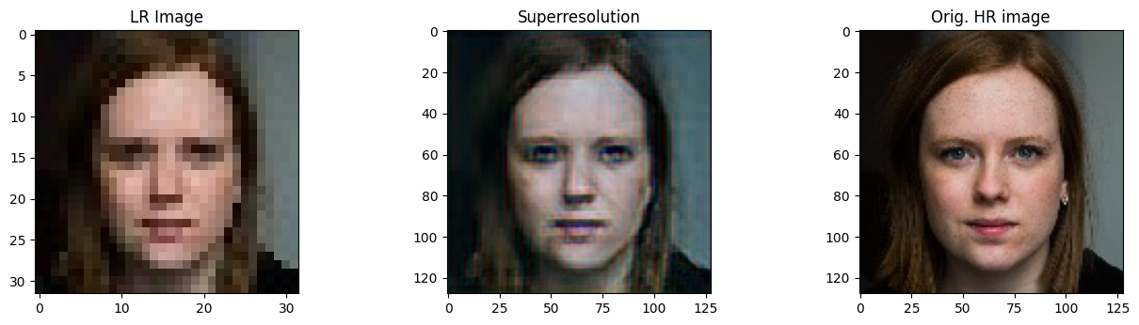
Results
Superior super-resolution results with both visual appeal and content accuracy with only 20 epochs
07

Slide 9
Limitations
The loss curve is fluctuating.
Dataset size is small (Due to hardware limitations)
Epoch is only 20.
Other pretrained image models (Inception, ResNet50, EfficientNet) can be introduced for better results
09

Slide 10
Future works
Data augmentation or using a large dataset.
Training in more powerful device with more epochs.
Training on more pretrained models to compare between them.
10

Slide 11
References
1. Esmaeilzehi, A., Ahmad, M. O., & Swamy, M. N. S. (2021, May). MISNet: Multi-Resolution Level Feature Interpolating Ultralight-Weight Residual Image Super Resolution Network. In 2021 IEEE International Symposium on Circuits and Systems (ISCAS) (pp. 1-5). IEEE
2. Wu, J., Xu, C., Han, X., Zhou, D., Zhang, M., Li, H., & Tan, K. C. (2021). Progressive tandem learning for pattern recognition with deep spiking neural networks. IEEE Transactions on Pattern Analysis and Machine Intelligence, 44(11), 7824-7840.Kalaivani, K. S., Uma, S., & Kanimozhiselvi, C. S. (2021, January). Comparison of deep learning approaches for sentiment classification. In 2021 6th International Conference on Inventive Computation Technologies (ICICT) (pp. 1043-1047). IEEE.
11

Slide 12
Thank You
reallygreatsite.com

