Slide 1
From Classic to Cutting-Edge: A Comparison of
Conventional and Deep Learning Approaches On
Sentiment Analysis
Farjana Alam(20101022)
Maidul Islam(20101309)
Course Code: CSE431
Section: 01
Team: 20
ST: Farah Binta Haque
RA: Md Sabbir Hossain

Slide 2
Objectives
Enhancing Accuracy.
Identifying the optimal approach.
Comparative analysis of traditional ML and deep learning approaches.
01

Slide 3

Introduction
The ever-evolving landscape of online communication necessitates robust tools for analyzing public opinion and sentiment. Within this realm, Twitter stands as a vibrant pulse of social discourse, where brand perception, political trends, and societal shifts unfold in real-time. However, extracting meaningful insights from the vast ocean of user-generated content on this platform requires a sophisticated approach to sentiment analysis.
02

Slide 4
Related Works
This paper titled "Sentiment Analysis and Emotion Detection on Cryptocurrency Related Tweets Using Ensemble LSTM-GRU Model" explores sentiment analysis and emotion detection in cryptocurrency-related tweets using an ensemble LSTM-GRU model. The study utilizes a dataset containing 980,549 training samples and 144,160 testing samples, and achieves high accuracy with a 0.99 score for sentiment analysis and 99.16% accuracy for emotion detection
By using the IMDB dataset, the authors of the paper titled "Comparison of Deep Learning Approaches for Sentiment Classification" evaluates the sentiment classification characteristics of three deep learning models: LSTM, RNN, and CNN, finding that the LS TM model outperforms the others in sentiment classification.
03

Slide 5
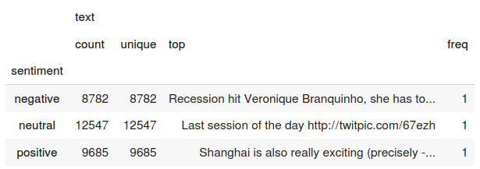
Dataset
Our data originates from a publicly available Twitter dataset on Kaggle.
The dataset is in CSV format.
It consists of 27480 rows
and 4 columns in the training dataset.
It consists of 3534 rows and
4 columns in the testing dataset.
The columns are textID, text, selected text and sentiment.
The dataset contains three distinct sentiment labels for the prediction: neutral, positive, and negative.
04

Slide 6
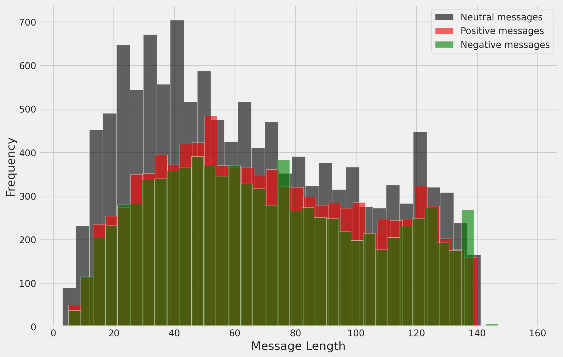
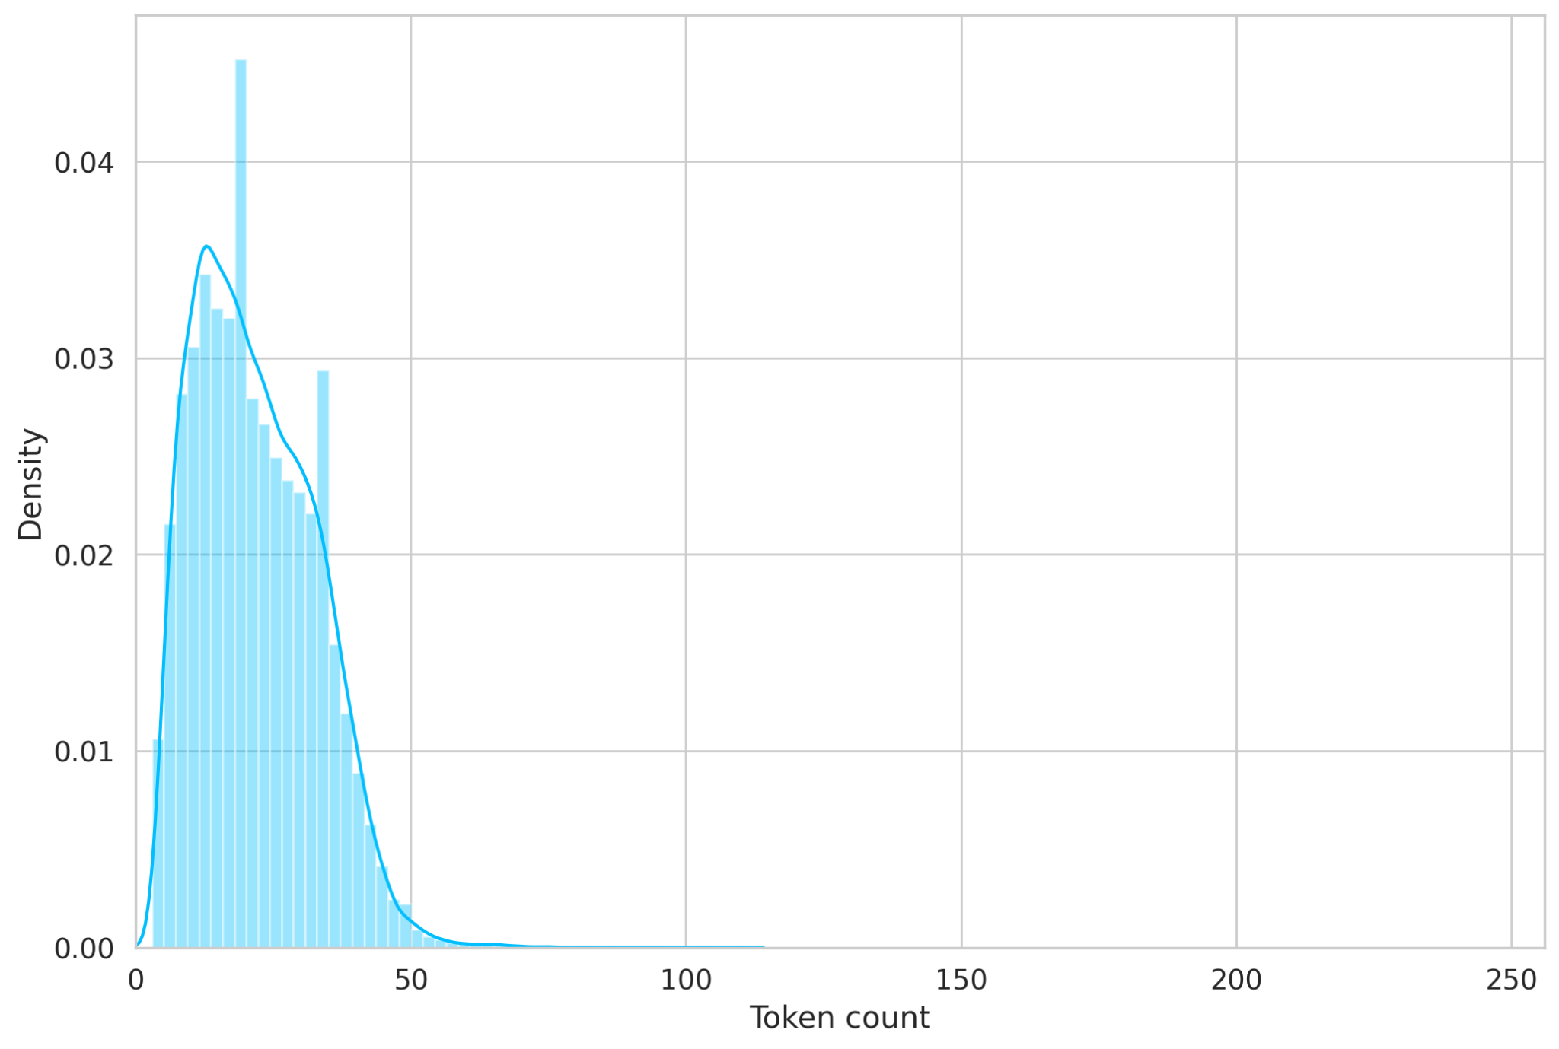
Pre-processing
Handling Missing Values.
Removal of unnecessary Outliers.
Text Normalization by converting all text to lowercase and non-essential punctuation are removed.
Tokenization
Calculated Tweet length as it is a potential indicator of sentiment expression.
Sentiment lexicon dictionaries were utilized to identify the presence of positive, negative, and neutral words in the text, creating additional features for model training.
Splitting into 80/20
05

Slide 7
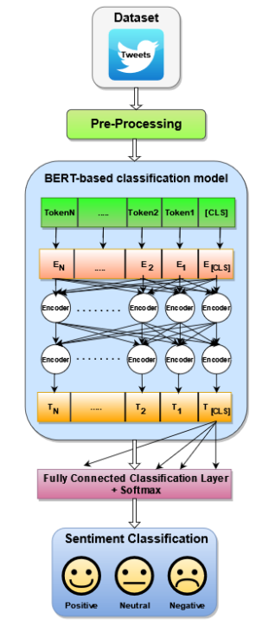
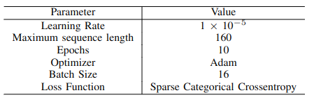
Methodology
Implemented algorithms
LR
MNB
SVM
BERT
06

Slide 8
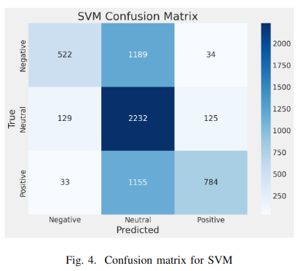
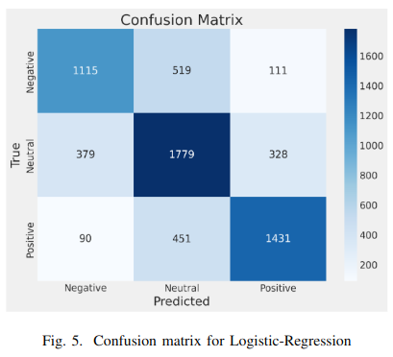
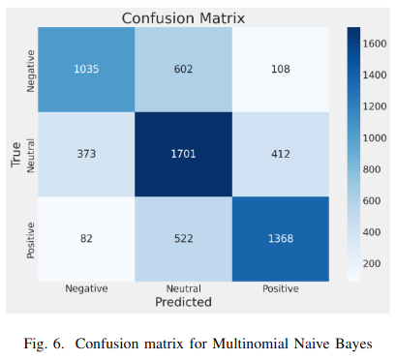
Results
07

Slide 9
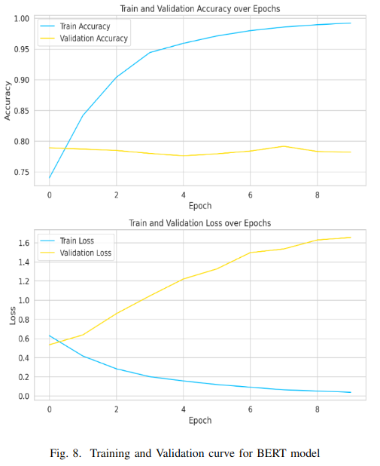
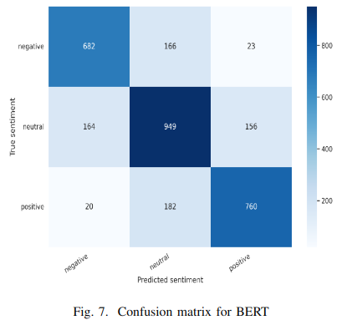
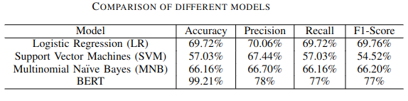
Results
08

Slide 10
Limitations
Validation accuracy is not satisfactory.
The BERT model is slightly overfitting.
Implemented on a small dataset.
09

Slide 11
Future works
Data augmentation.
Overfitting Mitigation Strategies
Real-time Analysis and implementation of other BERT variants like (RoBERTa, M-BERT, ALBERT etc).
10

Slide 12
References
1. Aslam, N., Rustam, F., Lee, E., Washington, P. B., & Ashraf, I. (2022). Sentiment analysis and emotion detection on cryptocurrency related tweets using ensemble LSTM-GRU model. Ieee Access, 10, 39313-39324.
2. Kalaivani, K. S., Uma, S., & Kanimozhiselvi, C. S. (2021, January). Comparison of deep learning approaches for sentiment classification. In 2021 6th International Conference on Inventive Computation Technologies (ICICT) (pp. 1043-1047). IEEE.
11

Slide 13
Thank You
reallygreatsite.com

