Slide 1
Decentralized Heart Health: A Federated Artificial Neural Network Approach to Predicting Heart Disease
Farjana Alam (20101022)
Maidul Islam (20101309)
Farhan Bin Bahar (20101519)
Mukarrama Tun Fabia (20101572)
Course Code: CSE449
Section: 01
Team: 32
ST: Farah Binta Haque
RA: Md Sabbir Hossain

Slide 2
Objectives
To develop a novel Federated Learning (FL) framework with ANN for heart disease prediction.
To address centralized approaches' drawbacks such as privacy, accessibility, and resource issues using FL's collaborative nature.
To evaluate FL's effectiveness in aggregating diverse data for accurate and personalized heart disease prediction.
01

Slide 3
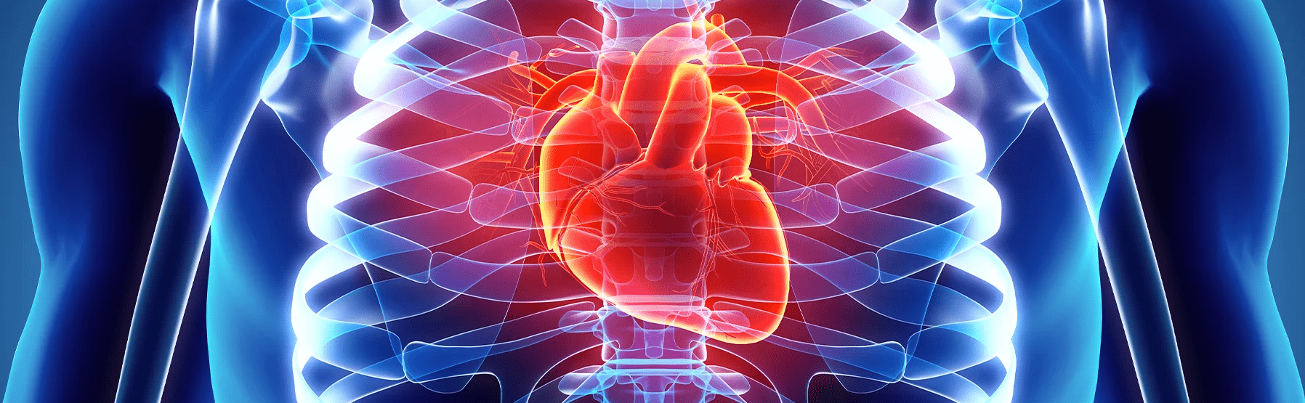
Introduction
Accurate prediction of heart disease is crucial for timely intervention and improved patient outcomes, addressing the global urgency to combat one of the leading causes of death. Considering the urgent need for precise and timely heart disease prediction, this paper introduces a novel Federated Learning (FL) framework employing Artificial Neural Networks (ANN). By leveraging diverse data sources and prioritizing privacy, the proposed framework aims to enhance patient care, enabling early diagnosis, timely intervention, and improved outcomes.
02

Slide 4
Related Works
The paper introduces "FedGKT," a novel federated learning algorithm for training large Convolutional Neural Networks (CNNs) on edge devices with limited resources. FedGKT reduces the demand for edge computation and bandwidth while maintaining comparable accuracy to standard approaches. It employs an alternating minimization technique, periodically transferring knowledge from smaller edge CNNs to a larger server-side CNN. Compared to FedAVG, FedGKT achieves similar or higher accuracy with significantly fewer resources, making it a practical and efficient solution for resource-constrained edge devices.
The paper introduces "Adaptive Personalized Federated Learning" (APFL) as a solution addressing challenges in Federated Learning. APFL improves global model performance while allowing individualized local models, seamlessly integrating local and global aspects. Emphasizing communication efficiency and superior generalization, APFL represents an evolutionary step in Federated Learning, offering a comprehensive solution with broad applicability. Empirical results demonstrate APFL's superiority, highlighting its positive impact on training, generalization, and diverse dataset performance. The paper concludes by stressing APFL's crucial role as a practical, adaptive approach to federated learning, with an emphasis on its communication-reduced optimization algorithm to effectively address challenges.
03

Slide 5
Dataset
Our data originates from a publicly available Heart Failure Prediction dataset on Kaggle.
Size: The dataset comprises 12 columns and 919 rows.
Features: Columns include age, gender, chest pain type, resting blood pressure, cholesterol, fasting blood sugar, resting echocardiogram, maximum heart rate achieved, exercise-induced angina, old peak, st slope, and heart disease.
Age Range: Patient ages range from 28 to 77 years.
Gender Distribution: 79% male and 21% female.
Chest Pain Types: Four types recorded, with 54% ASY, 22% NAP, and the remaining 24% divided between ATA and TA.
Blood Pressure and Cholesterol: Blood pressure ranges from 80 to 200, and cholesterol from 0 to 422.10.
Fasting Blood Sugar: Categorized as 0 for negative and 1 for positive.
Data Source: Obtained from Kaggle as the Heart Failure Prediction Dataset.
Origins: Out of 918 observations, 303 are from Cleveland, 249 from Hungarian, 123 from Switzerland, 200 from Long Beach VA, and 270 from the Stalog dataset.
04

Slide 6
Pre-processing
Categorical Feature Encoding
Feature Scaling
Data Splitting
Dropping Redundant Features
Splitting the dataset
05

Slide 7
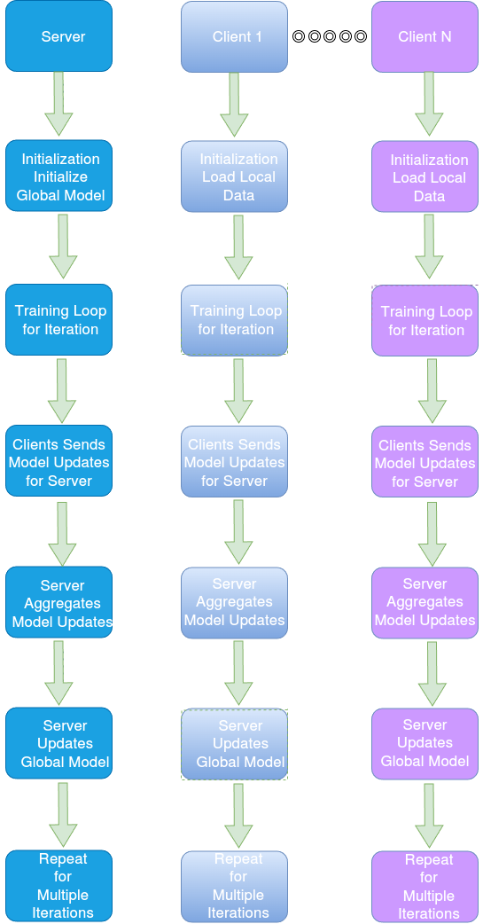
Methodology
Implemented algorithms
Federated ANN
Centralized Deep Learning Model.
Data Distribution.
Client Training.
Model Aggregation.
Averaging Strategy.
Server Model Update.
Resynchronization.
Iterations.
Improved Model.
06

Slide 8
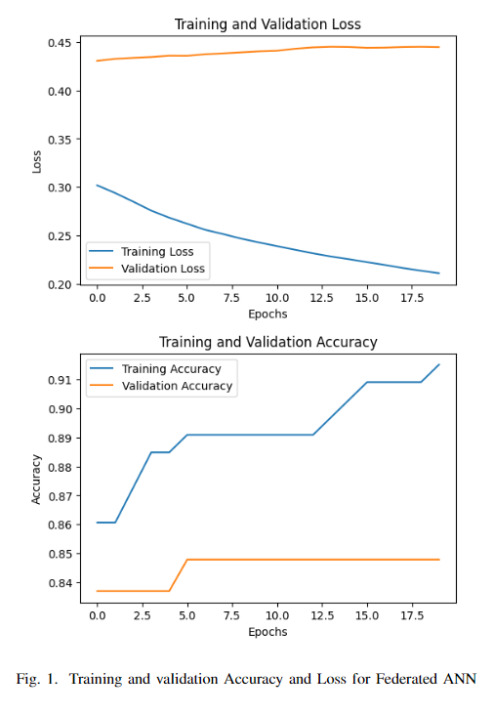
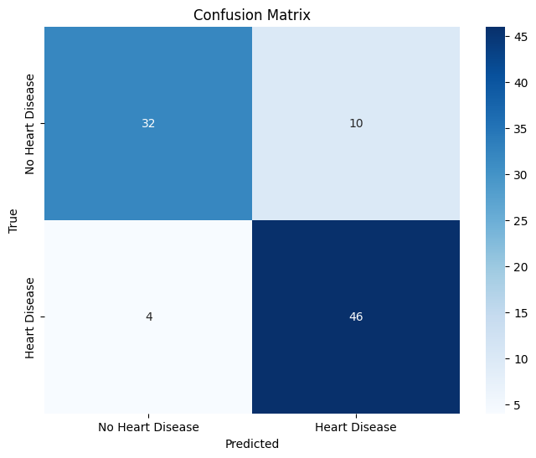
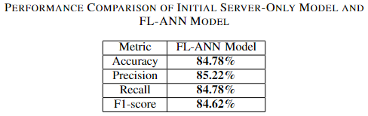
Results
07

Slide 9
Limitations
Slightly overfitting issues.
There are more robust DL models other than ANN.
Model was trained in a Google Cloud Platform (Hardware Limitations)
08

Slide 10
Future works
Introducing Data augmentation.
Incorporating more sophisticated Deep learning approaches like Generative Adversarial Networks (GAN), Transformers, Deep Reinforcement Learning (DRL)
Connecting multiple devices physically and perform training on different clients.
09

Slide 11
References
1. A., Smith, S., Ulm, G., Gustavsson, E., & Jirstrand, M. (2018, December). A performance evaluation of federated learning algorithms. In Proceedings of the second workshop on distributed infrastructures for deep learning (pp. 1-8).
2. He, C., Annavaram, M., & Avestimehr, S. (2020). Group knowledge transfer: Federated learning of large cnns at the edge. Advances in Neural Information Processing Systems, 33, 14068-14080.
10

Slide 12
Thank You
reallygreatsite.com

