Slide 1
Omniretail Sales Performance Analysis
A SQL & Power BI Based Case Study
Md. Maidul Islam
18 October 2025

Slide 2
Introduction & Objectives
Omniretail Pvt. Ltd. is a multi-region retail company operating across North, South, East, and West regions.
The goal of this project is to analyze sales performance using SQL and Power BI to:
Identify high-performing regions and stores
Understand customer and payment trends
Detect product return patterns
Provide actionable business recommendations

Slide 3
Methodology
The project followed a structured analytical workflow:
1️⃣ Data Cleaning (Excel Power Query): Cleaned raw dataset, transposed and standardized columns.
2️⃣ SQL Analysis: Executed 10 business case queries on regional and category performance.
3️⃣ Data Visualization (Power BI): Built interactive visuals and dashboards for insights.

Slide 4
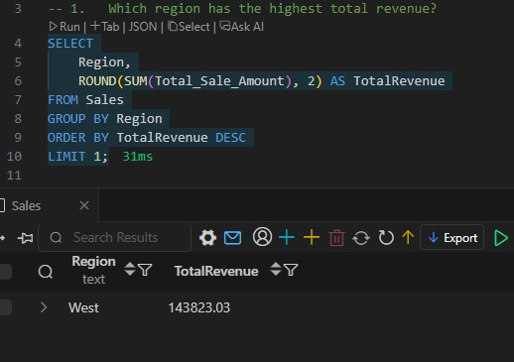
Key Finding 1 - Regional Performance
West Region Generates Highest Revenue
The West region recorded the highest total sales revenue among all regions, indicating strong customer demand and effective store performance.

Slide 5
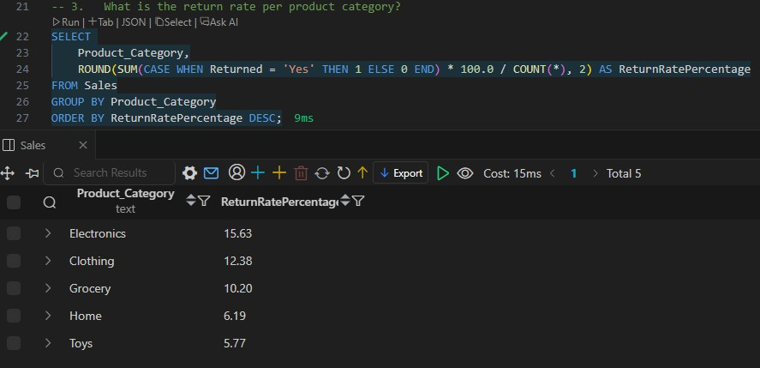
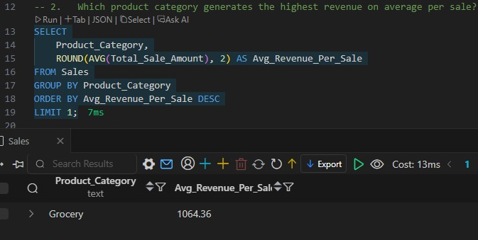
Key Finding 2 - Product Returns & Highest Revenue on APS
High Return Rate in Electronics Category But Highest Revenue on APS in Grocery Category.
Electronics products showed the highest return percentage, suggesting possible quality or after-sales issues.

Slide 6
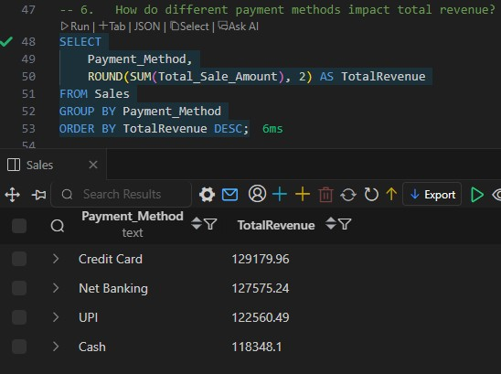
Key Finding 3 - Payment Trends
Credit Card is the Most Preferred Payment Method
Customers prefer Credit Card and Net Banking payments, which contribute more than 60% of total revenue.

Slide 7
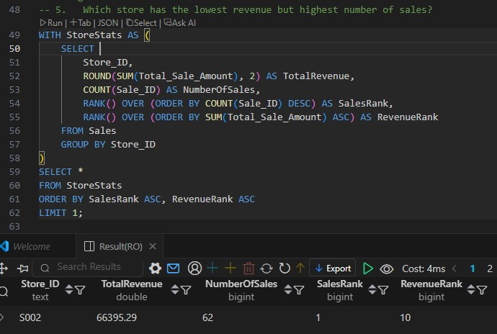
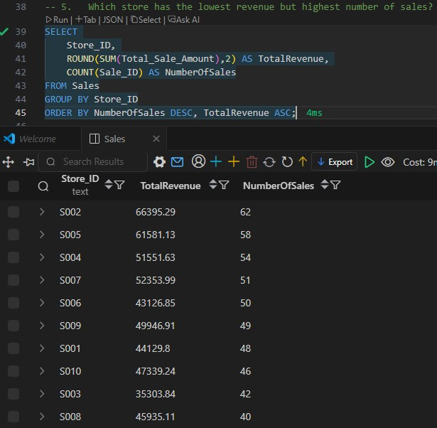
Key Finding 4 - Store Performance
Top Performing Stores by Revenue
The top 5 stores contributed over 65% of total revenue, with Store S002 leading significantly in total number of sales.

Slide 8
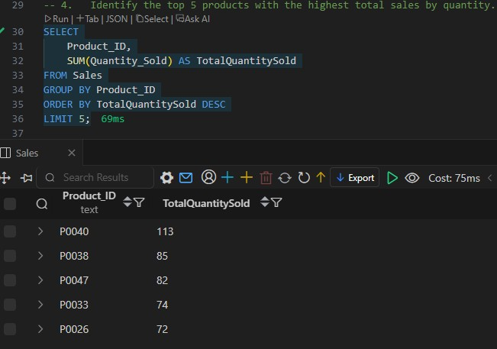
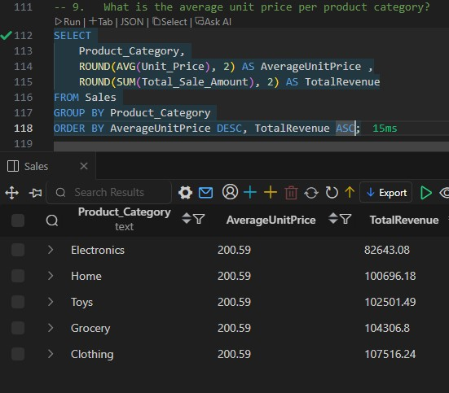
Key Finding 5 - Product Category Profitability
Clothing & Groceries Dominate Revenue Share
Clothing and Groceries together contribute more than 40% of total sales revenue, showing strong customer demand. P0040 is the top-selling product.

Slide 9
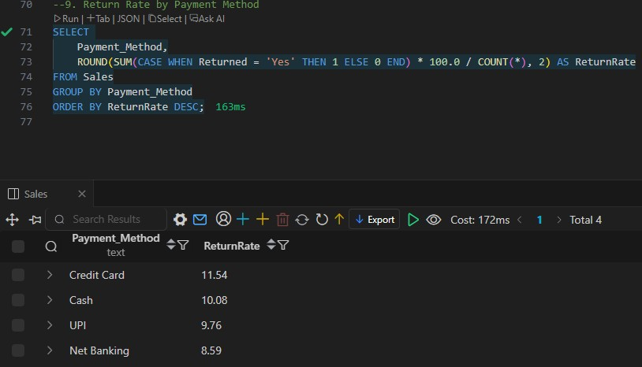
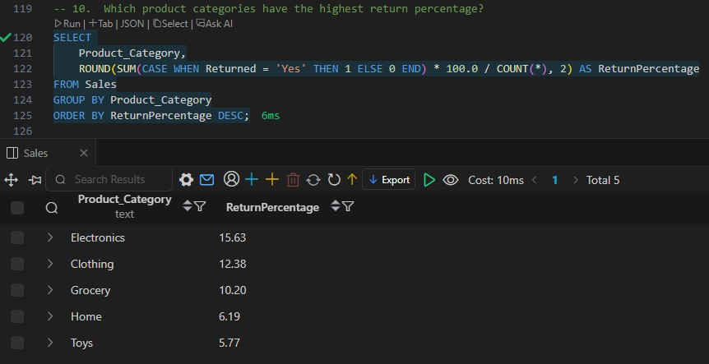
Key Finding 6 - Payment Method & Product Categories vs Return Rate
Credit Card & Electronics Category Have Higher Return Rate
Credit Card purchases show slightly higher return rates(11.54%), possibly due to easier refund processes.
Electronics Category shows higher return rates(15.63%), possibly due to potential quality or satisfaction issues.

Slide 10
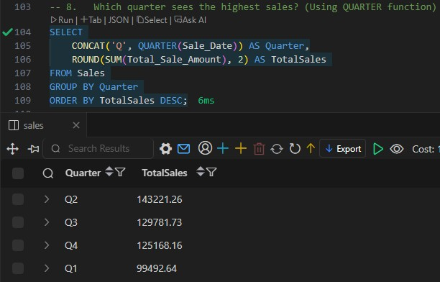
Key Finding 7 - Seasonal Trends
Q2 and Q3 Drive the Highest Sales
Sales peak during Q2–Q3, suggesting that mid-year promotional campaigns are highly effective for Omniretail.

Slide 11
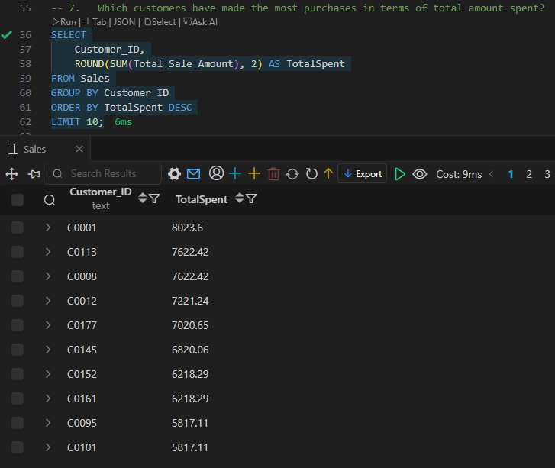
Key Finding 8 - Customer Insights
Top 10 Loyal Customers Contribute 25%+ of Total Revenue
A small group of repeat customers significantly drives total sales. Retention and loyalty programs can strengthen this further.

Slide 12
Recommendations
Increase marketing investment in West region and replicate its success in other regions.
Investigate high return rate in Electronics category to improve product quality.
Introduce incentives for digital payments like Credit Card or Net Banking.
Focus on Clothing and Grocery during high-sales quarters (Q2 & Q3).
Launch loyalty programs for top-spending customers.

Slide 13
Ad-hoc Analysis: Deeper Business Insights I
To provide a more comprehensive view, I went beyond the initial questions and conducted several ad-hoc analyses. These deeper dives have revealed some very specific and actionable insights that can further help Omniretail optimize its strategy.
Region-wise Average Order Value (AOV):
South region recorded the highest AOV, followed by West. Indicates better customer spending in those areas.
Region-wise Return Rate:
East region had slightly higher return percentage compared to other regions.
Product Category Return vs Revenue Ratio:
Electronics category shows the highest return rate (15.6%), while Toys had the lowest (5.8%).

Slide 14
Ad-hoc Analysis: Deeper Business Insights II
Payment Method Preference by Region:
Credit Card and UPI dominate across all regions, showing digital payment preference.
Top 5 Customers by Average Purchase Value:
Customers C0191, C0022, and C0032 are top spenders, showing high purchase consistency.
Category Performance by Quarter:
Q2 delivered the highest revenue, mainly driven by Clothing and Grocery sales.
Store Performance Efficiency (Revenue per Sale):
Store S008 achieved the highest revenue efficiency, followed by S002 and S005.

Slide 15
Ad-hoc Analysis: Deeper Business Insights III
Returned Items Trend Over Time:
Returns peaked in June and December, possibly due to festive or promotional seasons.
Return Rate by Payment Method:
Credit Card purchases showed slightly higher return rates compared to UPI and Net Banking.
Insight:
These Ad-hoc analyses provide deeper business understanding, helping to identify key improvement areas in product quality, regional focus, and payment behavior optimization.

Slide 16
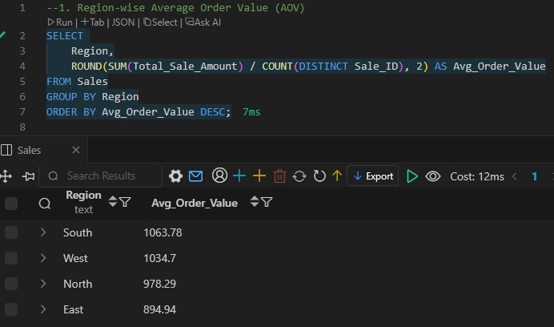
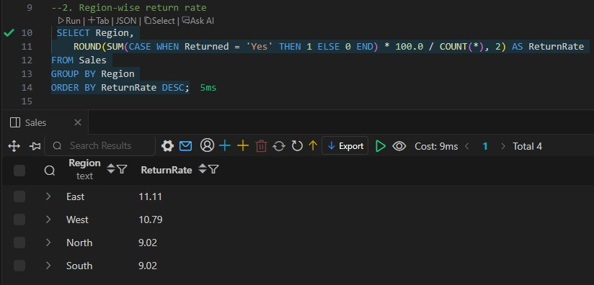
Screenshots

Slide 17
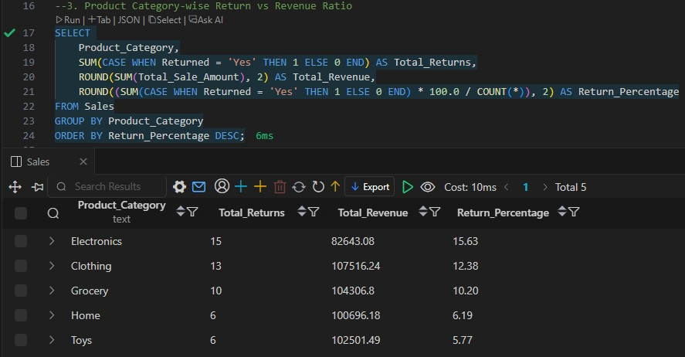
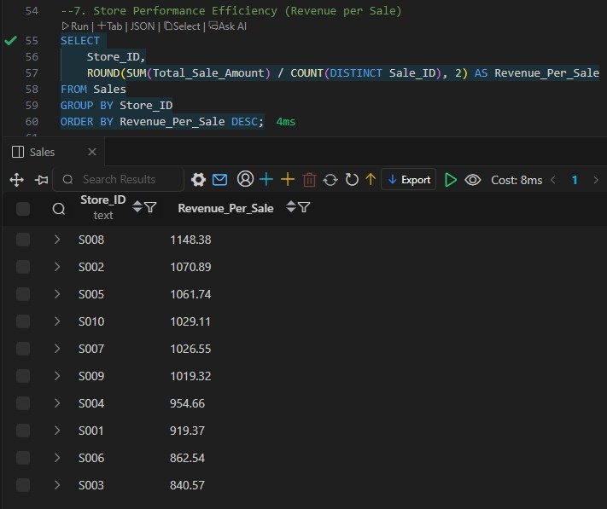
Screenshots

Slide 18
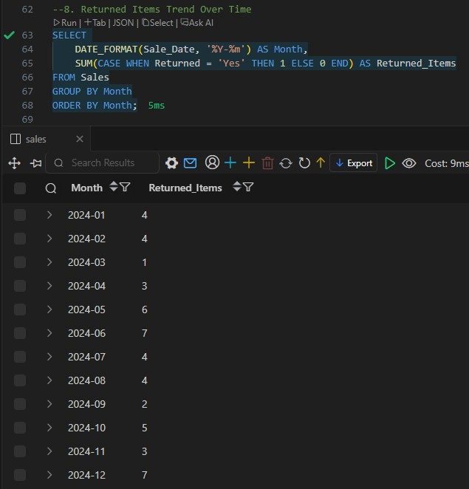
Screenshots

Slide 19
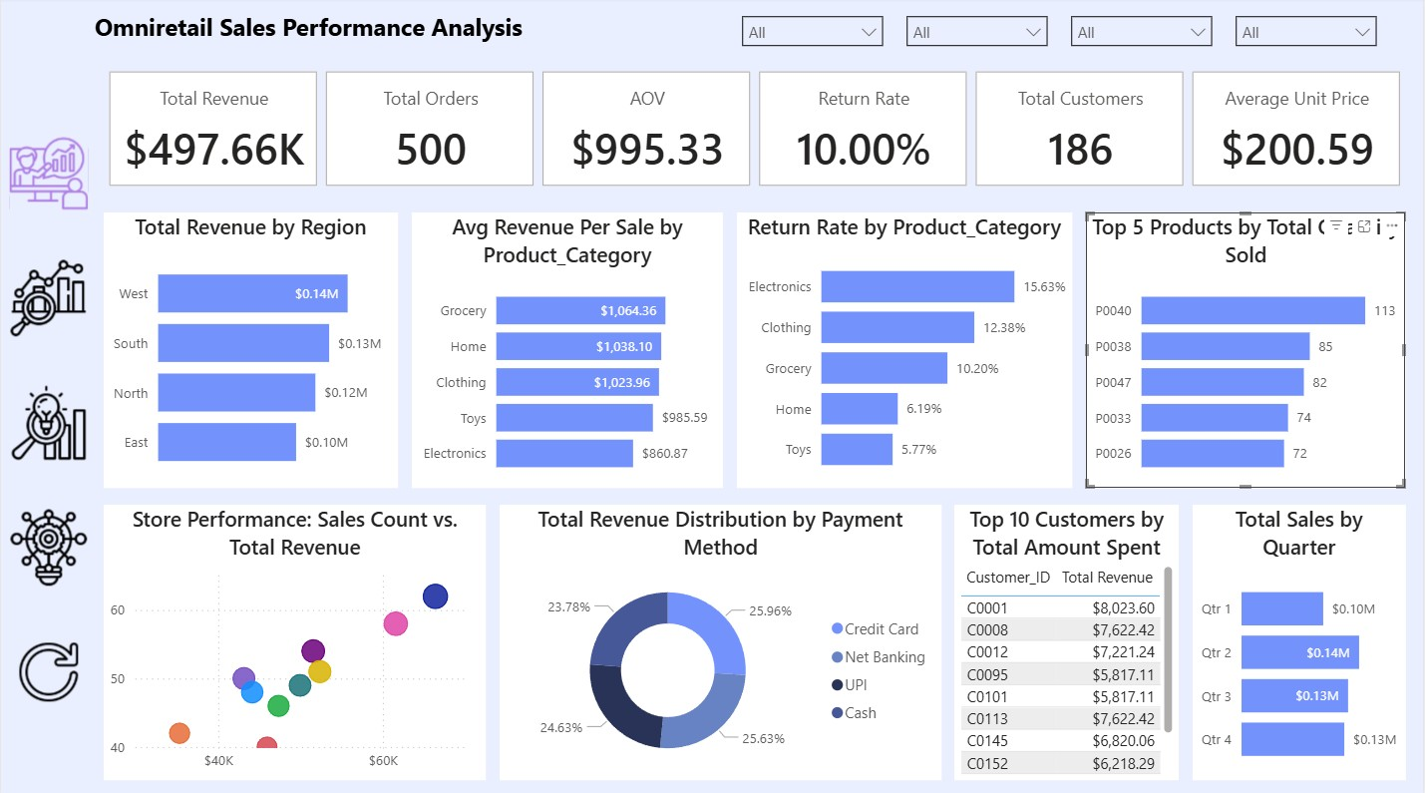
Screenshots

Slide 20
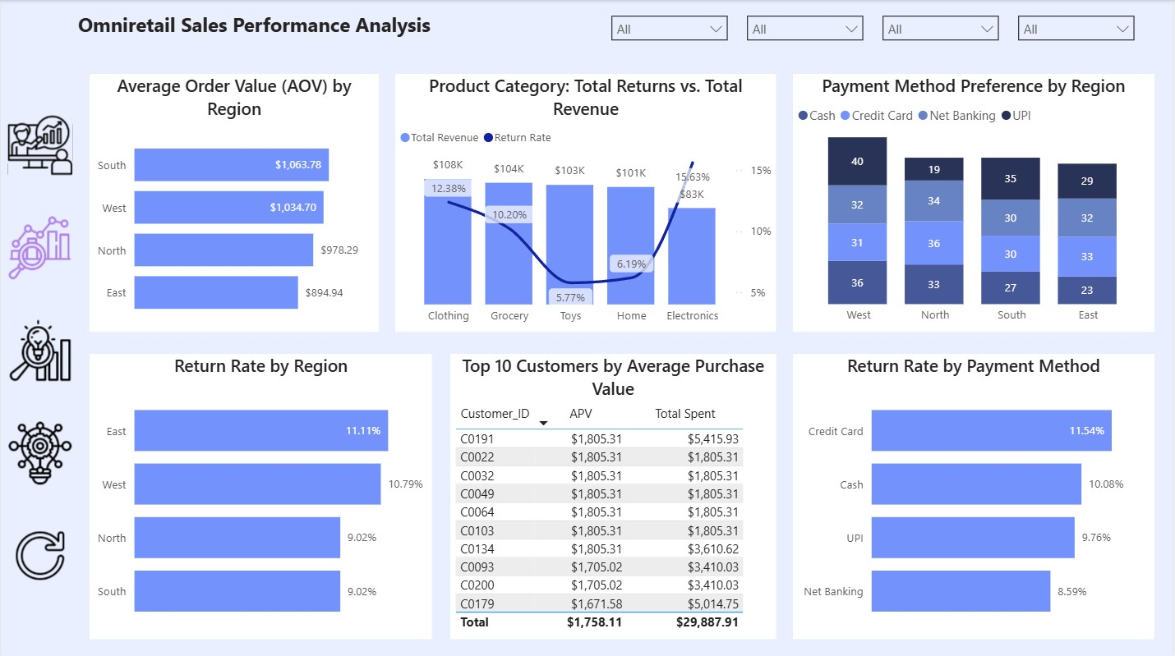
Screenshots

Slide 21
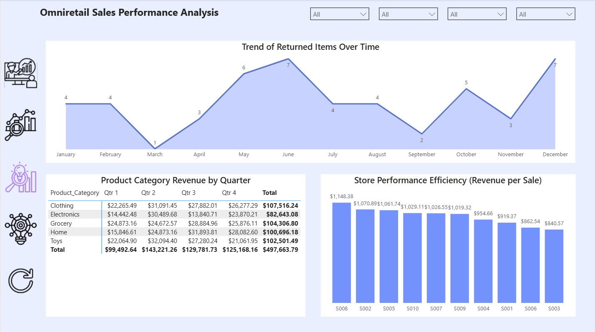
Screenshots

Slide 22
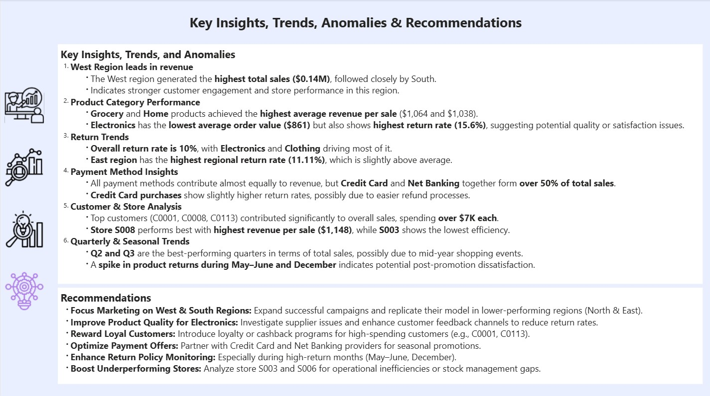
Screenshots

Slide 23
Conclusion
The SQL-based analysis of Omniretail’s sales data revealed performance patterns across regions, products, and payments.
Using Power BI, insights were visualized for data-driven decision-making.
Implementing the recommendations can improve efficiency, reduce returns, and boost revenue.

Slide 24
Thank You
Thank you for your attention!
Questions and feedback are welcome.

