Slide 1

Glass fashion shop
GROUP 5
1
Nguyễn Quốc Hoàng (Leader)
2
Nguyễn Lê Anh Vĩ
3
Huỳnh Nguyễn Phương Nam

Slide 2
Ideal
1
2
Introduction
3
Software functions
Menu
4
Interface Software
5
Advantages and disadvantages
6
Develop

Slide 3
1. Introduction
Shopping demand has become an indispensable part of everyone today. Their psychology often thinks "want to buy good things good to go to famous or shopping center to trend new fashion" but they usually do not have time to shop because busy work, family .. and more In times of modern technology with the explosion of the Internet, we are now launching Glasses onlineshop website, People can buy fashion glasses. Branded goods in the spare time, anywhere with only intenet connection. Change your fashion now is not difficult!
=> Build the Glasses onlineshop

Slide 4
2. Introduction
Create a sales website that can be viewed on multiple devices.
The number of customers visiting and buying higher than the traditional shop.
Is a convenient and easy way to shop online with a device with an intenet connection.
Customers can view detailed product information: image, manufacturer information, quality, price.
Connect to social networking sites like facebook, switter, google +, .... to promote.

Slide 5
3. Software function: User Requires analysis
1
The prestige of the store
Product Scale: to ensure sufficient supply of products, diverse brands, diverse stype
2
3
Price: competitive, more incentives for customers
Requirements: time, place of product shipping, payment (on request)
4
Customer service: feedback ...
5

Slide 6
3. Software function: Customer request
Creating a website have following function:
1
View and Update detail product
2
Edit and Delete product
3
Search product and Cart
4
Managing customers and feedback

Slide 7
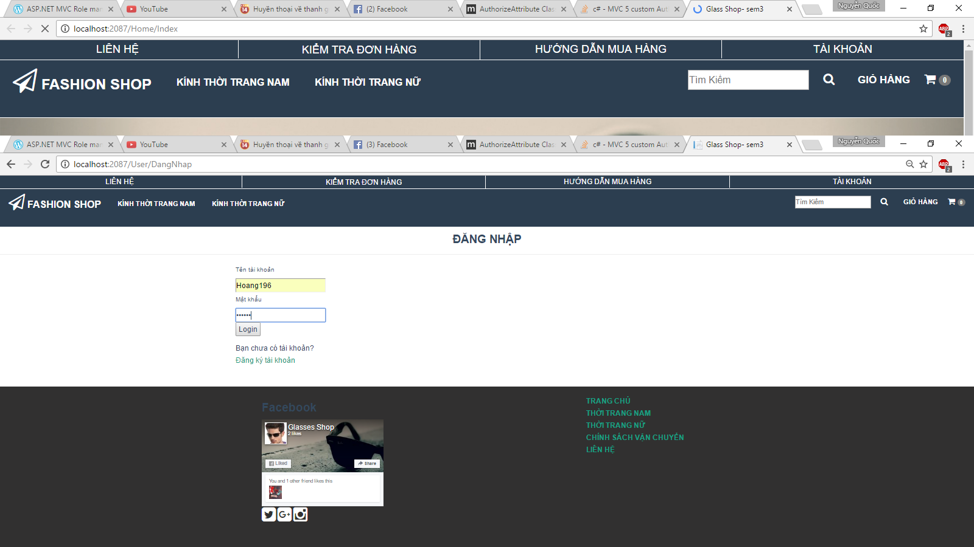
4. Interface software
Login

Slide 8
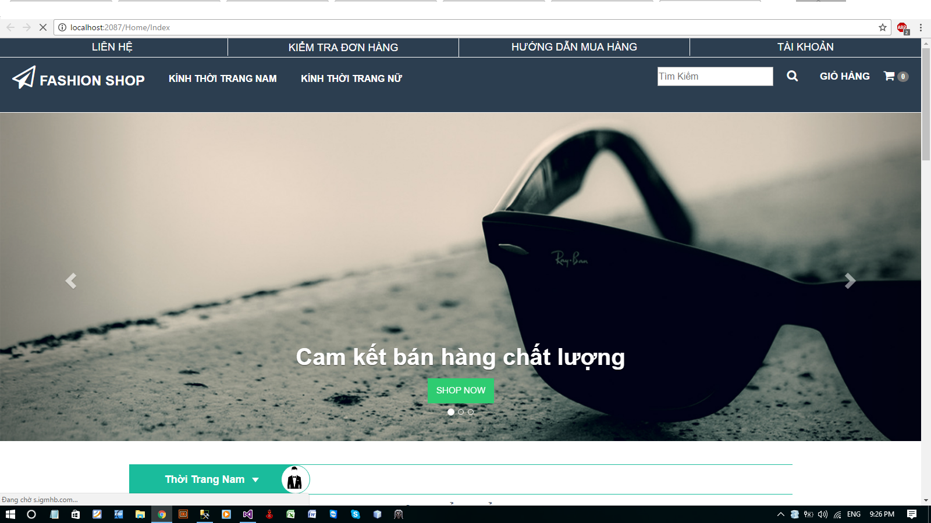
Main page

Slide 9
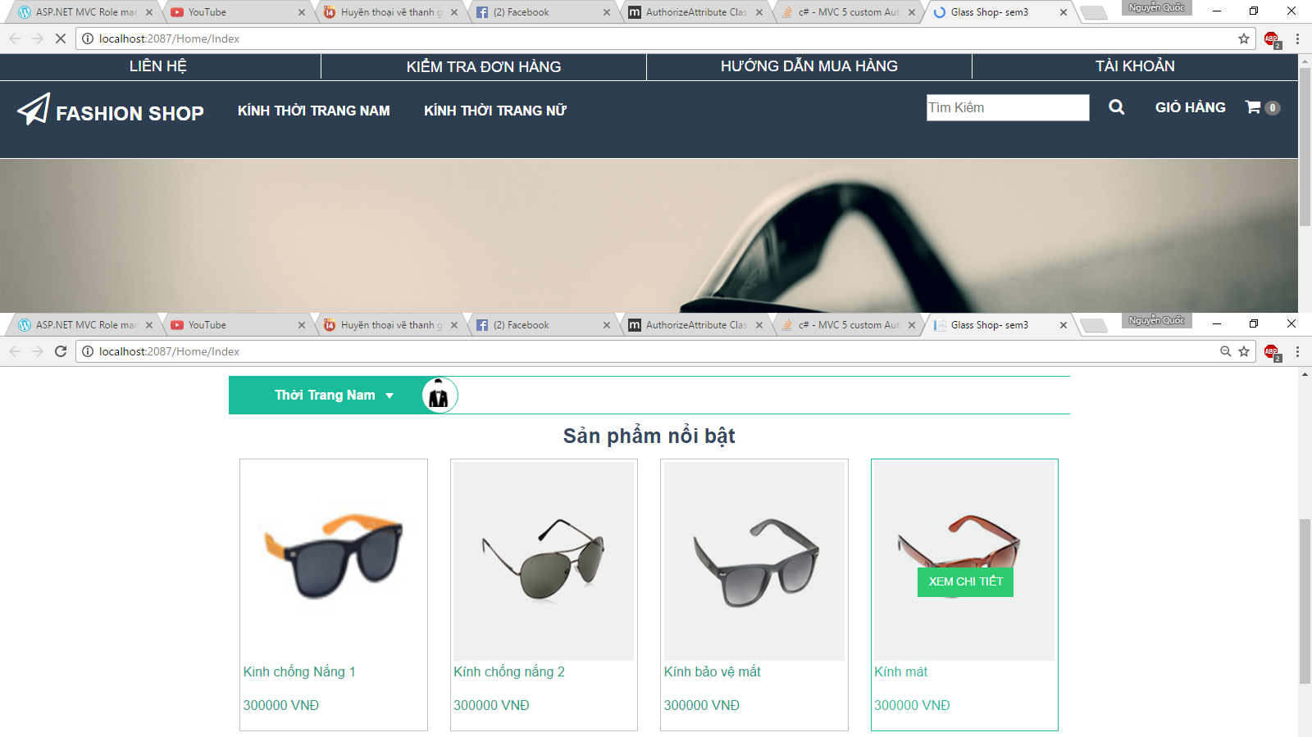
Product

Slide 10
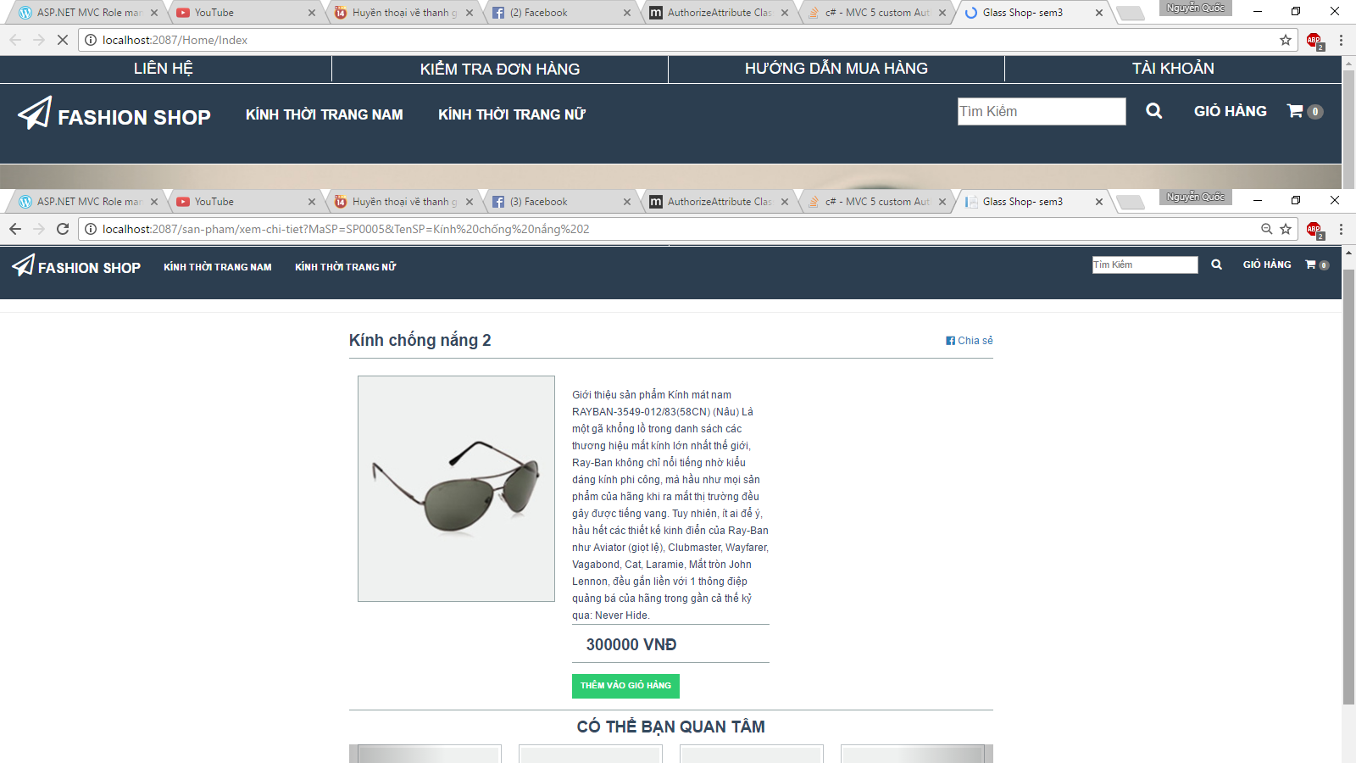
Information Product

Slide 11
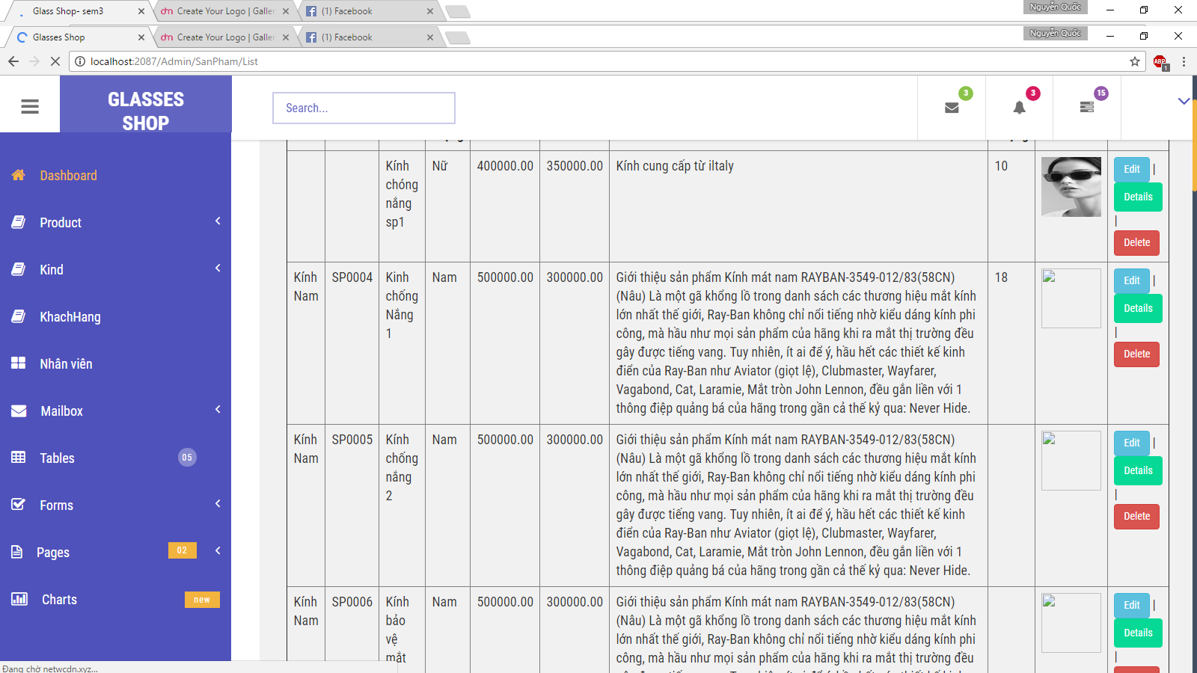
Detail Product

Slide 12
5. Advantages and disadvantages
A
D
V
S
N
T
A
G
E
- The management of users and managers of making Saves time and effort.
- In the webside features for the user can quickly buy product.
- The Product interface is simple, not too complicated for users.

Slide 13
5. ADVANTAGES & DISADVANTAGES
D
I
S
A
D
V
A
N
T
A
G
E
- Due to the limited skills and besides we do not yet fully equipped with the knowledge, we have not completed this management wedside. So we can not make a complete software.

Slide 14
6. Develop
In the future, when we have earned enough knowledge required, we really want to improve wedside our unfinished, to apply in practice and design a better wedside and better finish better.

Slide 15


