Slide 1
Security Tech Talk
April 2014
John McNew, Brian Sparks

Slide 2

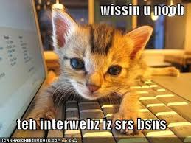
Application Security
Two types of organizations
Those who DON’T know their code is insecure
Those who DO know their code is insecure
The number of security concerns is too large to count.
For this discussion, we’ll focus on web applications.

Slide 3
Threats
Threat Agents (source: www.owasp.org)
Non-target specific: viruses, worms, etc.
Employees: Staff, contractors, maintenance, security etc.
Organized crime: seeking IP, account info, etc.
Corporations: corporate espionage, competitive intelligence
Human, Unintentional: Accidents, carelessness.
Human, Intentional: Insider, outsider (hackers)
Natural: Flood, fire, lightning, meteor, earthquakes

Slide 4
Vulnerabilities
Vulnerability
A hole or weakness in an application that allows an attacker to cause harm.
Examples (see OWASP Top Ten for complete list)
Lack of input validation on user input
Broken Authentication and Session Management
Insecure Direct Object References
Security Misconfiguration
Sensitive Data Exposure
Using Components with Known Vulnerabilities (update your Gems!)

Slide 5
Attacks
Techniques used to exploit vulnerabilities
Brute Force
Test every possible value of a parameter (password, filename)
Cache Poisoning
Introduce false or malicious data into a web cache.
DNS Poisoning
Introduce false DNS address info into DNS server cache.
Attack Examples
Cross-Site Request Forgery
Denial of Service
SQL Injection
Trojan Horse

Slide 6
Countermeasures
Countermeasures: Defensive technologies used to detect, deter, or deny attacks
Examples:
Authentication
Access Control
Session Management
Input Validation
Error Handling
Cryptography

Slide 7
Security Testing
You may need approval from your cloud services provider before using some of these tools/services.
Software Tools
HP WebInspect
https://download.hpsmartupdate.com/webinspect/
Automated vulnerability scanning
Brakeman
http://brakemanscanner.org/
Static Analysis Security Scanner for Ruby on Rails
Services
Security Innovations – penetration testing
HP Global Cyber Security – training, test coordination, etc.

Slide 8
Learning About Security Issues
OWASP WebGoat Project
A deliberately insecure web application.
Used to teach web application security lessons.
https://www.owasp.org/index.php/Category:OWASP_WebGoat_Project
WebScarab and Wireshark
Tools for viewing network traffic and HTTP/HTTPS requests
OWASP Book Store
http://www.lulu.com/spotlight/owasp
Metasploit – Tool for penetration testing (hacking into sites).
Book – Counterhack Reloaded (gets you into the hacker mind-set)

Slide 9
More Security Resources
Open Web Application Security Project (www.owasp.org)
The SysAdmin, Audit, Network, and Security (SANS) Institute (www.sans.org)
The Computer Emergency Response Team Coordination Center (www.cert.org)
The Center for Internet Security (CIS) (www.cisecurity.org)
ISACA (www.isaca.org)
PCI Security Standards Council (www.pcisecuritystandards.org)
HP Global Cyber Security
intranet.hp.com/HPIT/GetIT/ITSecurity/Pages/page.aspx?q=appsec-developer

Slide 10
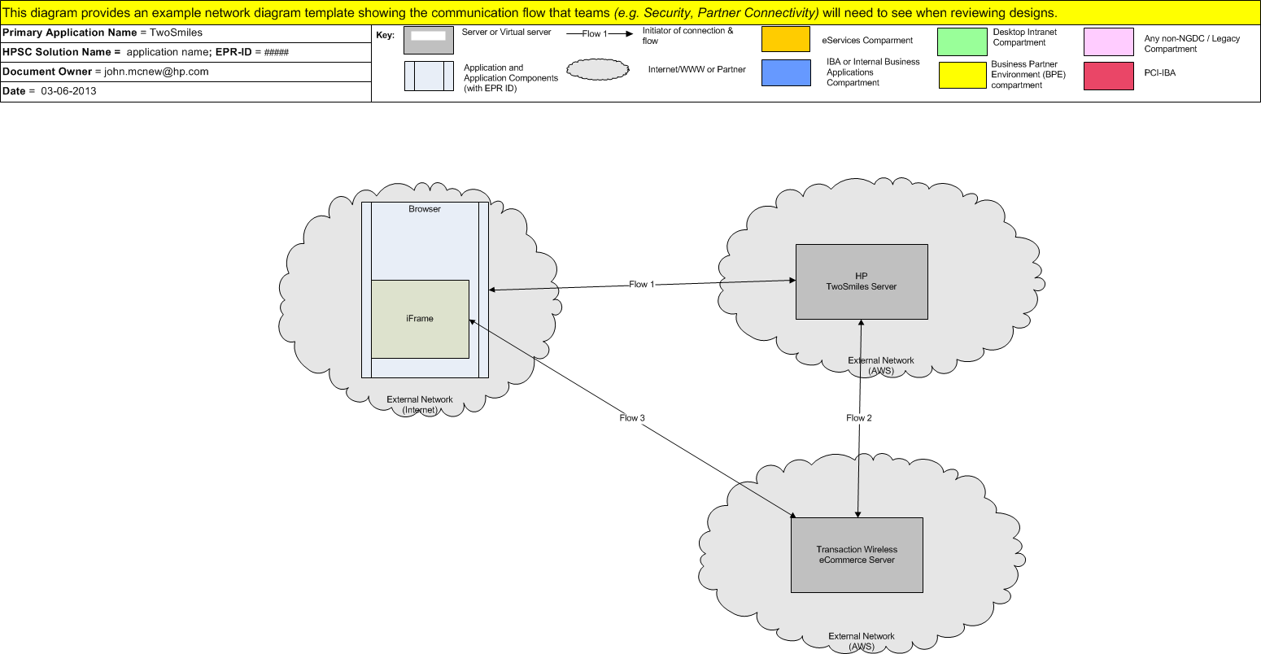
Security Testing Process for TwoSmiles
Contact HP Global Cyber Security
Review your application with them
Provide diagrams and/or documentation
HPGCS creates test plan
WebInspect
Brakeman
Security Innovations
Execute Test Plan
Fix any issues found
Repeat until nothing else found
Have HPGCS expert tell you that you are still vulnerable. ☹

Slide 11
Recommendations
Have at least one security expert in the section
Educate them
Send them to security conventions
Review our applications
Set up regular security reviews
Use established libraries when possible
Community-supported gems get lots of testing
Not every application involves money, but:
Hacked sites are embarrassing
Customers can lose their data/cash
We can lose customers

Slide 12



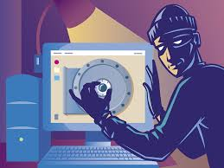
Security Demo
Here are some real cases encountered in the TwoSmiles project

