Slide 1
Coding

Slide 2
TABLE OF CONTENTS
01
02
03
04
Code
Programming Language
Basic Programming Languages
Applications

Slide 3
INTRODUCTION
In order to do any task, we must have instructions.
Same goes for all of our favorite applications and games to work on a computer, we have to give instructions to the computer.
Computers can’t think for themselves, they do whatever we tell them to do.
Notes:
. Giving instructions to the computer is called computer programming or coding.

Slide 4
—John Johnson
“First, solve the problem. Then, write the code.”

Slide 5
WHAT IS computer Code?
computer code refers to
the set of instructions
a system of rules
written in a particular programming language

Slide 6
WHAT IS Programming Language?
We have to give instructions to the computer in a language they understand. This language is called a programming language

Slide 7
Basic Programming Languages
Python
JAva
C, C++ and C#
Developers mostly use Java for web apps back-end interface or general service application programming interfaces (APIs) enhanced by frameworks
C is a powerful general-purpose programming language. It can be used to develop software like operating systems, databases, compilers, and so on.
This is a high-level and general-purpose language that focuses on code readability.

Slide 8

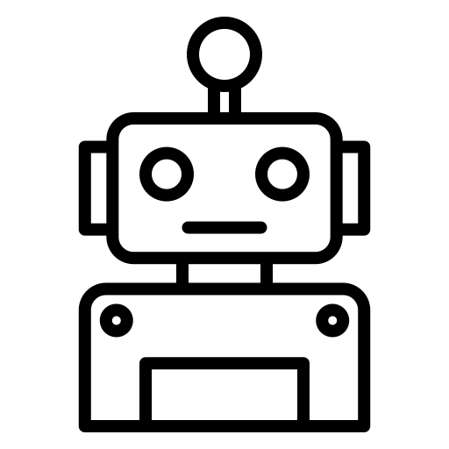
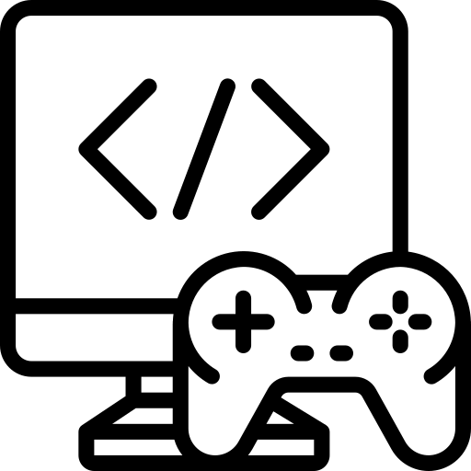
Applications
Web development
Robotics
Game Development

Slide 9
THANKS!
Do you have any questions?
If yes, then comment.

