Slide 1
WESTWOOD LAW FIRM PORTAL
System Architecture & Process Flows
System flow · use cases · data model · process flowchart · data flow · architecture
Westwood Law Firm — Client Portal Prepared September 2026
Notes:
Deck built from the six landscape diagrams, each rendered at 3840x2160 for crisp projection.

Slide 2
Contents
01 System Flow
Lead-to-matter lifecycle in eight steps
02 Use Cases
Visitor · Client · Lawyer · Admin — who can do what
03 Entity Relationship
PostgreSQL data model with RLS on every table
04 Process Flowchart
Decision points, validation loop, break-glass path
05 Data Flow
Entities → processes → data stores (level 1)
06 System Architecture
React SPA → Supabase → PostgreSQL, end to end
Notes:
Six diagrams, in the order of the system: flow, use cases, data model, flowchart, data flow, architecture.

Slide 3
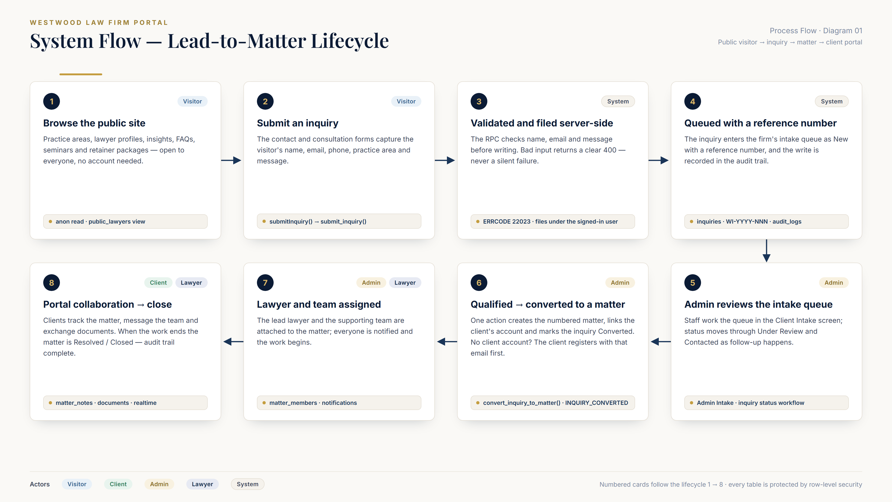
Notes:
Walks the full lifecycle: a visitor browses, submits an inquiry, the server validates and files it, admin reviews the intake queue and converts a qualified inquiry into a numbered matter, the lawyer and team are assigned, and the client collaborates in the portal until the matter closes with a complete audit trail.

Slide 4
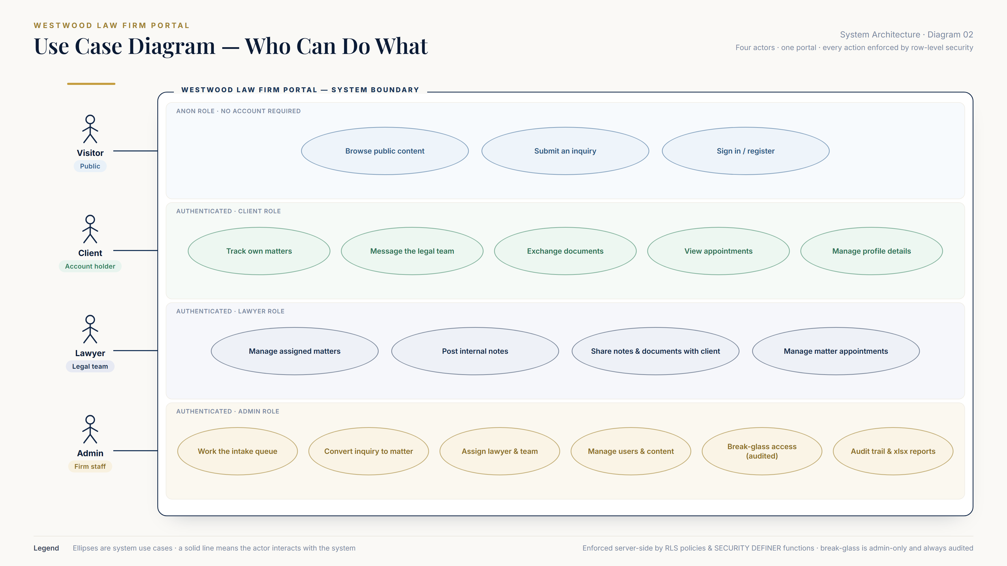
Notes:
Four actor lanes map every use case to the real permission model. Break-glass document access is admin-only and always audited. Clients message the team and exchange documents on their own matters; lawyers manage assigned matters, internal notes and the matter team.

Slide 5
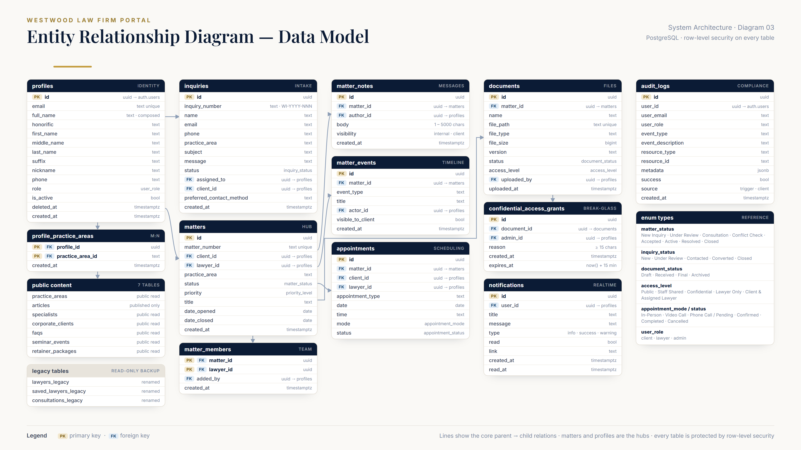
Notes:
The schema as deployed: profiles with composite names, matters as the hub, matter_members / matter_notes / matter_events, documents with access levels and 15-minute break-glass grants, notifications and the audit_logs trail. Enum values are listed at the right.

Slide 6
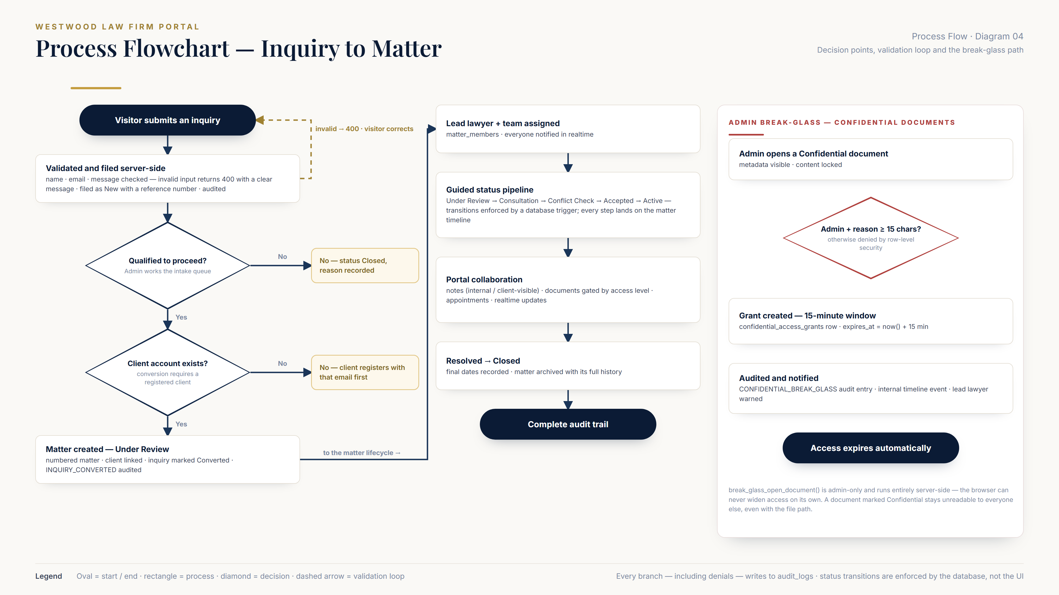
Notes:
Two decisions gate the intake: qualification by admin review, and the requirement that a registered client account exists before conversion. Invalid submissions loop back with a clear 400. The side panel shows the admin-only break-glass path for confidential documents.

Slide 7
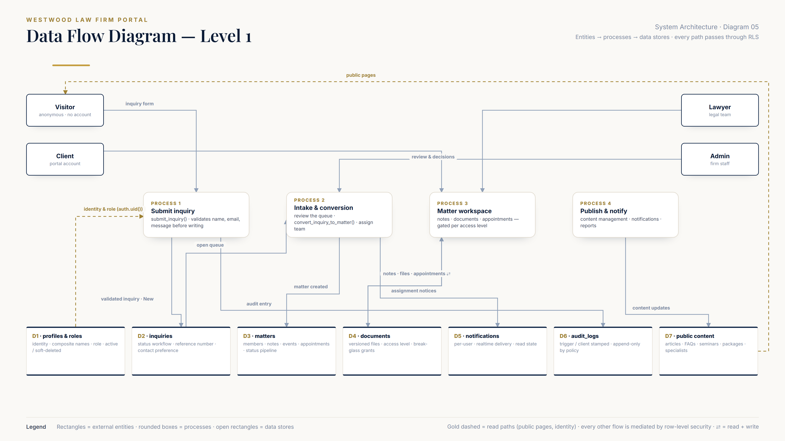
Notes:
Level-1 data flow: visitors, clients, lawyers and admins feed four processes, which read and write seven data stores. Gold dashed lines are read paths (public pages, identity). Every other flow passes through row-level security.

Slide 8
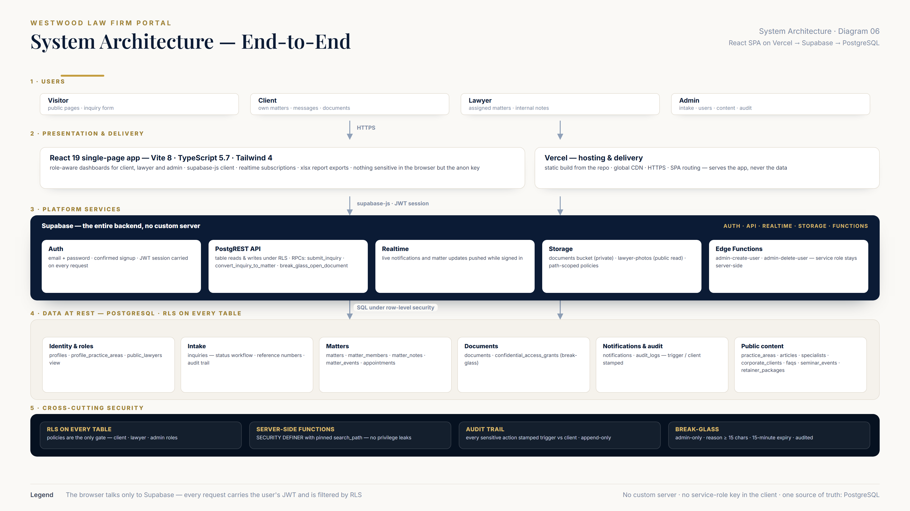
Notes:
Five bands: users, the React 19 SPA hosted on Vercel, the Supabase platform (auth, API, realtime, storage, edge functions), the PostgreSQL data tier, and the cross-cutting security spine. The browser never holds anything more than the anon key.

Slide 9
Security at a Glance
Row-level security on every table
Policies are the only gate — client · lawyer · admin
Break-glass is admin-only and audited
Reason ≥ 15 characters · 15-minute expiry · lead lawyer notified
The audit trail cannot be forged or erased
Trigger-written vs client-reported rows are stamped · cleanup is admin-only with a 30-day floor
Deactivated accounts are denied by the database
The role helpers return nothing for inactive users — not just a UI state
Nothing sensitive in the browser
No service-role key, no custom server — one source of truth: PostgreSQL
Notes:
Five properties that hold across the whole system — all enforced in the database, not just the UI.

