Slide 1
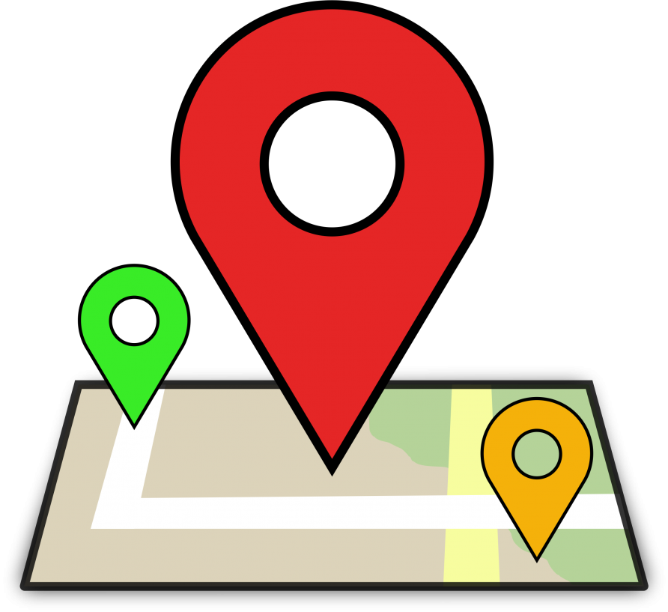
City Guide App
Choose Your Desired way
Maimuna Chowdhury
Roll-1907013

Slide 2
Objectives
To develop user friendly interface
To develop user friendly application
To give user a comfortable travelling
To help user in emergency need

Slide 3

Short Introduction
City Guide is a app that makes the movement of a traveller or a new comer in a city easier. The main purpose of this app is to give its user easier searching and comfort.

Slide 4
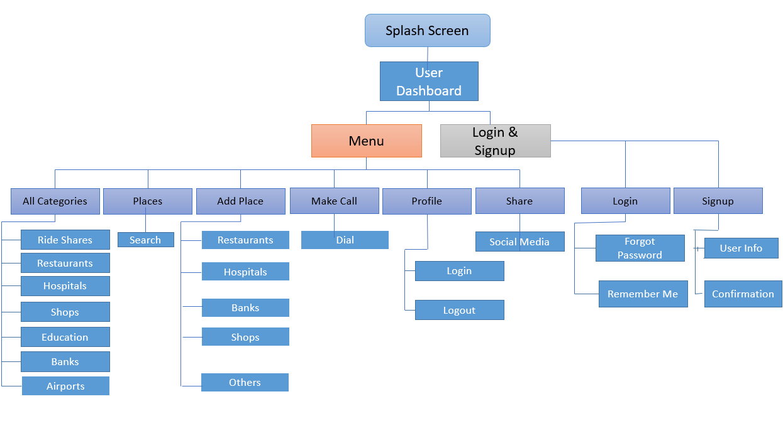
Sequence Diagram

Slide 5
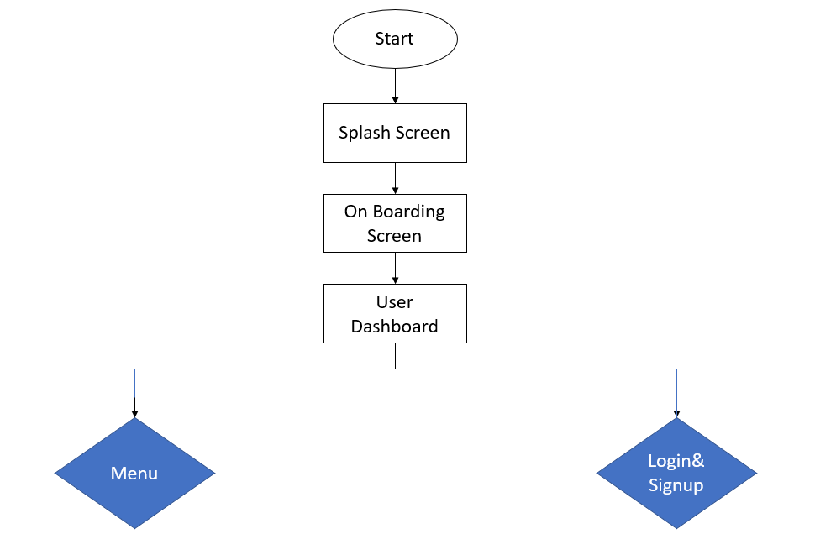
Flowchart

Slide 6
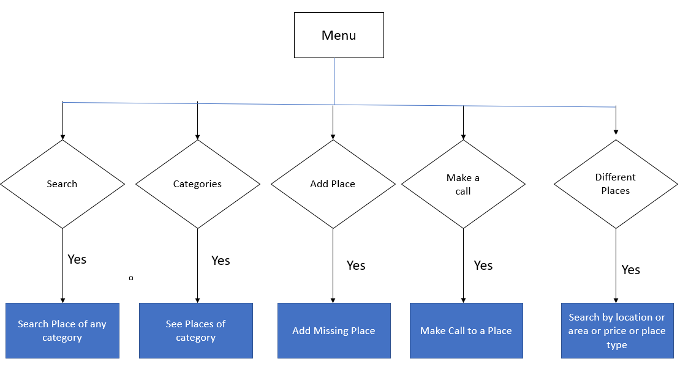
Cont.

Slide 7
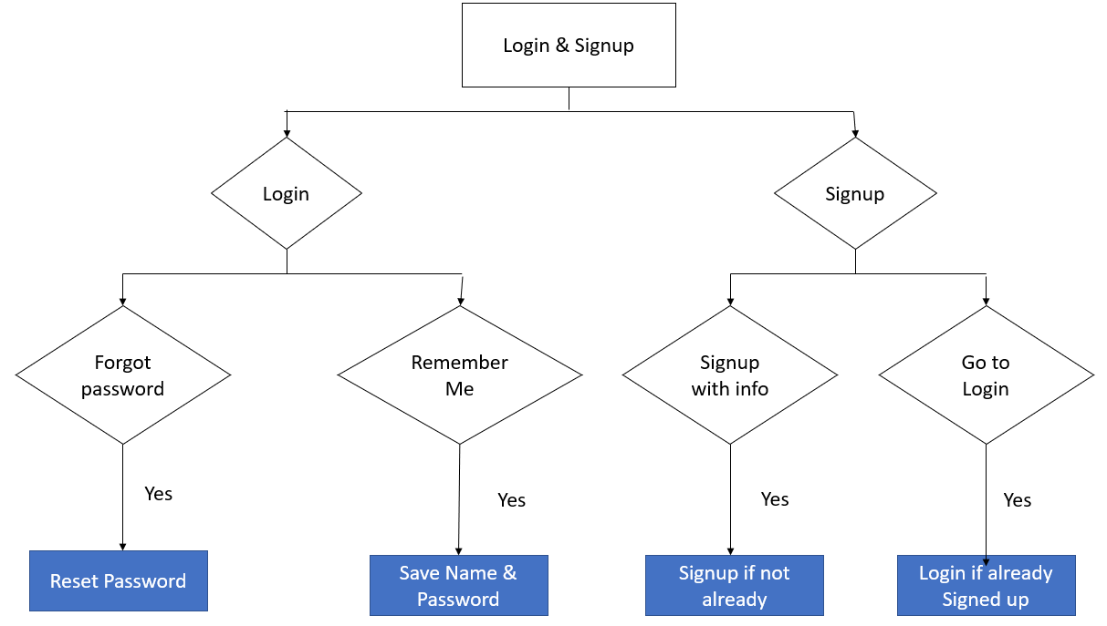
Cont.

Slide 8

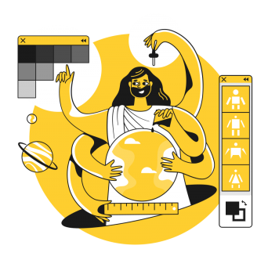

Features
On Boarding Screen
Search Your Location
Make a Call
Add Missing Place

Slide 9
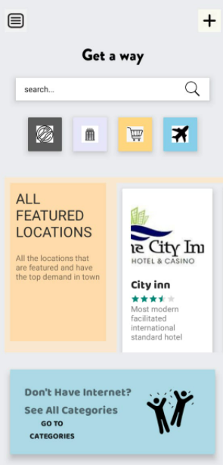


User Dashboard
Cont.
Showing what users can use
Option for Menu
Option for Login & Signup

Slide 10
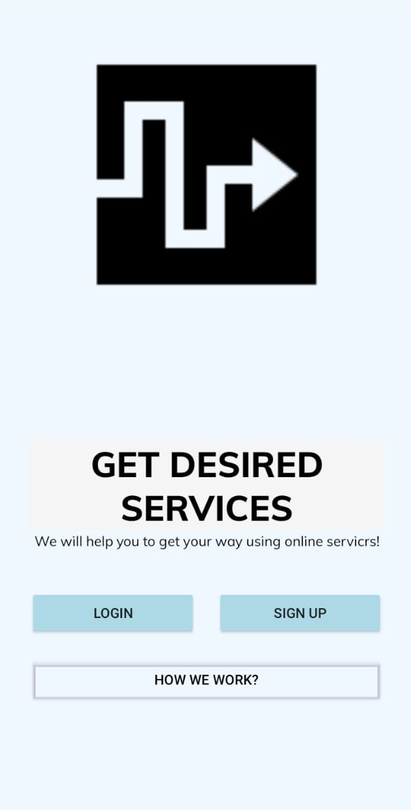
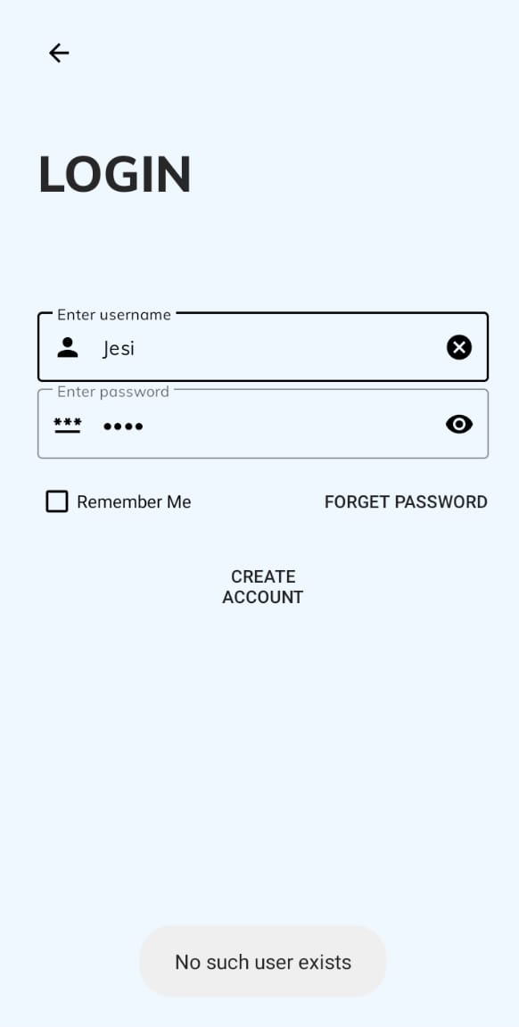
Login & Signup
Cont.
Login
Signup

Slide 11
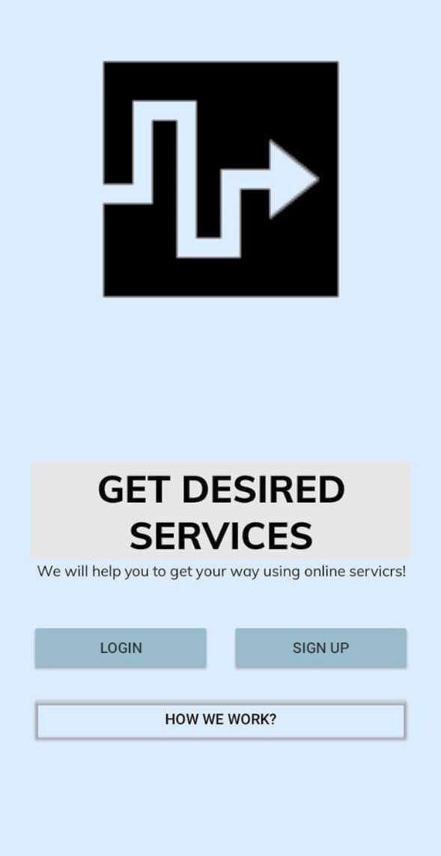
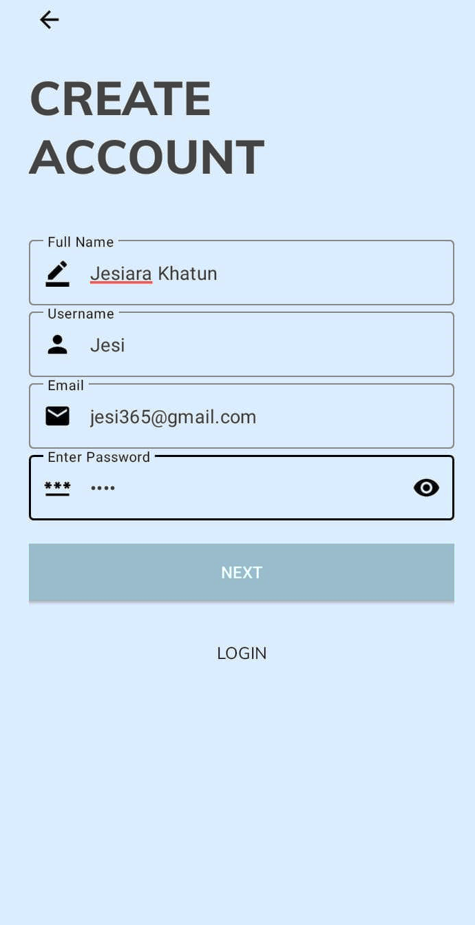
Cont.
If user has not registered yet then he or she has to register first

Slide 12
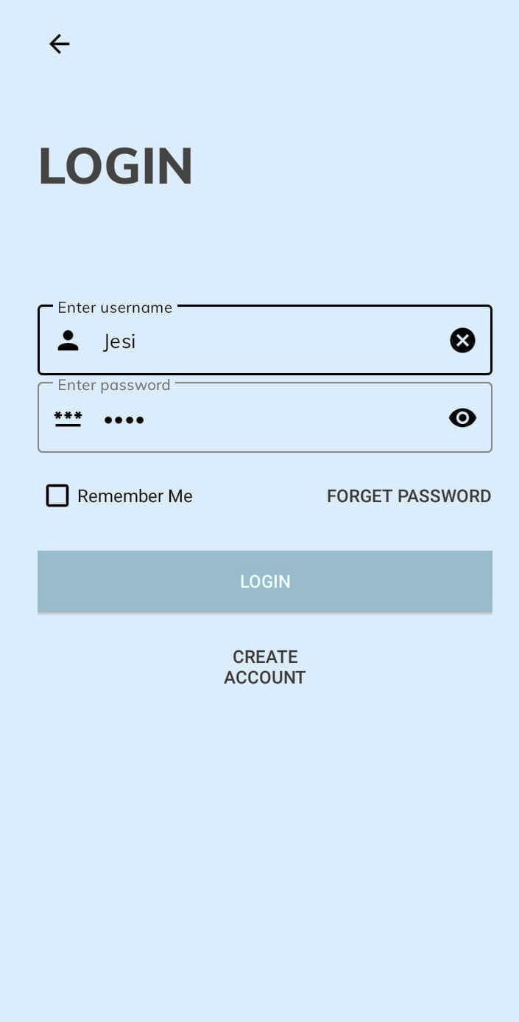
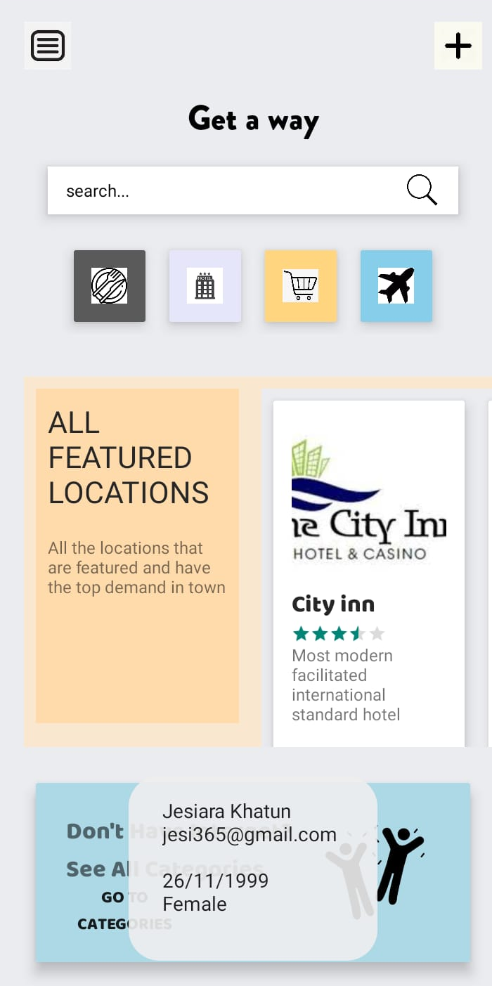
Cont.
If user has registered then he or she can login

Slide 13
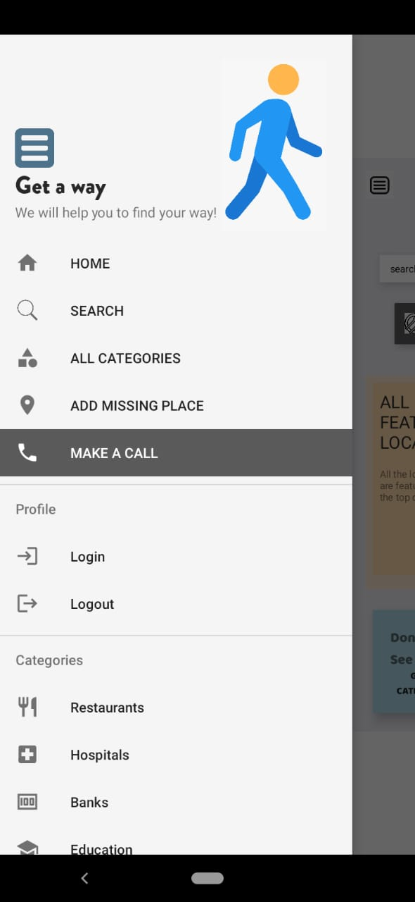
Menu
Cont.
Home
Search
All Categories
Add Missing Place
Make a Call
Login
Logout
Restaurants
Hospitals
Banks

Slide 14
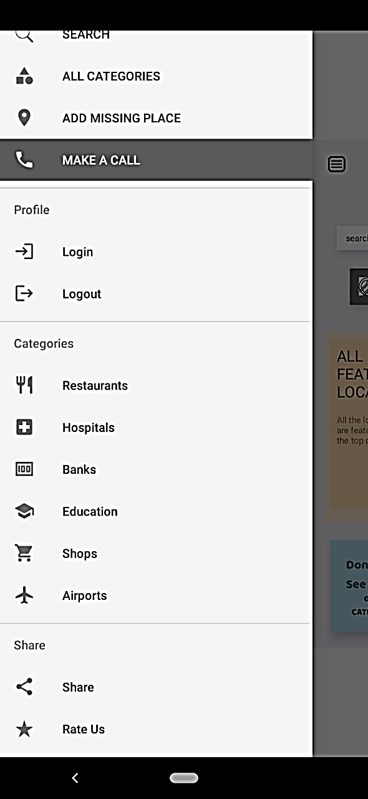
Menu
Cont.
Education
Shops
Airports
Share
Rate us

Slide 15
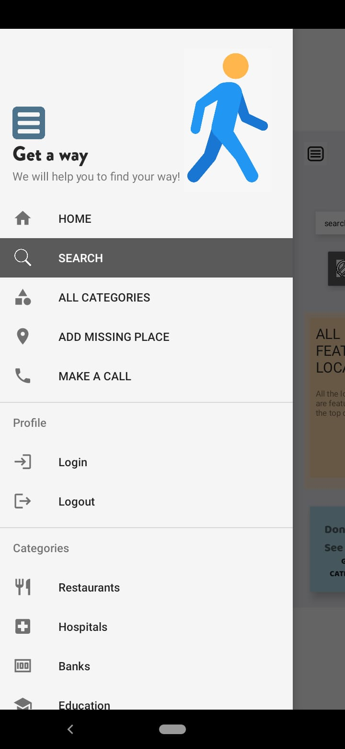
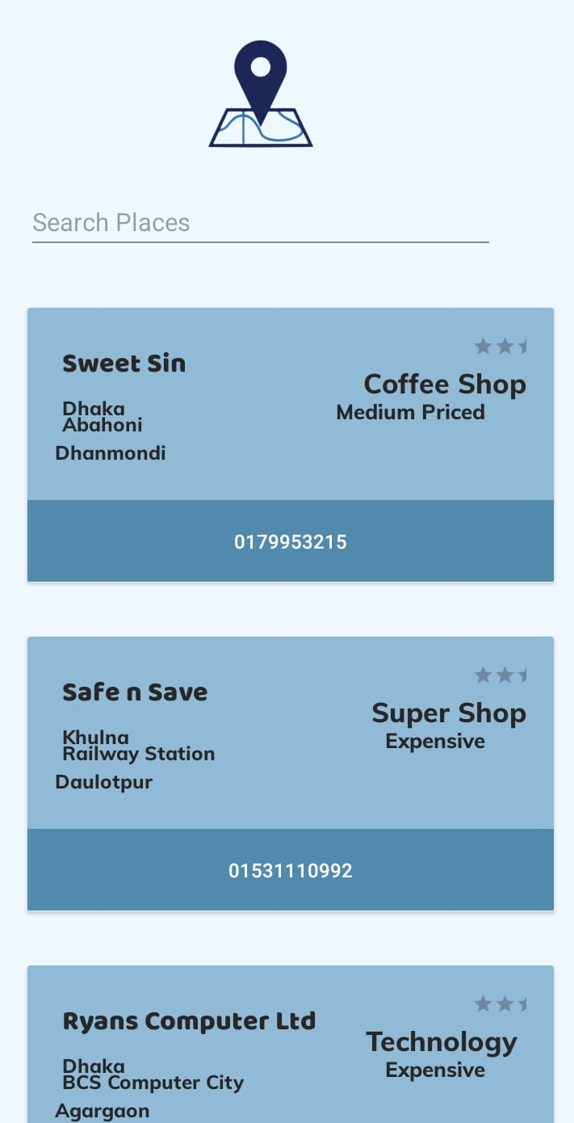
Menu
Cont.
Search
Searching any place user likes

Slide 16
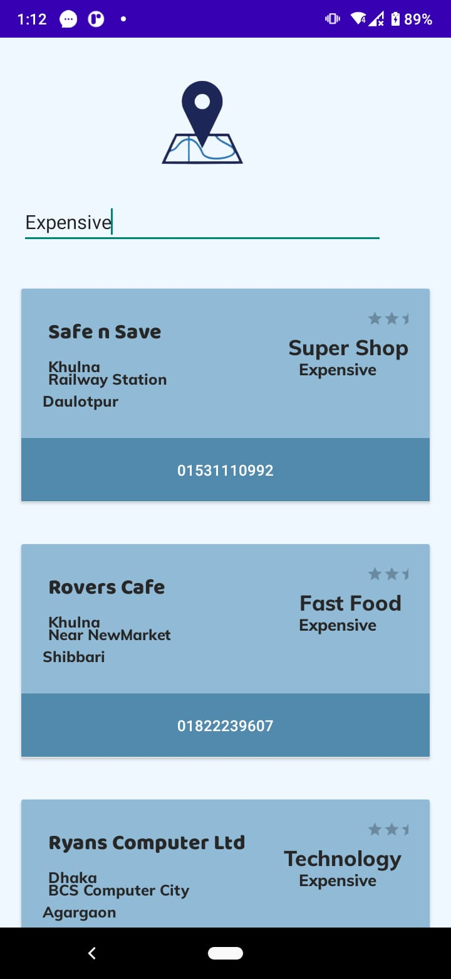
Menu
Cont.
Search
We can search places of any category like cheap, expensive, medium priced, or on area basis or on City basis

Slide 17
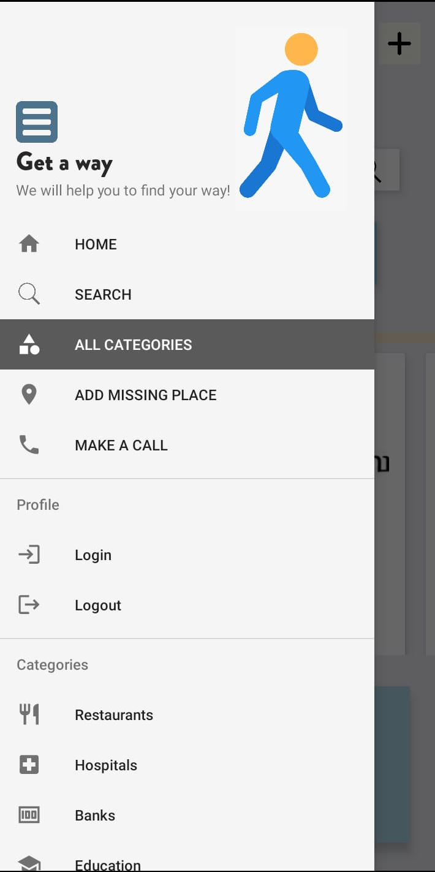
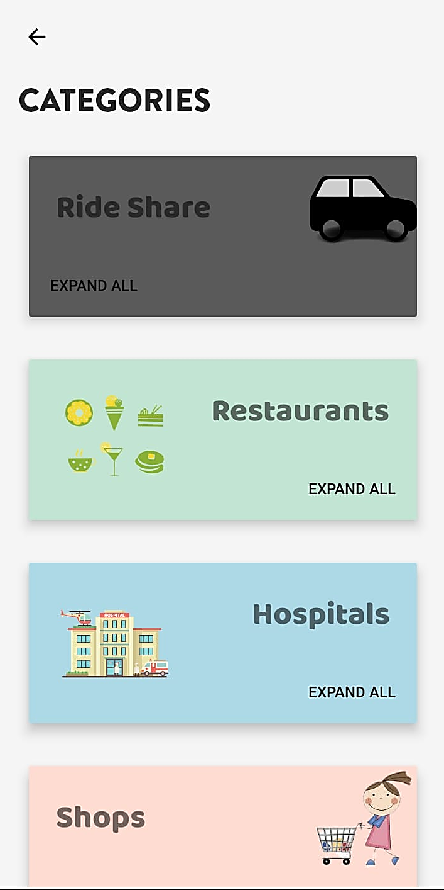
Menu
Cont.
All Categories
Ride Share
Restaurants
Hospitals
Shops
Education
Banks
Airports

Slide 18
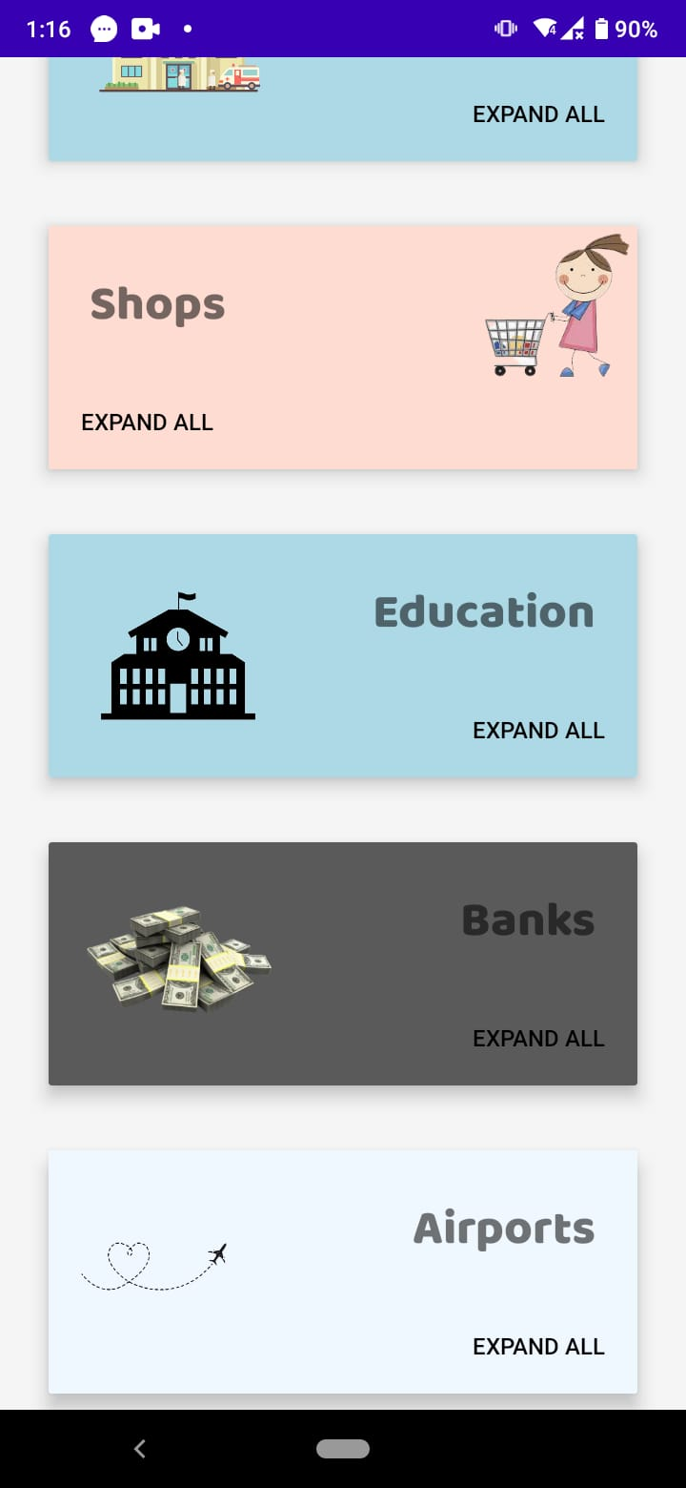
Menu
Cont.
All Categories
If user doesn’t have internet connection user can see some default ride shares, restaurants etc.

Slide 19

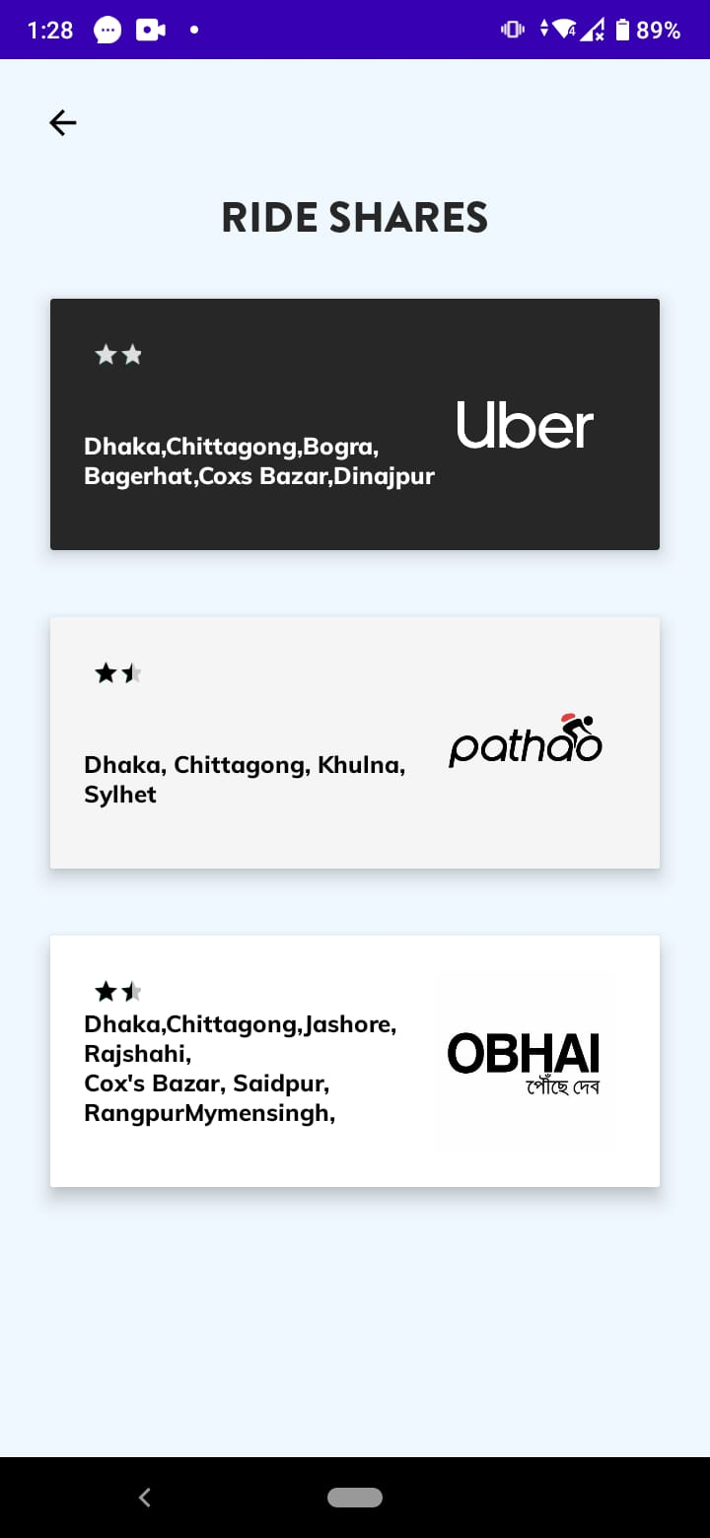
Menu
Cont.
All Categories
Ride Share
Search by cities

Slide 20
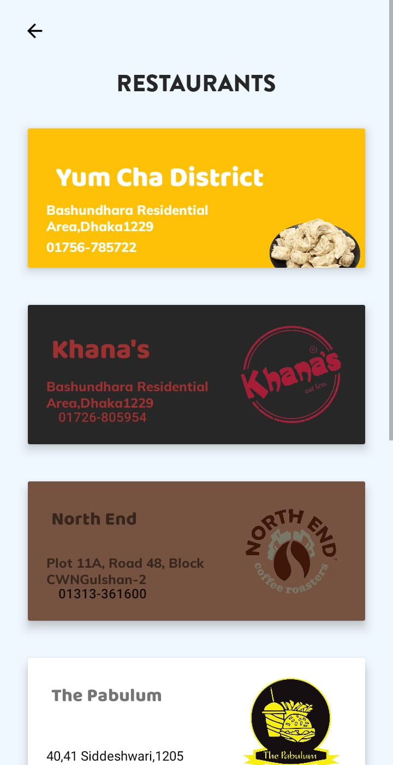
Menu
Cont.
All Categories
Restaurants
If user doesn’t have internet then he or she can see some default restaurants

Slide 21
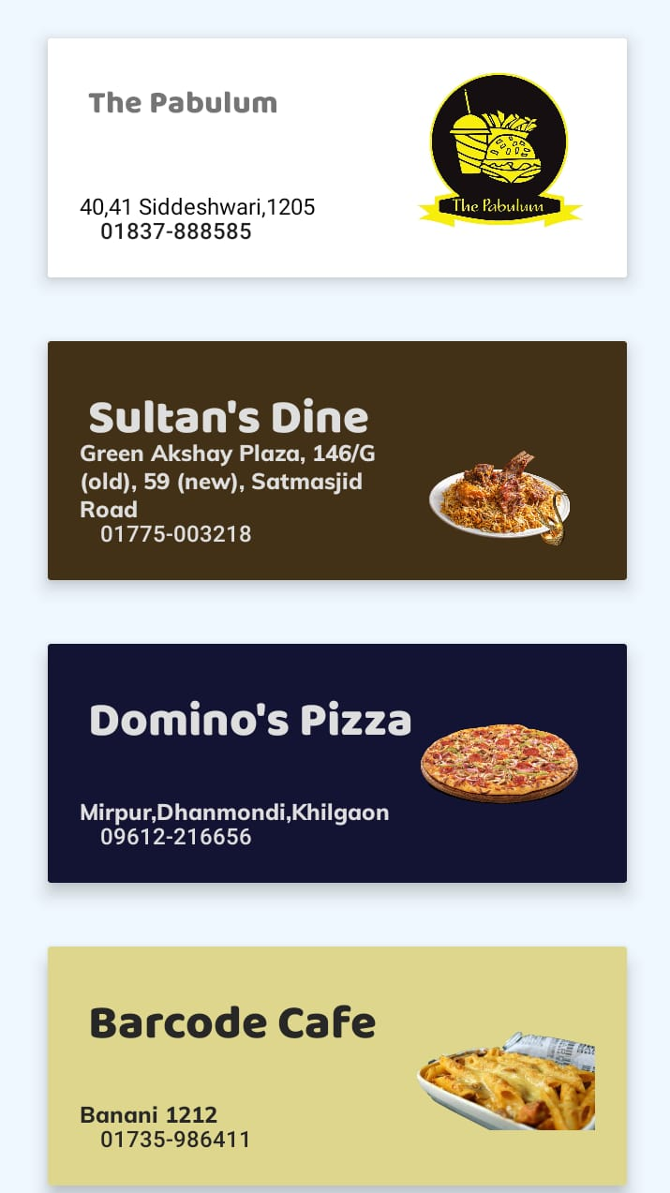
Menu
Cont.
All Categories
Restaurants

Slide 22
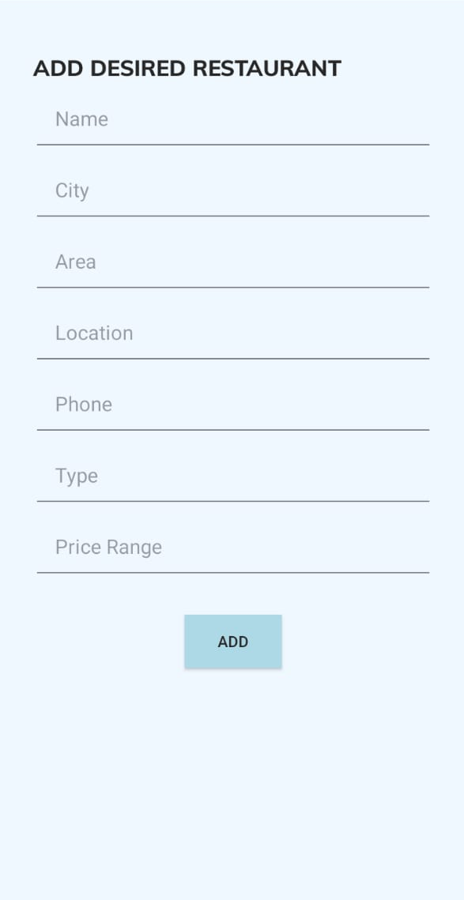
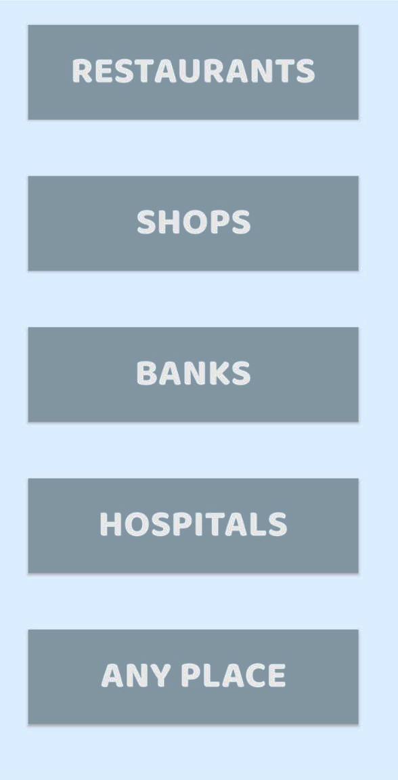
Menu
Cont.
Add Missing Places
User can add any type of place that user wants
Divided in different categories

Slide 23
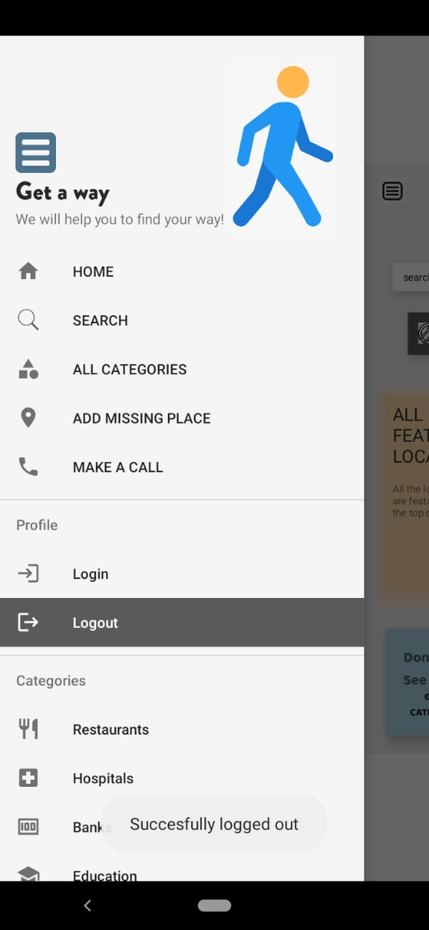
Cont.
Menu
Logout
Signs out
Need to login again for using

Slide 24
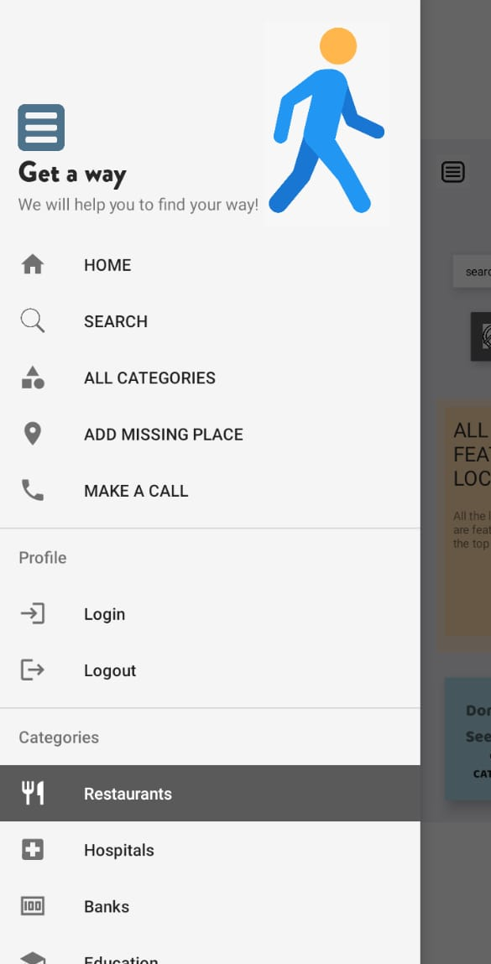
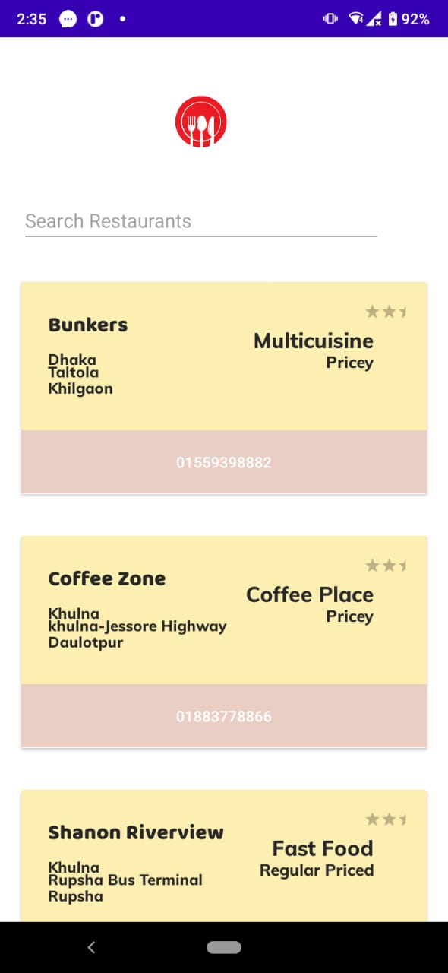
Menu
Cont.
Restaurants
Search by any category of restaurant

Slide 25
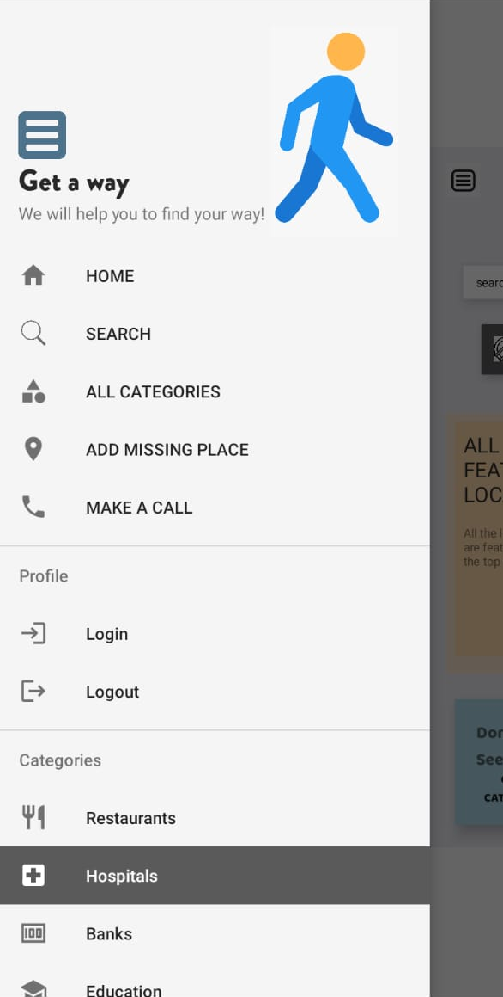
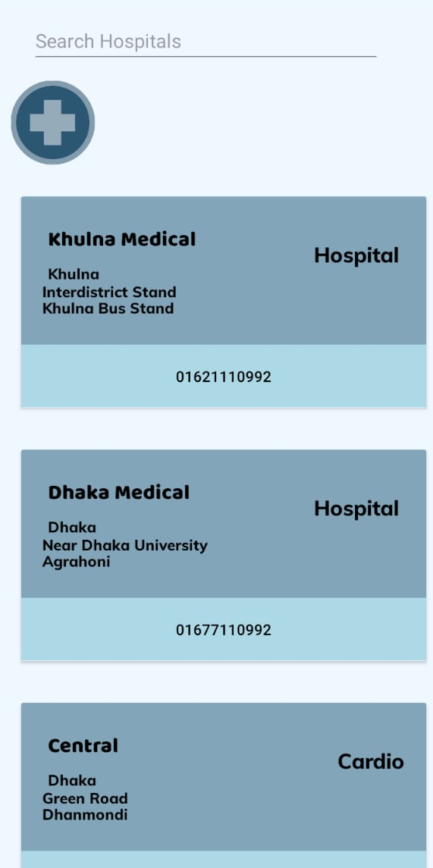
Menu
Cont.
Hospitals
Search by any category of Hospitals like cheap, expensive, public, private, cardio, kidney etc.

Slide 26
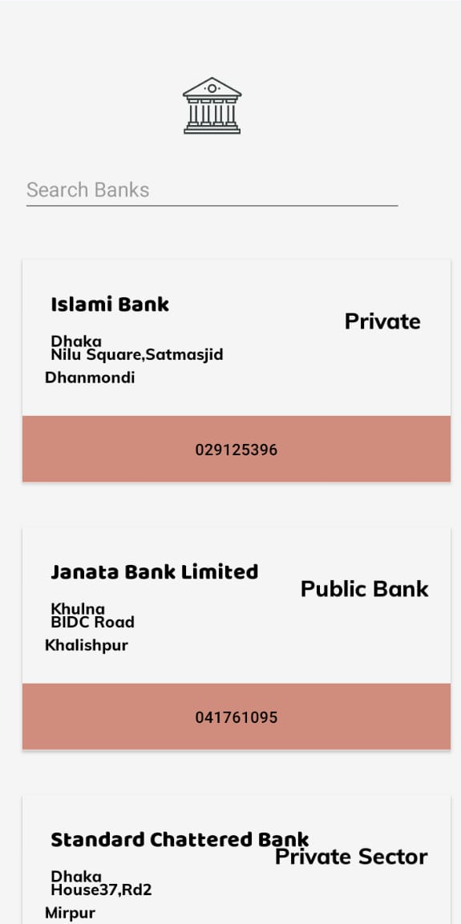
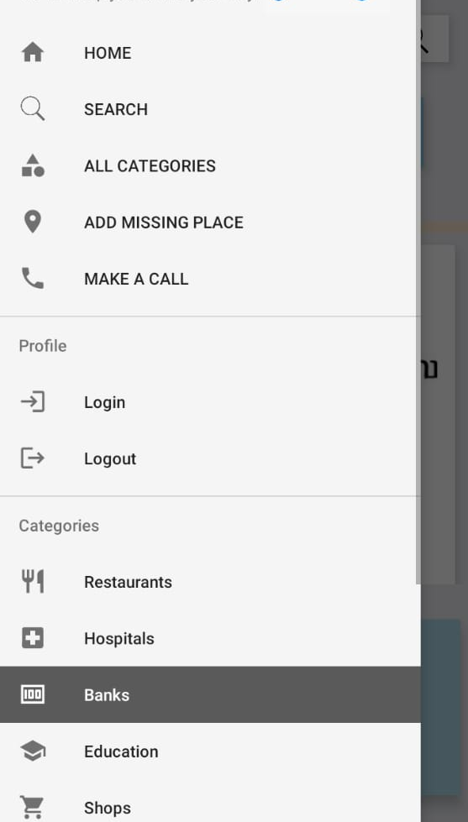
Menu
Cont.
Banks

Slide 27
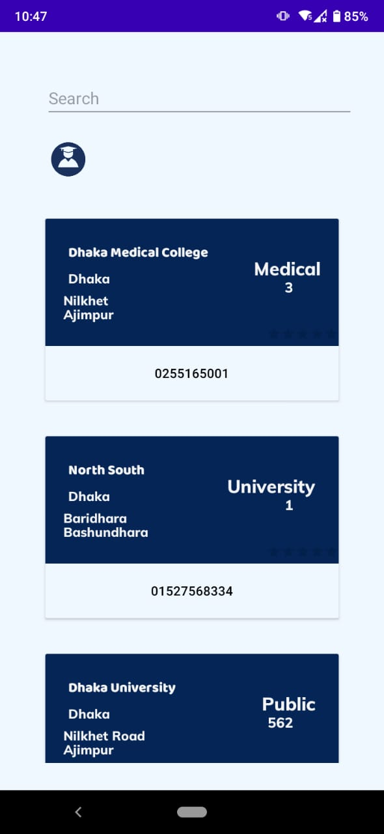
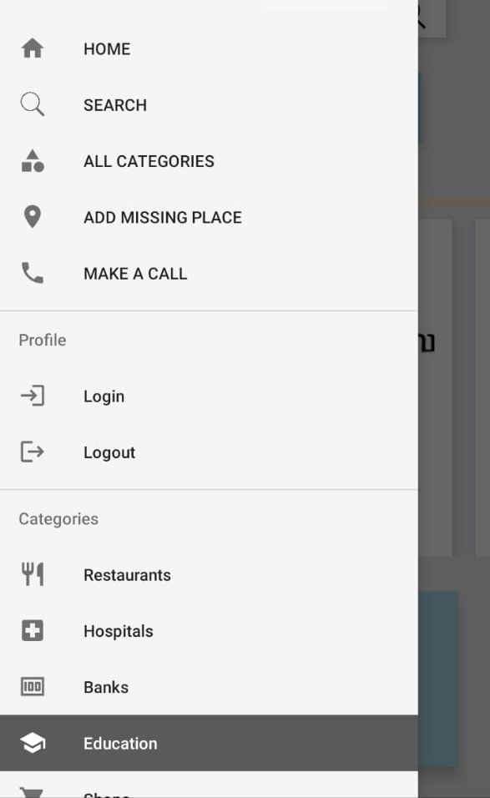
Menu
Cont.
Education

Slide 28
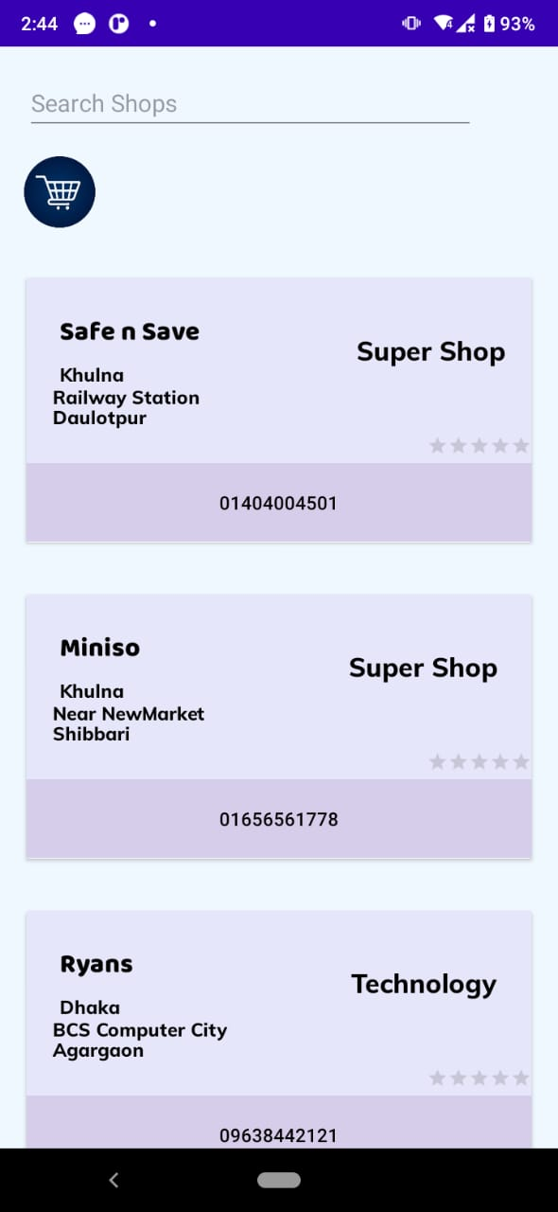
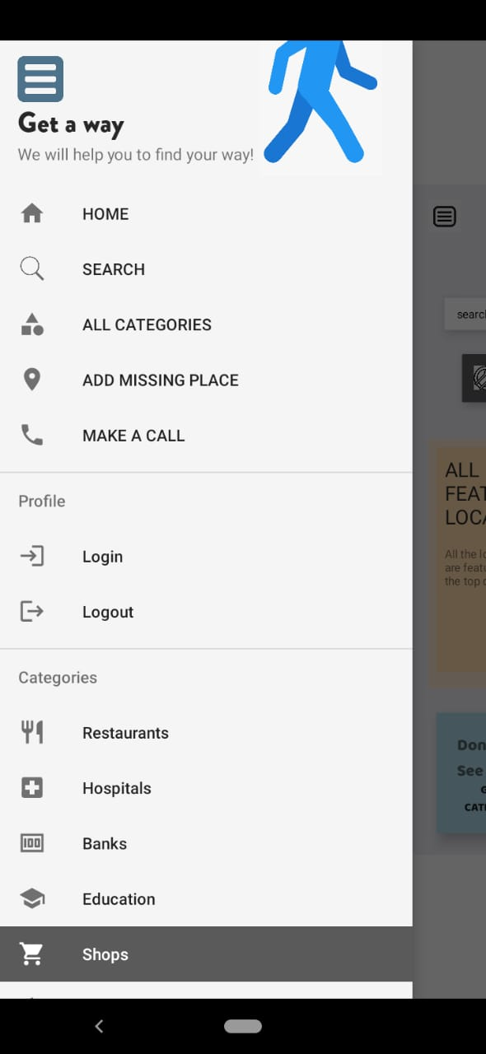
Cont.
Menu
Shops
Search by any category of Shops

Slide 29
Usability
Gathered different types of information at one place
Easy to search
Easy to make call
Not getting confused after entering any city

Slide 30
Conclusion
Through this project I have learned about many different features of android and tried to implement them at my best to make a user friendly app. I hope in future I can make progress in developing apps.

Slide 31
References
https://www.youtube.com/
https://www.geeksforgeeks.org/
https://www.youtube.com/results?search_query=firebase+tutorial+anisul+islam
https://www.youtube.com/results?search_query=neet+roots

Slide 32
Thank You

