Slide 1

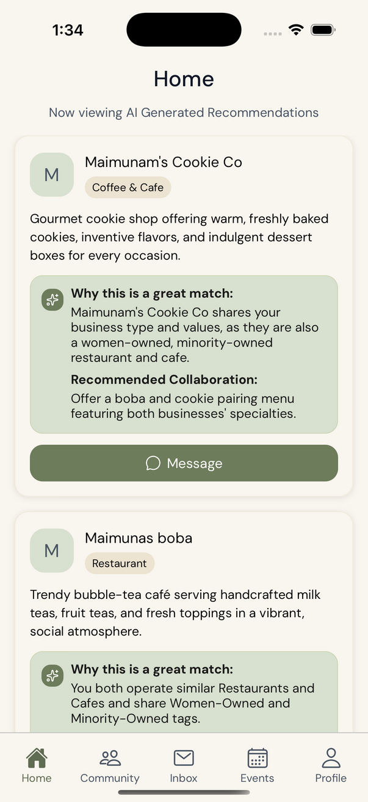
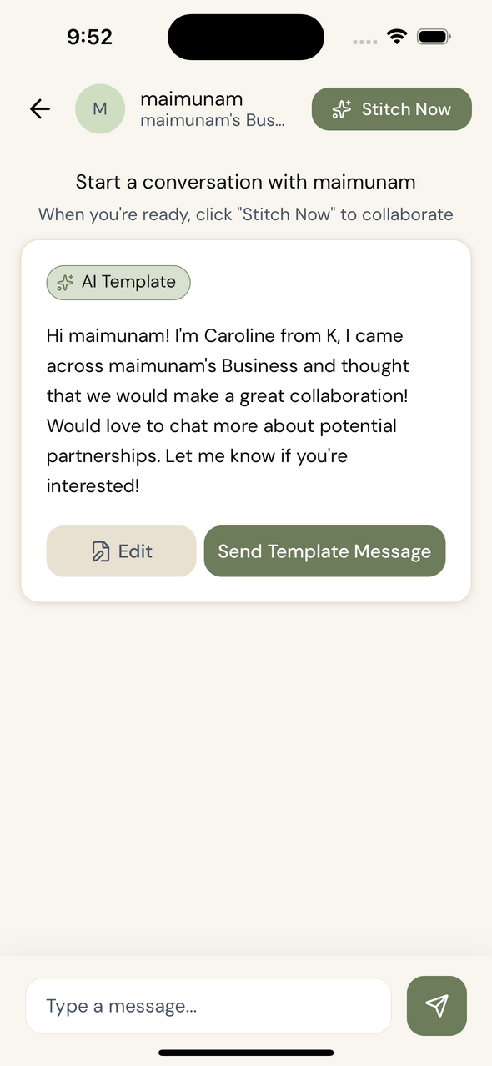
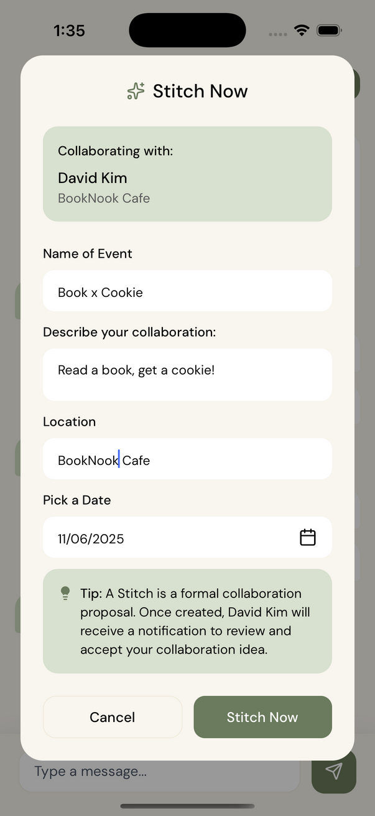
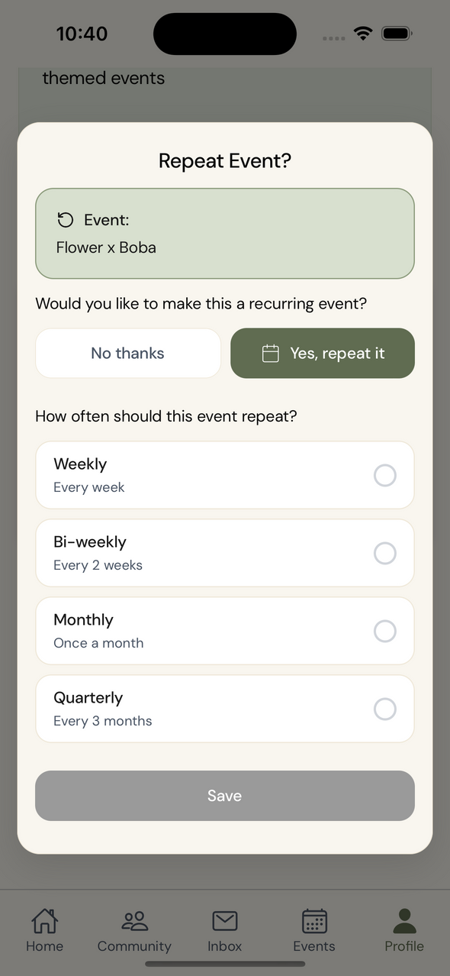
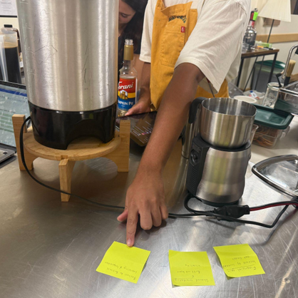
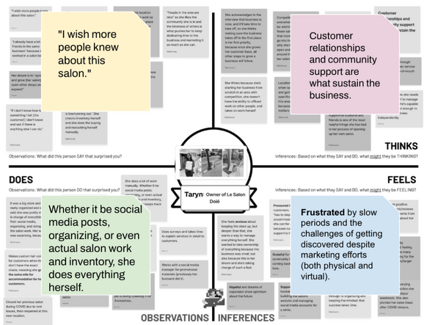
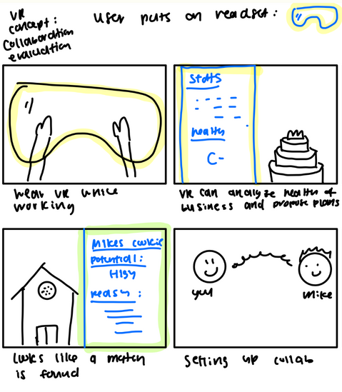
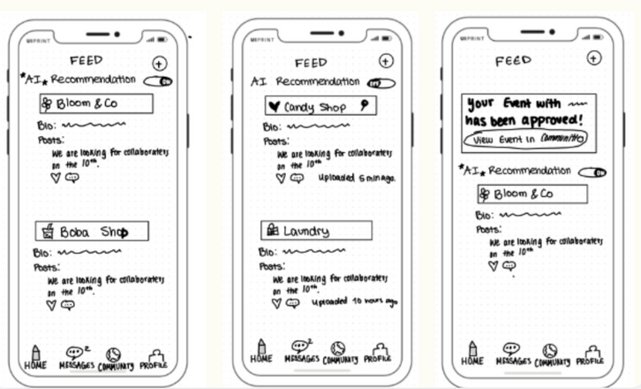
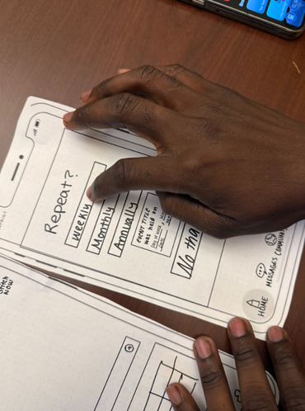
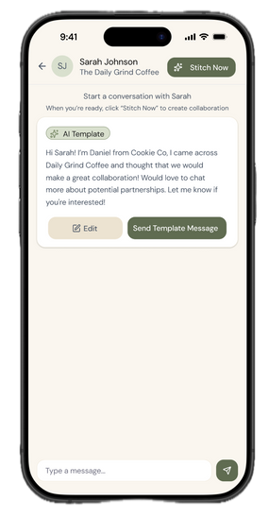
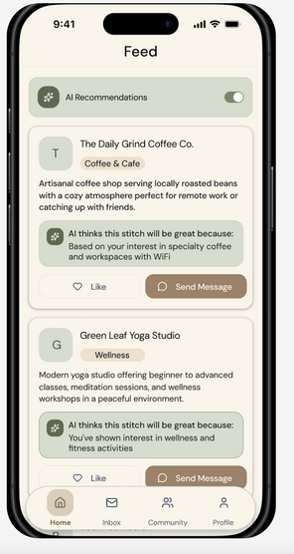
PROBLEM
SOLUTION
For all small businesses, finding support, adapting to a new generation, and creating community has been difficult.
STITCH uses an AI matching algorithm to allow small businesses to collaborate on events to attract new customers.
small businesses together
through community events.
APP SCREENS
Home Page
Message a Business
Create a Stitch
Repeat an Event
DESIGN PROCESS
Needfinding
How Might We...
Diverse Realizations
Low-fi Prototype
Usability Testing
Med-Fi Prototype
Eva T., Maimuna M., Sunny S. | CS 147 Autumn 2025 | hci.stanford.edu/courses/cs147/2025/au/projects/DesignforCommunityResilience/Stitch/

