Slide 1
Community Resilience for Small Businesses
10.03.2025
C

Slide 2
AGENDA
01
INTRODUCTION
02
NEEDFINDING METHODOLOGY
03
INTERVIEW RESULTS
04
ANALYSIS
05
SUMMARY
Team North Star

Slide 3

1
Introduction

Slide 4
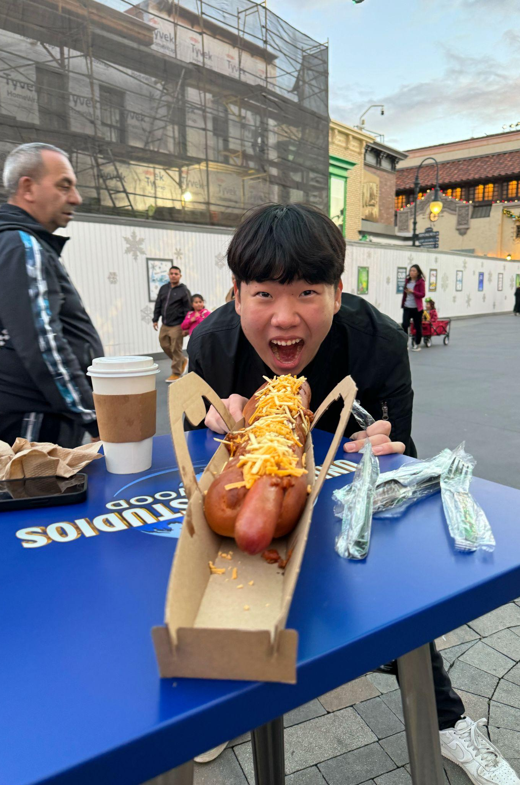
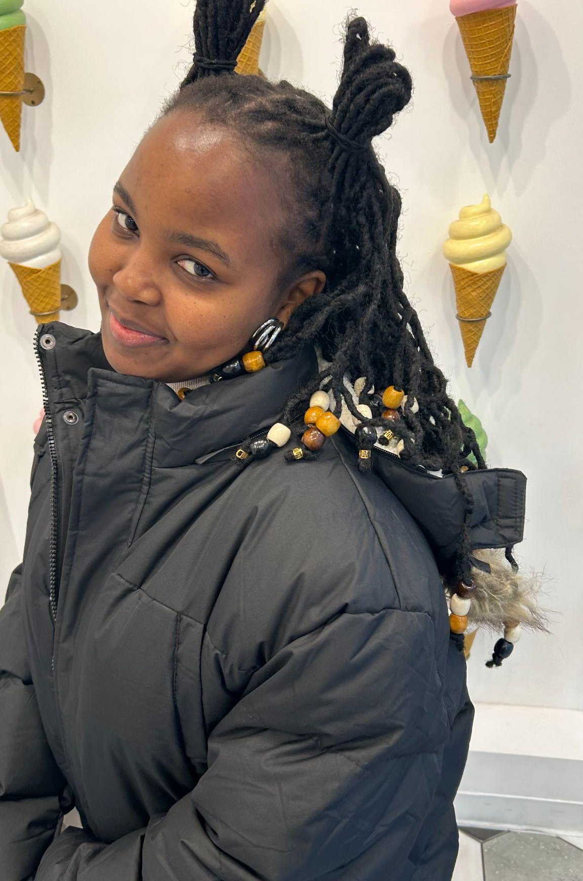
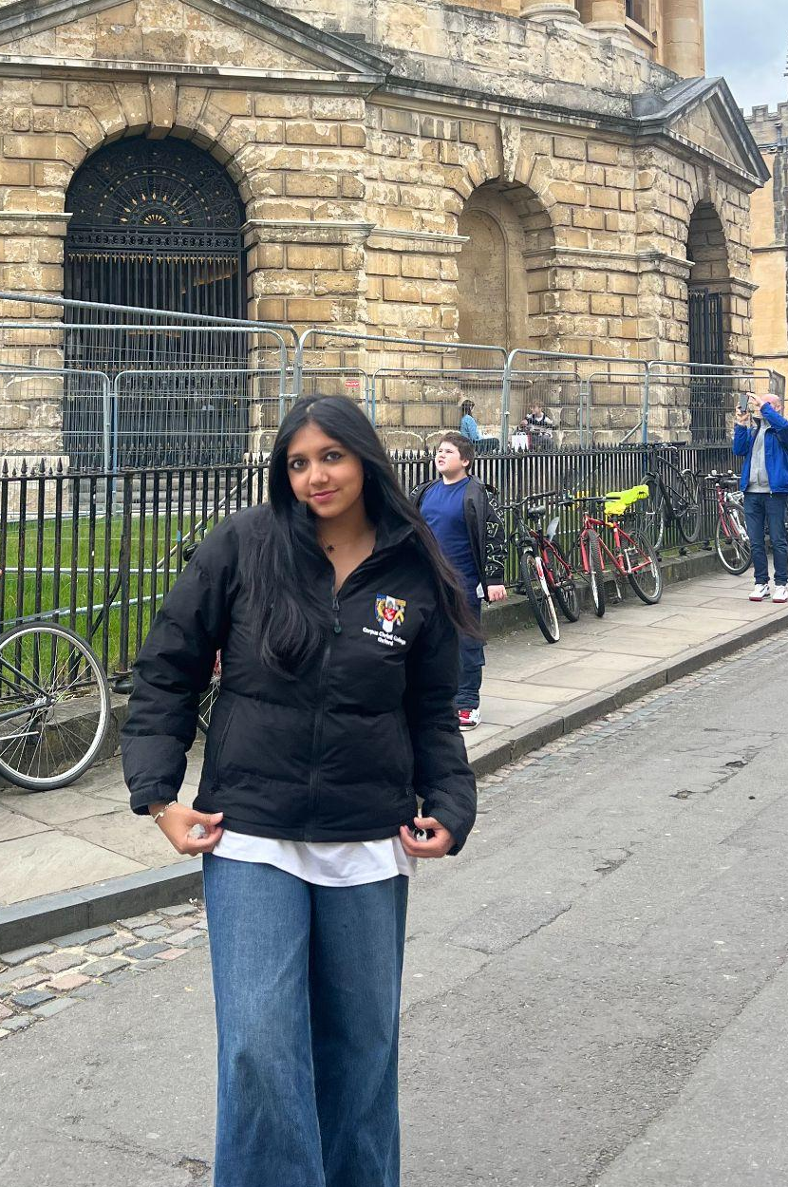

MEET
THE TEAM
Josh Bahk
Eva Moraa Tom
Maimuna Muntaha
Sunny Sun
Junior, CS
Rancho Cucamonga, CA
Senior, CS
Nairobi, Kenya
Senior, SymSys
NYC, New York
Junior, Symsys
Irvine, CA
Team North Star

Slide 5
OUR DOMAIN EVOLUTION
Many diverse interests
Economic downturns
Small businesses
Team North Star

Slide 6
OUR DOMAIN EVOLUTION
A lot of time spent here!
Many diverse interests
Economic downturns
Small businesses
Team North Star

Slide 7

A PRELIMINARY INTERVIEW
“Mike”
Researcher from New York
Team North Star

Slide 8
OUR DOMAIN
Small Business
Resilience
Team North Star

Slide 9

2
Needfinding Methodology

Slide 10
PARTICIPANT SELECTION
OUTSIDE OF STANFORD
SMALL BUSINESS FOCUS
RANGE OF BACKGROUNDS
Team North Star

Slide 11
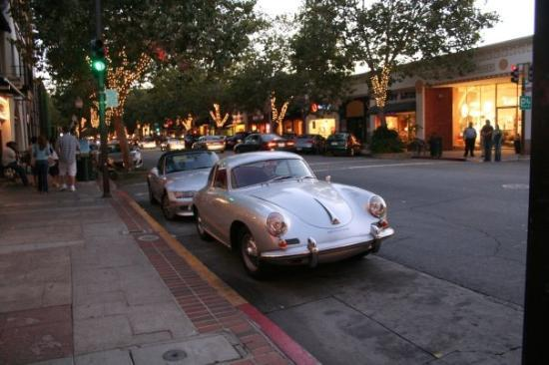
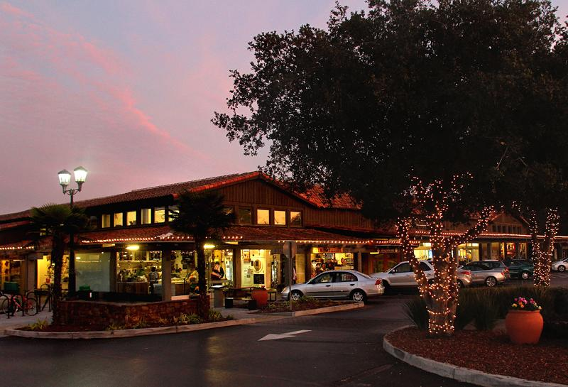
LOCATION
Uni Ave
Town & Country
Team North Star

Slide 12
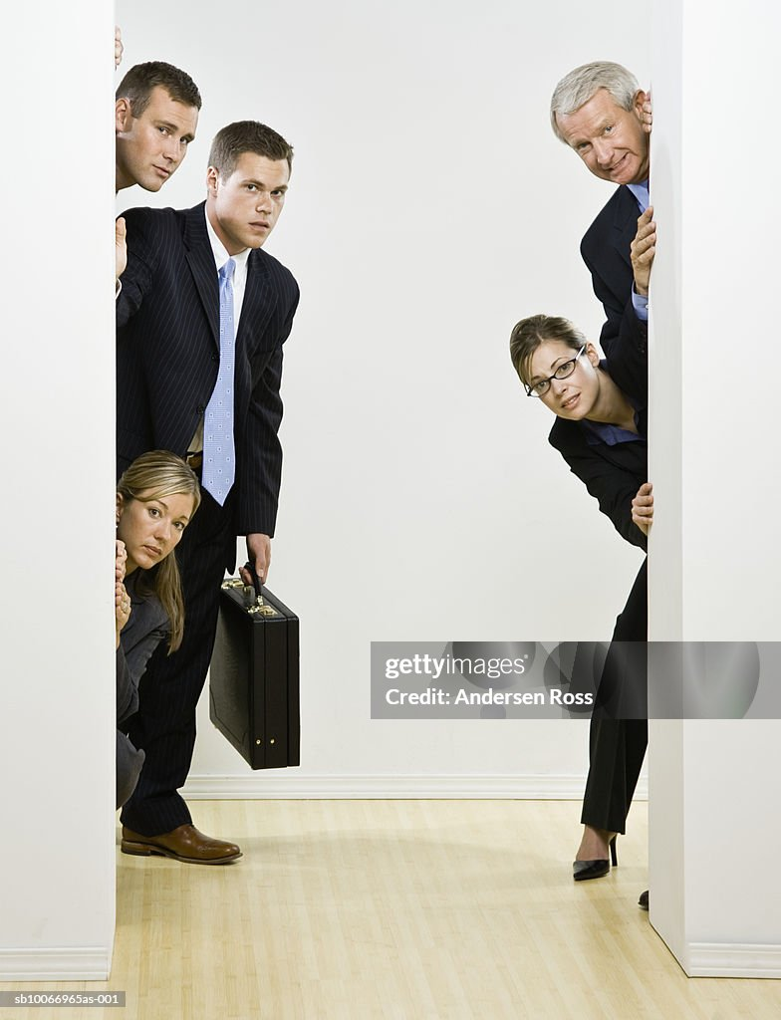
APPROACH
Team North Star

Slide 13
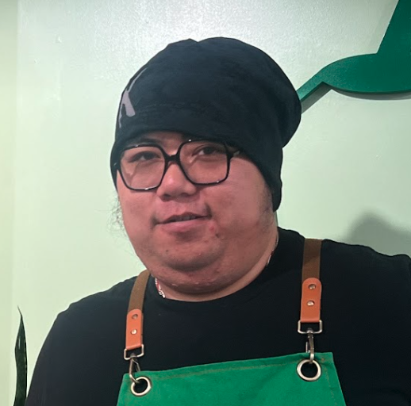
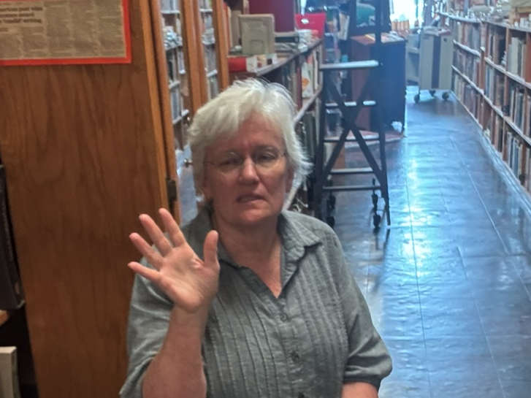
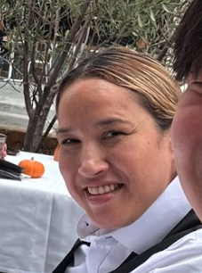

INTERVIEWEES
“Helen”
Manager at Italian restaurant for 22 years
“Taryn”
Owner of salon
“Mark”
Manager of boba shop
“Amy”
Owner of bookstore
Team North Star

Slide 14
EXTREME USER: A SPECTRUM
Resilience / Establishment in the Community
Brand new small business
(hair salon)
Open for 90 years,
staple in the community
(book store)
Team North Star

Slide 15
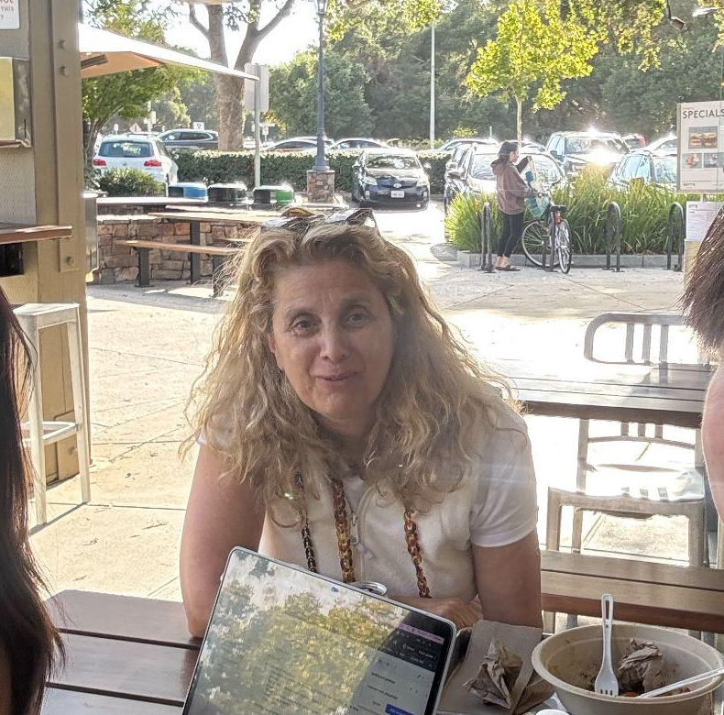

BUT WAIT, THERE’S MORE…
“Beatrice”
Customer
“Jessie”
Customer
Team North Star

Slide 16
GUIDING QUESTIONS
“Tell us about a challenge/crisis you have faced this past year/month”
“What’s your community and support system like as a business owner? “
“How is business now compared to last year? If there are any changes, do you think there’s a particular reason why?”
“How do you learn about information relevant to you as a small business owner?”
Team North Star

Slide 17

3
Interview Results

Slide 18
“I sometimes look for videos on how to manage so that I can improve”
“Mark”
Manager at Bubble Tea Shop
Team North Star

Slide 19
“This was a favorite of the regulars, but the regulars are getting older, the younger kids aren’t coming to us anymore. We don’t have cocktails or a bar, they’re going to NOLA”
“Helen”
Manager at Italian restaurant for 22 years
Team North Star

Slide 20
“We started in the middle of the Great Depression… very little money, very few resources, little materials you could get a hold of.”
“All the chains came in and killed all the little stores… we’re fortunate in having a really loyal following.”
“Amy”
Owner of bookstore
Team North Star

Slide 21
“My family drives 30 minutes all the way from San Jose to support the salon”
“I wish more people know about this salon”
“Taryn”
Owner of salon
Team North Star

Slide 22
“Big stores are probably 90% [of what I buy from]”
“I try to avoid the chain [restaurants] almost all the time”
“Beatrice”
Customer, grandma of 2
Team North Star

Slide 23
“I try not to go name brands, but if I know that a brand has good basics, I’ll probably gravitate towards that.”
“[When buying], I ask my friends’ opinions and I do my own research”
“Jessie”
Customer, High School Student
Team North Star

Slide 24

4
Analysis

Slide 25
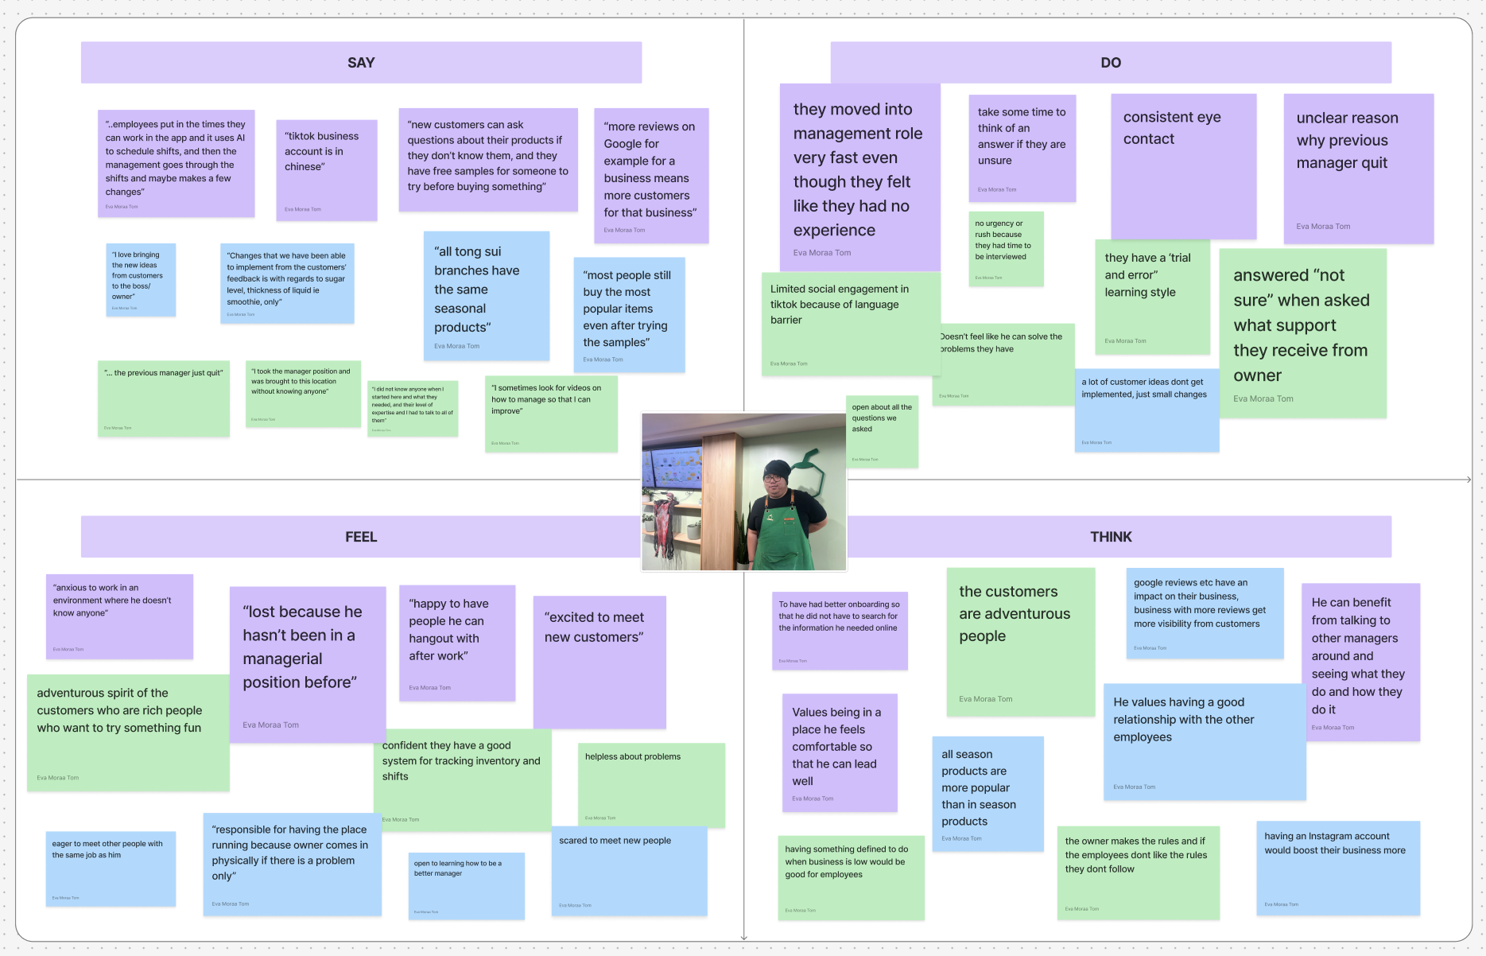

Slide 26
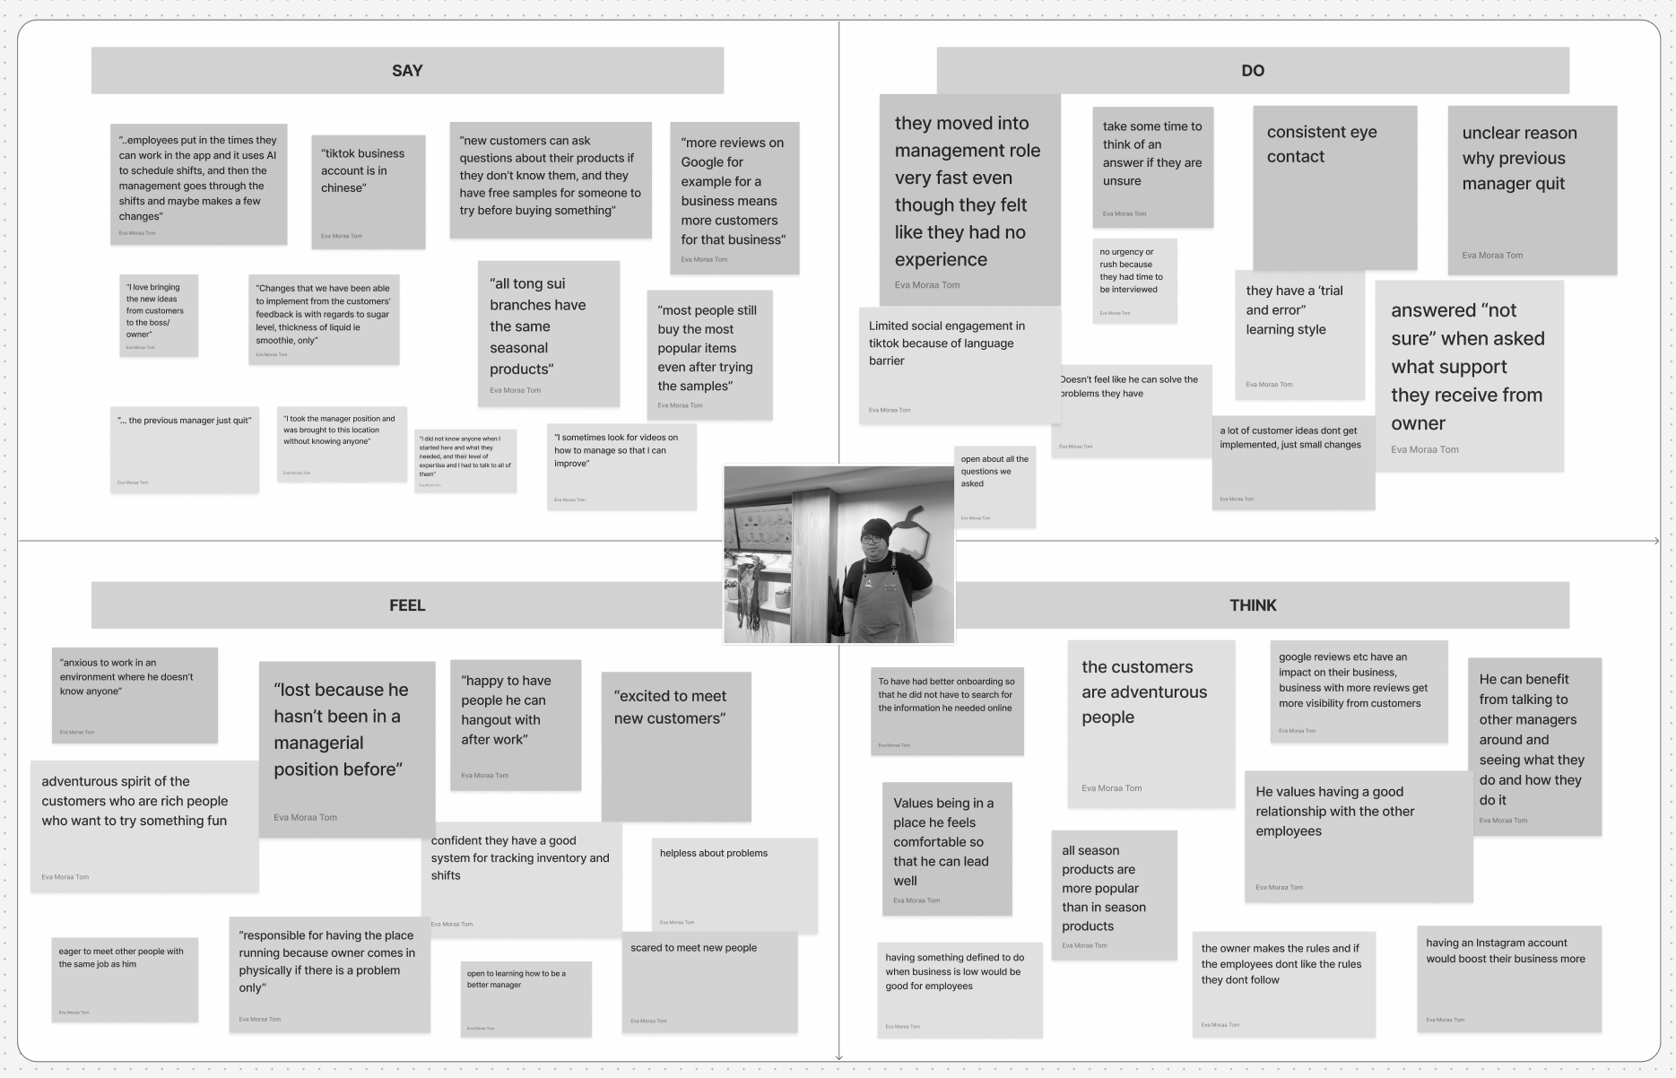
“I sometimes look for videos on how to manage so that I can improve”
they have a ‘trial and error” learning style
He can benefit from talking to other managers around and seeing what they do and how they do it
helpless about his ability to solve problems

Slide 27
Insights
Needs
Managers find it frustrating that despite stepping up quickly into management, they often feel unsure about support and their ability to find solutions, leaving them to constantly use trial and error method.
Managers need to feel supported when facing challenges instead of facing them on their own
Team North Star

Slide 28
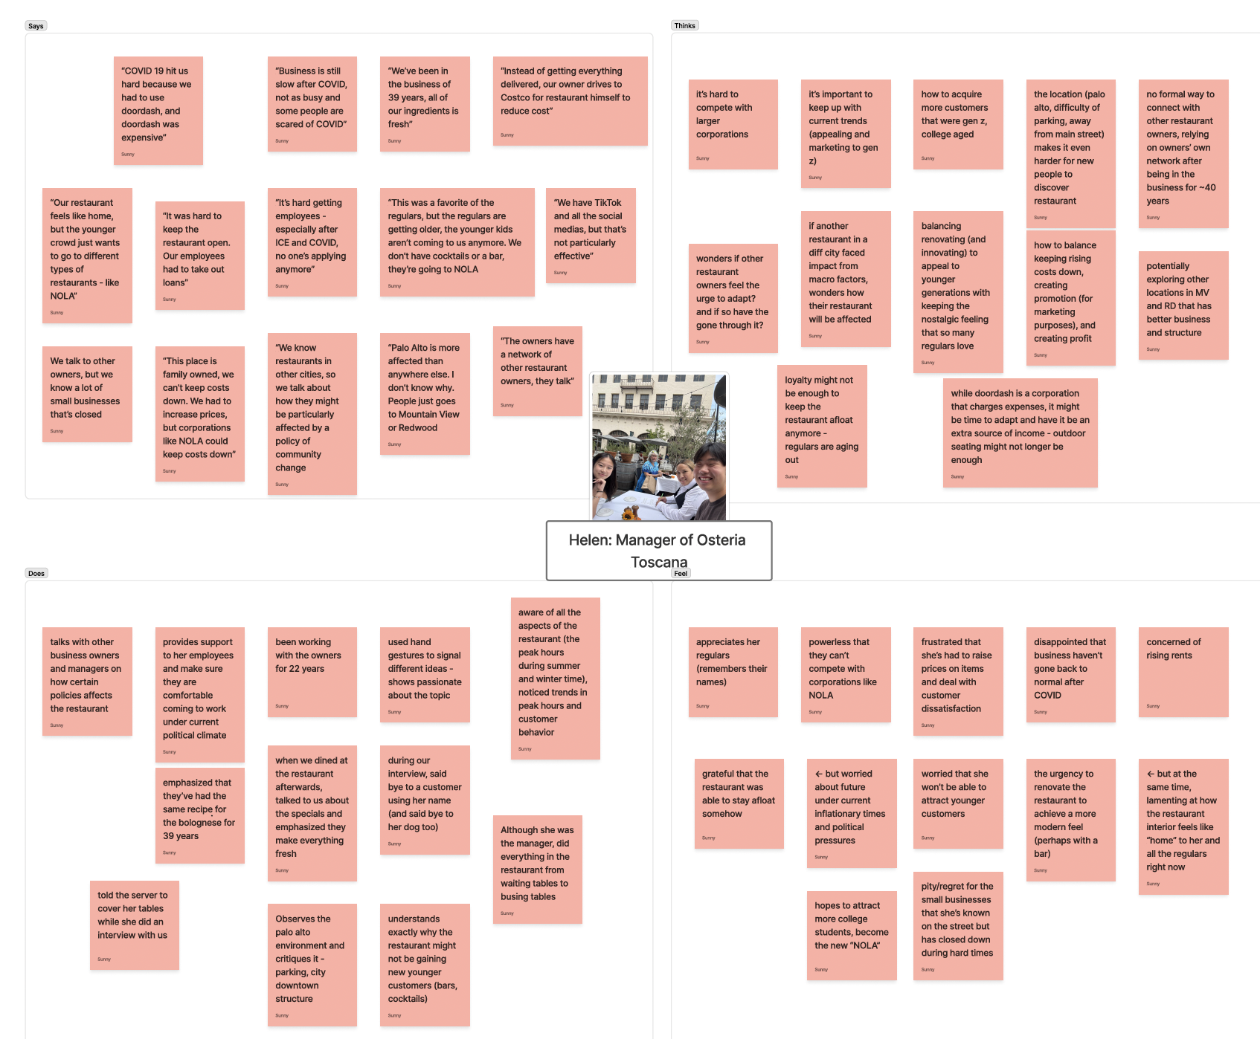

Slide 29
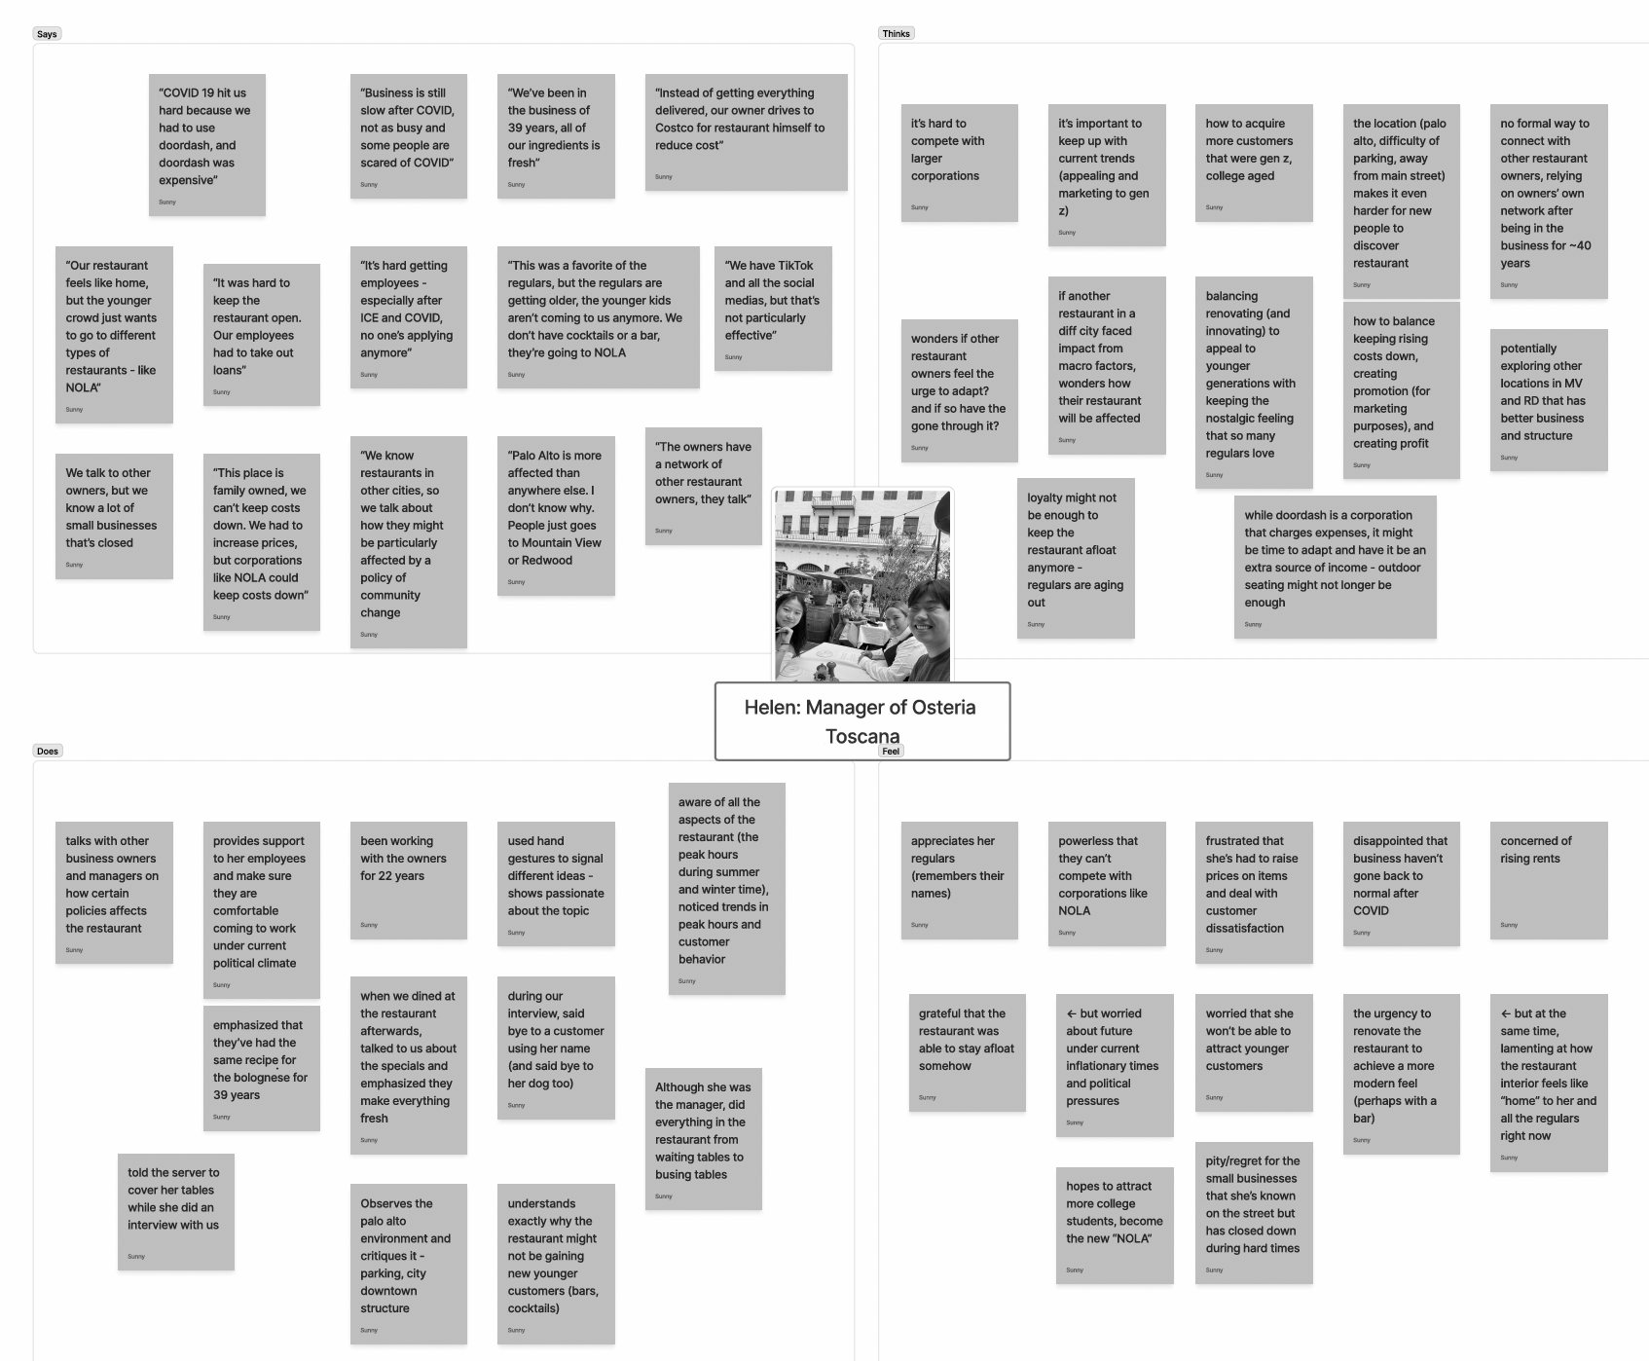
“Our restaurant feels like home, but the younger crowd just wants to go to different types of restaurants - like NOLA”
No formal way to connect with other restaurant owners, relying on owners’ own network after being in the business for ~40 years
During our interview, said bye to a customer using her name (and said bye to her dog too)
Pity/regret for the small businesses that she’s known on the street but has closed down during hard times

Slide 30
Insights
Needs
For small businesses, not only is having a loyal customer base important, but so is adapting to appeal to the younger generation
There is no formal way to engage with other small restaurant owners unless relying upon decades of network.
Small business owners need a way to find effective marketing strategies and increase customer acquisition
Small business owners need a way to communicate with other business owners and form networks
Team North Star

Slide 31
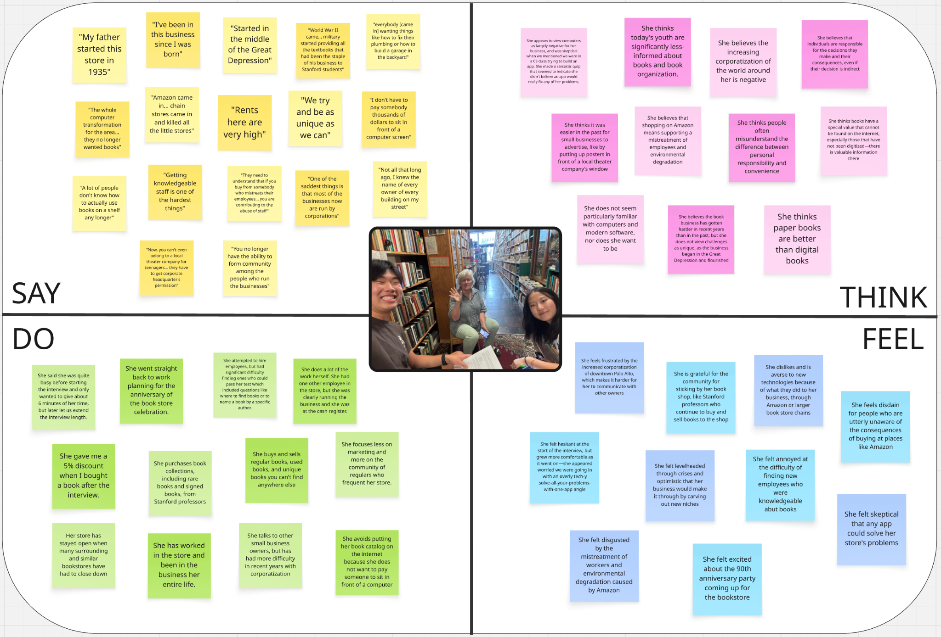

Slide 32
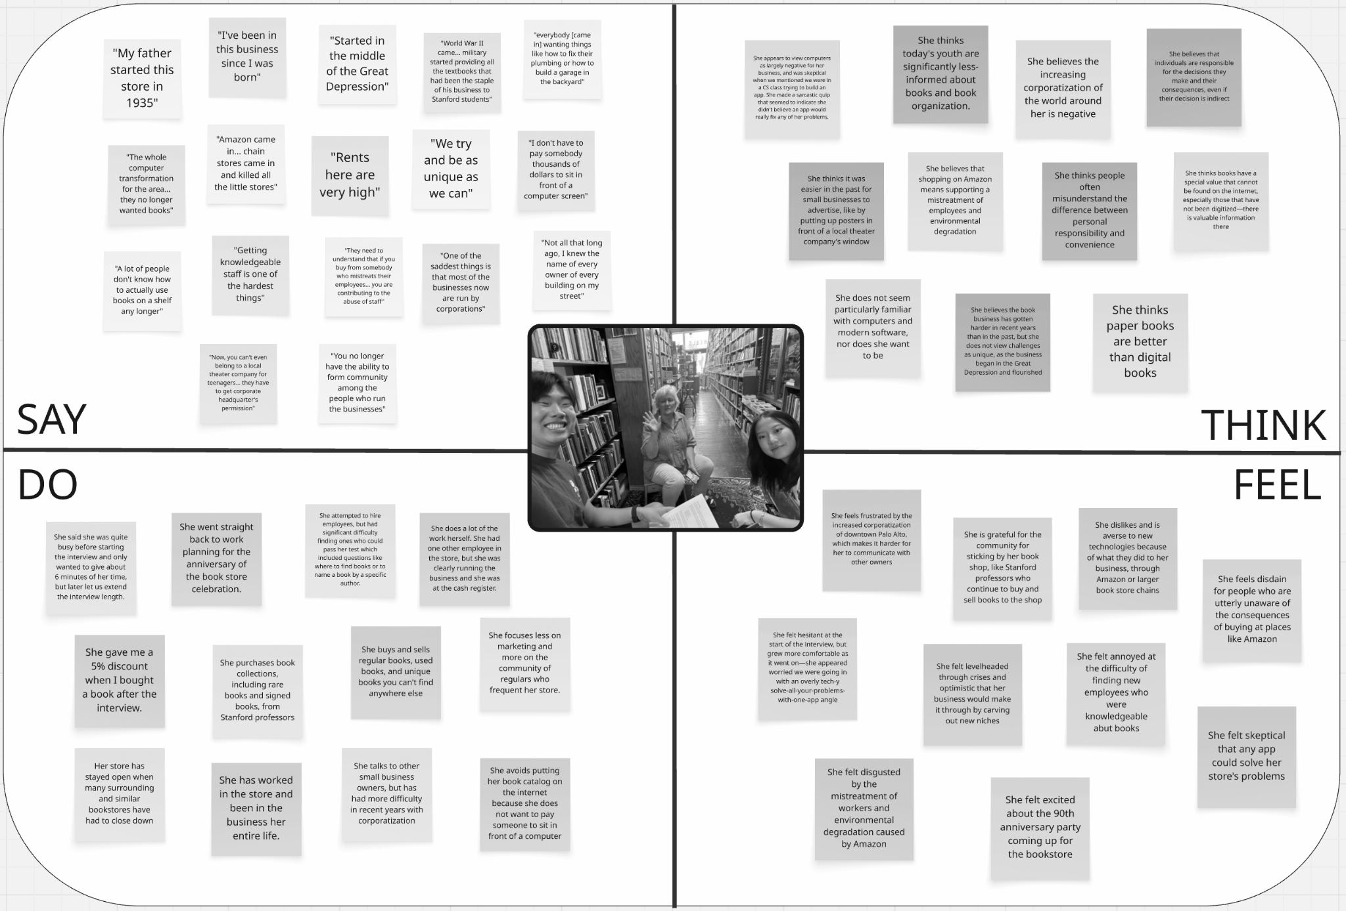
“You no longer have the ability to form community among the people who run the businesses”
Corporatization reduces the number of small businesses and drives existing ones further apart
Amy: book store owner
She does a lot of the work herself, relying less on employees
She’s annoyed at how hard it is to find knowledgeable employees these days

Slide 33
Insights
Needs
Small businesses have evolved over time, from being a community to now being isolated, combating the threats of corporations alone
Small businesses need a way to band together to mitigate risks, like economic downturn and developing corporations
Team North Star

Slide 34
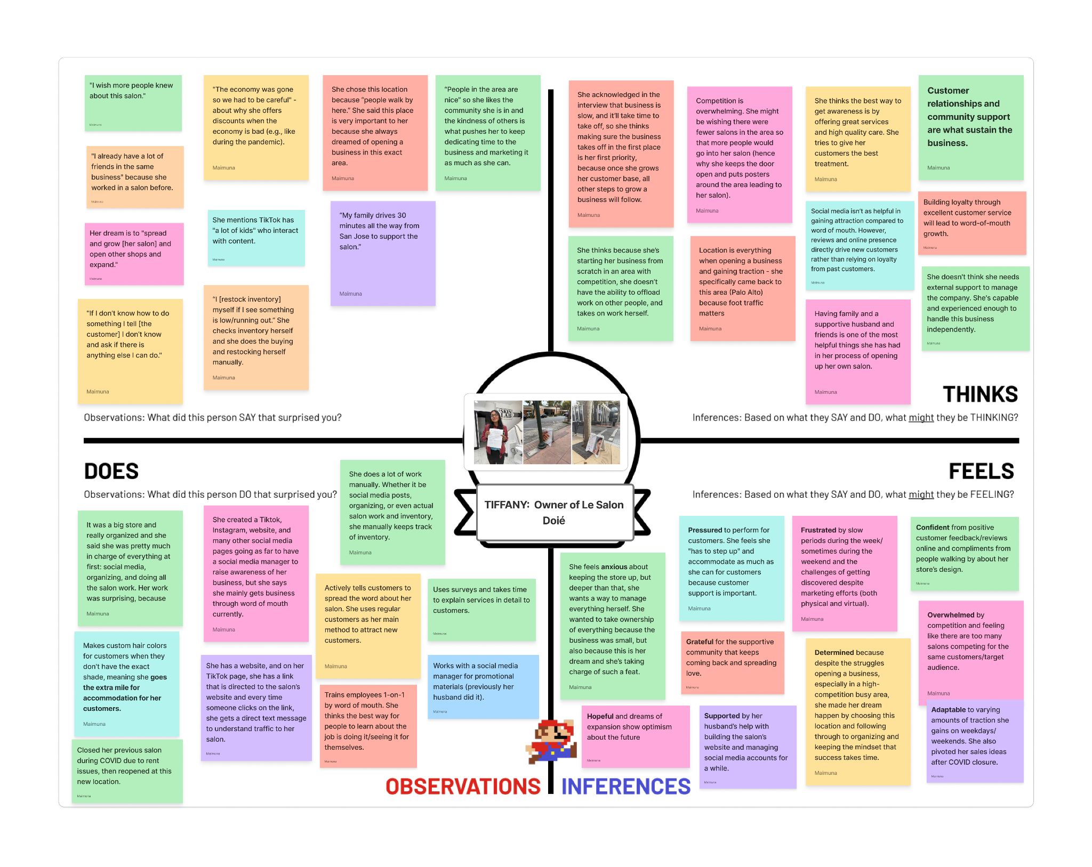
Taryn

Slide 35
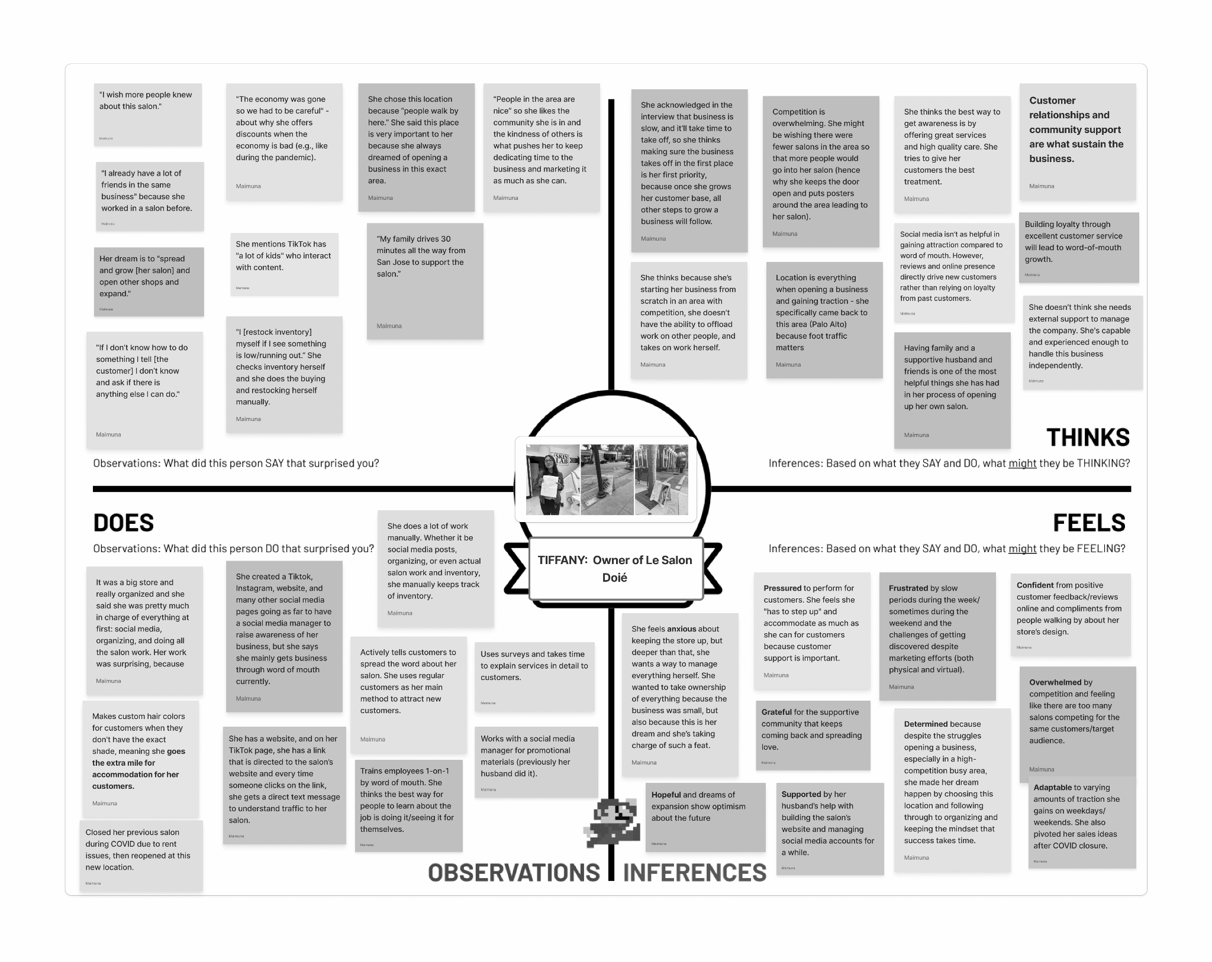
"I wish more people knew about this salon."
Customer relationships and community support are what sustain the business.
Taryn
Whether it be social media posts, organizing, or even actual salon work and inventory, she does everything herself.
Frustrated by slow periods and the challenges of getting discovered despite marketing efforts (both physical and virtual).

Slide 36
Insights
Needs
Even with marketing and utilizing social networks (both in-person and virtual), targeting specific audiences in an area isn’t easy for small businesses.
Currently, there are so many businesses offering the same services, that people go to the ones they’ve already been to making it harder for newer businesses to gain traction.
Small businesses need a way to reach out to people in the area and expand their networks even more.
Team North Star

Slide 37
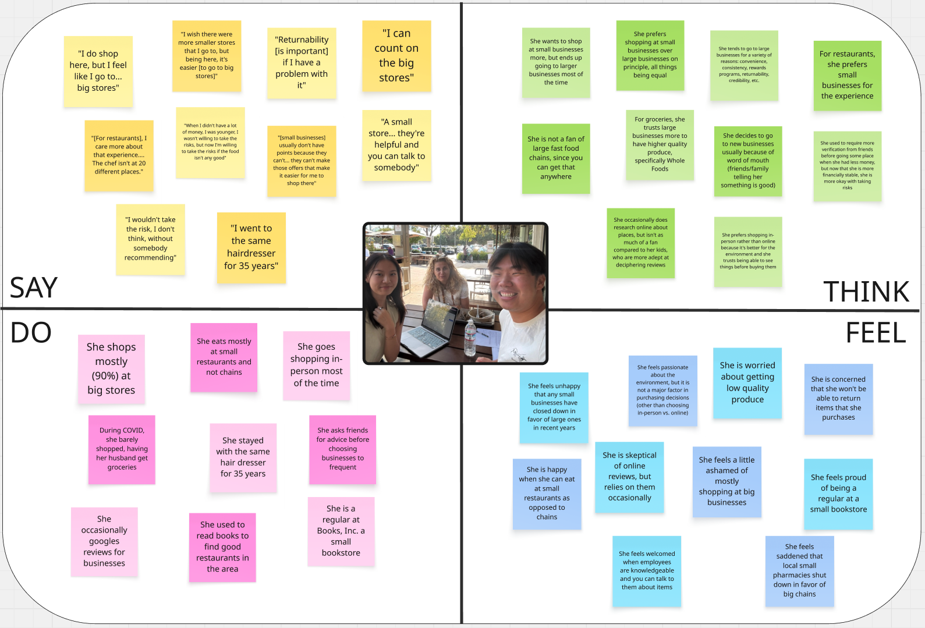

Slide 38
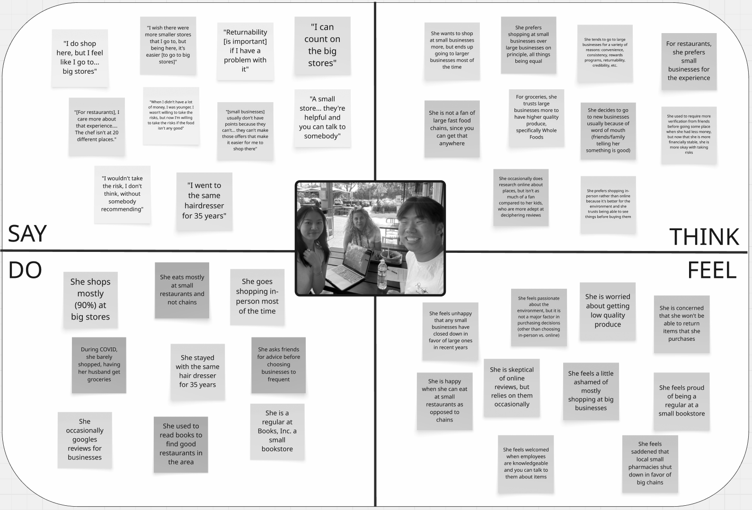
“[Small businesses] usually don’t have points… they can’t make offers that make it easier for me to shop there.”
She wants to shop at small businesses more, but ends up going to big businesses mostly
She frequents small businesses for restaurants, but never for groceries
She is unhappy that small businesses have closed down, but prefers other factors to determine her shopping habits.

Slide 39
Insights
Needs
On principle, customers want to support small businesses, but in practice, they tend to look at other factors like convenience and trust.
Customers have different preferences for large/small businesses depending on the good/service offered
Customers need greater convenience and trust to frequent small businesses more often
Customers have complex needs depending on the type of small business—a one-size-fits-all won’t be ideal
Team North Star

Slide 40
Tensions, Contradictions, Surprises
Tensions
Contradictions
Surprises
Many small businesses’ networks are created from informal connections, usually after decades of experience, but this disadvantages newer businesses as there is no formal network
Different preferences for small businesses/big box depending on sector
Managers still feeling like a beginner and having to google videos on how to manage.
Within the category of food, one customer prefer grocery shopping at big businesses, but supports small restaurants.
Favourite part of the manager’s day is getting recs from customers to pass on to owner, but none have ever been implemented.
The community and downtown was no longer what it once was, with much less sense of community.
Large corporations can keep their prices down, amongst economic downturn and inflationary periods, while small businesses struggle.
Reliance on AI to make the shift schedule for Boba shop.
Team North Star

Slide 41

5
Summary

Slide 42
WHAT WE LEARNED
Small business owners often have trouble staying in touch with others
Marketing to new customers can be a challenge
Consumers often desire supporting small businesses, but shop differently
Small businesses usually rely on regulars to spur business
Social media marketing is frequently attempted, but not very successful
Starting a small business can be incredibly difficult without regulars to depend on
Team North Star

Slide 43
WHAT’S NEXT?
Develop POVs, HMW statements and create experience prototypes
Interview new extremes: a former business owner whose store closed down
Synthesize the data from business owners and business customers
Use what we learned to hone in on a potential solution
Team North Star

Slide 44

THANK YOU

Slide 45

6
Appendix

Slide 46
Team North Star

