Slide 1
STITCH:
A4 Concept Video

Slide 2
Agenda
1.
Project name and value proposition
2.
Problem/solution overview
3.
Market research
4.
Values in design
5.
Tasks
6.
Storyboard & Video

Slide 3
STITCH
Stitch small businesses together through community events.

Slide 4
Brand Name Brainstorming Process
We started with Embed, but it felt too formal and technical.
We then shifted to Quilt, which captured the visual of stitching small businesses together to form a community fabric.
We then landed on Stitch, which is simple but memorable, and it captures the core action in ur brand name.
Tagline Uniqueness
Our tagline “Stitch Small Businesses Together Through Community Events”, is
unique because it names the three core pillars we want in our brand,
small businesses, collaboration, and community events
as the vehicle to achieve success, without
being jargon-heavy.
Project name and value proposition

Slide 5
For small businesses in the community, both new ones trying to establish themselves and old ones trying to keep up with the changing times, finding support, adapting to new generation, and utilizing the community has been difficult. STITCH uses AI matching algorithm to allow small business to pair with each other, collaborate on events, and attract new customers, growing together.
Problem/Solution Overview

Slide 6
Market Research

Slide 7



BNI(Business Network International)
340K+ global members, referral program network with local chapters. Members meet weekly, one business per profession per chapter.
Idea: Connects local businesses for mutual benefit. Emphasizes trust and meaningful relationships over transactional networking - similar to Stitch in this way
What has worked for them:
Structured weekly meetings build deep trust. Exclusive membership (one per industry) eliminates competition. Proven 40+ year track record generating billions in referrals.
What has not worked for them:
High commitment requirement (weekly meetings, fees ~$600-800/yr).
Limited to one business type per chapter.
Focused on referrals, not joint events/collaborations.
Key Difference:
BNI focuses on referrals between different industries. Stitch enables collaboration between complementary/similar value-aligned businesses for joint events.

Slide 8
Alignable
8M+ member online platform connecting small businesses in 35K+ local communities across US/Canada. Free and premium tiers.
Idea: Digital platform for local small business networking. Community-focused, connecting businesses in specific geographic areas.
What has worked for them:
Large user base and geographic coverage. Location-based connections make networking locally accessible. Educational content and discussion groups add value.
What has not worked for them:
Less structured than in-person networks.
Can feel like LinkedIn for small businesses without deep engagement.
Premium features needed for full access.
Key Difference:
Alignable is broad networking/referrals. Stitch specifically facilitates joint events and values-based collaboration, with community event integration.

Slide 9
Eventbrite
Not Business to Business Platform.
Idea: Event discovery platforms where businesses can find/create networking events based on interests and location.
What has worked for them:
Large user bases for event discovery. Easy to create and promote events. Geographic and interest-based filtering helps relevance.
What has not worked for them:
Not designed for business collaboration.
Events are one-off, no sustained partnerships.
No values alignment or vetting process.
Key Difference:
This is a consumer event platform. Stitch is B2B focused on sustained business collaborations with values matching, not just event attendance.

Slide 10
Local Chamber Of Commerce
Traditional membership organizations providing networking events, business advocacy, and community connections for local businesses.
Idea: Local business networking focus. Community integration. Facilitates business-to-business connections.
What has worked for them:
Established community presence and credibility.
Regular networking events.
Connection to local government and community initiatives.
What has not worked for them:
Often feel outdated/traditional.
Limited digital tools.
Broad membership without targeted matching.
Focus on general networking over specific collaborations
Key Difference:
Chambers offer general networking. Stitch provides targeted, values-based matching for specific joint event opportunities with digital-first tools.

Slide 11
What makes us Unique
Values-First Matching: Unlike all competitors, Stitch ensures businesses only collaborate with partners sharing their values (e.g., preventing profit-driven cafes from partnering with nonprofit cat lounges)
Joint Event Focus: Purpose-built for collaborative events, not just referrals or general networking
Community Event Integration: Seamless connection to local community events (carnivals, school games) with tailored marketing tools - no competitor offers this
B2B Tool, Not Customer-Facing: Designed specifically as a business owner tool, not a marketplace for consumers

Slide 12
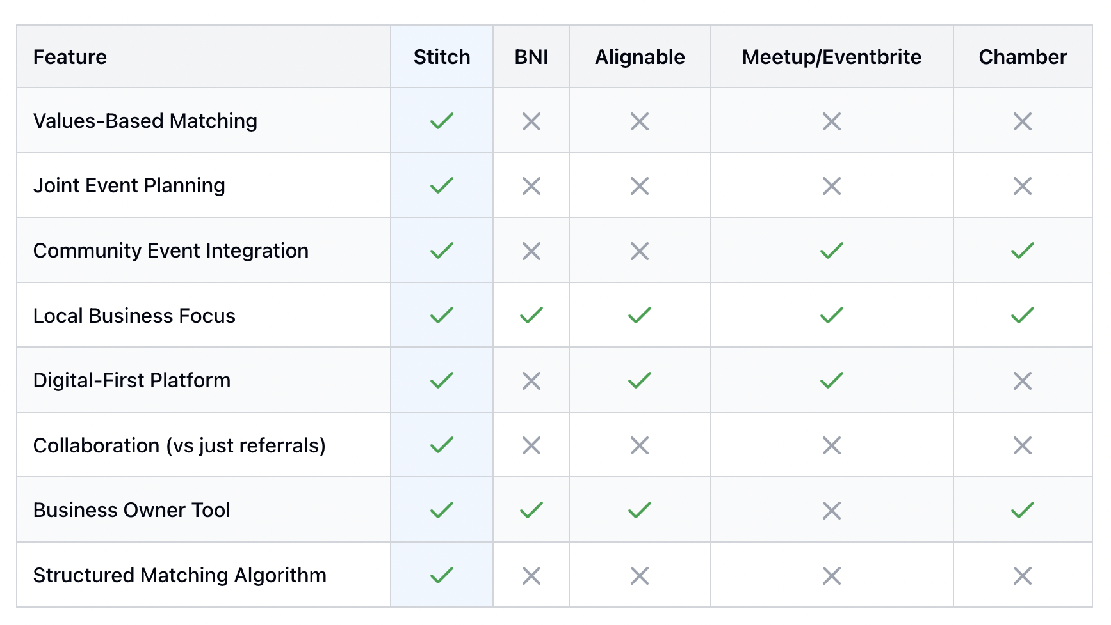

Slide 13
Values in Design

Slide 14




Transparency
For each pairing, explain why a pairing was made, ensure data privacy, and set norm and visible community standards.
Empowerment
We want to empower small businesses and foster collaboration rather than competition. We want to give them Give small businesses agency and tools to take control of their growth, not just passive recommendations.
Accessibility
Every small business, regardless of technical skill or budget, should be able to use STITCH easily.
Inclusivity
Celebrate diversity across age, culture, and industry; help old-school and Gen-Z-owned businesses coexist and co-grow.

Slide 15


Stakeholders
Direct Stakeholders
Small business owners
Employees of participating businesses (including managers and employees)
Indirect Stakeholders
community event organizers (if the business owners use organizers for events
customers of the partnered businesses
suppliers
local govt officials
marketing agencies
people of community being exposed to such collaboration

Slide 16
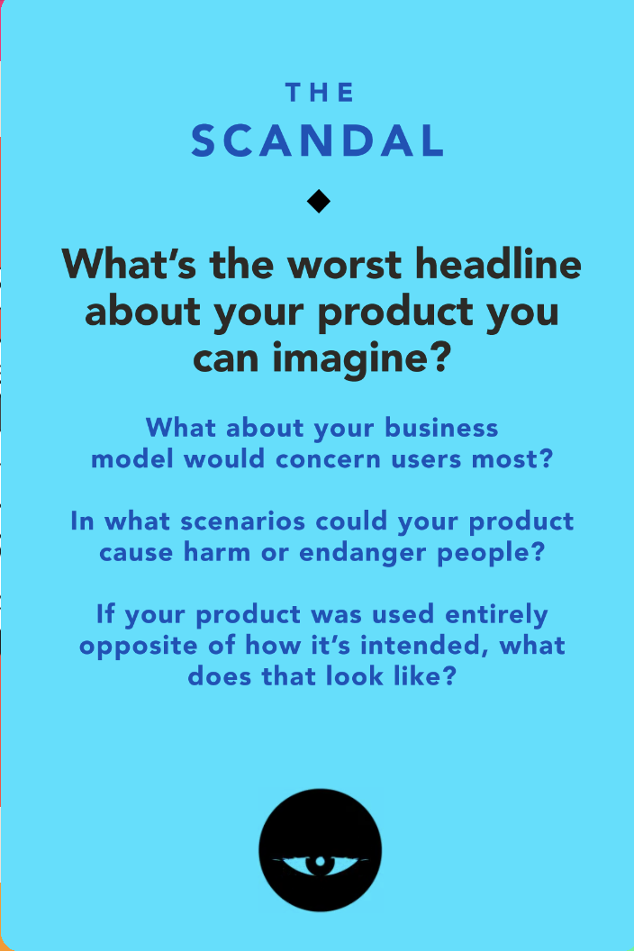
Ethical Implications:
Two brands with misaligned values collaborate/partner on an event and when one brand’s reputation gets damaged the other brand suffers too.
For example: A sustainable fashion boutique partners with a fast-fashion brand masquerading as eco-friendly. When the fast-fashion company's labor practices are exposed, both brands suffer reputational damage and customers feel deceived.
We will ensure that there is verification and transparency of all the small businesses that sign up to use Stitch so that we can verify their values and only align them with other small businesses that have the same values.

Slide 17
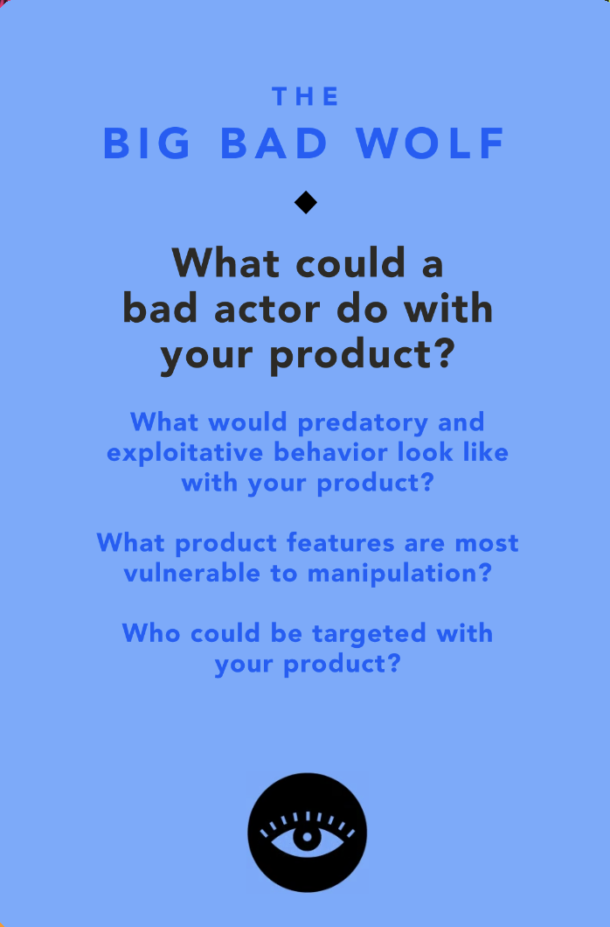
Ethical Implications:
A bad actor can exploit Stitch’s matching to gain an unfair competitive advantage or deceptively absorb the other small businesses’ customers.
For example: A larger business pretends to be a small business, partners with genuine small businesses through Stitch for joint events, then steals their customer base by offering lower prices or better terms.
We will have partnership agreements and accountability. The agreement will include terms,roles and how revenue will be shared between the two businesses at the end of the event. Businesses with predatory patterns get flagged, for example if there are multiple complaints about a business this will trigger investigation or removal from Stitch. Small business owners can rate their partners post-event and we can use this to keep track of how other businesses collaborate with each other.

Slide 18
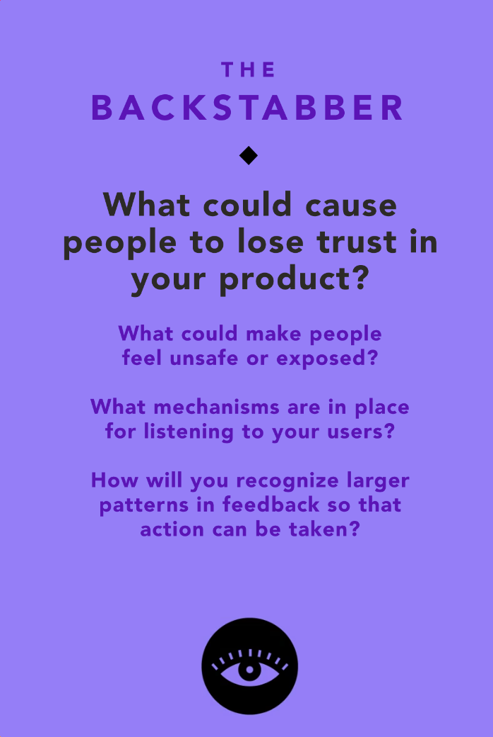
Ethical Implications:
Businesses lose trust in Stitch if they perceive bias in how event times are assigned to collaborations.
For example: A flower shop repeatedly gets matched to night-time collaborations while other businesses consistently get assigned prime daytime slots. Even if night-time works for the flower shop, repeated patterns of unequal time slot distribution make it appear the platform is biased or unfairly favoring certain businesses.
Stitch uses randomization in event time matching while respecting business preferences. We track how many times each business receives specific time slots to ensure equal distribution over time. Businesses input their ideal operating times upfront, and the algorithm prioritizes matching them to events during these preferred windows. This transparency removes perception of bias.

Slide 19
Tasks
Simple: A small business messages another small business to talk about a collaboration
This is the most frequent task that a user will do. In order to determine whether or not to collaborate with a business, not only will a business use our AI matching algorithm, but they will also frequently message multiple business to discuss the details of the partnership.
Timestamp: 0min.36sec
Moderate: A collaboration with another business is planned and hosted
When messaging another business works out and both settle on the details/date/time of the collaboration, then our app generates ideas nad helps plan the event. This is less frequent than the simple task because not all messages with businesses turn into collaboration
Timestamp: 0min.56sec
Complex: A small business collabs with multiple different new business monthly
The first collaboration was so successful that a super user might want to keep planning collabs with that store, and even extend partnerships to multiple stores. The frequency of repeats will be lower than just hosting one event, but this is reserved for super users who had a successful collab.
Timestamp: 1min.24sec

Slide 20
Storyboard

Slide 21
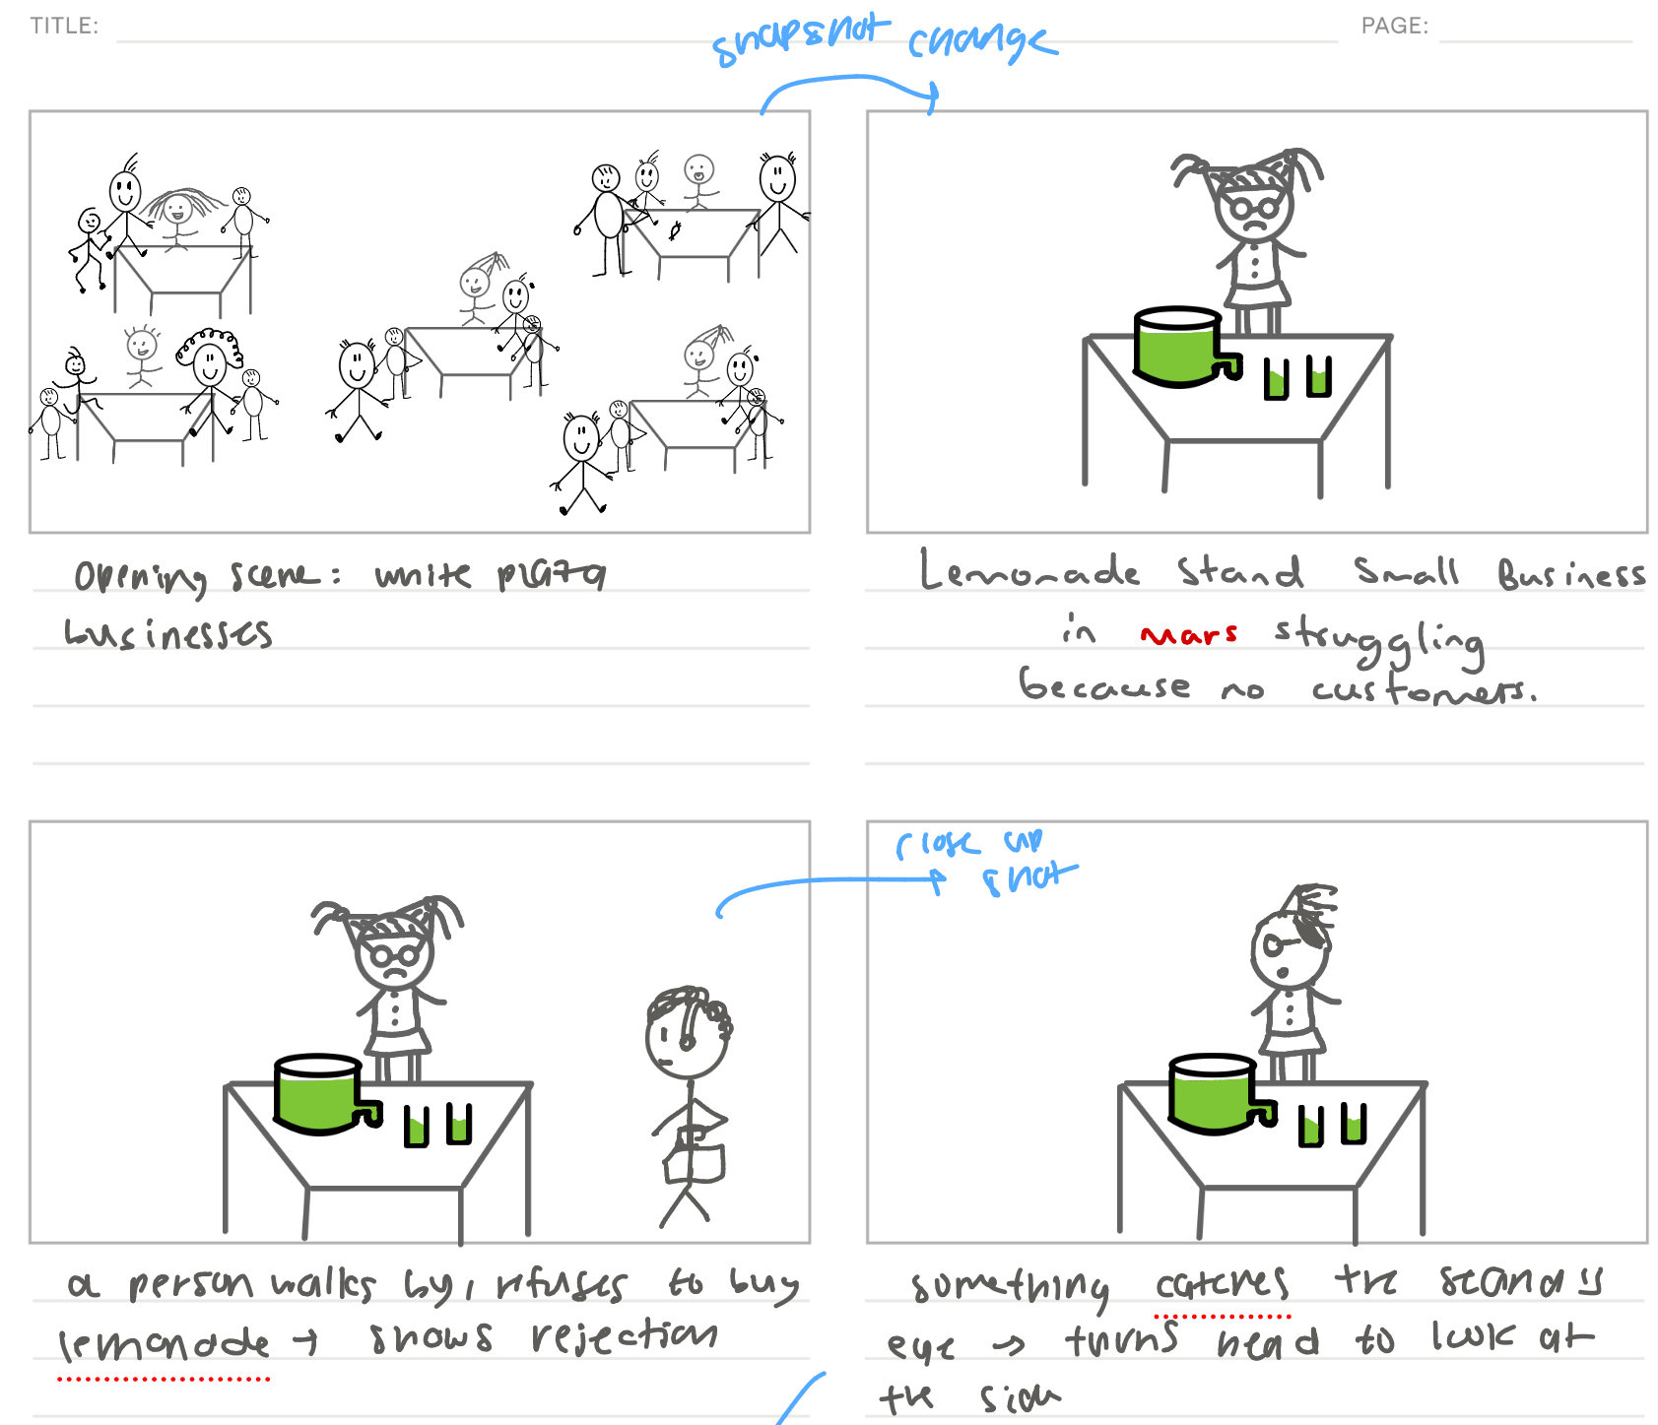

Slide 22
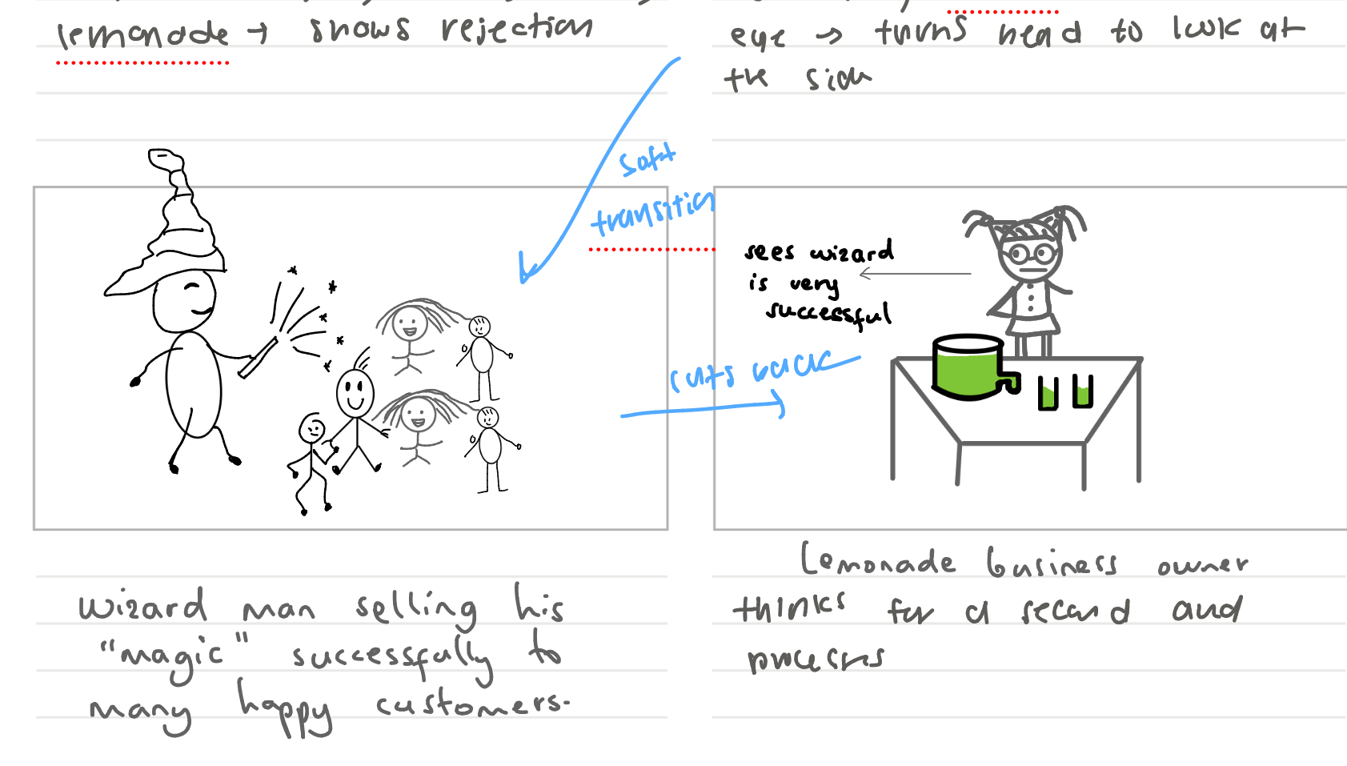

Slide 23
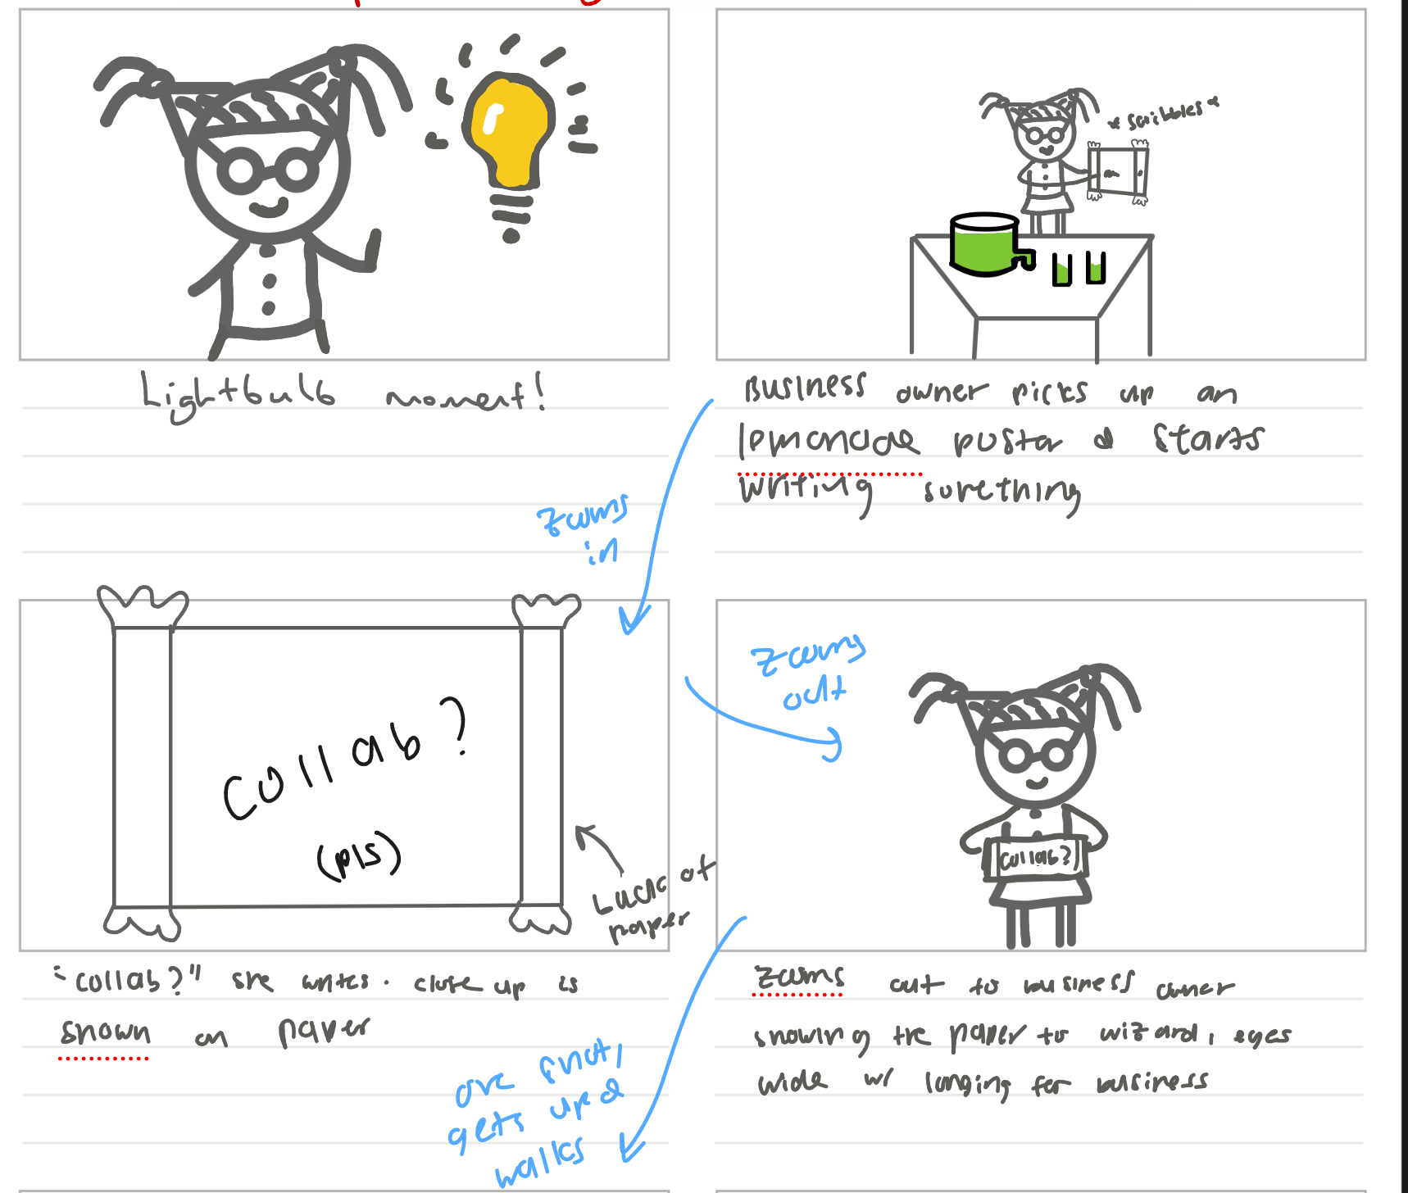
TASK 1

Slide 24
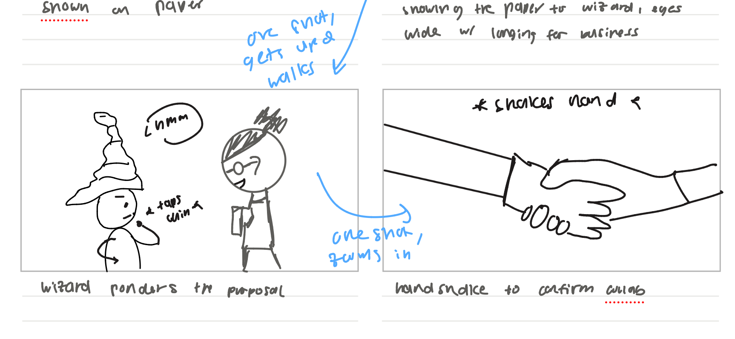

Slide 25
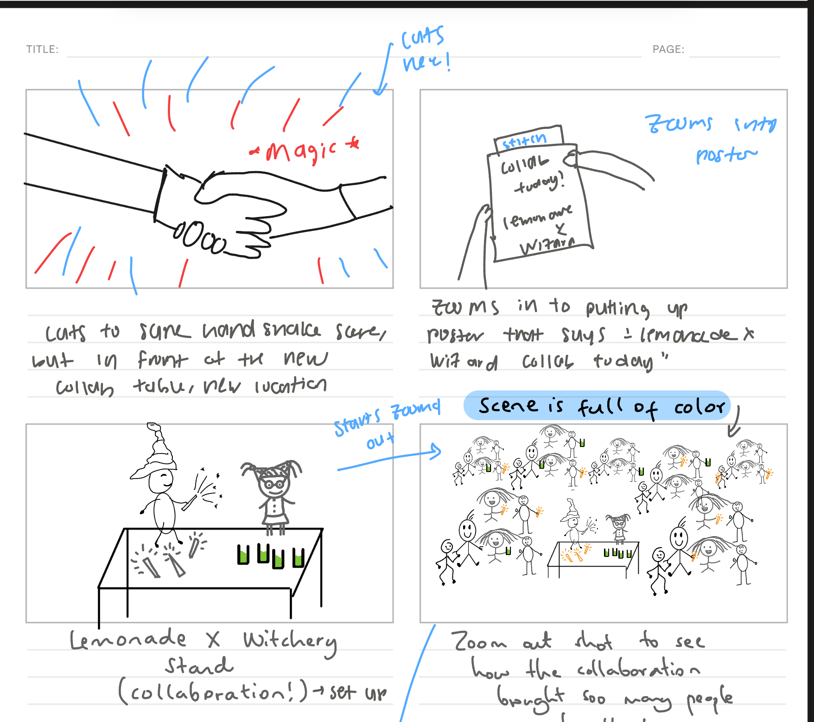
TASK 2

Slide 26
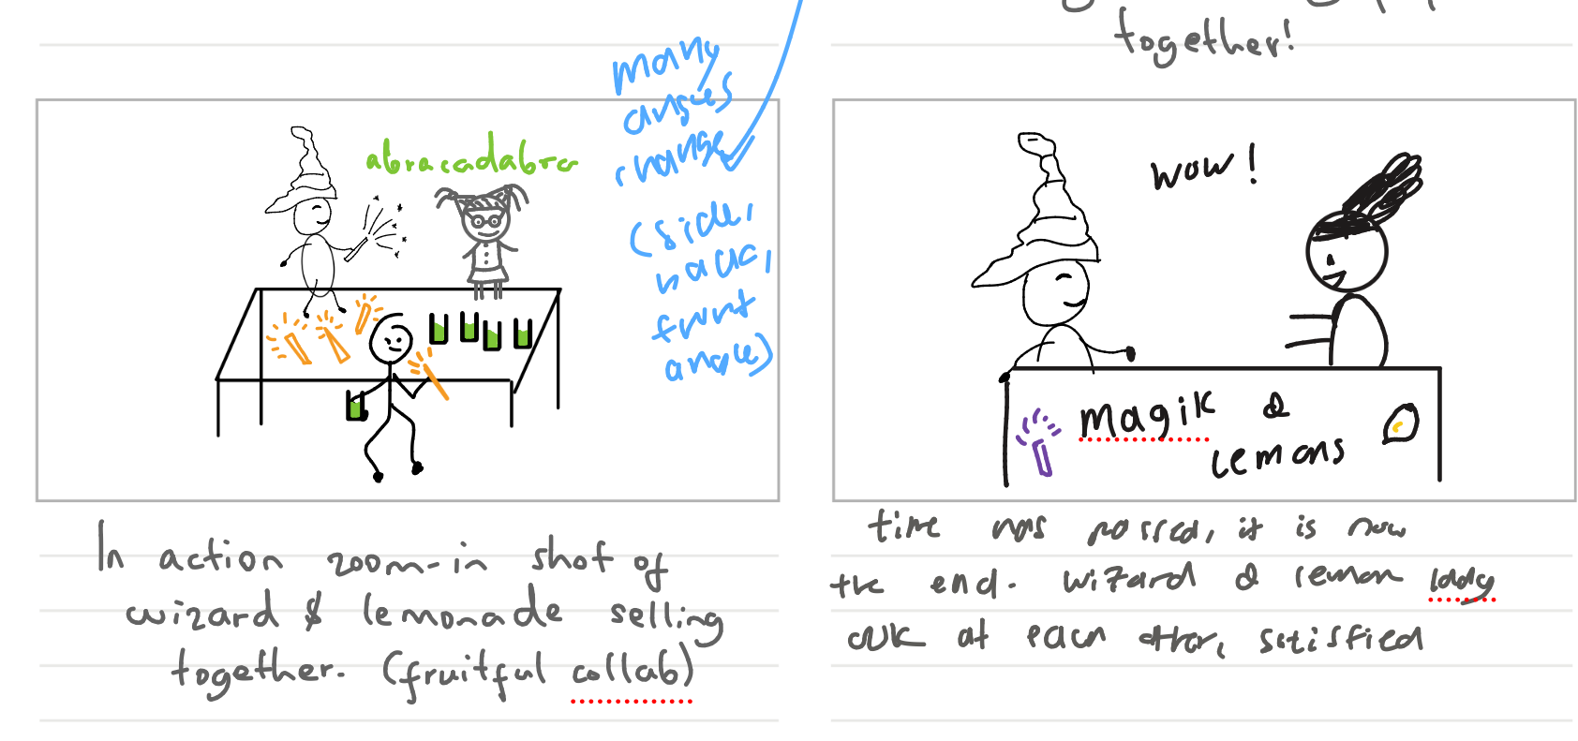

Slide 27
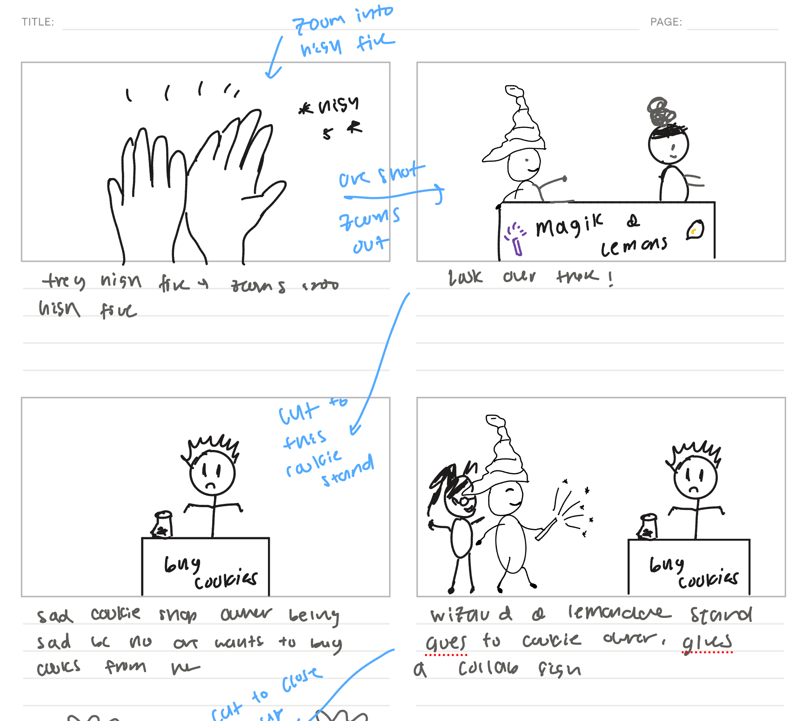

Slide 28
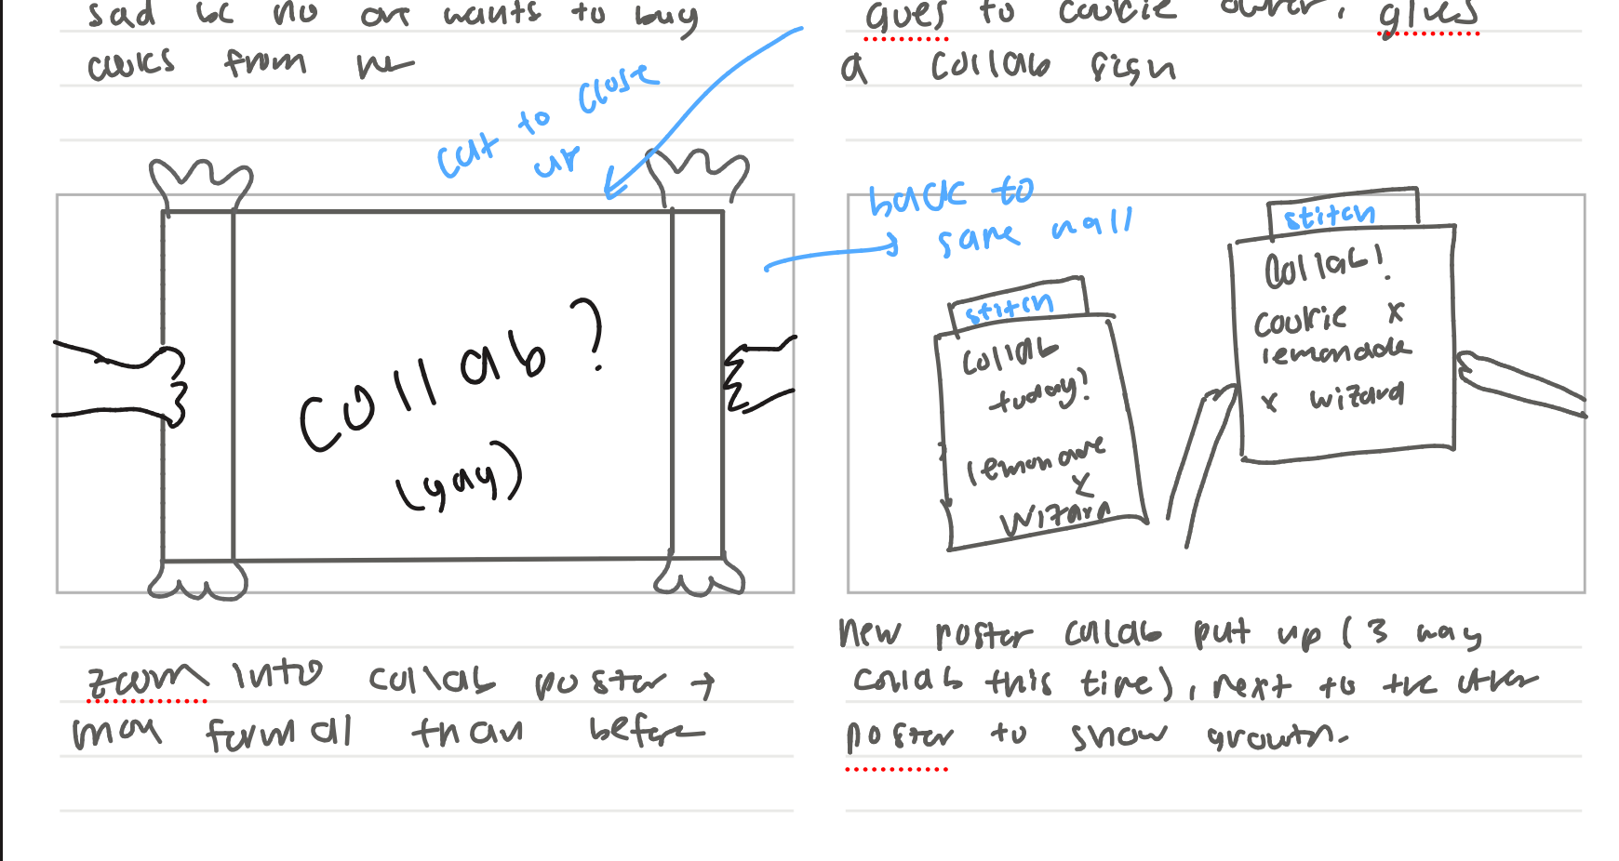
TASK 3

Slide 29
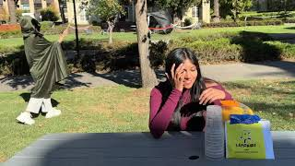
VIDEO
https://www.youtube.com/watch?v=LUw6e-Bvnl8&feature=youtu.be

Slide 30
Thank You!

