Slide 1



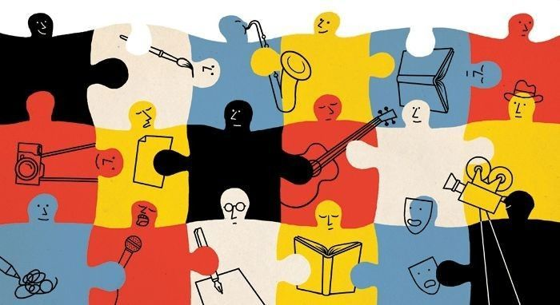

A6: Med-Fi Prototype
STITCH
Small Businesses Together
through community events
website link

Slide 2


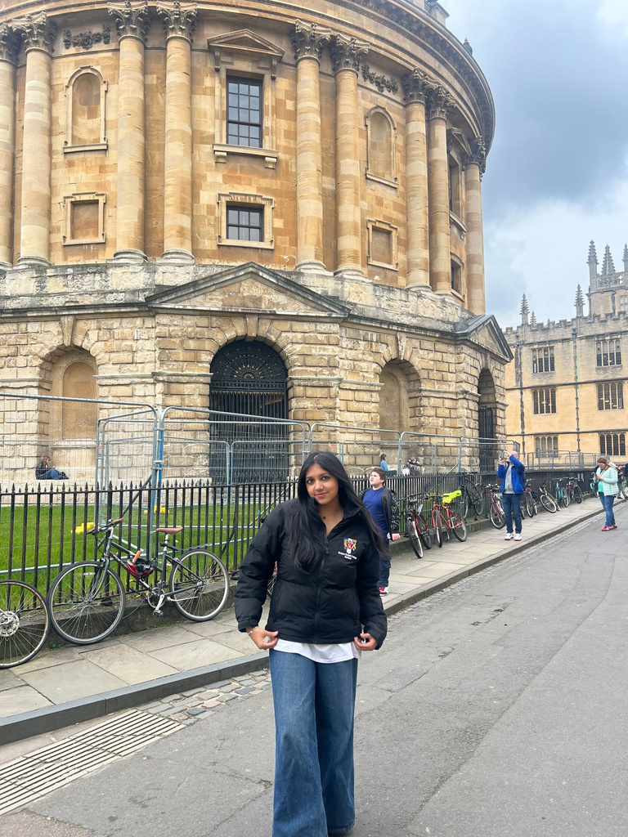
The Team Behind Stitch:
Eva T.
Sunny S.
Maimuna M.

Slide 3



website link
Problem Statement
New small businesses are trying to establish themselves.
Old small businesses are trying to keep up with the changing times.
For all small businesses, finding support, adapting to a new generation, and creating community has been difficult.

Slide 4
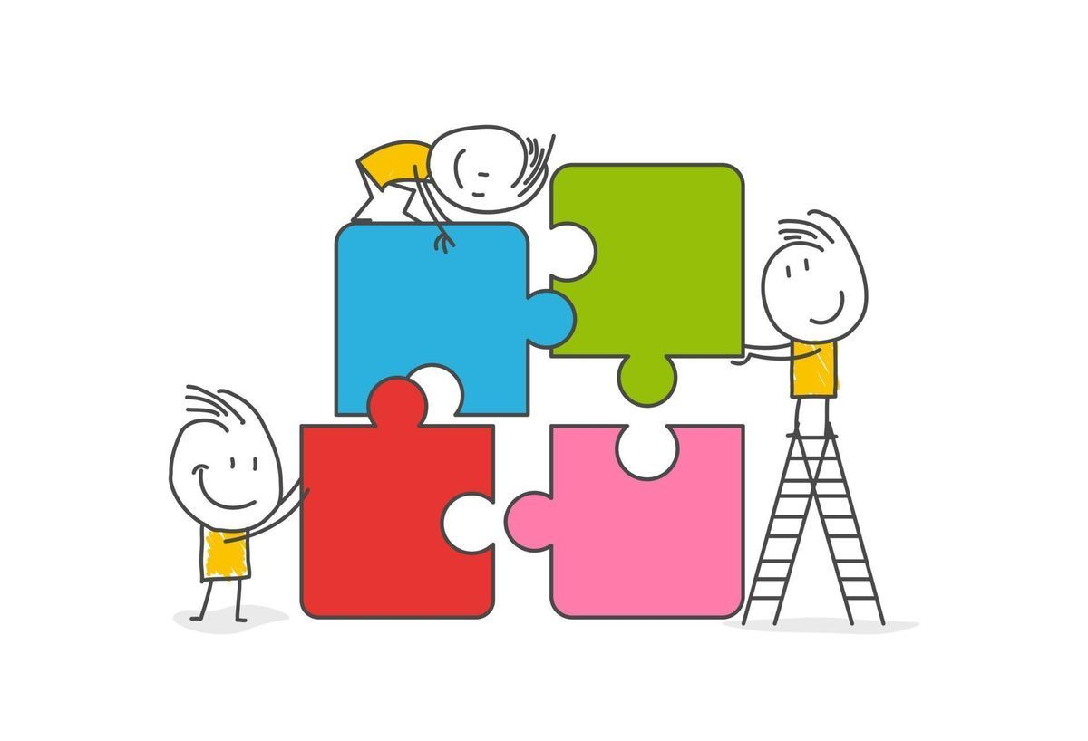
website link
website link
Our
Solution
STITCH uses an AI matching algorithm to allow small businesses to collaborate on events to attract new customers.

Slide 5
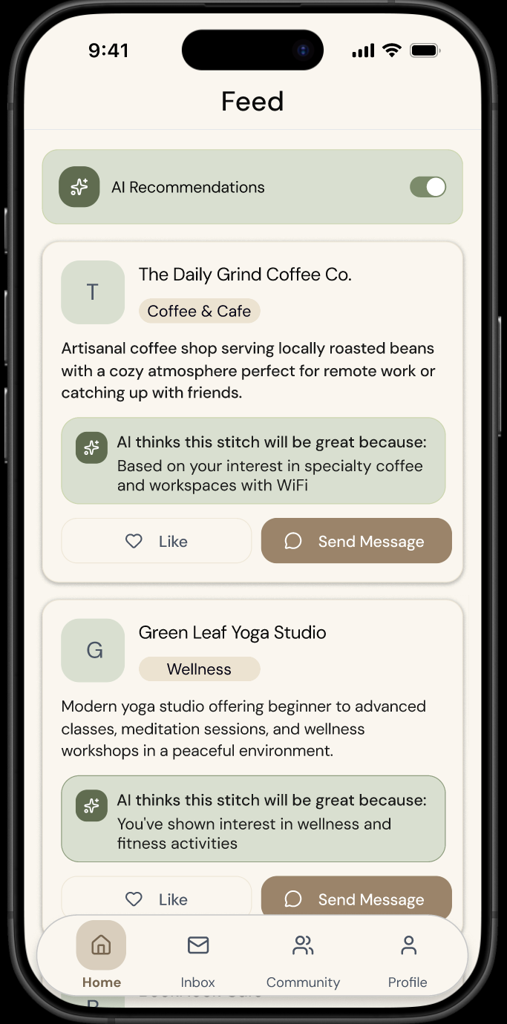
website link
Values
In Design
Value 1: Transparency
User should understand the underlying details behind AI matches

Slide 6
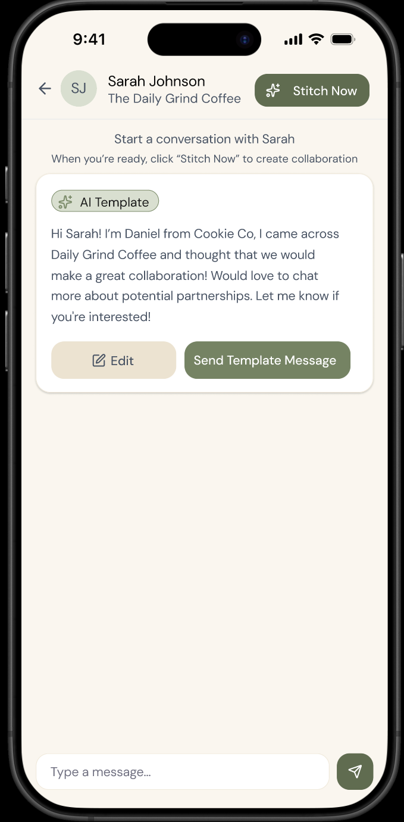
website link
Values
In Design
Value 2: Accessibility
Every user, regardless of technical skill or background, can easily navigate and benefit from all platform features through intuitive, human-centered design

Slide 7
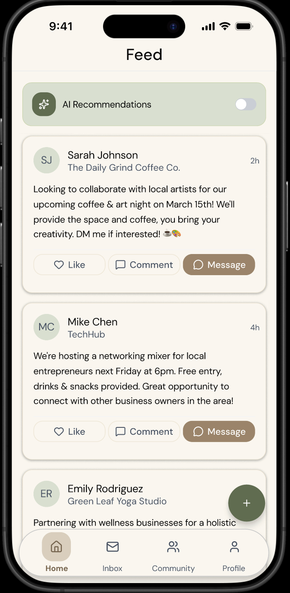
website link
Values
In Design
Value 3: Empowerment
We strengthen community by enabling members to support, learn from, and uplift one another, turning individual success into collective progress.

Slide 8
Tension In Values

Slide 9

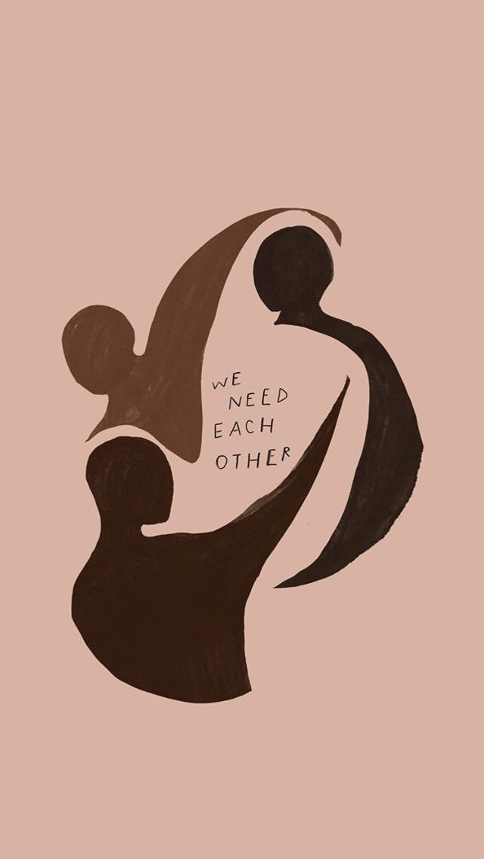
Transparency vs. Accessibility
Tension: Users should understand AI matching details versus every user can easily navigate features regardless of technical skill.
Why it's a tension: Full algorithmic transparency risks overwhelming non-technical owners, but oversimplifying reduces trust in recommendations.
Tension In
Values
How Stitch addresses it: We show simplified AI matches with brief explanations for each match tag, providing transparency through information access.

Slide 10
Accessibility vs. Empowerment
Tension: Easy navigation for all users versus enabling members to organize complex community-wide initiatives and sustained networks.
Why it's a tension: Maximum accessibility requires simplification, but true empowerment demands advanced features like bulk messaging and multi-business coordination.
Tension In
Values
How Stitch addresses it: We provide progressive disclosure, simple default flows for new users, with advanced features such as “create a stitch” revealed as engagement deepens.

Slide 11
Transparency vs. Empowerment
Tension: Users understand AI matching details versus fostering collective community progress where all businesses feel equal opportunity.
Why it's a tension: Full transparency about business matches could create unhealthy competition and hierarchies, but hiding information prevents users from understanding how to improve.
Tension In
Values
How Stitch addresses it: We provide transparency about the why behind individual matches without exposing comparative network-wide data or rankings.

Slide 12
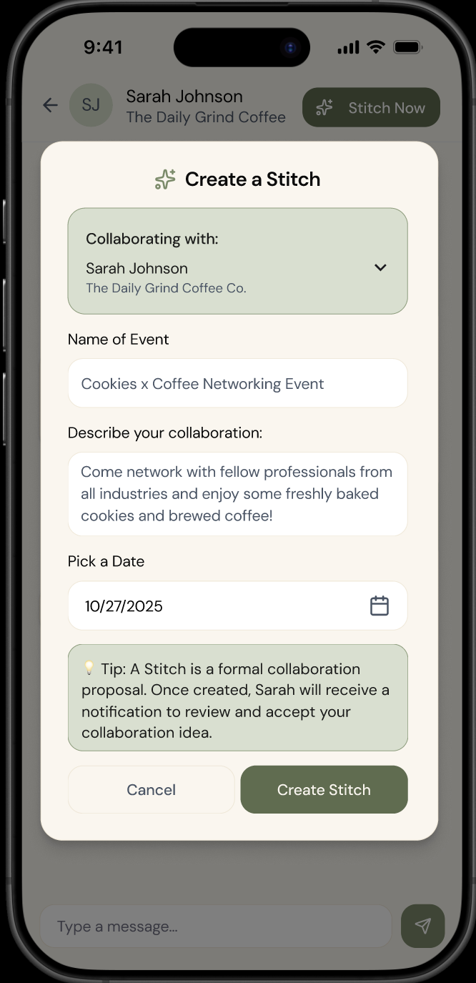
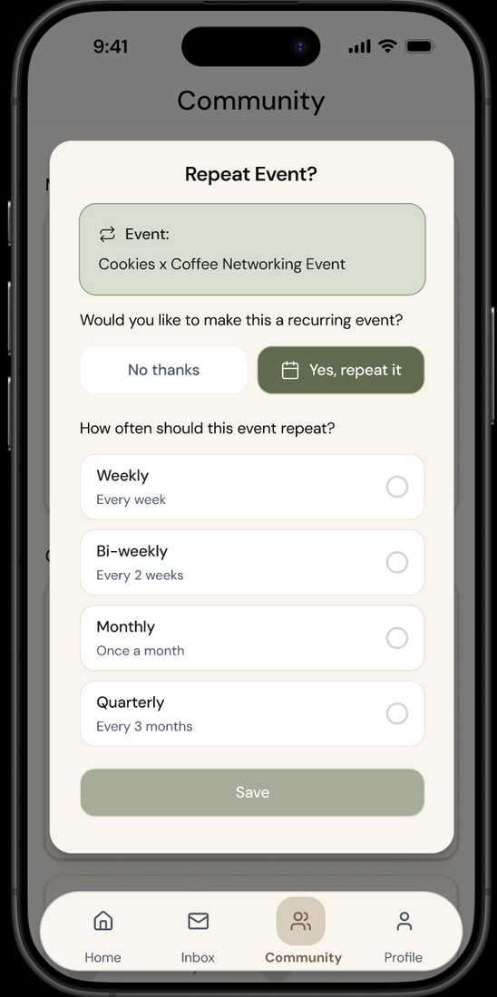
Tasks
Simple: message another
small business
Moderate: post an event to collaborate
Complex: collaborate on an
event multiple times

Slide 13
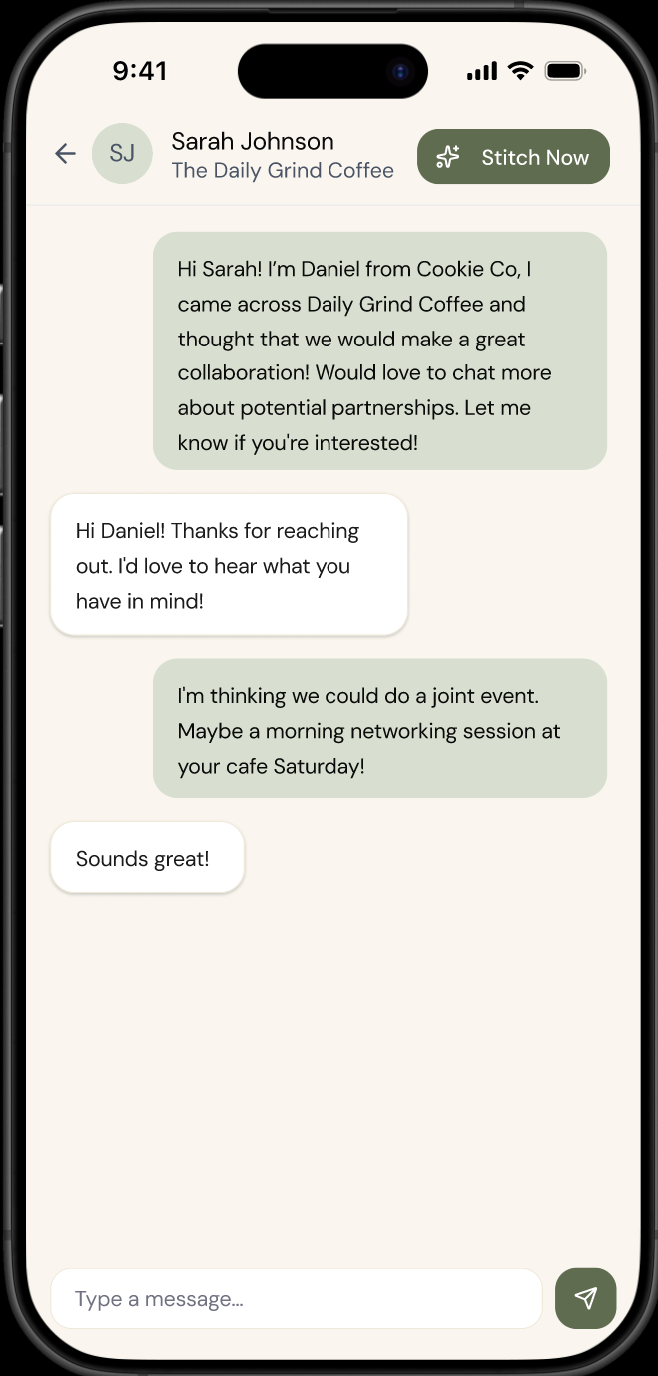
Usability
Goals &
Measurements
website
Efficiency in business partner discovery.
measured by: time taken to send the first collaborative message to an AI-recommended business is < 2 mins.
Number of clicks to complete the send a message task.
design features to enhance goal:
Feature 1: Quick Action Cards on AI Recommendations such as "Message" and "Stitch Now" buttons.
Feature 2: Smart Message Templates with Personalisation.
Feature 3: "Stitched Event" automatically added to community events tab.

Slide 14
website
Clarity of AI matching
measured by:
comprehension success rate: the number of users who can correctly identify shared values between their business and the recommended partner after viewing the match card.
design features to enhance goal:
Feature 1: Match Explanation Card, “Why this AI recommendation”
Usability
Goals &
Measurements

Slide 15
Revised Interface
Sketches

Slide 16
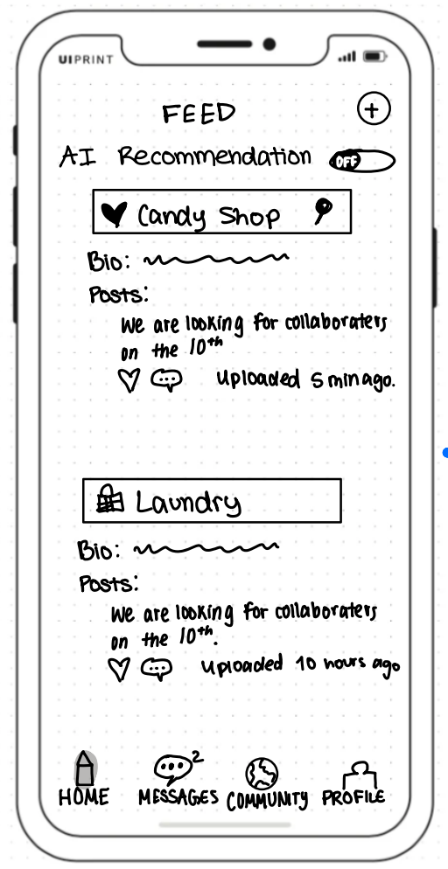
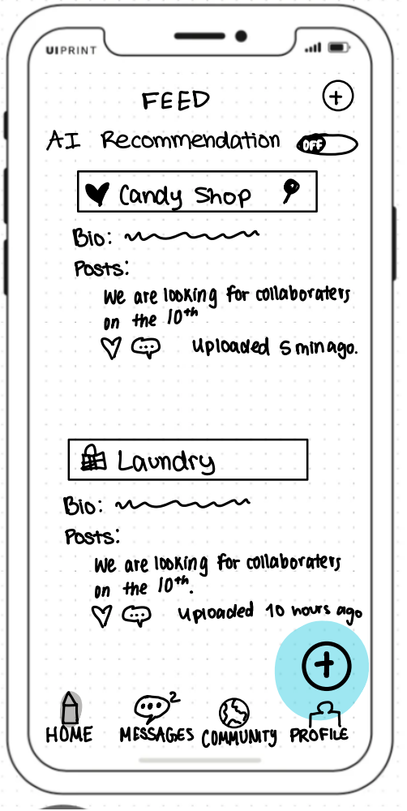

Design Change 1:
Home Page “+” Button
Before:
Feedback:

Slide 17
Design Change 1:
Home Page “+” Button
Changes Made:
Added a plus button to the feed page when AI recommendations are off.
Rationale:
Many low-fi user testers were confused between the Stitch now and ‘+’ button, so we put the plus button at the bottom, similar to other apps to post on the non-AI feed, with an explanation for stitch now in the message feed.

Slide 18
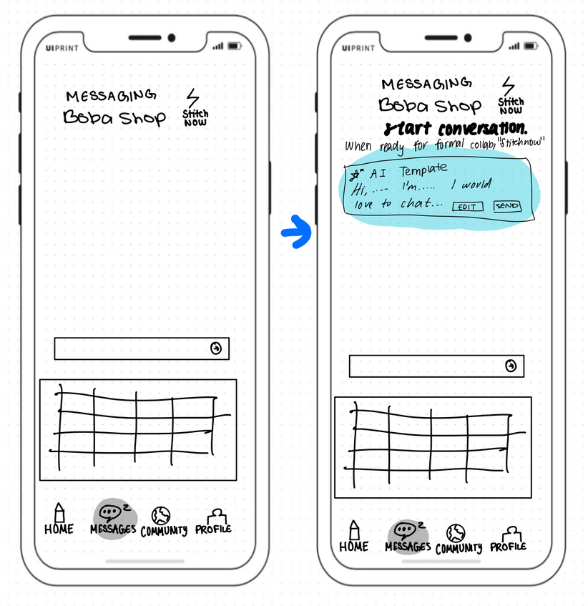
Design Change 2:
AI-generated auto-text feature
Before:
Feedback:

Slide 19
Design Change 1:
AI-generated auto-text feature
Changes Made:
We created an AI-generated auto-populated message for business owners
Rationale:
This feature saves time for small business owners who want to form collaborations easily and efficiently with the amount of time they have.

Slide 20
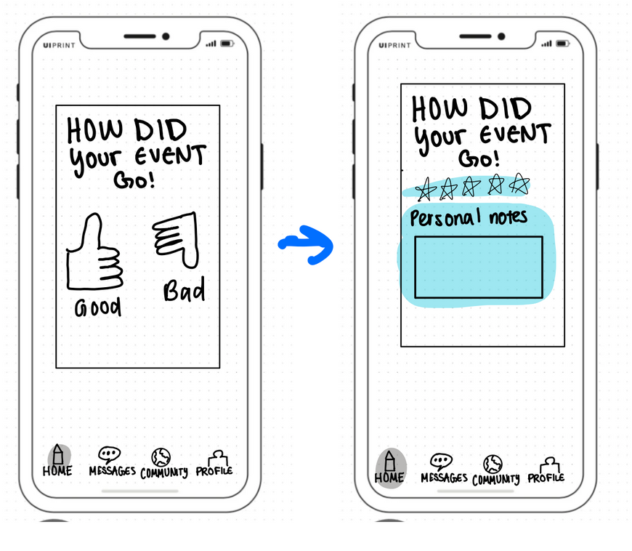
Design Change 3:
Reflection post-event
Before:
Feedback:

Slide 21
Design Change 3:
Reflection post-event
Changes Made:
We added more of a range of feedback for an event. We also added a personal reflection area that only the business owner themselves can access.
Rationale:
Business owners may want to reflect in the future after the event, and by keeping notes of what worked & what didn’t, they may have a much easier time.

Slide 22
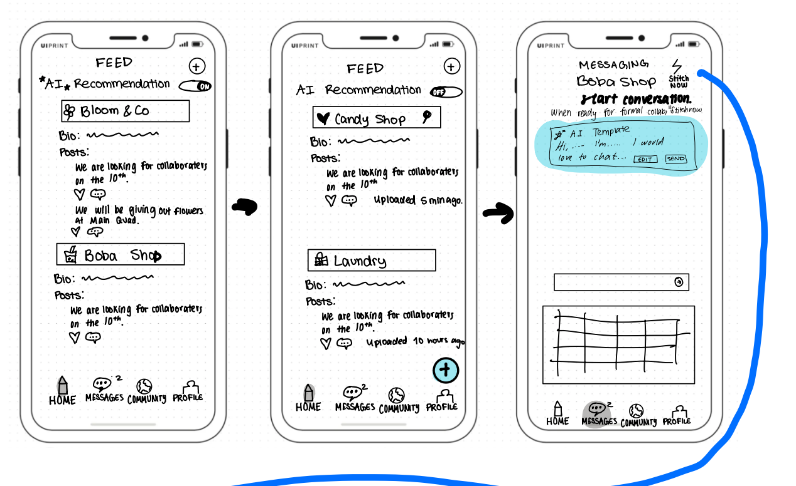
Simple Task Workflow

Slide 23
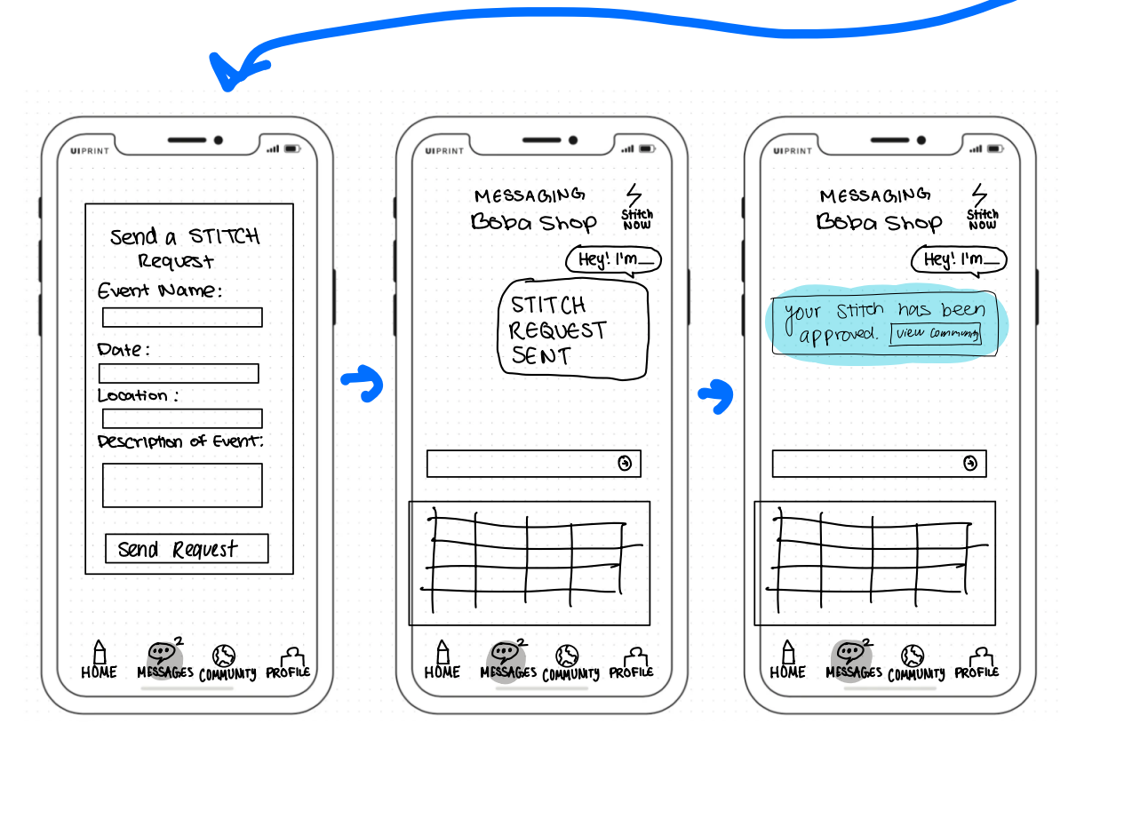
Medium Task Workflow

Slide 24
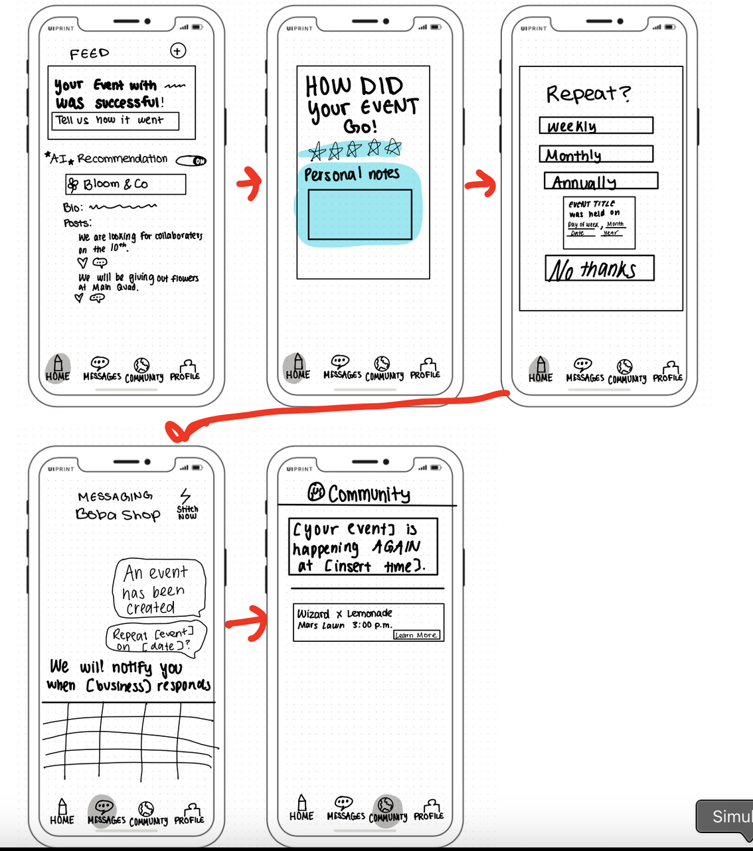
Complex Task Workflow

Slide 25
Med-Fi
Task Flows

Slide 26
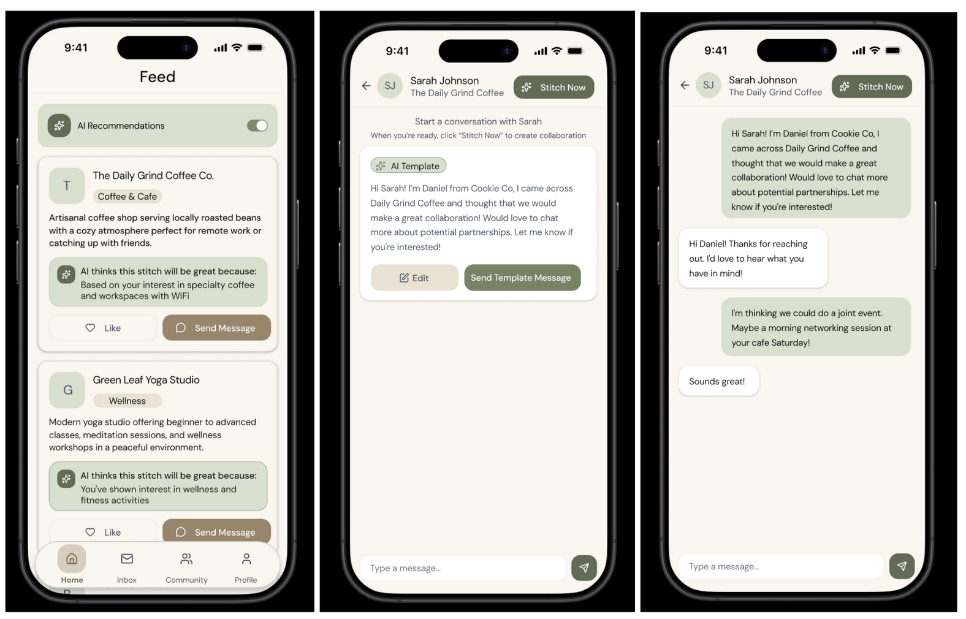
Simple Task: send a message to collaborate
Click the send message button to one of the businesses you want to collaborate with.
You can choose to send your own message or send the AI-powered message.
Send message and continue conversation!

Slide 27
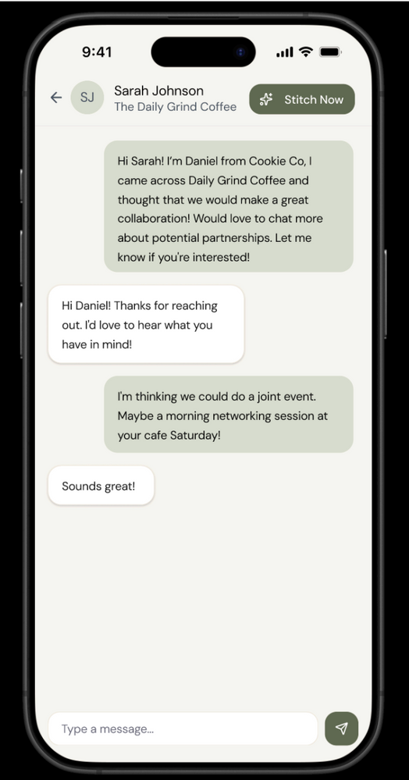
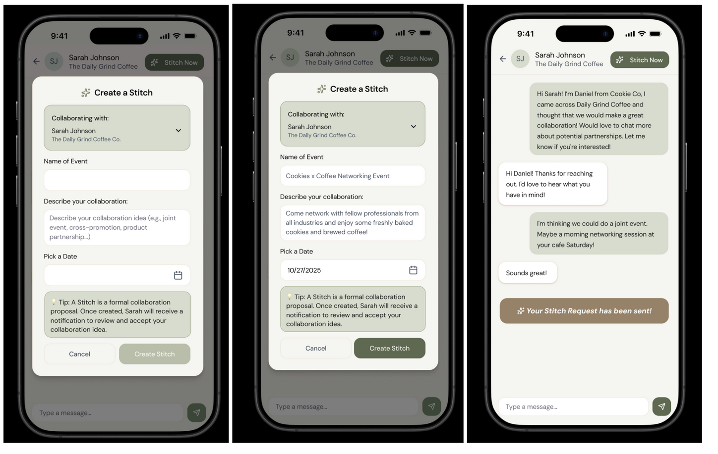
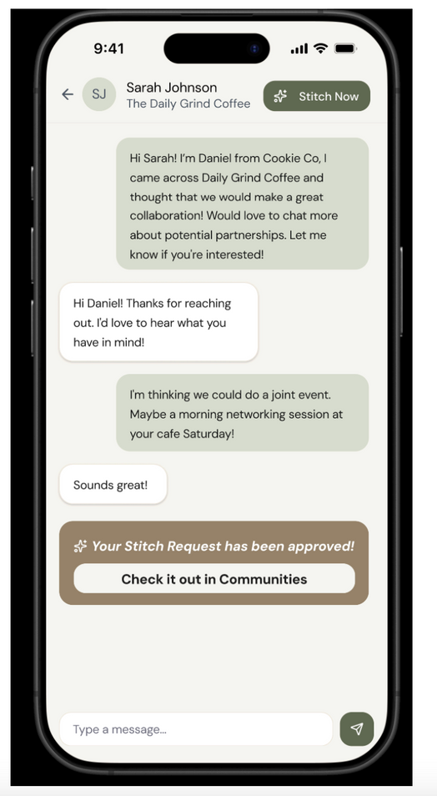
Medium Task: post an event to collaborate
When you have agreed with a business on the event details, you can click Stitch Now and formally upload the event on to the app.
Fill in event details and click Stitch now
Now, the business needs to wait for approval from co-hosting business to ensure mutual agreement for an event.
Once the other business approves, the event is automatically uploaded onto the communities page.

Slide 28
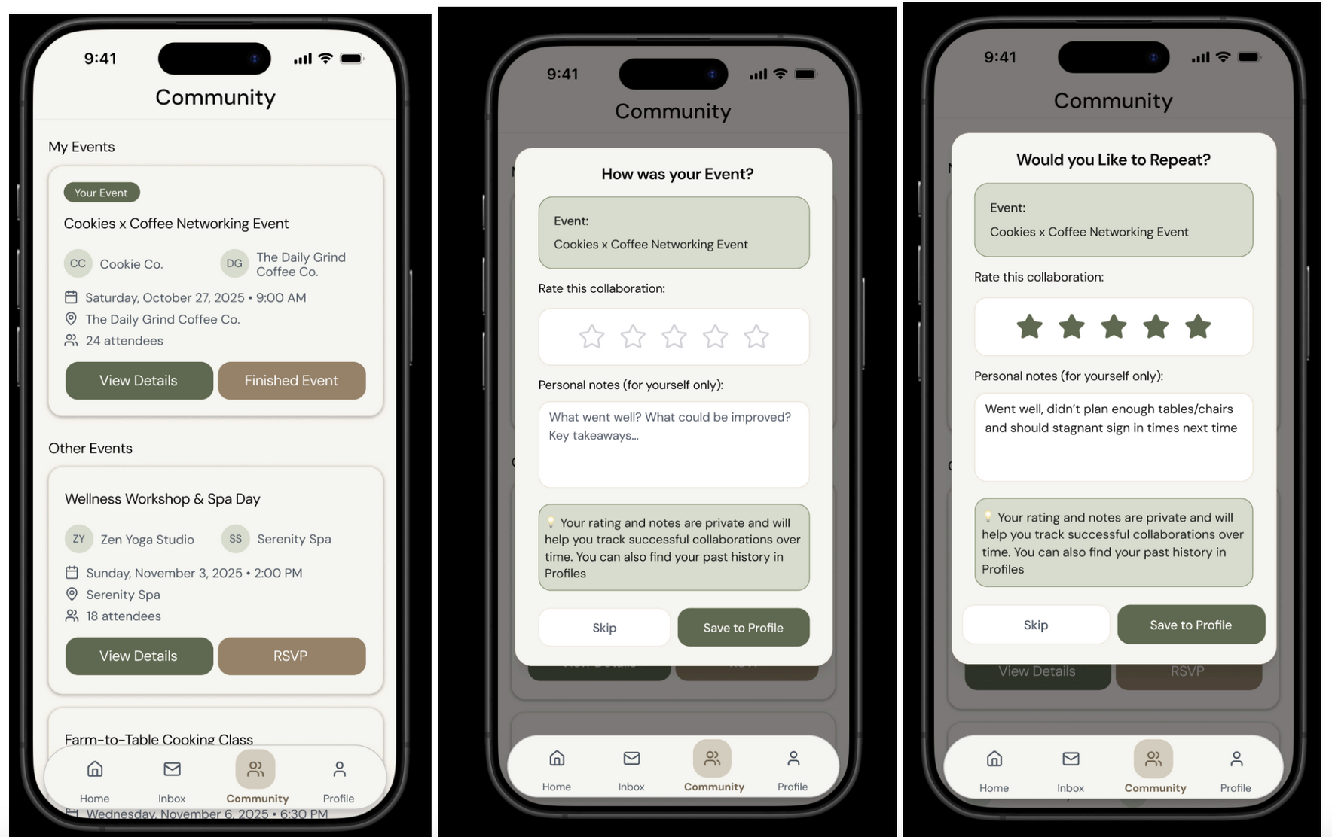
Complex Task: collaborate on an event multiple times
When event is finished, click finished event.
Fill in details post-event collaboration.
Save post-event details.

Slide 29
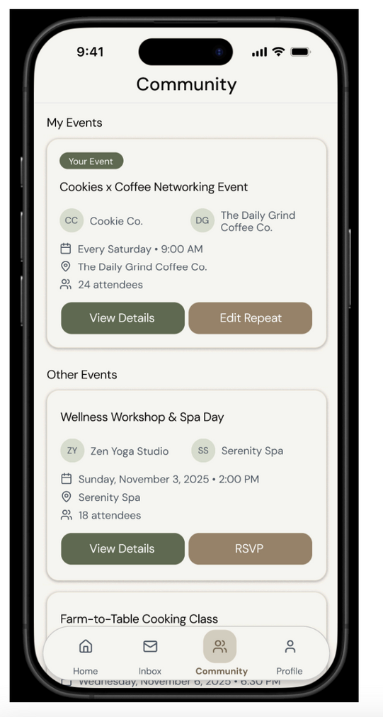
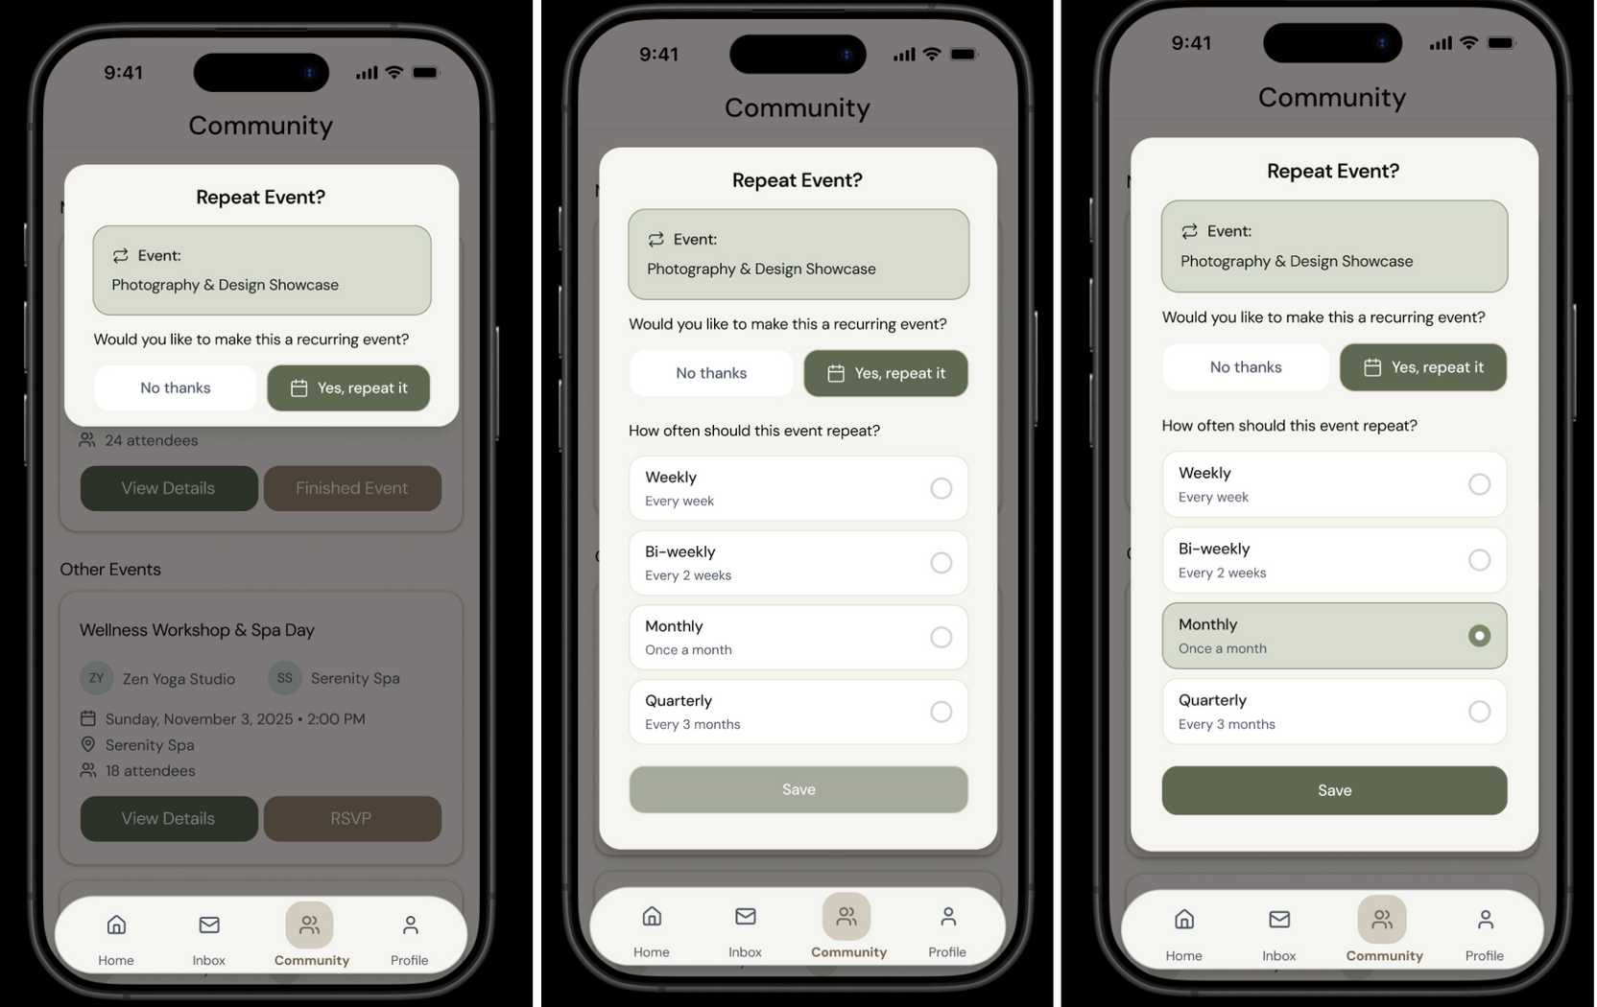
Complex Task: collaborate on an event multiple times
If a business owner wants to repeat an event,
They can fill in information
Then save the repeated information.

Slide 30
Prototype Implementation Tools

Slide 31

PROS:
Speed because no learning curve, easy to use, erase
Natural ideation as it mimics paper sketching allowing fluid brainstorming.
CONS:
No interactivity and hard to simulate actual taskflows without getting messy
Limited Collaboration as only one person can draw at a time unlike Figma where multiple people can work on the same component.
Notability

Slide 32

PROS:
Real-time collaboration because multiple team members can design, comment, and iterate simultaneously.
Interactive prototyping - can create clickable flows with transitions, animations, and realistic interactions
CONS:
learning curve - requires familiarity with Figma's interface, components, auto-layout, and prototyping tools
Overthinking details - Easy to get distracted by visual polish (colours, fonts, pixel-perfect spacing) before validating core flows
Figma

Slide 33
Limitations
&
TradeOffs

Slide 34
Limitations & TradeOffs
The prototype emphasizes testing core user flows ie, partner discovery, messaging, and event creation, rather than full-feature completeness.
Several components, like the Profile tab, the like button, and edit event functionality, are non-functional and will be developed later.
Features like media uploads, editable AI messages, and open date pickers are excluded to keep testing focused and manageable.
limit 1:
xxxx

Slide 35
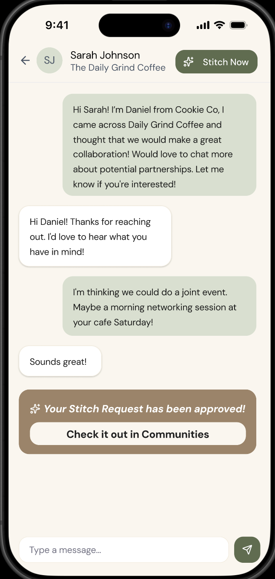
Wizard Of Oz Features
Autopopulated message conversations
Automated “Stitch Approval” Message after 800ms
Pre-selected Dates in Date Picker(Only October)
limit 1:
xxxx
Instant Community Events Updated to add the new ‘stitched’ event.

Slide 36
Hard-coded features
AI Template Messages
Event Post Content
Stitch Form Details
limit 1:
xxxx
Conversation History
Business Details Data, Calendar Dates

Slide 37
Link To Figma
Dev Mode: https://www.figma.com/design/ARrTEwUiCxvuIFAGOPhEXB/CS147-Med-Fi-Stitch?node-id=106-860&t=6npEL4DZmuVagPPv-0
Prototype:
https://www.figma.com/proto/ARrTEwUiCxvuIFAGOPhEXB/CS147-Med-Fi-Stitch?node-id=147-2722&p=f&t=6npEL4DZmuVagPPv-0&scaling=scale-down&content-scaling=fixed&page-id=0%3A1&starting-point-node-id=1%3A1566

Slide 38
Appendix

Slide 39
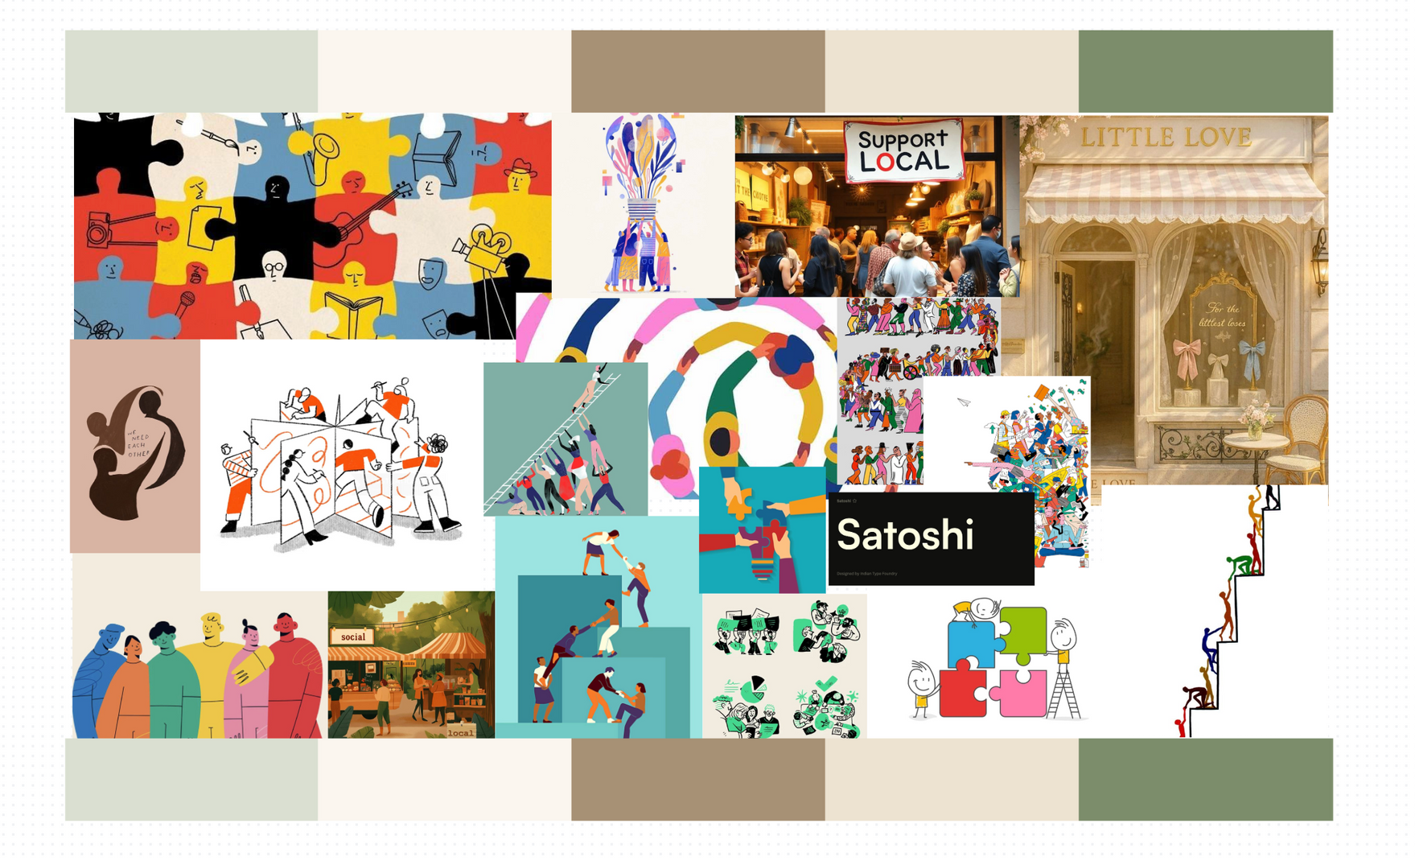
MoodBoard

