Slide 1

Challenges and Fairness in Federated Learning
SHAMLA SHIRIN
MCA S4
ROLL NO : 24

Slide 2

What is Federated Learning?
Decentralized Training: Trains models on distributed devices, leveraging local data without centralizing it.
Privacy-Preserving: Protects user privacy by keeping data on devices; only model updates are shared, not the raw data.
Iterative Global Improvement: Improves a shared global model through aggregated updates from individual devices.
Fairness Considerations: Aims to reduce bias and ensure equitable model performance across diverse user groups.

Slide 3
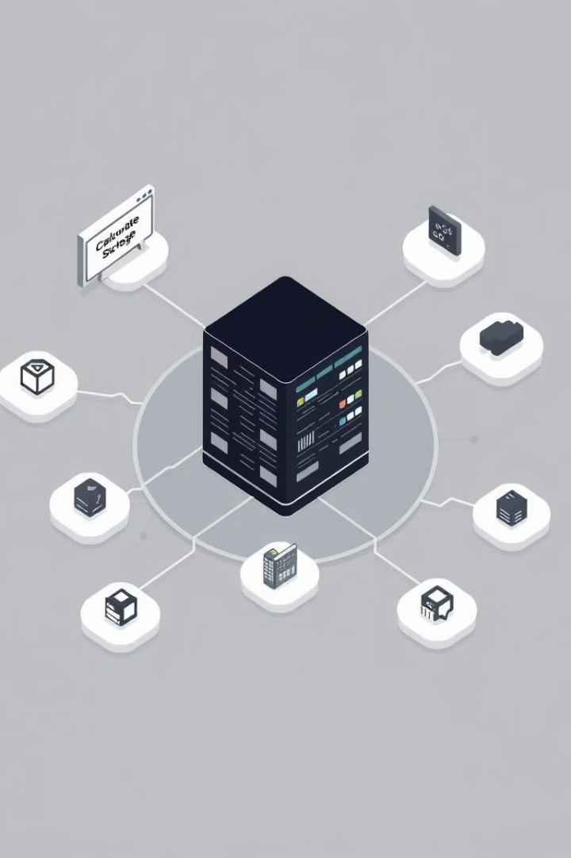
Challenges in FL Fairness
Non-IID Data
Bias across clients
Client Selection Bias
Unequal contribution
Resource Constraints
Varying compute power
Security Threats
Adversarial attacks

Slide 4




Approaches to Address Fairness
Fair Client Selection
Diverse participation
Fair Model Aggregation
Balance model updates
Algorithmic Techniques
FedMinMax
AgnosticFair

Slide 5



Privacy-Preserving Techniques
Differential Privacy (DP)
Protects user data by adding small random changes (noise) to model updates before sharing them.
Secure MPC (SMPC)
Allows multiple users to train a model without revealing their individual data to anyone.

Slide 6


Evaluation Metrics for Fairness
Demographic Parity
Equalized Odds
Federated Shapley Value
Ensures equal outcome distribution across different demographic groups.
Balances false positives and false negatives across groups.
Quantifies each client's contribution to the global model's performance.

Slide 7
Challenges of Federated Learning
High Communication Costs
Scalability
FL require frequent communication between devices and servers , which slow down learning.
FL must efficiently handle millions of devices without reducing accuracy.
Security Threats
Fairness & Bias
FL is vulnerable to adversarial attacks and poisoned updates.
Ensuring equal representation of all users remains a challenge.

Slide 8

Future of Federated Learning
More Decentralized Models
Better Fairness Techniques
To improve speed & efficiency.
To ensure equal model performance for all users.
Stronger Privacy Protection
Integration with Edge Computing
To prevent security risks.
For real time AI processing.

Slide 9
Conclusion
Federated Learning improves machine learning privacy, but fairness challenges remain due to data bias and unequal contributions. Fair client selection, balanced aggregation, and privacy techniques are crucial. Future research should prioritize scalability, security, and fairness evaluations for equitable and effective FL models.

Slide 10

THANK YOU

