Slide 1
JSE SME CAPITAL MATCHING INITIATIVE
Funding Readiness Insights
Segmentation findings, tier-by-tier actions, and the case for capital partners
1,116
245
R10.30 bn
26,506
SMEs scored and ranked
Investor-ready, High tier
Total capital requested
New jobs promised
Notes:
1,116 unique businesses from 1,186 raw applications. Every figure on this deck traces back to the scored segmentation output.

Slide 2
What the pipeline actually looks like
Every application was scored 0–100 on funding readiness, then grouped into three tiers
HIGH TIER
MID TIER
LOW TIER
245
595
276
22.0% of the application pool
53.3% of the application pool
24.7% of the application pool
Asks less, collectively, than it earns. The most credible projection of job growth in the pool, and the strongest transformation profile. Ready to present to investors now.
The largest tier, and the biggest job projection of the three. Genuine trading businesses whose gaps are correctable
SMEs that are in their early stages of growth. Asks far beyond what they earn. This is a development pool for future rounds, not a rejection pile
R3.24 bn ask · 11,436 jobs promised
R2.66 bn ask · 11,751 jobs promised
R4.40 bn ask · 3,319 jobs promised
Notes:
The Mid tier carries the largest absolute job promise (11,751), slightly ahead of High (11,436). High is the most credible deliverer; Mid is the largest.

Slide 3
How every SME was scored
Four weighted pillars, drawn only from fields the application form already collects, summed to a single 0–100 Funding Readiness Score.
1
Revenue & Growth
30 weight
Reported turnover for 2023, 2024 and 2025, plus year-on-year movement
TIER THRESHOLDS
High
62 – 100
2
Jobs & Scale
25 weight
People already employed, plus the new jobs the business anticipates creating
Mid
48 – 61
Low
0 – 47
3
Funding-Ask Viability
25 weight
The size of the capital funding ask relative to the revenue, plus completeness of the application
THE FAIRNESS RULE
A missing answer scores neutral (0.5 points), never zero. No business is penalised for a gap the form itself created, which is why the Low tier is a group to be worked on, not a final assessment of their viability
4
B-BBEE Transformation
20 weight
B-BBEE level plus Black, women, youth and disabled-person ownership
The thresholds are fixed, so a tier keeps the same meaning when the next round of applications is scored.

Slide 4
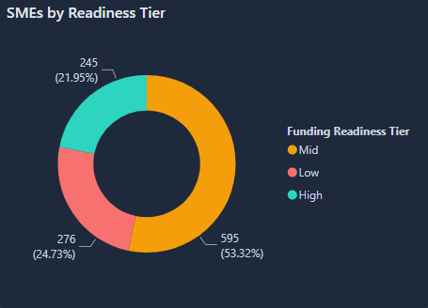
The pipeline skews viable
Distribution of all 1,116 scored SMEs across the three funding-readiness tiers.
WHAT IT SHOWS
A shortlist exists today
245 need no preparation. Prior rounds matched 90 businesses in 2023 and 190 in 2024 — those were completed matches; this is a ready shortlist.
The middle is the real prize
At 53.3%, too large to work case by case. Only a batched process can move it.
The bottom is defined, not lost
24.7% need remediation first. A finite, plannable workload.
High and Mid together — 840 businesses — outnumber the Low tier 3 to 1.
Notes:
Percentages: High 21.95%, Mid 53.32%, Low 24.73%.

Slide 5
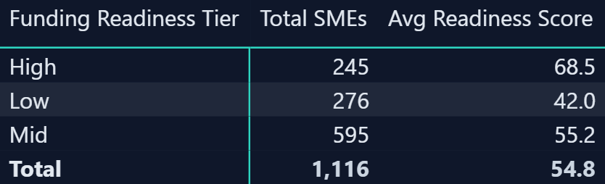
The tiers are genuinely distinct
Average funding readiness score by tier — the separation is wide enough to act on.
26.5 points
54.8 / 100
13.2 points
separate the High tier average (68.5) from the Low tier average (42.0). These are not marginal distinctions.
is the pool average — it sits inside the Mid band, confirming that the typical applicant is a real business with fixable gaps.
separate the Mid tier average (55.2) from the Low tier average (42.0) — the gap the development programme has to close.

Slide 6
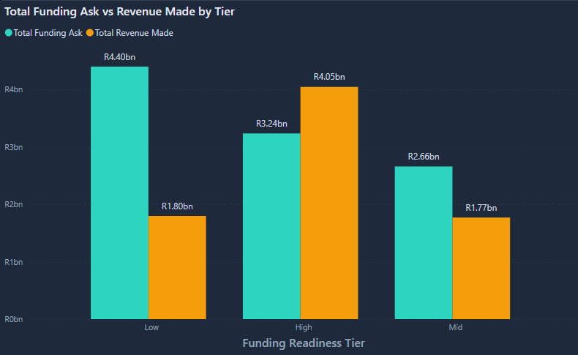
Ask versus revenue: the risk signal
Total capital requested against total revenue generated, by tier.
WHAT IT SHOWS
High — asks 0.80× revenue
R3.24 bn against R4.05 bn earned. The only tier asking less than it makes.
Mid — asks 1.50× revenue
R2.66 bn against R1.77 bn. A growth ask, structurable with light right-sizing.
Low — asks 2.44× revenue
R4.40 bn against R1.80 bn — 42.7% of the total ask on 23.6% of the revenue.
Notes:
Average ask per business: High R13.2m, Mid R4.5m, Low R15.9m. The Low tier asks more per business than the High tier while earning 40% of what High earns.

Slide 7
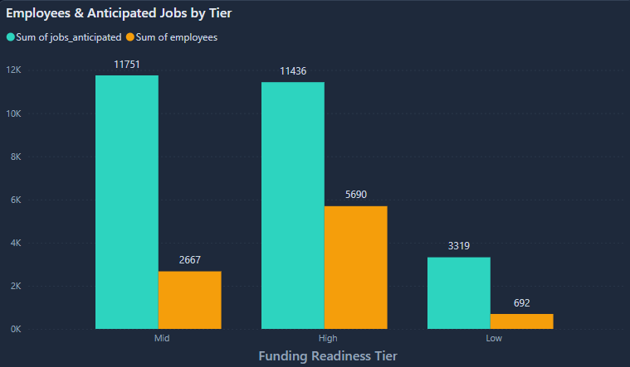
The job-creation promise
New jobs anticipated — as stated by applicants — against people already employed, by tier.
THE GROWTH CASE
26,506 promised
Against 9,049 already employed — a promise to roughly triple applicant employment.
High is most credible
Promises 2.0× its headcount. Mid promises 4.4×, Low 4.8×.
Mid is the biggest
11,751 jobs at R226k of ask per job — against R283k for High and R1.33m for Low.
Notes:
Cost per promised job = tier total ask divided by tier total anticipated jobs. This is the sharpest efficiency argument in the deck: the Mid tier converts capital into promised jobs more efficiently than any other tier.

Slide 8
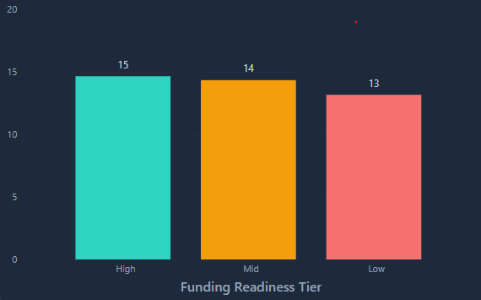
Transformation is strong across every tier
Average B-BBEE transformation score by tier, out of a possible 20.
WHY IT MATTERS
A two-point spread
15, 14 and 13 out of 20. Transformation qualifies the pool; it does not separate it.
It is a mandate unlock
Every tier clears the bar most development financiers are required to apply.
So it cannot be the filter
Tiering has to rest on revenue, scale and ask viability instead.

Slide 9
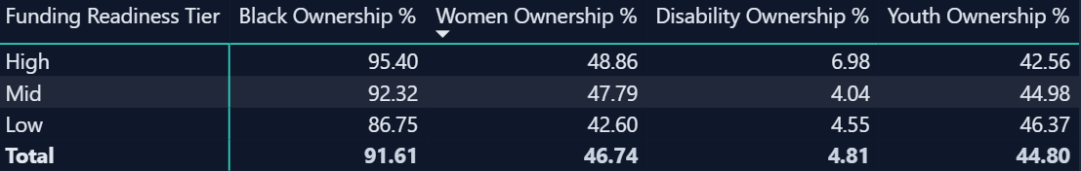
Ownership profile in detail
Average ownership percentages by tier, across the four transformation dimensions.
91.6%
46.7%
44.8%
4.8%
Black ownership
Women ownership
Youth ownership
Disability ownership
Exceptional and consistent — 95.4% in the High tier and still 86.8% in the Low.
Close to parity across every tier — second only to Black ownership in the pool.
Highest in the Low tier (46.4%) — the youngest businesses are the youngest-owned.
The one genuine gap. A targeted outreach opportunity for the next campaign round.

Slide 10
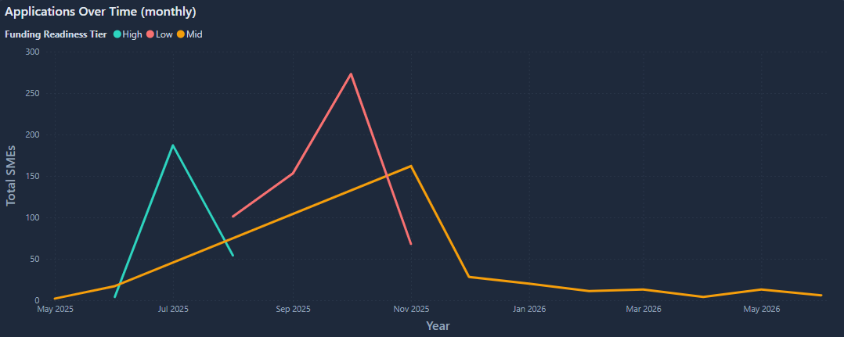
Volume swings; quality holds steady
Monthly applications across the campaign run, split by funding-readiness tier.
THE PATTERN
High — present all year
Peaks at 70 in October, ahead of 52 in July. Never absent in any month of the run.
Mid — the volume engine
Peaks at 135 in October and is the largest tier in eleven of fourteen months.
Low — moves with Mid
Investor-ready businesses arrived in every month of the campaign, not only in its opening quarter.
Peaks at 68 in October and November. Volume falls after November across all tiers alike.
Two thirds of the High tier — 161 of 245 — applied from September 2025 onward. October alone produced 70, more than any other month.
Notes:
Wording on this slide comes from the scored data: High-tier applications occur in all fourteen months, peak at 70 in October 2025, and hold a 17-28% share of monthly volume throughout. The chart shown is the Power BI dashboard visual and does not yet reflect this - it joins the segmentation output (no date field) to the cleaned data on company name, which is not unique, so it plots each month’s total against a single tier. The dashboard visual needs rebuilding.

Slide 11
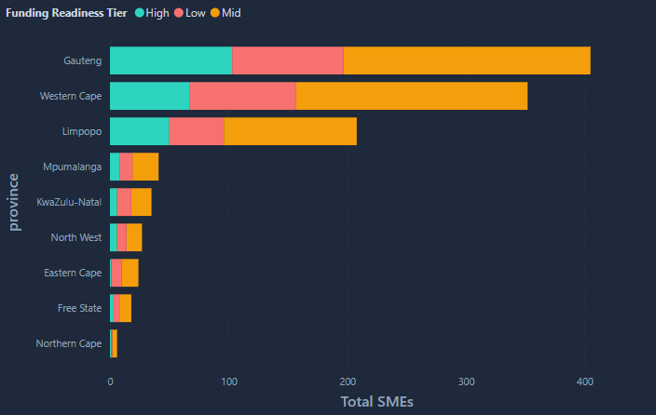
Where the pipeline lives
Applications by province, split by funding-readiness tier.
CONCENTRATION
Three provinces carry it
Gauteng, the Western Cape and Limpopo — and the same three dominate the High tier.
That maps to live events
Exactly where the initiative ran in person in 2023 and 2024. Presence produced pipeline.
Six provinces are absent
Mpumalanga down to the Northern Cape barely register. Six provinces the initiative has never visited in person.

Slide 12
ACTION — HIGH TIER
Fund now: take 245 businesses to market this quarter
WHAT THE SME TEAM DOES
245
1
Package now, do not re-screen
Build a one-page profile per business from fields already captured. Nothing further needs collecting (re-screening this tier only delays it)
investor-ready businesses
THE POSITION
2
Match to mandate, not to queue
These require no preparation. They trade at scale, employ real people, hold the strongest transformation credentials in the pool, and — alone among the tiers — ask for less than they earn. The only thing standing between them and capital is an introduction.
Sort by sector, province and transformation profile, then map each cluster to the funders whose mandate it fits. A B-BBEE-mandated development financier and a sector fund want different subsets.
3
Lead with the ratio
The 0.80× ask-to-revenue figure is the strongest single argument in the pipeline. Put it on the first page of every pack.
Capital sought
R3.24 bn
Revenue generated
R4.05 bn
4
Convert three into reference stories
Ask-to-revenue
0.80×
Prioritise the first closes for publicity. Each named deal is what recruits the next funder into the initiative.
Already employed
5,690
Notes:
245 is the investor-ready shortlist; 90 (2023 pilot) and 190 (2024) were matches actually made — related figures, but not the same measure. Average ask R13.2m against average revenue R16.5m.

Slide 13
ACTION — MID TIER
Develop and re-score: the largest source of new deals
WHAT THE SME TEAM DOES
595
1
Run it as a programme, not a queue
595 businesses cannot be worked case by case. Batch them by the gap that is holding them back — ask size, missing fields, weak growth evidence — and address each batch once.
businesses, 53.3% of the pool
THE POSITION
2
Right-size the ask first
Real trading businesses whose gaps are specific and correctable — usually an oversized ask or a few missing fields. They promise more jobs than any tier, at the best capital-to-jobs ratio in the pool. Rejecting them is the costliest option available.
At 1.50× revenue the average Mid-tier ask is close to fundable. A structured conversation about a realistic figure moves a large share of this tier over the threshold with no other change.
3
Target the 48–61 band from the top down
Businesses scoring 58–61 need the least to reach the High tier. Work them first and re-score to book early wins.
Capital sought
R2.66 bn
Jobs promised
11,751
4
Sell it on capital efficiency
Cost per job
R226k
R226k of requested capital per promised job — the best ratio in the pool. For job-mandated funders this tier is a stronger story than the High tier.
Avg readiness score
55.2
Notes:
Mid carries the largest absolute job promise of any tier, ahead of High. Mid jobs multiple is 4.4x its current headcount; treat the promise as ambitious but the capital efficiency as real.

Slide 14
ACTION — LOW TIER
Remediate: fix the ask before anyone sees the business
WHAT THE SME TEAM DOES
276
1
Do not introduce them yet
A 2.44× ask that a funder declines costs the initiative credibility it will need for the next introduction. Remediation is protective, not punitive.
businesses needing remediation
THE POSITION
2
Complete the data before anything else
Two fixable problems, not two hundred: asks wildly out of proportion to trading history, and materially incomplete applications. Transformation credentials stay strong and youth ownership is the highest in the pool. These are young businesses, not bad ones.
Much of the low score reflects missing fields rather than weak businesses. Direct engagement to fill the gaps will move some of this tier on data alone.
3
Recalibrate every ask, then re-score
This tier requests R15.9m per business — more than the High tier — on a quarter of the revenue. Right-sizing is the single highest-leverage intervention available anywhere in the pipeline.
Capital sought
R4.40 bn
Revenue generated
R1.80 bn
4
Hold them for the next round
Ask-to-revenue
2.44×
Re-scoring after support turns the model into a progress tracker. A business that moves Low to Mid between rounds is a measurable programme outcome.
Share of total ask
42.7%
Notes:
The Low tier holds 42.7% of the total capital ask but only 12.5% of the promised jobs. Cost per promised job is R1.33m, versus R283k in High and R226k in Mid.

Slide 15
ACTION — NEXT CAMPAIGN ROUND
Run the next round differently: timing and geography
Two structural findings change how the campaign itself should be operated, independent of any individual business.
TIMING
GEOGRAPHY
Quality arrives all year — match as you go
Live events create pipeline; absence creates silence
High-tier businesses applied in all fourteen months. Two thirds of them — 161 of 245 — arrived from September 2025 onward, not in the opening quarter.
Gauteng, the Western Cape and Limpopo dominate the pool — the same three provinces that hosted in-person events in 2023 and 2024.
Begin matching while applications are still open. Investor-ready businesses arrive every month, so waiting for the close holds up the majority of them.
Six provinces barely register. There are eligible businesses there; no one has been to find them.
The High tier holds a steady 17–28% share of monthly volume. Total applications, not timing, decide how many investor-ready businesses a round yields.
Run the next round's events in two under-represented provinces and measure application lift against the current baseline. That is a controlled, defensible test.
October produced more applications than any other month. Identify what drove that peak and repeat it deliberately.
Disability ownership sits at 4.8% pool-wide, the only weak transformation dimension. Build targeted outreach into the next round.
The campaign has already proved it can attract quality. It attracts that quality steadily but locally — so match as you go, and run the next round somewhere new.

Slide 16
FOR CAPITAL PARTNERS
The investment case
A quantified, transformation-strong pipeline of 1,116 businesses — already sorted, so capital can be deployed against a mandate instead of a mailbox.
IF YOU WANT LOW RISK
IF YOU WANT JOBS
IF YOU WANT IMPACT DEPTH
245 businesses
595 businesses
276 businesses
R3.24 bn of requests against R4.05 bn of revenue, from employers of 5,690 people. The only cohort in the pool asking for less than it earns, and deployable with no further screening.
11,751 promised jobs — the largest of any tier — from genuine trading businesses making proportionate asks, at the most efficient capital-to-jobs ratio in the pipeline.
The youngest and most youth-owned cohort in the pool. Requires development capital and patience rather than growth funding, and builds the deal flow for future rounds.
0.80× ask-to-revenue
R226k of ask per promised job
46.4% youth ownership
Across all three tiers: 91.6% average Black ownership, 46.7% women ownership, and 26,506 jobs promised against 9,049 already created.
Notes:
Close on the mandate-matching point: the segmentation lets a funder self-select into the tier that fits its mandate, rather than the SME team guessing.

