Slide 1
Cross-Site Scripting & Cross-Site Request Forgery
By Logan Brooks

Slide 2
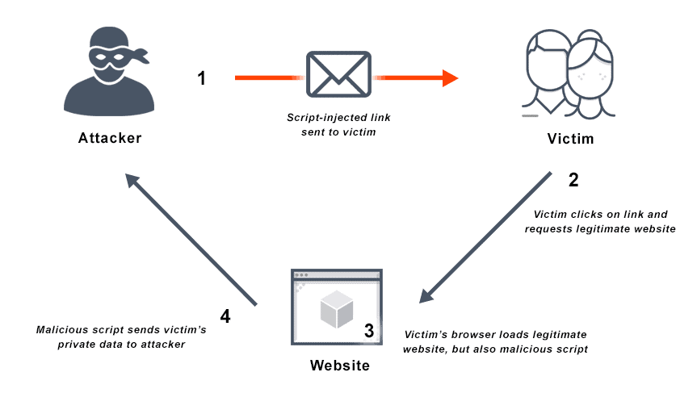
Cross-Site Scripting (XSS)
Malicious code is injected and executed on a victim’s browser
Reflected XSS
URL/Link-based
Stored XSS
Database-based
Notes:
Used for stealing session cookies and other private user information, potentially compromising the user’s account entirely
Diagram depicts Reflected XSS
Reflected XSS typically occurs in search boxes or URL parameters and requires user interaction to execute the attack.
Stored XSS, is more dangerous because the injected script is stored on the server (e.g., in a database) and is executed every time a user visits the affected page. Attackers often exploit forums, comment sections, and other user-driven content forms to inject malicious scripts into the databases.
Stored:
Attacker sends malicious code directly to the website
Users accessing the website will activate the malicious script
User data is sent to the attacker
// ONLY FOR QUESTIONS LATER, DON’T MENTION THIS
Stored vs SQL injection
While SQL injections are used to steal information from databases, stored XSS attacks are used to redirect users to websites that can extract information from them

Slide 3
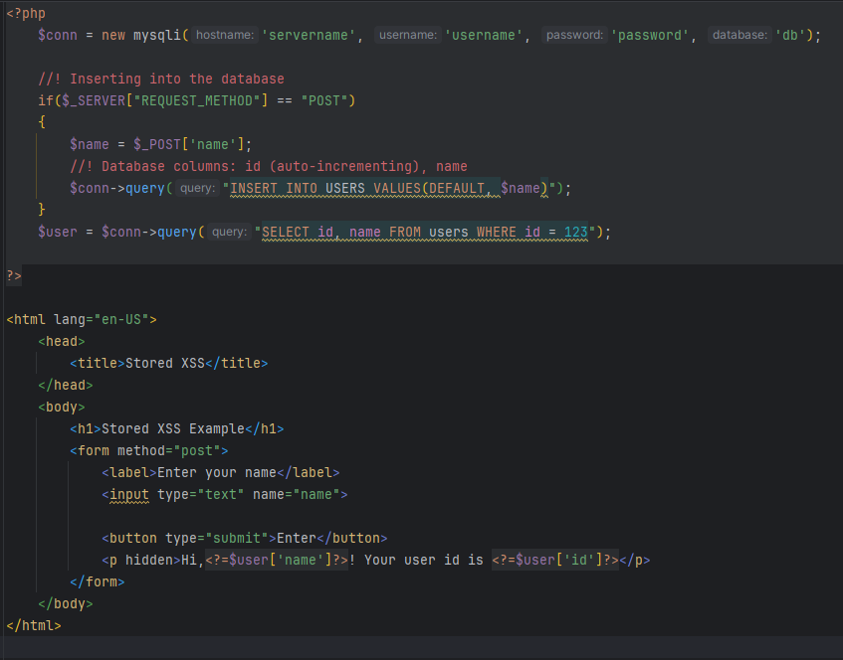
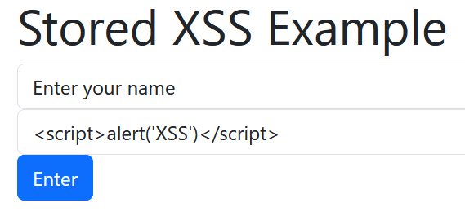

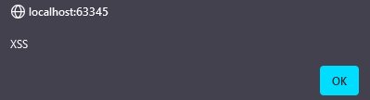
Malicious code is injected into DB
Link is sent to victim
Code executes in victim’s browser
Notes:
XSS

Slide 4

Prevention methods
Output Encoding
Input Validation and Sanitization
Custom HTTP headers
Built-in Framework Features
Content Security Policy

Slide 5
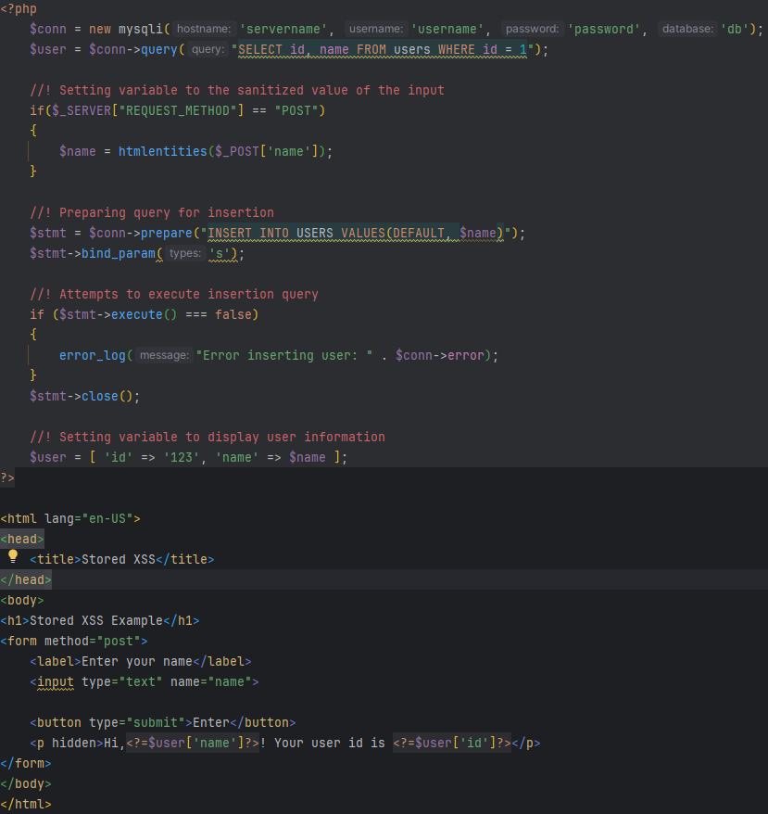
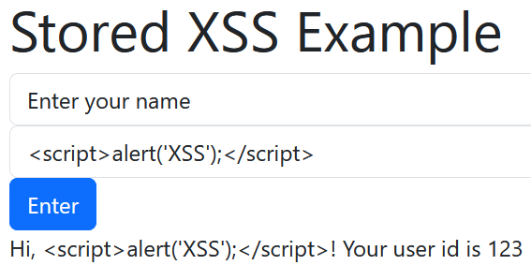

CODE FIX
Hackers when I sanitize my inputs
Notes:
The first two steps are the same as the previous slide, those being the malicious code being entered and sent to the user, but this time, the result is a webpage that displays the intended script as plaintext instead of running

Slide 6
Cross-Site Request Forgery (CSRF)
Notes:
Attackers use phishing or other forms of social engineering to get users to take actions without their consent or knowledge

Slide 7



CSRF
1
2
3
4
Request is Created
Request is Sent Out
User Sends Request
Request is Received
Notes:
Step 1:
An attacker will create a request for a given website that includes their malicious code in the URL.
Step 2:
In order to get the request to be activated on the victim’s device, the attacker injects the request into a hyperlink. This can then be embedded through hyperlinks, images, or forms. They can then send out this hyperlink to users through many different means in hopes that they will click on the link.
Step 3:
In the event that the user is logged into the site the attacker created the request for, the request will then be sent to the site
Step 4:
If the request is properly formed, the website will fulfill it, executing the malicious code, which could range from sending data, transferring funds, or granting access to the attacker.

Slide 8
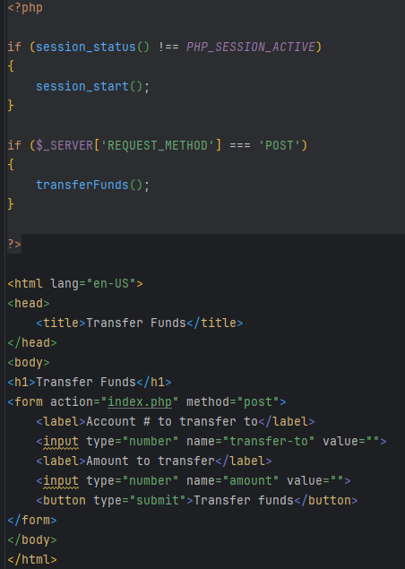
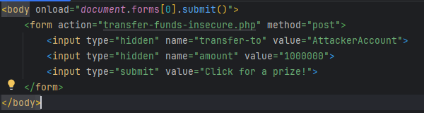
Vulnerable Code
Malicious Script

Slide 9
How do we fix it?

Slide 10

CSRF Tokens
Unique!
Unpredictable!
Numbers!
Notes:
A unique, secret, and unpredictable value generated by the server-side application and shared with the client
The client must include the token in the request for any sensitive actions
This prevents attackers from forming fully valid HTTP requests
Should be added to any state-changing or action-causing requests and validated on the backend
Insert into a custom HTTP request header via JavaScript

Slide 11





CSRF Tokens
User visits a URL
CSRF Token is Generated
Notes:
In a normal scenario, a user will navigate to a webpage via a URL. At this point, a CSRF token is generated within the code for the URL. This is typically done by adding a hidden input with the value set to the generated token. It is then validated by the server.
Now, when the attacker tries to send out requests via malicious links, they won’t be accepted, as the form doesn’t contain the CSRF token.

Slide 12
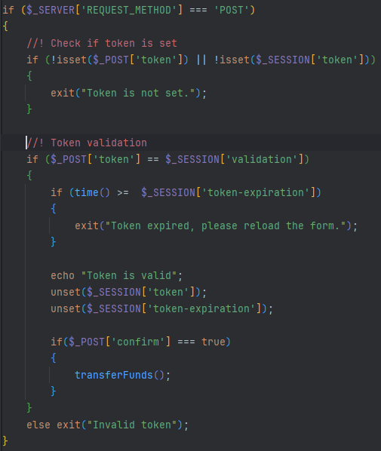
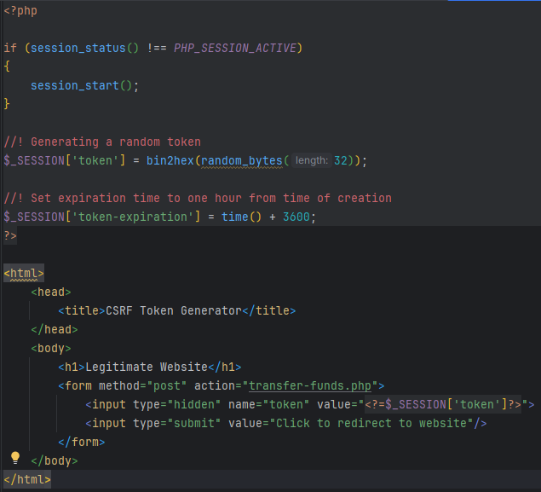
Improved Code
Token-Generating Website

Slide 13



Real world examples
2020 TikTok Exploit
Vulnerability allowed users to send malware
Attackers could then perform CSRF attacks
2019 Fortnite Exploit
A retired page had an XSS vulnerability
Allowed attackers to gain access to the data of all Fortnite users
Notes:
CSRF
- Tend to be patched quickly due to how simple they are to fix in most cases
TikTok
Patched within three weeks
McAfee
2014
Vulnerability discovered in the user management module of McAfee Network Security Manager
YouTube
2008
Allowed attackers to perform nearly all actions on behalf of users
Fixed almost immediately
XSS
Fortnite
Other vulnerabilities discovered included SQL injection, web app firewall bypass issue, and an OAuth account takeover vulnerability
eBay
2015
A url parameter redirected users to different pages, but the value was not validated
British Airways
2018
Attacked by Magecart, a high-profile hacker group
Exploited a vulnerability in a JS library

Slide 14
FIN.

