Slide 1
Hackathon Presentation Topic- Identify New Bikes

Slide 2
Team Members
NAME | EMPLOYEE ID
Divya Shelar | 2068448
Lalit Mali | 2068170
Shubham Patil | 2068171
Ashish Daundkar | 2068139

Slide 3
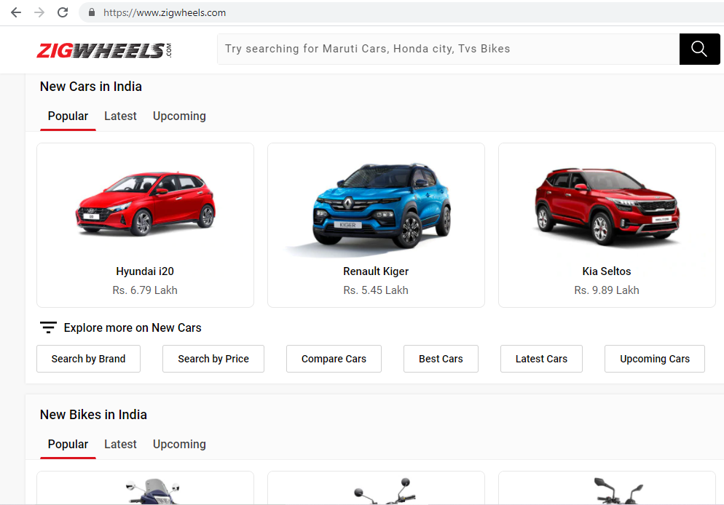
Website:
https://www.zigwheels.com/

Slide 4
TOOLS & TECHNOLOGY USED:
01. Selenium with Java in Eclipse
02. TestNG
Selenium is a portable framework for testing web applications. Selenium provides a playback tool for authoring functional tests.
TestNG is a testing framework for the Java programming language created by Cédric Beust and inspired by JUnit and NUnit.
03. Maven
04. POM with POI
05. Jenkins
Maven is a build automation tool used primarily for Java projects.
A Project Object Model or POM is the fundamental unit of work in Maven. It is an XML file that contains information about the project.
Jenkins – an open source automation server which enables developers around the world to reliably build, test, and deploy their software.

Slide 5
Work Done:
1. The Code is written in JAVA and is automated in different browsers with the help of Selenium. The project and dependencies are managed with the help of Maven.
3. Input data is obtained from properties file and from excel sheet with the help of Apache POI.
2. POM is used to create classes for each page therefore reducing usage of same code for various objects.
4. Jenkins is used for continuous integration of various versions of the code.

Slide 6
Requirements and Execution Steps:
Display "Upcoming" bikes details like bike name, price and expected launch date in India, for manufacturer 'Honda' & Bike price should be less than 4Lac.
For Used cars in Chennai, extract all the popular models in a List; Display the same
Try to 'Login' with google, give invalid account details & capture the error message
Display new bikes from Honda manufacturer
Search in search bar
Display upcoming bikes under 4lacs
Go to Used cars drop down and select the following cities: Chennai
Extract the displayed options and write them in excel sheet
Click on Login button in Homepage
Login to google with invalid credentials and capture screenshot

Slide 7
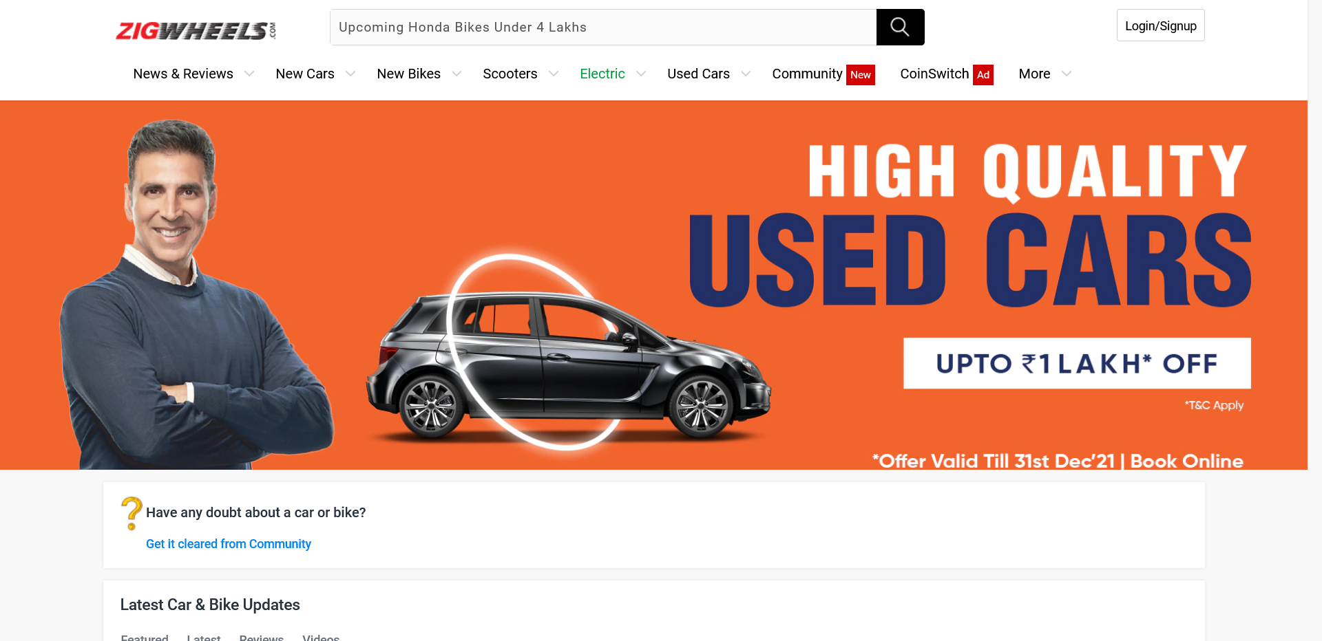
Screenshots: New Bikes

Slide 8
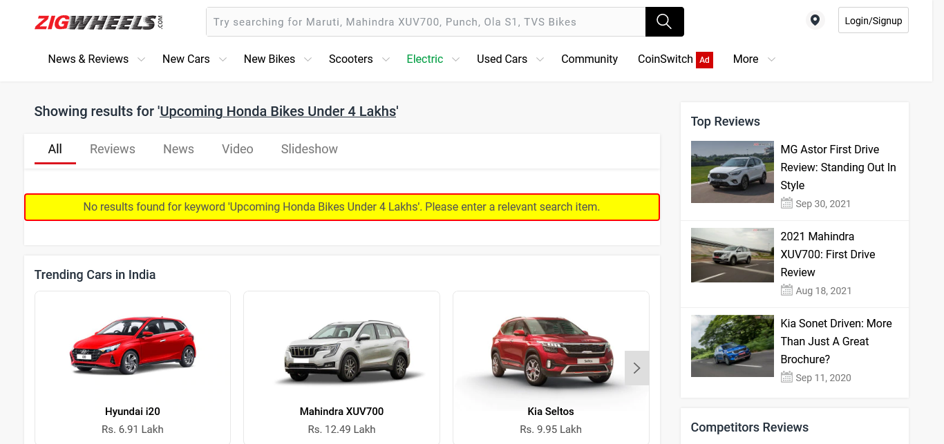
Screenshots: New Bikes

Slide 9
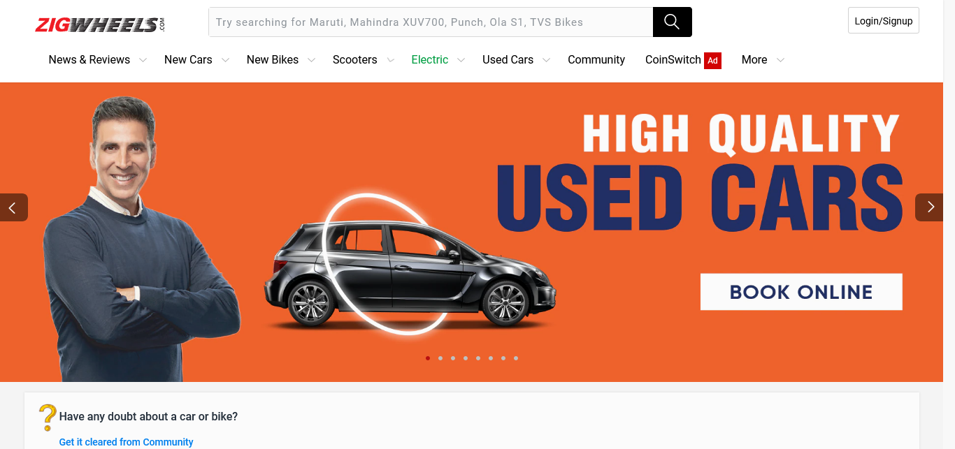
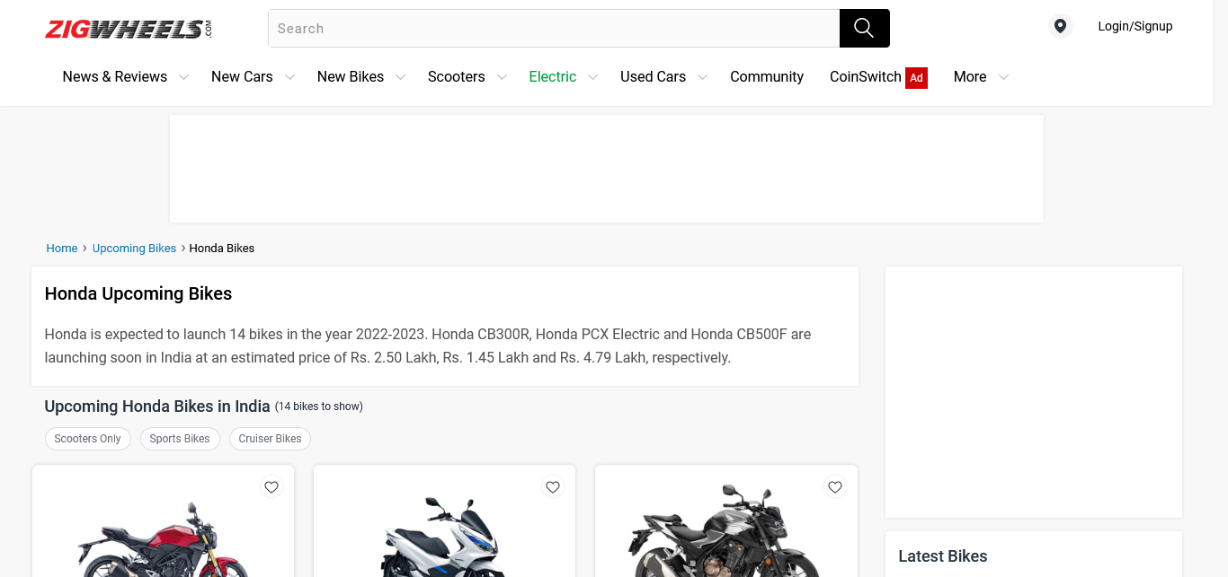
Screenshots: Upcoming Bikes Under 4 lakhs

Slide 10
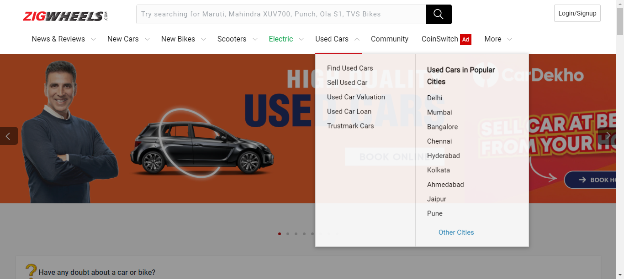
Screenshots: Used Cars

Slide 11
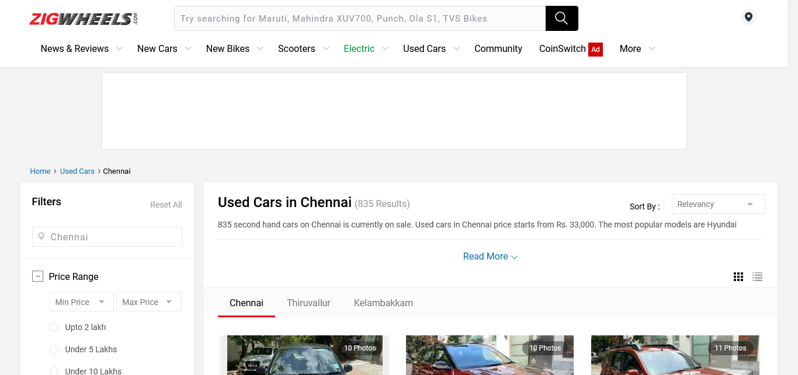
Screenshots: Used Cars

Slide 12
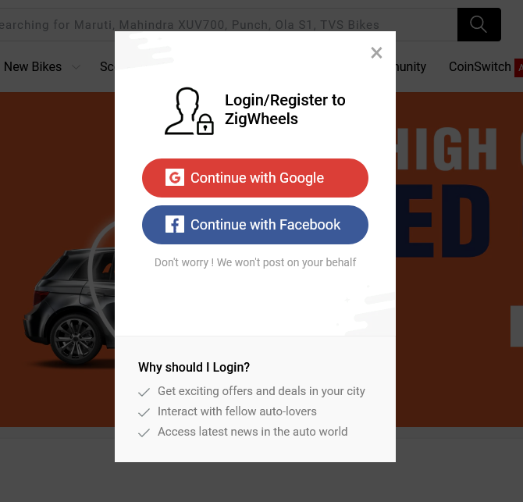
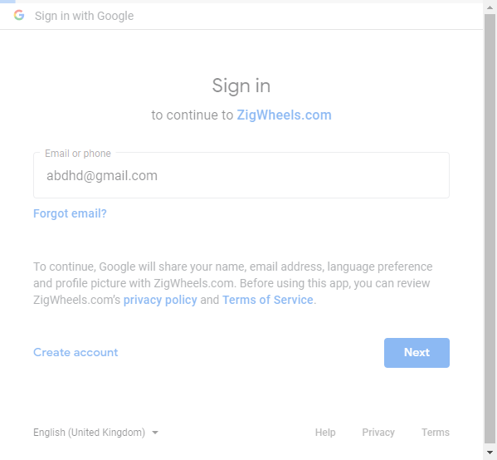
Screenshots: Login Page

Slide 13
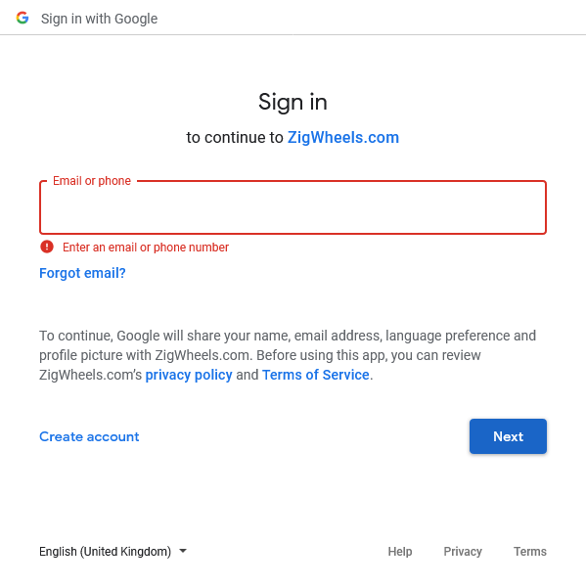
Screenshots: Login Page

Slide 14
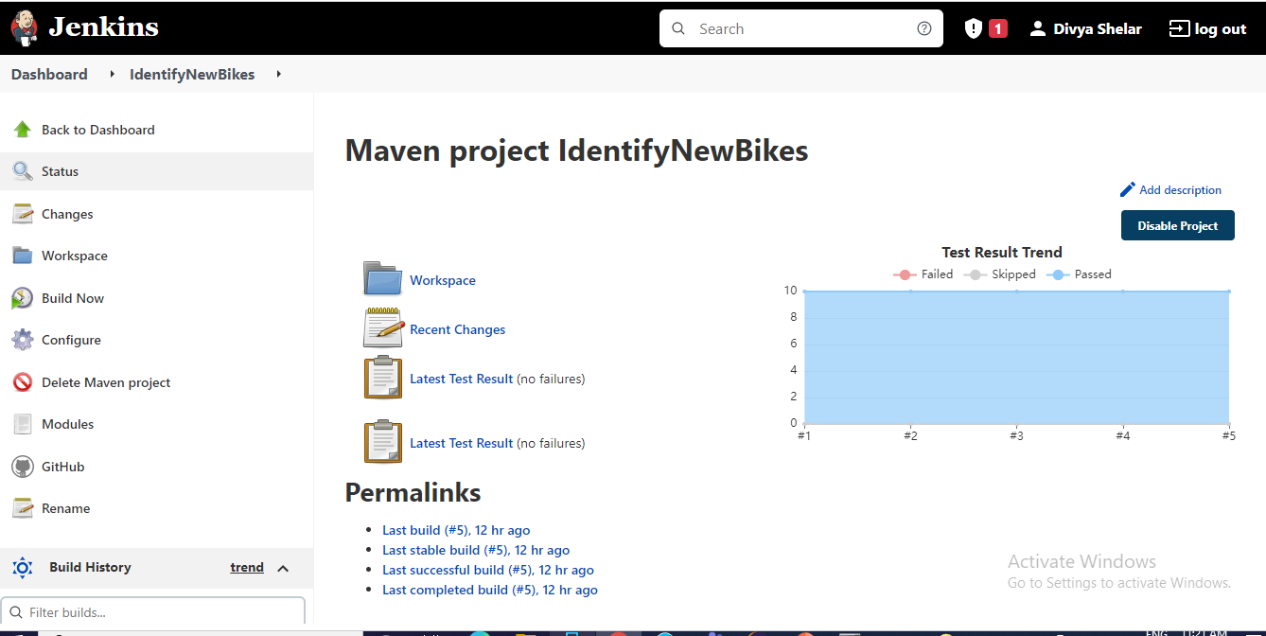
Jenkins Screenshots

Slide 15
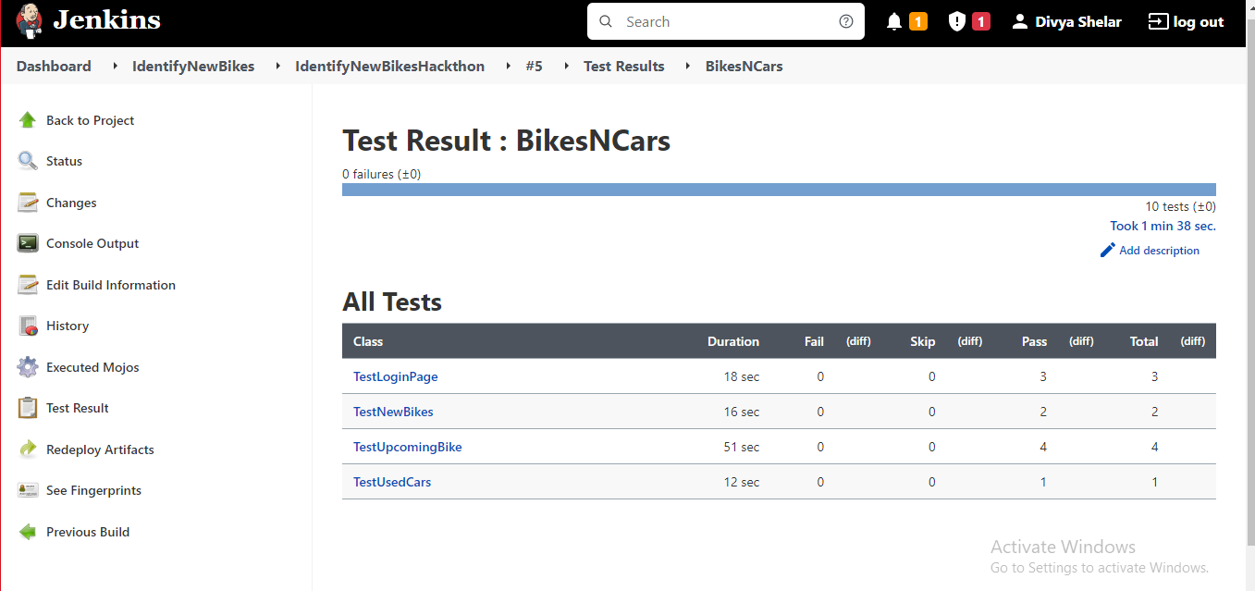
Jenkins Screenshots

Slide 16
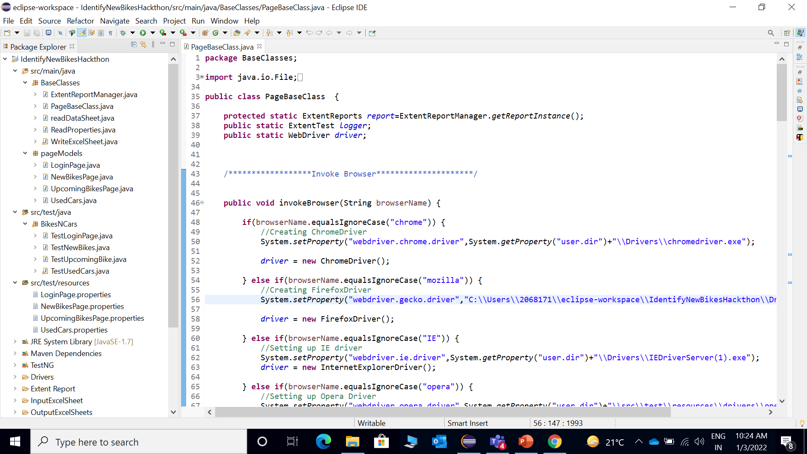
Project Structure

Slide 17
Thank You

