Slide 1
Vision Nav
DEEP TECH HACKATHON · CHALLENGE 1
Shared vision for mobile robots: a rover guided by a camera in the room
[ Team: Cool Rover ]
phone camera = indoor GPS
Notes:
RATIONALE 0:00–1:00 (slides 1–2). ~15 s here.
'We are Cool Rover, Challenge 1: a small robot that measures distance to obstacles and avoids them. Our rover gets its eyes from a camera in the room — the camera knows where the robot is, the robot's sonar measures what is in front of it.'

Slide 2



Reuse existing vision, don't rebuild it
01 · RATIONALE
Every robot carries its own eyes
0
LiDAR on the robot
Delivery robots and robot vacuums each pack LiDAR, cameras and sonars.
That makes robots costly and heavy
0
cameras on the robot
More hardware means a higher price, more power, more weight and harder maintenance.
The eyes already exist: CCTV
1
cheap sonar is enough
Cameras watch buildings, homes and city streets. Our prototype uses them to guide the robot.
Notes:
~45 s. 'Today the industry spends a lot to give robots vision. Delivery robots, robot vacuums — every one of them carries its own LiDAR, cameras and sonars. That makes them expensive and power-hungry, but also heavy, complicated and hard to maintain. Yet the vision already exists almost everywhere: CCTV inside buildings, in private homes, on the streets of big cities. Our prototype reuses that vision. A camera in the room tells the robot where it is; the robot itself carries no LiDAR, no camera — just one cheap sonar.' If asked for numbers: savings in cost, power and weight are the goal; we have not measured them yet.

Slide 3




Phone, server, rover: one loop at 10 Hz
02 · TECHNICAL EXECUTION
Phone camera
Server (Python)
Rover (UNO R4 WiFi)
Looks down on the arena
Spots ArUco markers
Shows the planned path
Pixels → cm (homography)
Obstacle map
Path following at 10 Hz
2 DC motors via L298N
Sonar + 20 cm hard stop
Telemetry back at 10 Hz
→ marker corners, 15 fps
→ D <left> <right> <ms>
→ distance, mode, 10 Hz
Console in any browser: live map · click to go · go home · follow me · joystick
Notes:
TECHNICAL EXECUTION 1:00–2:30 (slides 3–5). ~35 s here. Из сервера - координаты и куда двигаться
'The phone above the arena sees four corner markers and one marker on the rover. It sends only marker coordinates — a few bytes, not video. The Python server on a laptop turns pixels into centimetres, keeps the obstacle map, plans the route and sends every wheel command, 10 times a second. The rover — Arduino UNO R4 WiFi, two DC motors, one HC-SR04 sonar — drives, reports its sonar distance and enforces a 20 cm hard stop. Everything is controlled from a browser console: click to go, go home, follow me, joystick.' Why this split: the rover has no encoders or gyro, so it cannot know where it is by itself; the camera gives it its true position.

Slide 4
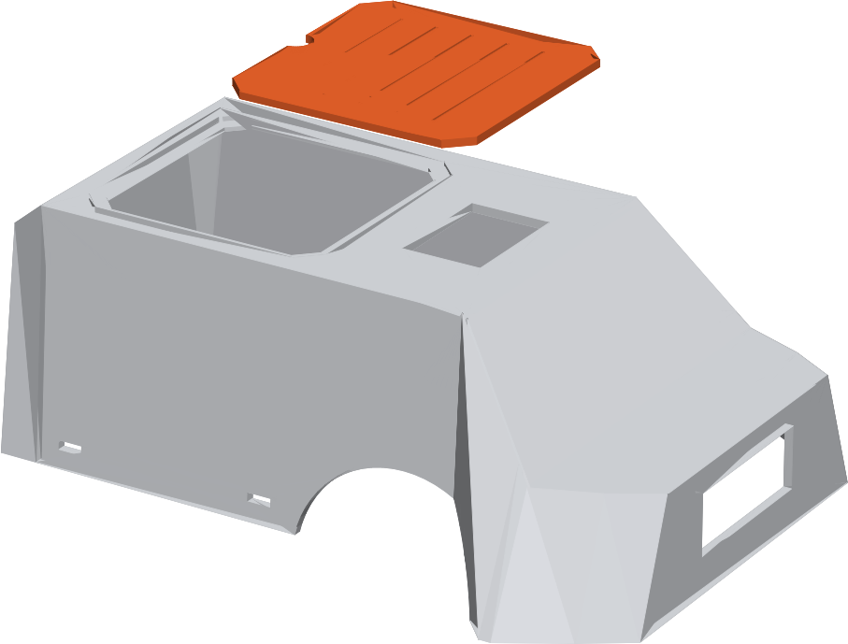





Kit parts, our own shell
03 · PHYSICAL DESIGN
Arduino UNO R4 WiFi
Brain, Wi-Fi link to server, LED face
L298N + 2 DC gear motors
PWM drive, automatic straight-line trim
HC-SR04 sonar
Looks out through the shell's front window
Buzzer
Parking-sensor beeps from 45 cm
2 × 18650 cells
Power for motors and board
Shell 221 × 164 × 80 mm · removable hatch
Notes:
Backup — do not present unless asked about hardware. Hold up the real rover: kit electronics inside, 3D-printed shell and hatch.

Slide 5
Camera says where, sonar says what
04 · DISTANCE + OBSTACLE AVOIDANCE
01
Localize
4 corner markers → homography → rover position in cm, heading within a few degrees.
02
Map
Every echo lands at its true floor position. 3 echoes confirm a cell; free rays erase noise.
03
Plan
A* on a 5 cm grid, inflated by the robot radius, smoothed into straight legs.
04
Drive
Straight to the next corner, stop, pulse-turn — heading checked by the camera every frame.
obstacle (sonar)
+ robot radius
A* path
Notes:
~35 s. Both challenge requirements on one slide. 'Distance: the sonar still measures what is in front. Because the camera knows where the rover is and which way it faces, every echo lands at its true position on a 5 cm grid; three echoes confirm an obstacle. Avoidance: A* plans around those cells, padded by the robot's radius, and re-plans every half second — so a new box bends the path. The rover drives straight legs and corrects its heading with short turn pulses, checked by the camera.'

Slide 6



Start indoors, where cameras already exist
05 · REAL-WORLD APPLICATIONS
WHERE IT FITS
DEPLOYMENT NEEDS
Offices · first pilot
Cleaning or delivery robots guided by the building's own cameras.
1
Camera views that cover the floor
Warehouses
2
Calibration for each camera
Transport carts on floors with fixed camera coverage.
3
A reliable, low-latency link to each robot
Shared residential spaces
Corridors and lobbies with operator-run cameras.
4
Encoders or an IMU for camera blind spots
Notes:
APPLICATIONS 4:00–5:00 (slides 8–9). ~45 s here.
'We would start indoors, where operators control camera coverage. First pilot: cleaning or delivery robots on an office floor, guided by the building's own cameras. Then warehouse transport and shared residential spaces. Deployment needs camera views that cover the floor, calibration per camera, a reliable link to each robot, and encoders or an IMU for the spots no camera sees.'

Slide 7
48 hours, three ideas, one that works
06 · HOW WE GOT HERE
FRI 19:00
SAT 14:00
SAT 19:00
SUN 10:00
SUN 13:00
Sonar + servo scanner
Chase a phone by Bluetooth / Wi-Fi
Reality check
Pivot: camera = GPS
Tune on hardware
Sweeping HC-SR04 draws a polar map — only while standing still.
RSSI hunt
Rover spun and collided. −54 dBm at 1 m vs −60 at 3 m: too flat to steer by.
Phone tracks a marker on the rover; server plans with A*.
3D-printed shell installation, self-calibration, pulse turns, straight-line legs.
Notes:
Backup — do not present. Use if asked how the idea evolved: sonar scanner, Wi-Fi RSSI chase, reality check, pivot to camera localisation.

Slide 8

Demonstration Live Map

