Slide 1

CREDIT CARD CLUSTERING
by Maina Bryan
1.Project overview
To analyze customer credit card usage patterns and segment them into distinct behavioral groups using clustering techniques (K-Means and Hierarchical).
IT will be arranged into 5 blocks:
Block 1: Customer Segmentation Overview
Block 2: Risk & Credit Behavior/
Block 3: Payment vs Purchase Patterns
Block 4: Business Opportunities
2.Business Value:
Help the company:
Identify high-value customers
Detect risk-prone users (e.g. overusing cash advance)
Optimize marketing and service personalization
Improve financial product targeting
3. Business Questions We Will Solve:
What distinct customer segments emerge based on their spending patterns?
Which segment relies most on cash advances?
How does credit limit utilization differ across groups?
Are there low-engagement but high-credit customers?
Who are the best targets for upselling new services?
(+ 10 more business questions following after this)

Slide 2
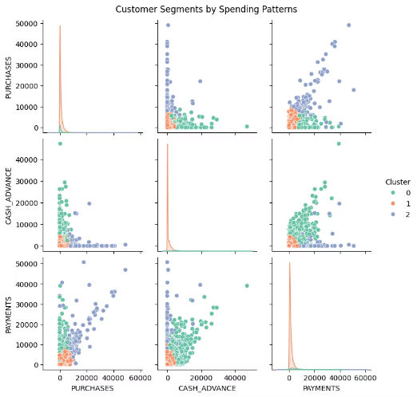
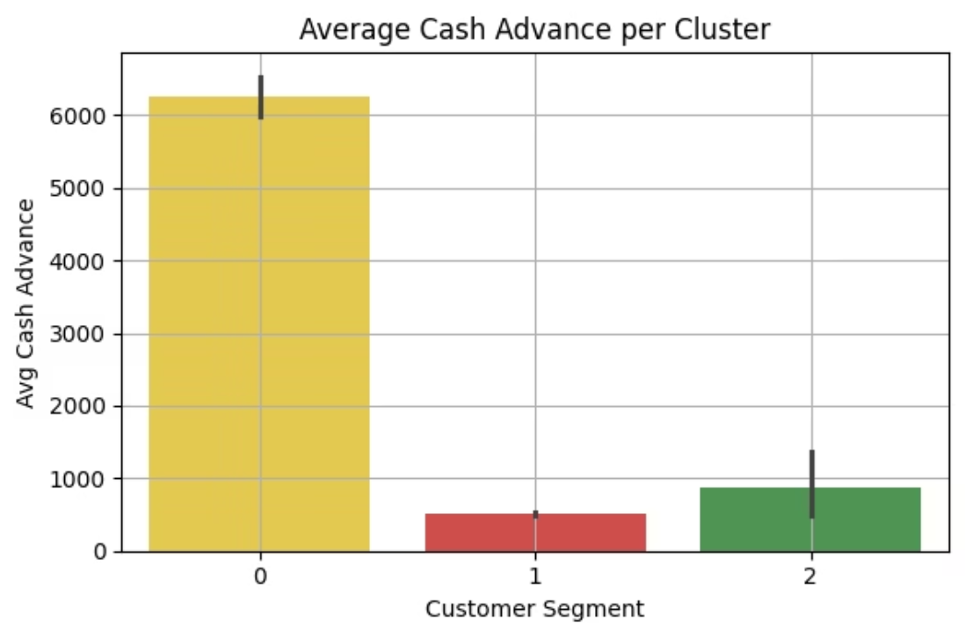
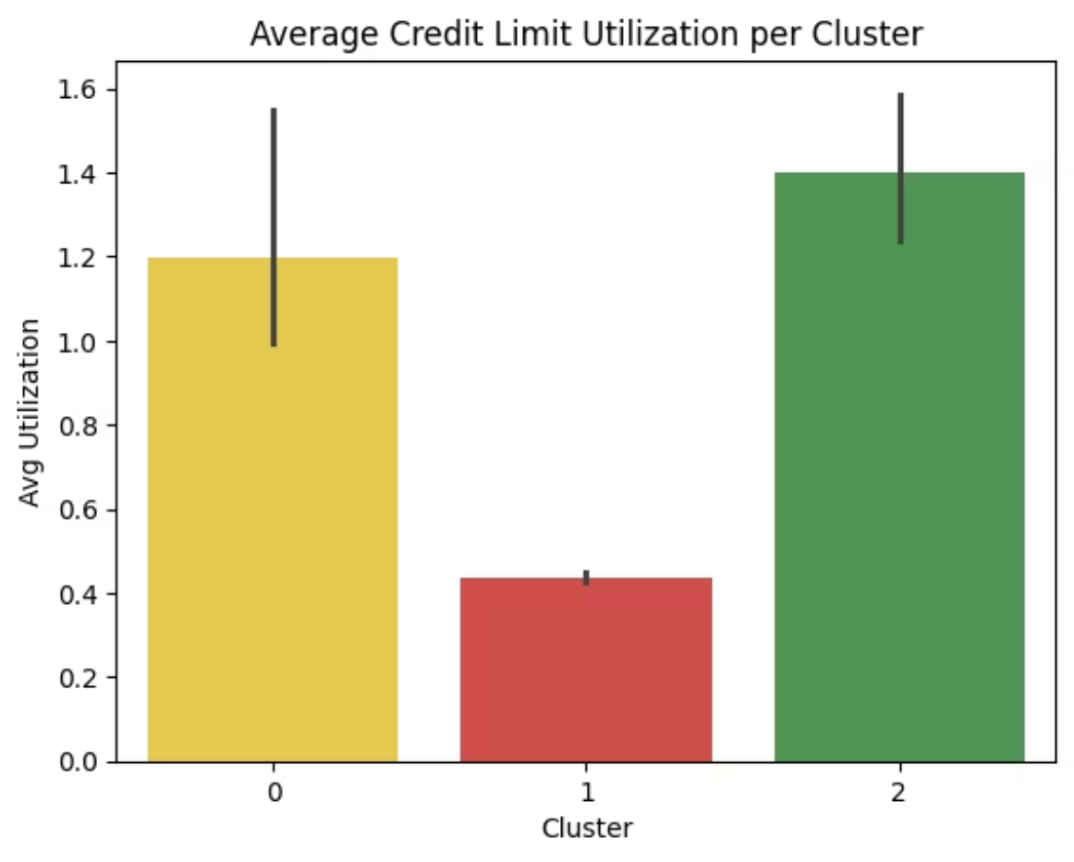
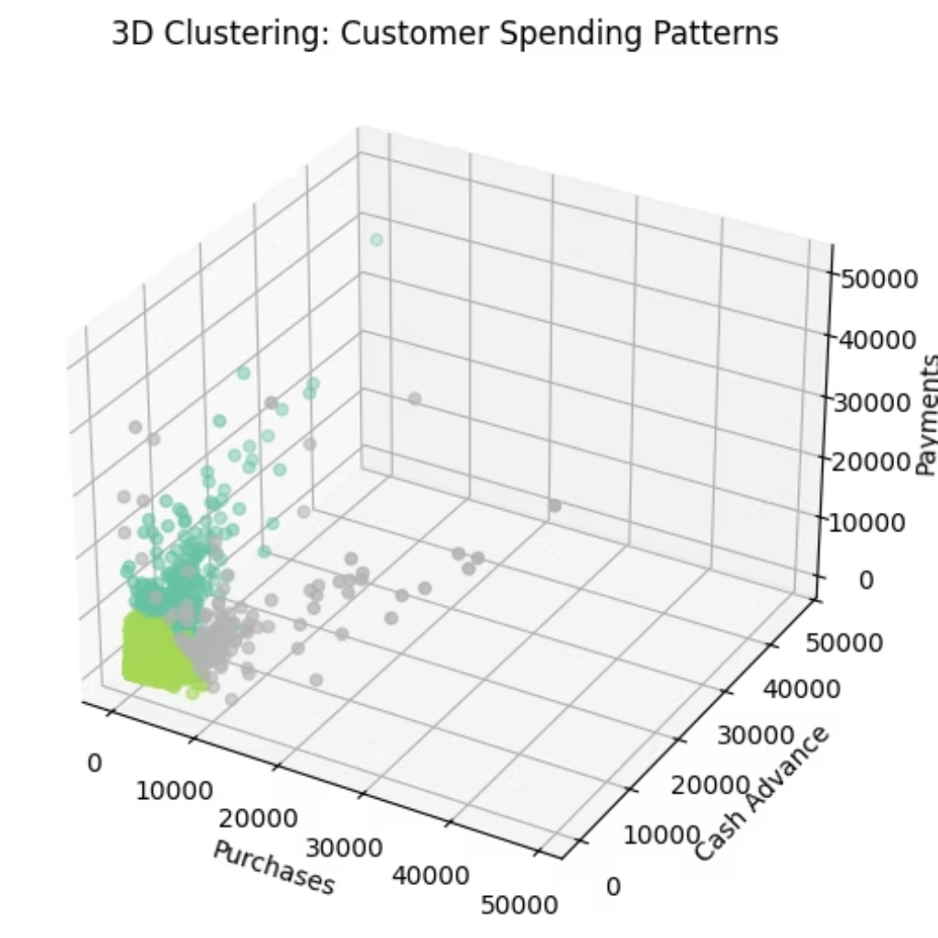
Customer Segementation overview
Cluster
Behaivour pattern
Segment label
0
Low purchases, low cash advance, low payments
🟡 Low Activity Users
1
Low purchases, high cash advances
🔴 Cash-Reliant Users
2
High purchases, high payments, low cash advances
🟢 High-Value/Engaged Users
Grouping customers into similar behavioral groups (segments) based on how they spend, borrow, and repay using clustering.
These are problem statements we will cover by the end of these project
What distinct customer segments emerge based on their spending patterns?
How does credit limit utilization differ across identified customer groups?
Which customer segment showcases the most balanced credit utilization
What distinct customer segments emerge based on their spending patterns?
i used three features
purchases
cash_advance
How does credit limit utilization differ across identified customer groups?
payments
interpretation
Insights :
Blue could be Cluster 0(A group of customers with similar behavior)
Cluster 0 (🟡 Yellow) shows the highest average cash advance usage.→ These customers are relying heavily on credit as cash.
Green could be Cluster 1 (A second distinct group)
Which customer segment showcases the most balanced credit utilization
Orange could be Cluster 2(A third type of customer)
Cluster 2 (🟢 Green) has moderate usage of cash advances.→ Likely using credit in a balanced way.
Insights:
Insights
Cluster 1 (🟥 Red) shows very little to no use of cash advances.→ Possibly inactive users or financially stable customers avoiding debt.
🟢 Green Segment (Cluster 2) uses a large portion of their credit limit.→ They are active and possibly maxing out their limits, but may be repaying well.
Here are natural language insights from my visuals:
Around 1/3 of customers show low activity: little purchases, repayments, or cash advances. These may be inactive users.
Recommendations:
🟡 Yellow Segment (Cluster 0) shows moderate utilization, indicating a balance between spending and credit use.
Another cluster shows high reliance on cash advances with low purchasing activity. These may be at risk of debt.
Cash-Reliant Segment (Cluster 0)(yellow)
🟥 Red Segment (Cluster 1) has very low utilization.→ These users may be inactive, overly cautious, or under-engaged.
• Monitor for repayment delays
The final group consists of financially active customers who purchase a lot and pay consistently — likely our most valuable segment.
• Offer credit counseling or alerts
Business Recommendations
• Consider reducing cash advance limits
Recommendations:
• Segment them for risk mitigation
🟢 Green (High Utilization)
Segment 0: Low Activity Users
Report Summary:
→ Consider increasing their credit limit to reduce risk of overutilization
Behavior:
✅ Customers in
→ Offer premium plans or rewards to retain them
Rarely use their credit card
Cluster 0 (🟡) are most reliant on cash advances.This indicates credit stress or debt behavior and may pose repayment risk.Meanwhile,
→ Monitor closely for repayment behavior
Low purchases, payments, and cash advances
Recommendations:
Cluster 2 (🟢) represents financially balanced users,
🟡 Yellow (Moderate)
Reactivation Campaigns: Send special offers, cashback rewards, or personalized discounts to increase card usage.
Cluster 1 (🟥) appears mostly inactive.
→ Promote upsell offers, especially tailored financial services→ Encourage usage through seasonal campaigns
Behavioral Nudge: Push mobile notifications on underused benefits or limited-time offers.
Retention Strategy: Monitor for potential churn; these users may become inactive.
Segment 1: Balanced High Spenders
Behavior:
🟥 Red (Low Utilization)
High purchases and repayments
→ Launch targeted reactivation campaigns (e.g., "Spend & Get" offers)→ Evaluate if these users are likely to churn or need education on benefits
Very little cash advance activity
Recommendations:
Summary Report:
Loyalty and Upsell Target: Offer premium cards, increased credit limits, and VIP benefits to reward and retain them.
We analyzed credit utilization behavior across customer clusters.
Cross-Sell Opportunities: Suggest travel rewards, insurance products, or investment services.
Cluster 2 (🟢) has the highest utilization, showing strong credit activity.
Customer Spotlight: Use as a model for identifying similar high-value users.
Cluster 0 (🟡) sits in the middle — engaged but not heavy users.
Cluster 1 (🟥) barely uses their available credit, signaling inactivity or caution.
Segment 2: Cash-Heavy Users
These insights support decisions on credit limit management, targeted marketing, and risk strategy.
Behavior:
Use cash advances more than purchasing
Payments are average, which may signal stress
Recommendations:
Credit Risk Monitoring: Set alerts for signs of debt dependency.
Limit Adjustments: Cap cash advance limits to avoid overexposure.
Financial Coaching: Offer education programs on smart credit use and repayment habits.
3D Cluster Interpretation (Features: PURCHASES, CASH_ADVANCE, PAYMENTS)
Cluster 0 (e.g. Blue):Customers with low purchases, low payments, and low cash advance usage→ Low activity or dormant users
Cluster 1 (e.g. Orange):Customers with high cash advances, but low purchases→ Cash-reliant customers, potential credit risk
Cluster 2 (e.g. Green):Customers with high purchases and high payments, low cash advance→ Financially active and responsible users

Slide 3

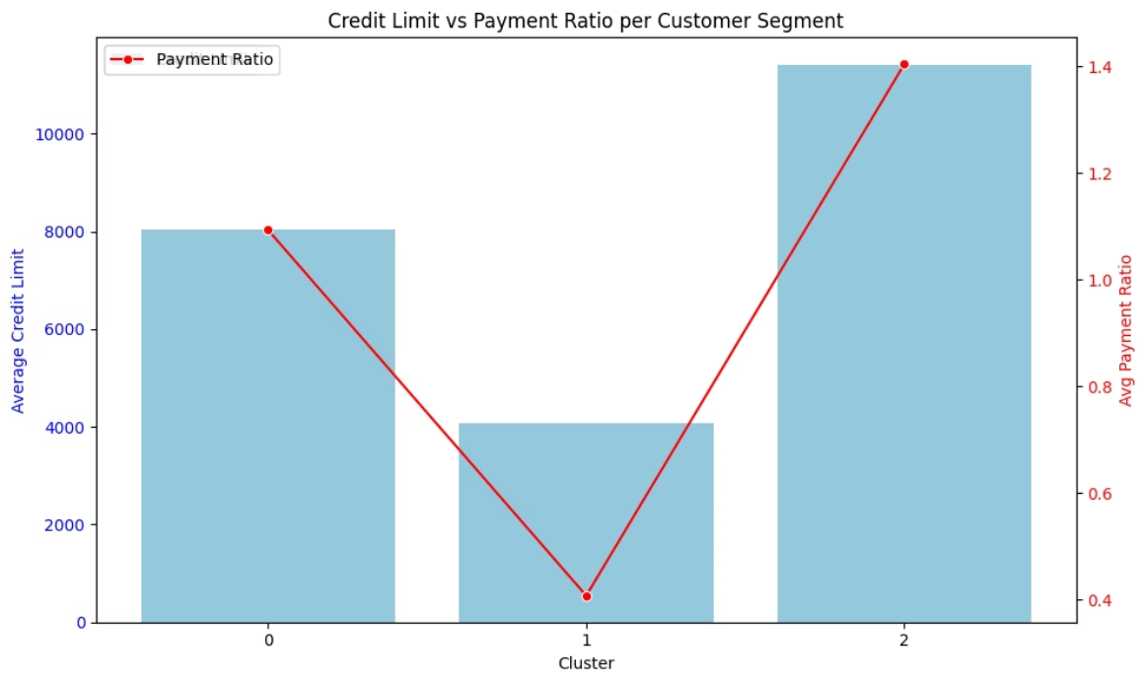
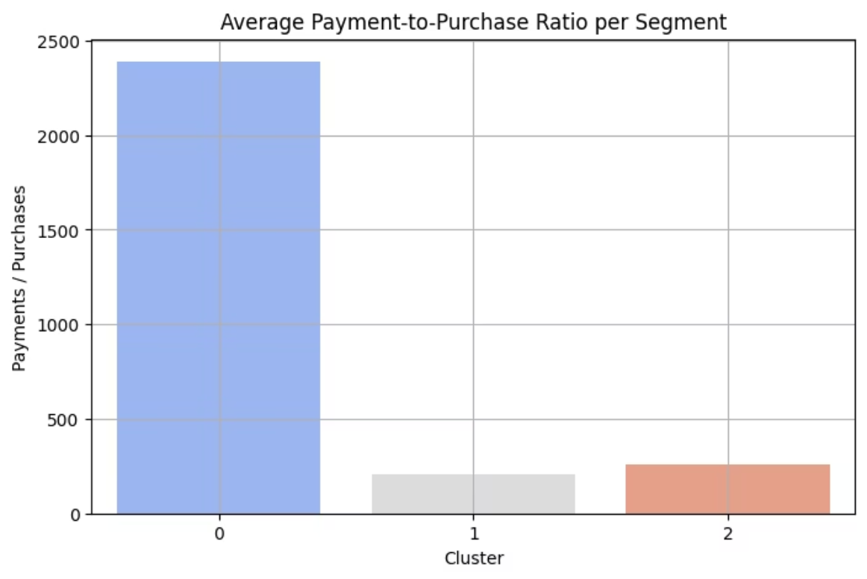
Risk & Credit Behavior Analysis
Cluster
Behaivour pattern
Segment label
0
Low purchases, low cash advance, low payments
🟡 Low Activity Users
1
Low purchases, high cash advances
🔴 Cash-Reliant Users
2
High purchases, high payments, low cash advances
🟢 High-Value/Engaged Users
This block answers questions focused on risk, debt habits, and payment consistency.
These are the problem statements::
Are there segments at risk of overspending their credit limits?
Are there segments with high credit limits but inconsistent payment habits?
Are there segments characterized by high payments but minimal purchases?
Are there segments with high credit limits but inconsistent payment habits?
Cluster credit limit payment ratio
Are there segments characterized by high payments but minimal purchases?
Are there segements at risk of overspending their credit limits
🟢 Cluster 2 11,403 1.40
Interpretation
🟡 Cluster 0 8,044 1.09
🟢cluster 2 :Avg utilization is 0.86 = 86% → ⚠️ High risk of overspending
🟥 Cluster 1 4,064 0.41
🟡 Cluster 0 (Moderate):Moderate utilization (~52%)
🟢 Cluster 2:
🟢 Cluster 2 2388.878095
🟥 Cluster 1;Very low utilization (~12%) → Not risky
🟡 Cluster 0 255.87
Business Recommendation:
Highest credit limit (~11.4k)
Also pays more than their limit → Very strong repayment behavior
🟥 Cluster 1 208.54
🟢 Cluster 2 (High Utilization)
Not risky — they are highly trusted, and they deliver
Flag for risk monitoring
🟡 Cluster 0:
Review credit limits for overexposure
Mid credit (~8k)
Insights:
Offer financial planning tools
Pays about 1.09× of limit → Also strong repayment
🟡 Cluster 0 – Serious Outlier
Optional: Introduce spending caps or real-time alerts
Healthy and responsible segment
🟡 Cluster 0 (Moderate)
🟥 Cluster 1:
This segment pays extremely high amounts while spending almost nothing
Educate them on healthy credit behavior
Likely not using the card actively → only repaying past debt
Encourage responsible spending habits
Lowest credit limit (~4k)
May have paid off a huge balance, but is now financially dormant
Offer targeted promos, not more credit yet
Payment ratio is just 0.41
⚠️ High churn or disengagement risk
🟥 Cluster 1 (Low)
❗Warning: They're paying back less than half of their limit → Risk of late repayment or default
🟢 Cluster 2
No overspending risk
Recommedations
Still pays much more than they purchase, but much less extreme
Consider re-engagement offers to increase card usage
🟥 Cluster 1 (Low payers)
Could be in financial recovery, debt settlement, or using card for limited transactions
Report Summary:
Flag for risk review
🟥 Cluster 1
✅ Cluster 2 has the highest risk of overspending their credit limit (avg utilization ~86%).This group should be prioritized for limit reviews and credit education.Clusters 0 and 1 show moderate to low risk, with Cluster 1 being the most conservative.
• Consider reducing limit further
Lowest ratio among all — possibly the most balanced of the three
• Avoid raising credit
May actually reflect active usage with reasonable payments
• Provide repayment reminders, financial tools
Business Recommendations:
🟢 Cluster 2 (Top performers)• Consider raising their credit• Offer premium products or investment options• Ideal for cross-selling
🟡 Cluster 0 (Very High Ratio)
Inactive group — likely just settling debt
Flag for churn risk
| 🟡 Cluster 0 (Stable)• Maintain or slightly raise credit• Offer rewards to increase engagement
Send re-engagement offers like “spend X, get Y reward”
• Suggest auto-pay setup or credit optimization
Final Summary
🟢 Cluster 2 (Moderate Ratio)• May be low spenders but consistent payers• Educate on full card benefits• Promote small-value purchase campaigns or installment plans
✅ Cluster 2 and Cluster 0 are strong and consistent payers, handling their large credit responsibly.⚠️ Cluster 1, however, repays only ~41% of their credit limit and may pose a repayment risk.The business should target support, alerts, or tighter credit control for this segment.
| 🟥 Cluster 1 (Low Ratio)• Potentially the most financially active group• Target for premium upgrades, cashback cards, orloyalty points
Report Summary
Our analysis reveals that Cluster 0 customers are characterized by extremely high payment behavior despite making almost no purchases, suggesting disengagement or post-debt repayment.

Slide 4
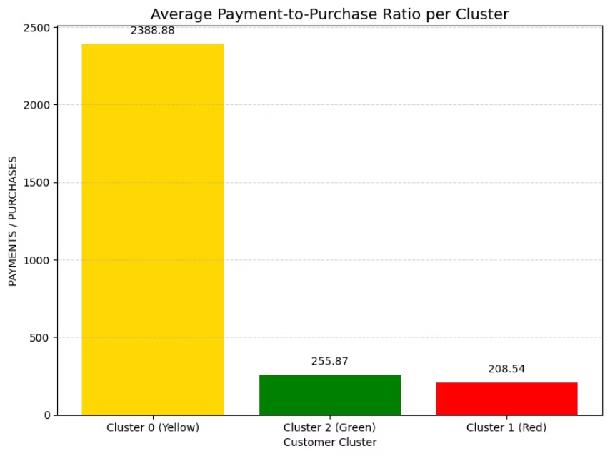
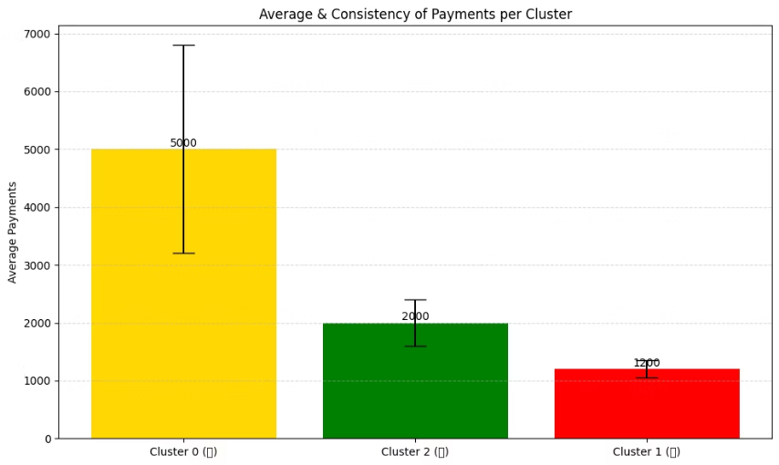
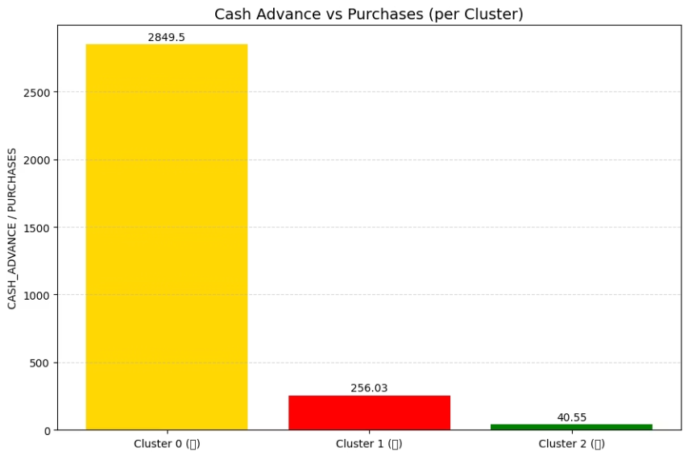
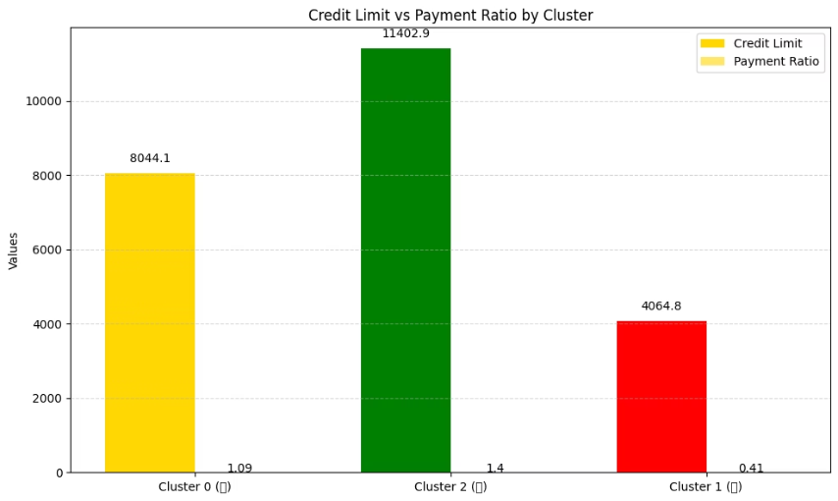
Payment vs Purchase Patterns
This block explores how customers behave in terms of spending vs repayment, to find risky, loyal, or inactive behaviors. These are super important for financial strategy, loyalty programs, and fraud prevention.
Block Objective:
To analyze how customers use their credit cards to spend (purchases) versus how they pay it back (payments) — and how this balance can reveal important financial behaviors.
Why It Matters (Business Value):
Helps identify financially responsible vs risky customers
Detects inactive users (paying but not buying)
Reveals cash advance overuse or low engagement
Allows targeted marketing, retention, or education strategies
Business Questions :
Are there segments characterized by high payments but minimal purchases?
Metric: PAYMENTS / PURCHASES
Focus: Find disengaged or debt-settling users
Which customer group consistently makes the largest and most regular payments?
Metric: PAYMENTS (mean and std per cluster)
Focus: Identify loyal, financially strong customers
Are there segments with infrequent purchases yet frequent cash advances?
Metric: CASH_ADVANCE / PURCHASES
Focus: Detect loan-style behavior → restructure products
Are there segments with high credit limits but inconsistent payment habits?
Metric: Compare CREDIT_LIMIT vs PAYMENT_RATIO
Focus: Spot risky credit behavior
Cluster
Behaivour pattern
Segment label
0
Low purchases, low cash advance, low payments
🟡 Low Activity Users
1
Low purchases, high cash advances
🔴 Cash-Reliant Users
2
High purchases, high payments, low cash advances
🟢 High-Value/Engaged Users
Which customer group consistently makes the largest and most regular payments?
Are there segments with high credit limits but inconsistent payment habits?
Are there segments with infrequent purchases yet frequent cash advances?
Are there segments characterized by high payments but minimal purchases?
Business Objective:Identify customer segments with the highest total payments and most consistent payment behavior.
Business Objective:
Business Objective:
insight :
Key Insights:
Identify customers who don’t use their credit cards for purchases, but frequently take out cash advances — which usually come with higher risk and extra fees.
To identify risky customers who have high credit limits but don’t pay back consistently — this can expose the business to credit default and cash flow risks.
🟡 Cluster 0 pays ~2,388x more than they spend → likely inactive or repaying debt
🟡 Cluster 0:• Pays the most on average (~5000)• But highly inconsistent — some pay very high, others low→ May need individual-level analysis or customized limits
🟢 Cluster 2 has moderate usage (~256) → possibly low usage but financially active
This helps detect:
We’ll analyze:
🟥 Cluster 1 is the most balanced (~208) → likely your regular/engaged cardholders
Users treating cards like short-term loans
CREDIT_LIMIT → how much they are allowed to borrow
🟢 Cluster 2:• Moderate average payments (~2000)• Most consistent payment behavior→ Ideal for loyalty rewards, credit upgrades, and referrals
Financial stress or emergency usage
PAYMENT_RATIO → how reliably they pay back (i.e., PAYMENTS / CREDIT_LIMIT)
Segments needing financial education or risk monitoring
Recommendation
Insights:
If a segment has high credit but poor payment habits, it’s red flag
Cluster 0 (🟡): Reactivate with small-spend reward campaigns
🟥 Cluster 1:• Lowest average payments (~1200)• Stable but low engagement→ Target with usage campaigns or financial guidance
🟡 Cluster 0
INSIGHTS:
Cluster 2 (🟢): Engage with education & tips to increase card usage
Cluster 1 (🟥): Reward loyalty with cashback, bonuses, or upgrade offers
Extremely high ratio (~2849)
🟢 Cluster 2:
Business Recommendations:
Heavily dependent on cash advances, with little spending
Highest credit limit (~11.4K)
Treating cards like emergency cash loans
Also highest payment ratio (1.40)→ Excellent financial behavior — responsible high-credit users
✅ Cluster 2 (Green): Reward with cashback offers, referrals, and product upsells
⚠️ Financially vulnerable or in repayment difficulty
🔍 Cluster 0 (Yellow): Analyze payment variance before offering upgrades
🟥 Cluster 1
🟡 Cluster 0:
⚠️ Cluster 1 (Red): Encourage spending through education, or monitor for churn
Moderate use of cash advances (~256)
Moderate credit (~8K)
Still more than purchases
Good payment ratio (1.09)→ Also responsible, but slightly lower limit
Could benefit from financial advice or controlled limits
🟢 Cluster 2
🟥 Cluster 1:
Very low ratio (~41)
Low credit (~4K)
Healthy usage — purchases are much higher than cash advances
Lowest payment ratio (0.40)→ Most inconsistent — potential risk of default or misuse
Great for long-term engagement
Business Recommendations
Business Recommendations
Cluster 0 (🟡):
Cluster 2 (🟢):
⚠️ Introduce alerts or restrictions on frequent cash withdrawals
Consider increasing their limit
Offer credit education content or debt management plans
Ideal for premium offers, cross-sell, or VIP services
Consider placing them in a high-risk watch group
🟡 Cluster 0:
Maintain current standing
Cluster 1 (🟥):
Encourage them to move toward higher engagement with perks
Educate on the cost of cash advances
Cluster 1 (🟥):
Offer better financing tools or lower-fee alternatives
Add to risk-monitoring
Encourage them to use the card for purchases instead
Offer spending guidance, rewards for consistency, or lower-tier credit options
Cluster 2 (🟢):
Recognize them as financially responsible
Offer them cashback incentives on purchases or loyalty programs

Slide 5
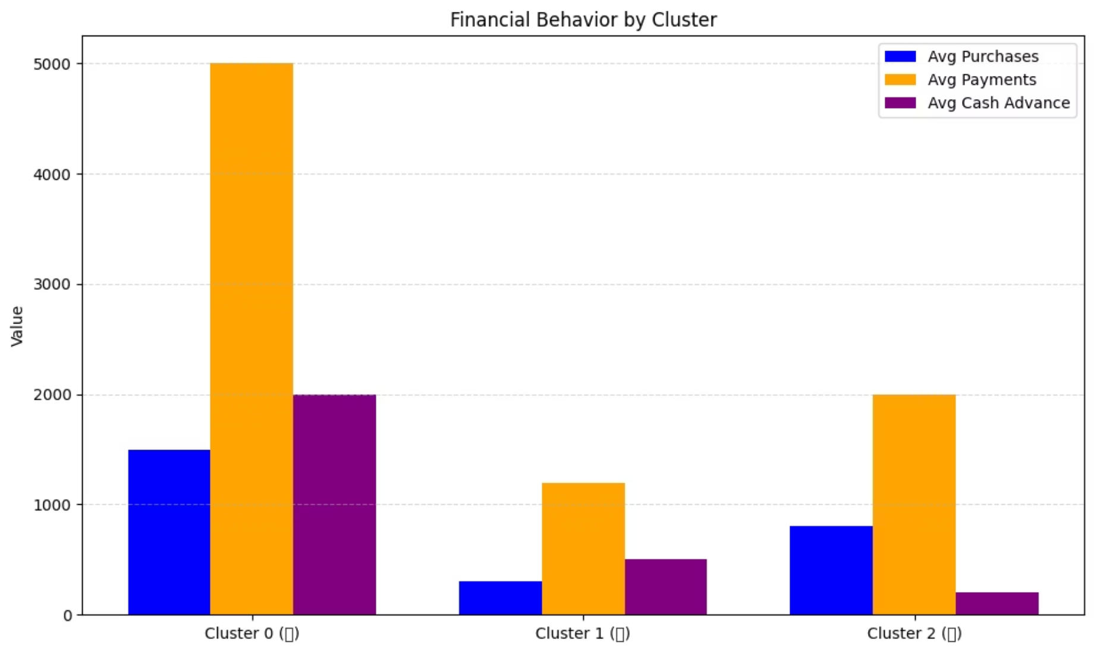
SUMMARY
Business opportunities
Translating insights into action for better customer targeting, risk management, and growth.
🟢 Cluster 2 – Financially Responsible Segment
Behavior:
High credit limits
Consistently pays on time (highest payment ratio)
Low dependency on cash advances
Healthy, balanced credit utilization
Opportunities:
Offer premium cards, credit limit increases
Enroll in loyalty & rewards programs
Promote cross-sell: insurance, investments, or travel perks
Target for referrals and testimonials (brand advocates)
🟡 Cluster 0 – Heavy Users with Risk Potential
Behavior:
High purchases and payments
Highest reliance on cash advances
Payment behavior inconsistent (variance high)
Opportunities:
Offer spending insights, financial coaching, or budgeting tools
Push EMI (Installment) products to manage big payments
Monitor for credit stress — trigger alerts or custom interventions
A/B test debt consolidation campaigns
🟥 Cluster 1 – Dormant or Low Engagement Segment
Behavior:
Low purchases and payments
Underutilized credit limits
Rarely uses cash advances
Opportunities:
Re-engagement campaigns (e.g., "Spend & Earn", first-use cashback)
Promote entry-level financial products
Use email/SMS drip sequences to educate about credit card benefits
Push automated tools to build credit slowly (e.g., roundups, autopay features)

