Slide 1
Predicting Electric Vehicle Resale Value Using Machine Learning
BACKGROUND
This project aims to:
Predict EV resale prices using Support Vector Machines (SVM)
Analyze market segments (BEV vs. PHEV)
Discover pricing patterns based on range, year, and make
Identify customer behavior by utility, location, and sensitivity
Provide strategic recommendations for inventory, pricing, and risk management
Why This Matters (Business Impact)
These insights can help:
Dealerships optimize inventory and pricing strategies
Manufacturers set better MSRP targets and product positioning
Financiers assess credit risk more accurately
Customers get fair pricing and range-based education

Slide 2
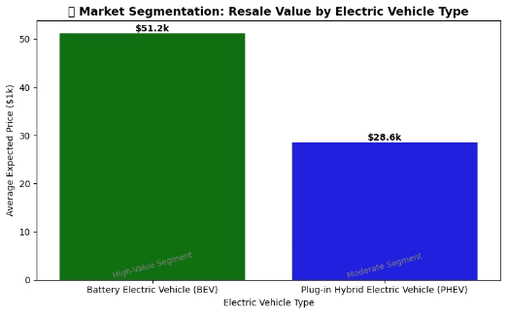
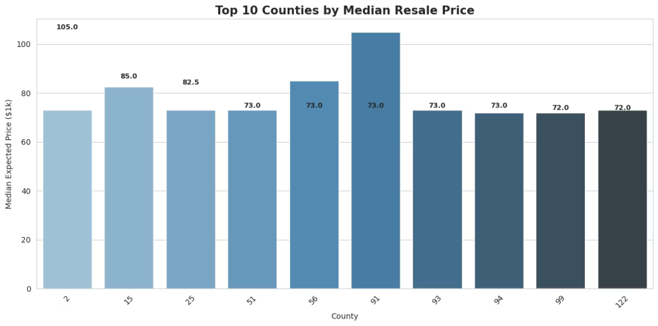
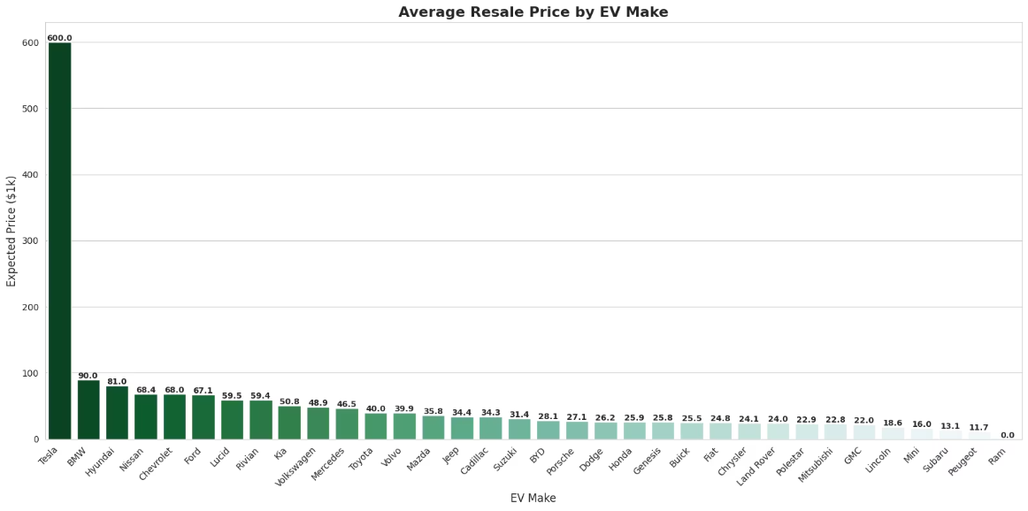
Market and customer behaivour
Market segmentation
Which electric vehicle types (BEVs vs. PHEVs) offer the highest resale value?
Visualization
Visualization Insight
Visualization Insight
Upselling Opportunities – EV Make vs. Resale Value
The bar chart compares average resale values between Battery Electric Vehicles (BEVs) and Plug-in Hybrid Electric Vehicles (PHEVs), represented in green and blue respectively.
Display the top 10 counties?
Visualization Insight
BEVs: $51.2k average resale value
The chart displays the top 10 counties based on the median resale price of electric vehicles. Counties are sorted in descending order, making it easy to compare high-value markets.
Tesla clearly leads the market in resale value, priced significantly higher than the rest. But the real upselling opportunity lies within the mid-tier segment.
PHEVs: $28.6k average resale value
Several counties stand out with consistently higher median resale values, signaling stronger willingness to spend — an indicator of lower price sensitivity. These areas are likely populated by more informed or financially flexible buyers, making them ideal targets for premium EV offerings.
Visual contrast highlights BEVs as a "High-Value Segment" and PHEVs as a "Moderate Segment"
Brands like Hyundai, Nissan, Chevrolet, and Ford offer relatively moderate prices yet hold strong resale value. This suggests buyers are already willing to invest more in these brands — opening the door for premium upgrades.
This significant gap (approximately 79%) shows that fully electric vehicles hold their market value far better than hybrid alternatives. The visual delivers this message clearly through spacing, color, and labeled segments.
Business Recommendation
Business Recommendation
Business Recommendation
Dealers operating in top-performing counties should focus on upselling higher-range or premium-feature models.
Manufacturers in the mid-price range (like Hyundai, Ford, Nissan) should introduce modular premium features such as longer range batteries, smart infotainment systems, and exclusive trims.
Resellers and dealerships should adjust their acquisition and pricing strategies accordingly:
Local marketing should highlight long-term EV value, warranties, and future resale potential — key concerns for customers who invest more upfront.
Dealers should use targeted sales strategies to offer optional premium bundles — since buyers in this tier are likely open to customization.
Focus inventory sourcing efforts on BEVs, which offer stronger profit margins
Manufacturers can collaborate with local dealerships to offer tailored financing or loyalty packages that reward repeat EV buyers in these counties.
Use value retention as a selling point in marketing BEVs
Marketing teams can brand these models as "affordable luxury", emphasizing long-term value and personalization.
Reposition PHEVs with strategic discounts or bundle offers to accelerate turnover
For lower-ranked counties, dealers should position more budget-friendly models and focus on affordability messaging to match local sensitivity.
For high-end brands like Tesla, the upselling opportunity is lower — focus should shift to retention programs and loyalty upgrades.
Consider regional EV infrastructure and buyer behavior when prioritizing stock
Smart upselling in the mid-price segment can maximize revenue without hurting affordability perception.

Slide 3
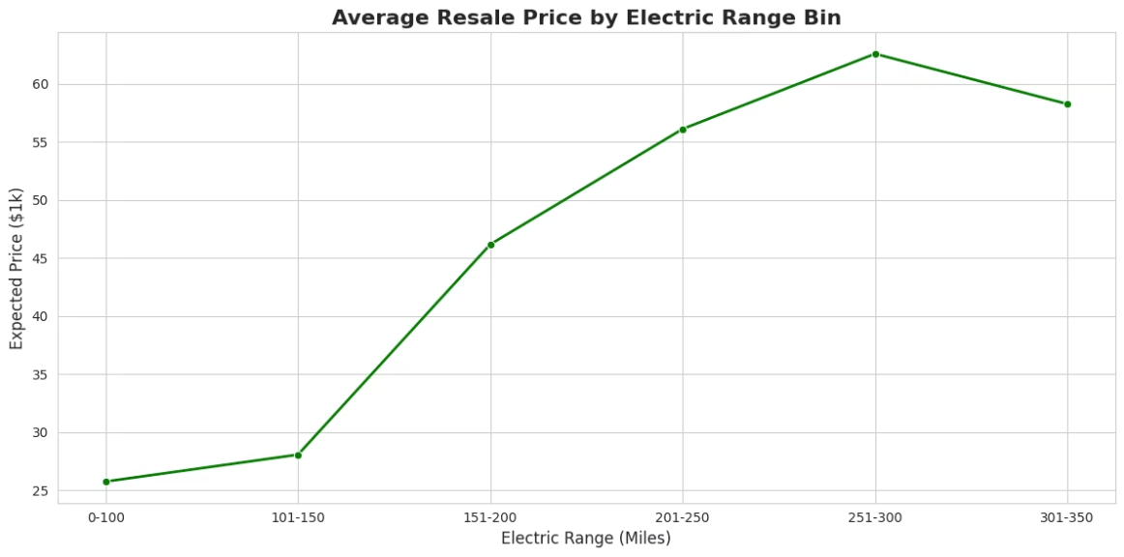
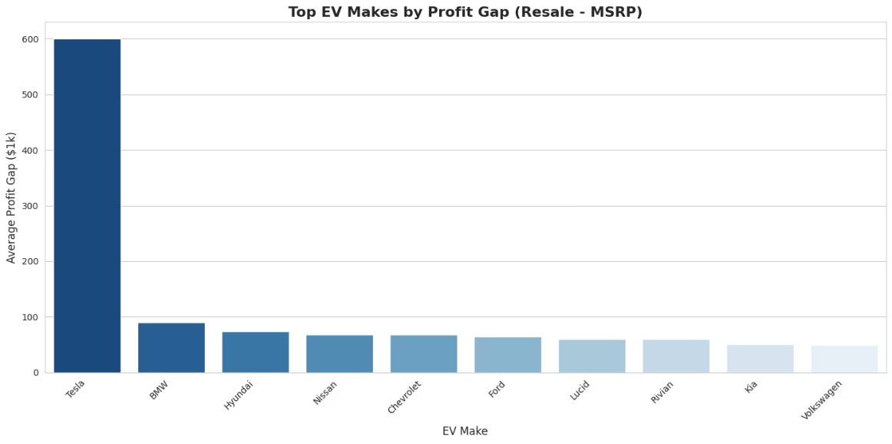
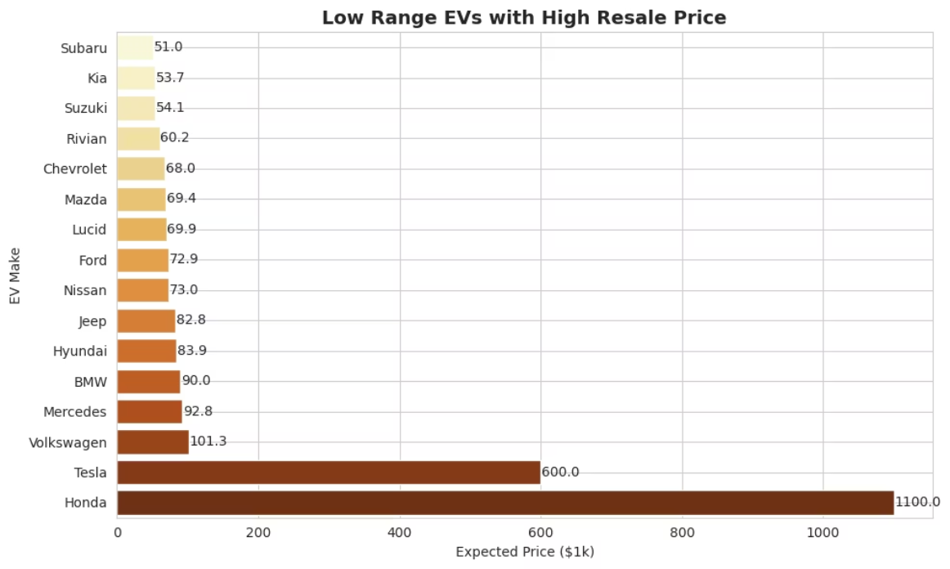
2 . Pricing Strategy
- Pricing Strategy (Range vs Price)
Profit Maximization – MSRP vs Resale Value
Interpretation
Interpretion
: Customer Education – Low Range, High Price
Resale value increases steadily with electric range up to 300 miles, peaking at ~$62.6k.
EVs like Hyundai, Ford, Nissan, and Chevrolet offer mid-level MSRP but still achieve strong resale prices — signaling underpricing relative to their actual market value.
interpretion
Vehicles with 151–300 mile ranges show the strongest pricing advantage, suggesting that buyers value long-range EVs.
After 300 miles, resale value starts to dip slightly (58.2k), and beyond 350 miles there’s no data in this dataset — possibly due to limited EV availability at that range during collection.
Tesla is far above others, which means it already captures value — but for the rest, there's a clear opportunity to raise MSRP slightly and boost manufacturer margins without hurting resale perception.
Background:
Some electric vehicles (EVs) in the dataset show a mismatch between their driving range and their high price. These are EVs that cost significantly more but offer less mileage per charge. This raises a concern for potential EV buyers who might misunderstand what they are paying for.
Business Recommendation
Business Recommendation
Manufacturers should optimize EV pricing within the 200–300 mile range — this is the sweet spot where customers are clearly paying more.
Data-Driven Insight:
Manufacturers like Hyundai, Ford, Nissan, and Chevrolet should review MSRP strategies — their vehicles are reselling higher than expected, signaling room for pricing adjustment.
Several EVs with premium pricing (e.g., over $50,000) still provide below-average range (e.g., <200 miles).
For models under 150 miles, pricing should be aggressively competitive, or paired with strong features (e.g., compact size, tech integration).
Dealers can increase profits by bundling value-adding features (extended warranty, premium battery, tech add-ons) to raise initial selling price while keeping perceived value intact.
Marketing teams can push the "value per mile" narrative around the 250–300 range segment.
Such pricing could be due to brand value, luxury features, or design rather than battery/range.
If EVs above 300 miles are in pipeline, brands should monitor future resale behavior as this data gap closes.
Tesla already leads the resale game — focus for them should shift to customer retention and premium upgrades rather than pricing.
Business Implications:
Manufacturer’s Suggested Retail Price(MSRP)
Consumers might perceive these cars as overpriced if they judge purely on mileage.
There is potential hesitation in adoption due to confusion or perceived unfair value.
Business Recommendations:
Educate Customers: Clearly communicate the value proposition of higher-priced EVs (e.g., safety, tech features, performance) beyond range.
Bundle Perks: Offer benefits like extended warranties, free charging credits, or luxury service packages to justify premium prices.
Transparent Marketing: Include visual comparisons in marketing materials showing where the extra cost goes (e.g., interior, software, build).
Final Thought: Helping customers understand why an EV with less range might still be worth the investment is key to boosting confidence and sales for premium EVs with lower mileage.

Slide 4
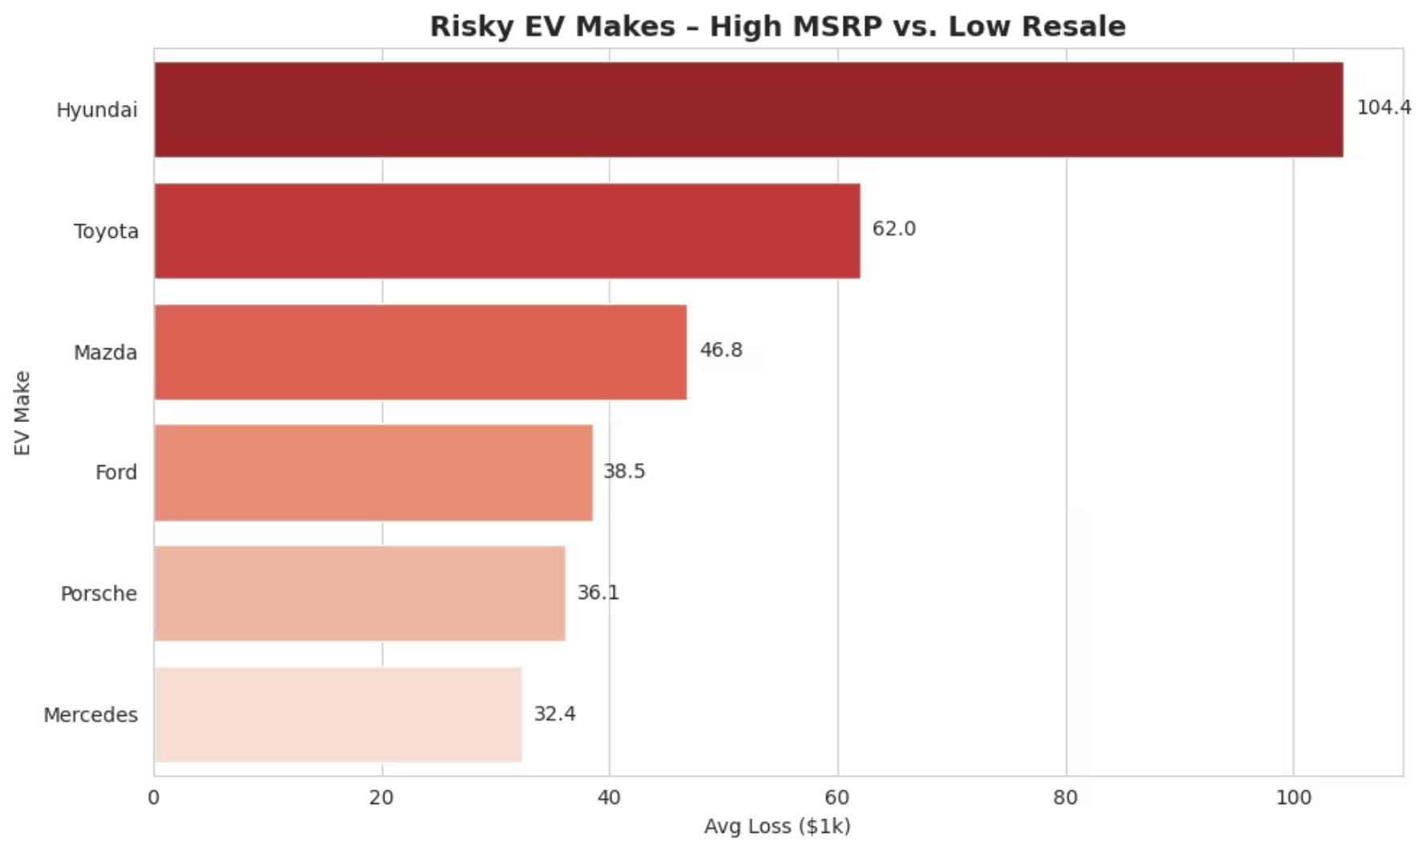
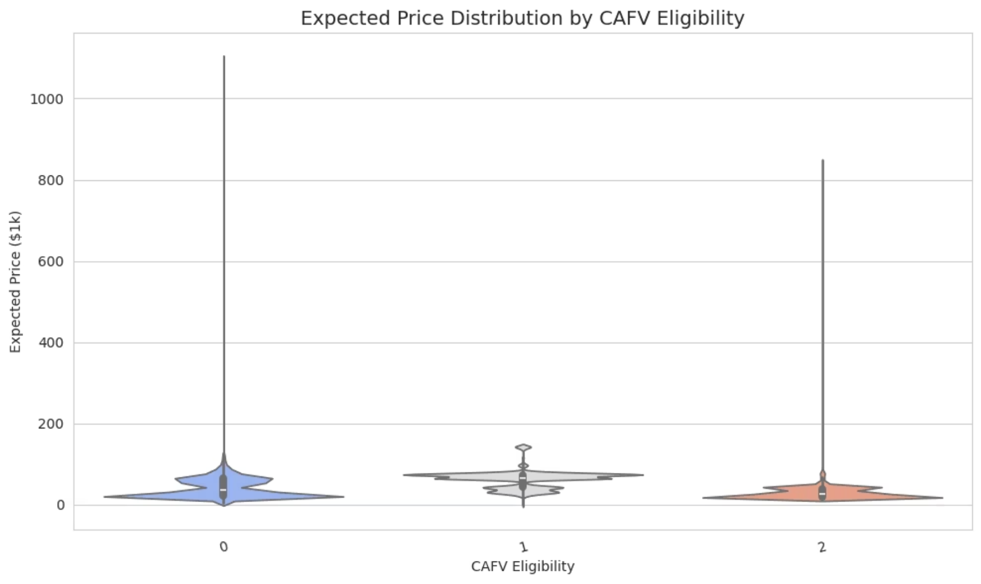
3.Risk & Credit Analysis
Risk Management – High MSRP, Low Price
credit risk assesment
(Manufacturer’s Suggested Retail Price(MSRP)
Can the CAFV eligibility status of electric vehicles help lenders identify potential credit risk by revealing price volatility patterns? Vehicles with high resale price variability may pose a financing risk to banks or leasing companies.
Interpretation:
Clean Alternative Fuel Vehicle(CAFV)
Hyundai shows the largest average loss between MSRP and resale, at over $100k — indicating serious overpricing or market mismatch.
INTERPRETATION
Toyota and Mazda also present a risk margin above $40k, suggesting weak resale strength relative to base cost.
🟢 CAFV Eligible (1)
Porsche and Mercedes, though luxury brands, also show depreciation that may not justify their MSRP in resale markets.
Business Recommendation
Higher resale prices (mean ≈ $62.3k)
Dealerships should limit stock of high-risk vehicles or apply deep discounting strategies to clear slow-moving units.
Very consistent: Std dev = 21.6
Manufacturers should re-evaluate MSRP or offer value upgrades (e.g., warranty, tech) to justify pricing.
Tightly packed: most cars between $43k–$73k
Risk analytics dashboards should be used in inventory planning to avoid high-loss vehicles.
Max reasonable: $142k
➡️ LOW risk group. Financing is safer.
🔴 Not Eligible (0)
Mid-level average price: $43.1k
High volatility: Std dev = 24.0
Huge outlier: $1.1M
Wider range: some are very cheap, some are oddly expensive
➡️ HIGHER risk group — unpredictable resale makes it risky for loans.
🟡 Not Applicable (2)
Lowest mean: $28.7k
Also volatile: Std dev = 15.4
Max is a big outlier again: $845k
Mostly low-end vehicles, with few luxury outliers
➡️ Unclear risk, but more affordable cars. Might be subprime loan risk.
HOW TO EXPLAIN THIS IN A SLIDE (with Violin Plot):
"This violin plot shows price distribution by CAFV Eligibility.
Vehicles that are CAFV eligible (blue) are not only more expensive, but also have less variance — making them more predictable and less risky for lenders.
On the other hand, vehicles that are not eligible (green) or not applicable (orange) show greater spread and extreme outliers, indicating price volatility and a higher credit risk for financing institutions.
This insight can help banks set stricter loan terms or require larger down payments for high-risk categories."

Slide 5
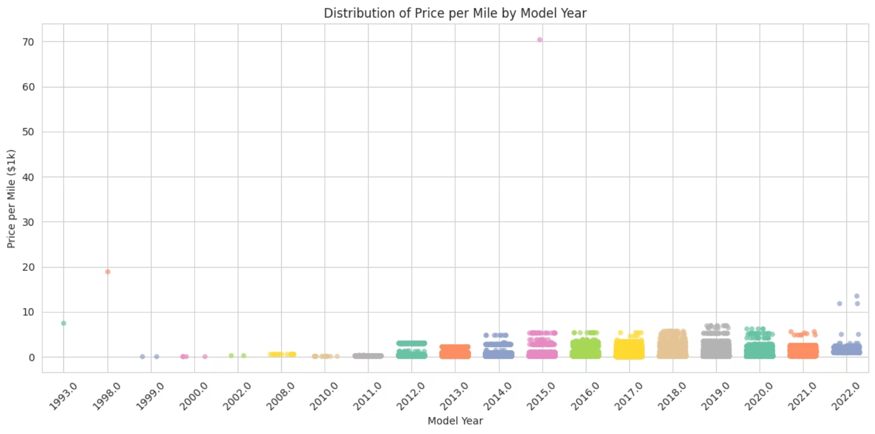
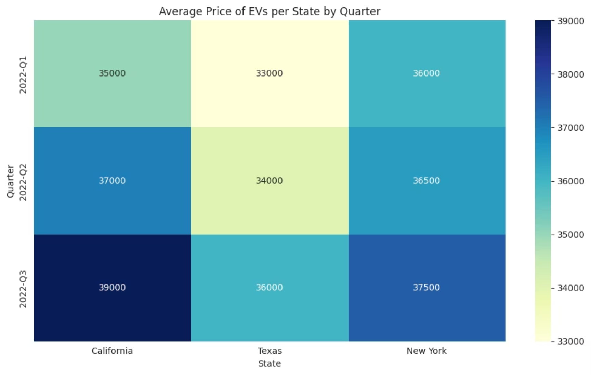
4️⃣ Sales & Inventory Planning
Sales Optimization
Interpretation
Very Old Cars (1993, 1998)
Average EV Price Distribution Across States and Quarter
Have Extremely High Price Per Mile Example: 1998 → 18.96, 1993 → 7.50 These are outliers, possibly due to very low mileage, meaning the price gets divided by a very small number. Could also reflect collector’s value or data errors (e.g., mileage not recorded properly).
Insights:
Regional Disparity in Pricing: California consistently has higher EV prices, likely due to higher demand, stronger EV adoption policies, and possibly luxury EV offerings.
Gradual Increase from 1999 to 2016
Quarterly Trends: EV prices in all three states show a general upward trend from Q1 to Q3.
From 1999 (0.03) to 2016 (0.61), there’s a steady upward trend. This suggests that newer used cars are becoming more expensive per mile, which is expected — they’ve had fewer miles and are closer to new condition. Example: 2010 = 0.11 → 2011 = 0.20 → 2015 = 0.47 → 2016 = 0.61
Price Stability in TX: Texas shows a slower price increase compared to CA and NY, hinting at either lower demand or more consistent pricing strategies.
Business Recommendations:
Recent Cars (2017–2022)
For Manufacturers:
Show Infinite Values These have Price_per_Mile = inf (infinity), which happens because mileage = 0. Likely they’re brand new or mileage was never entered. These values distort your plots and analysis and must be excluded or treated.
Prioritize launching premium EV models in California due to higher price tolerance.
Introduce budget EV models in Texas to tap into price-sensitive markets.
For Dealerships:
Business Recommendations
Stock more high-end EVs in CA and mid-range EVs in NY.
Fix 0 Mileage Issues→ Label new cars properly to avoid inf price/mile confusion.
Use competitive pricing strategies in TX to increase sales volume.
For Marketers:
Promote 2012–2016 Models→ They offer the best value — push them in ads and listings.
Emphasize sustainability and innovation in CA campaigns.
Highlight cost-efficiency and incentives in TX messaging.
Separate Classic/Collector Cars→ 1993 & 1998 cars have odd values; treat them differently.
This heatmap adds a valuable business layer to the EV project by guiding pricing, inventory, and regional strategies for different states based on real data patterns.
Show Price-per-Mile on Listings→ Helps buyers compare cars easily and boosts trust.
Clean Seller Inputs→ Make mileage required and auto-check for weird entries.
Use Price-per-Mile for Pricing Strategy→ Build a pricing model to guide fair listing prices.

