Slide 1
Toys & Games Virtual Hackathon
Presentation on Project: LIEGE LORD DABA
Team: EDUCON

Slide 2
Team Members Team: EDUCON
SL.No | Name
1. | Satwik Ghosh
2. | Koustav Ghosh
3. | Mainak Ghosh
4. | Anisha Ghoshal

Slide 3
History of Chess Game
The history of chess spans 1500 years.
The earliest predecessor of the game probably originated in India, before the 6th century AD.
From India the game spread to Persia, Arab and southern Europe.
Its early form in the 6th century was known as “chaturanga”, which translates as four divisions (of the military): infantry, cavalry, elephantry, and chariotry. These forms are represented by the pieces that would evolve into the modern pawn, knight, bishop, and rook respectively.

Slide 4
Abstract
Here are the reasons:
Improves memory
Develops perspective
Increases intelligence
Deepens focus
Elevates creativity
Boosts planning skills
Increases self-awarness
Protects against dementia
The game of chess is admired all over the world. From teens to aged, people gather in living rooms, pubs, plazas, and libraries to match wits over the cherished checkered board.
Why is it that people are willing to devote such time to the game?

Slide 5
Objectives of Chess
The objective in chess is to checkmate your opponent’s king, and there are four potential ways the game can end:
First, you can checkmate your opponent.
Second, you and your opponent can reach stalemate/draw.
In timed games, each player has a specific amount of time to make their moves.
Either player may resign at any time or their opponent wins the game.

Slide 6
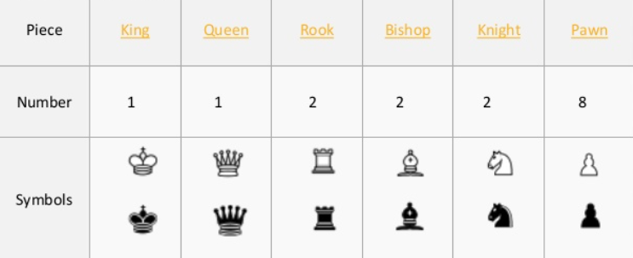
Setup of Chess Game
Chess is played on a chessboard, a square board divided into 64 squares (eight-by-eight) of alternating color, which is similar to that used in draughts (checkers) (FIDE 2008).
No matter what the actual colors of the board, the lighter-colored squares are called "light" or "white", and the darker-colored squares are called "dark" or "black".
Sixteen "white" and sixteen "black" pieces are placed on the board at the beginning of the game. Horizontal rows are called ranks and vertical rows are called files. Piece King Queen Rook Bishop Knight Pawn Number 1 1 2 2 2 8 Symbols

Slide 7
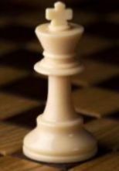
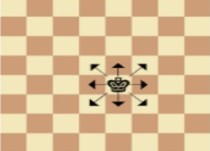
Pieces of Chess & Movements
KING
The king is the most important chess piece on the chessboard.
If he is checkmated the game is over!
The king moves exactly one square horizontally, vertically, or diagonally.

Slide 8
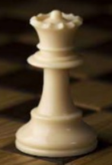
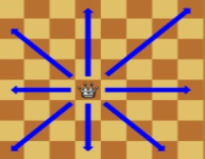
Pieces of Chess & Movements
QUEEN
Queen is considered the most powerful chess piece on the chessboard
She is placed next to the king on her own color.
The queen moves any number of vacant squares in a horizontal, vertical, or diagonal direction

Slide 9
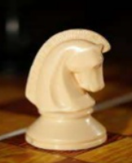
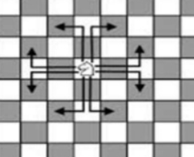
Pieces of Chess & Movements
KNIGHT
The knight is situated between the bishop and the rook.
These chess piece have the unique trait of being able to ‘leap’ over other chess pieces. They move “L” shape.
A knight moves to the nearest square not on the same rank, file, or diagonal.

Slide 10

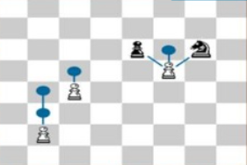
Pieces of Chess & Movements
PAWN
Each player has eight pawns, providing the first line of defense for their king.
In their first move, each pawn has the option to move one or two spaces. After this move they can only move one space forward. To capture, the pawn moves diagonally one space.
Pawn can never move backwards.

Slide 11
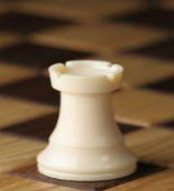
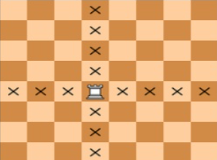
Pieces of Chess & Movements
ROOK
There are two rooks for each player on the chessboard, situated on the corners, next to the knight.
A rook moves any number of vacant squares in a horizontal or vertical direction. It also is moved when castling.

Slide 12
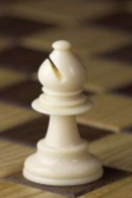
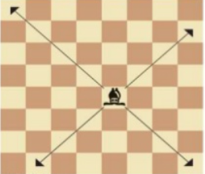
Pieces of Chess & Movements
BISHOP
It is situated next to the queen and king, respectively.
The bishop is bound to the color where it starts on. One bishop starts on White Square and the other starts on a black square.
A bishop moves any number of vacant squares in any diagonal direction.

Slide 13
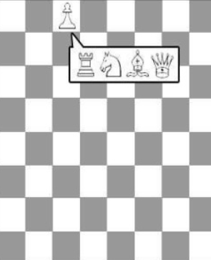
Pieces of Chess & Movements
PAWN PROMOTION
If a player advances a pawn to its eighth rank, the pawn is then promoted (converted) to a queen, rook, bishop, or knight of the same color at the choice of the player (a queen is usually chosen).

Slide 14
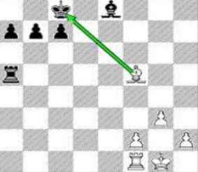
Pieces of Chess & Movements
CHECK
A king is in check when it is under attack by at least one enemy piece. A piece unable to move because it would place its own king in check (it is pinned against its own king) may still deliver check to the opposing player.

Slide 15
Implementation Plan of Chess Game using Python
Our chess Game project is written in Python. The project file contains image files and python scripts (chess.py). GUI uses pygame library. Talking about the gameplay, its a strategy board game between a Player and AI. There’s a colored checkered gameboard with 64 Squares arranged in an 8x8. The chess board contains different color each time the player starts the game. During the gameplay, at some point, the AI might take a bit time for its movement. Whenever the AI that plays against the human evaluates all possible moves made by either player up to a certain level of depth.

Slide 16
Design
A simple and clean GUI is provided for easy gameplay. The gameplay design is so simple that the user won’t find it difficult to use and understand. Different images are used in the development of this game project, the gaming environment is just like the real chess board game. In order to run the project, you must have installed Python and Pygame on your PC.

Slide 17
Data Structure in Chess Game
This program is a chess game. The user may play against a friend or the computer.
The game state is mainly stored as a 2D list of strings, and most of the processing is thus done on a list of strings.
The GUI takes the current state and displays it on the screen. The GUI allows drag and drop movement of pieces as well as click-click movement.
The Data Structure used here is a Search tree(in AI Mode).
Other Data Structures Used:
2D List: For storing state of game.
List: For Storing all possible moves in AI mode.
Dictionary: For storing results from Alpha-beta pruning & Transposition Table.

Slide 18
Algorithm for Chess Game
1. Alpha-beta pruning:
Alpha-beta pruning is a modified version of the minimax algorithm. It is an optimization technique for the minimax algorithm.Alpha-beta pruning can be applied at any depth of a tree, and sometimes it not only prune the tree leaves but also entire sub-tree.
The two-parameter can be defined as:
a. Alpha: The best (highest-value) choice we have found so far at any point along the path of Maximizer. The initial value of alpha is -∞.
b. Beta: The best (lowest-value) choice we have found so far at any point along the path of Minimizer. The initial value of beta is +∞

Slide 19
Algorithm for Chess Game
2. Transposition table:
A transposition table is a cache of previously seen positions, and associated evaluations, in a game tree generated by a computer game playing program. If a position recurs via a different sequence of moves, the value of the position is retrieved from the table, avoiding re-searching the game tree below that position.
Often, two different pathways in a search tree can result in the same board being evaluated. Instead of evaluating the same board several times, the program stores a table of values in a dictionary where the keys are the positions. This way, repeated positions can have their evaluations looked up fairly quickly, as the board state is hashed.

Slide 20
Algorithm for Chess Game
3. Opening Book -
Chess programs often look up the positions at the beginning of the game in an Opening Book. The opening database can then be used as long as the opponent plays a new move from the database, so usually more common opening lines will be stored to a much higher depth than the uncommon ones. As soon as the program is "out of book" it has to continue using the normal search routines.
The opening book is again a dictionary that stores boardpositions often seen in the beginning few moves in chess. Appropraite moves that can be played at such positions is stored in the dictionary. A random move is selected and played from the list of suggested moves wihtout searching if the AI finds itself confronting a such a board postion. Note that this opening book was recorded by myself and so it does not have many positions stored in it.

Slide 21
THANK YOU

