Slide 1
Predicting Heart Disease Using Machine Learning and IoT
M. Varshitha

Slide 2

Abstract
Heart disease is a leading cause of death worldwide.
• This study integrates Machine Learning (ML) and IoT to predict heart disease.
• Algorithms: Support Vector Machine (SVM),Gradient Boosting, Random Forest, KNN.
• IoT-based real-time monitoring enhances accuracy and timely intervention.

Slide 3
Introduction
• Traditional methods of diagnosis can be inaccurate and expensive.
• Machine Learning improves prediction accuracy using fewer attributes.
• IoT enables real-time monitoring, making healthcare proactive rather than reactive.

Slide 4
Literature Survey
• ML models used in previous studies: Naïve Bayes, Decision Trees, Neural Networks.
• IoT applications in healthcare are emerging.
• Challenges: Cost, accessibility, and efficiency in ML-based healthcare solutions.

Slide 5
Identified Problem
• High cost and inefficiency of traditional heart disease diagnosis.
• Lack of integration between Machine Learning models and IoT-based monitoring.

Slide 6
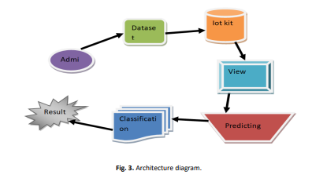
Methodology
1. Data Collection: UCI Heart Disease dataset.
2. Data Preprocessing: Handling missing values, feature selection.
3. Model Training: SVM, Gradient Boosting, Random Forest, KNN.
4. Performance Evaluation: Accuracy comparison.
5. IoT Integration: Real-time patient monitoring via sensors.

Slide 7
Proposed Solution
Machine Learning-Based Prediction:
Uses Gradient Boosting, SVM, KNN and Random Forest for heart disease prediction.
IoT-Enabled Real-Time Monitoring:
Wearable sensors track ECG, heart rate, and blood pressure.
Data is transmitted in real-time for continuous health tracking.
Hybrid System for Early Detection:
ML models analyze patient data for risk assessment.
Enhanced Accuracy & Efficiency:
Reduces dependency on costly and time-consuming traditional diagnosis.
Provides a scalable, accessible, and cost-effective healthcare solution.

Slide 8
Conclusion
• Combining Machine Learning and IoT enhances heart disease prediction.
• Random Forest proved to be the most effective model with 98.5% accuracy.
• Future advancements will focus on improving ML models and expanding IoT capabilities.

Slide 9
References
Han J, Kamber M, Pei J. Data Mining: Concepts & Techniques.
Palani appan S, Awang R. Intelligent Heart Disease Prediction System.
Sultana M, Haider A. Data Mining Techniques for Heart Disease Prediction.
Xu S, Zhang Z. Cardiovascular Risk Prediction Framework.

Slide 10


