Slide 1
The Ramifications of ISO/IEC 5230 and ISO/IEC 18974 for Legal Professionals in 2024

Slide 2

ISO/IEC 5230:2020 Open Source License Compliance

Slide 3

ISO/IEC 18974:2023 Open Source Security Assurance

Slide 4
Sister Standards - Processes for Programs
ISO/IEC 5230 (License Compliance)
Scopable program size
Addresses inbound processes
Addresses internal policy, training, process
Addresses outbound processes
Focus on process point
Avoids prescriptive process content
ISO/IEC 18974 (Security Assurance)
Scopable program size
Addresses inbound processes
Addresses internal policy, training, process
Addresses outbound processes
Focus on process point
Avoids prescriptive process content

Slide 5
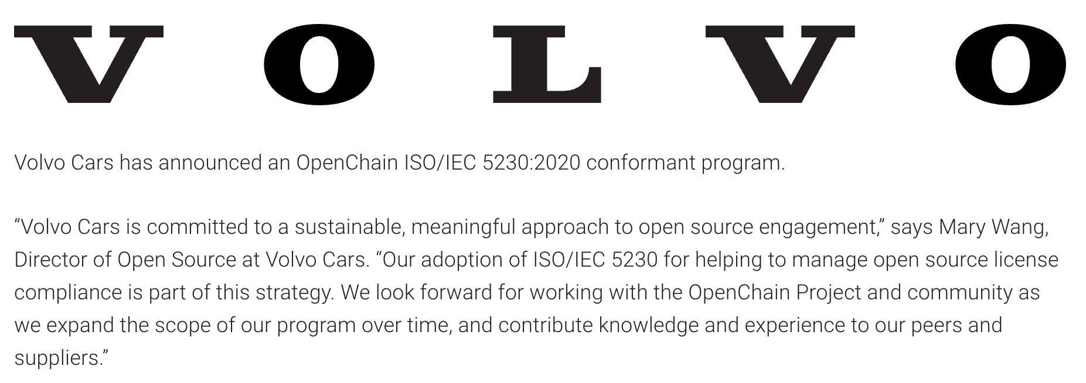
A Continual Heartbeat Of Adoption

Slide 6
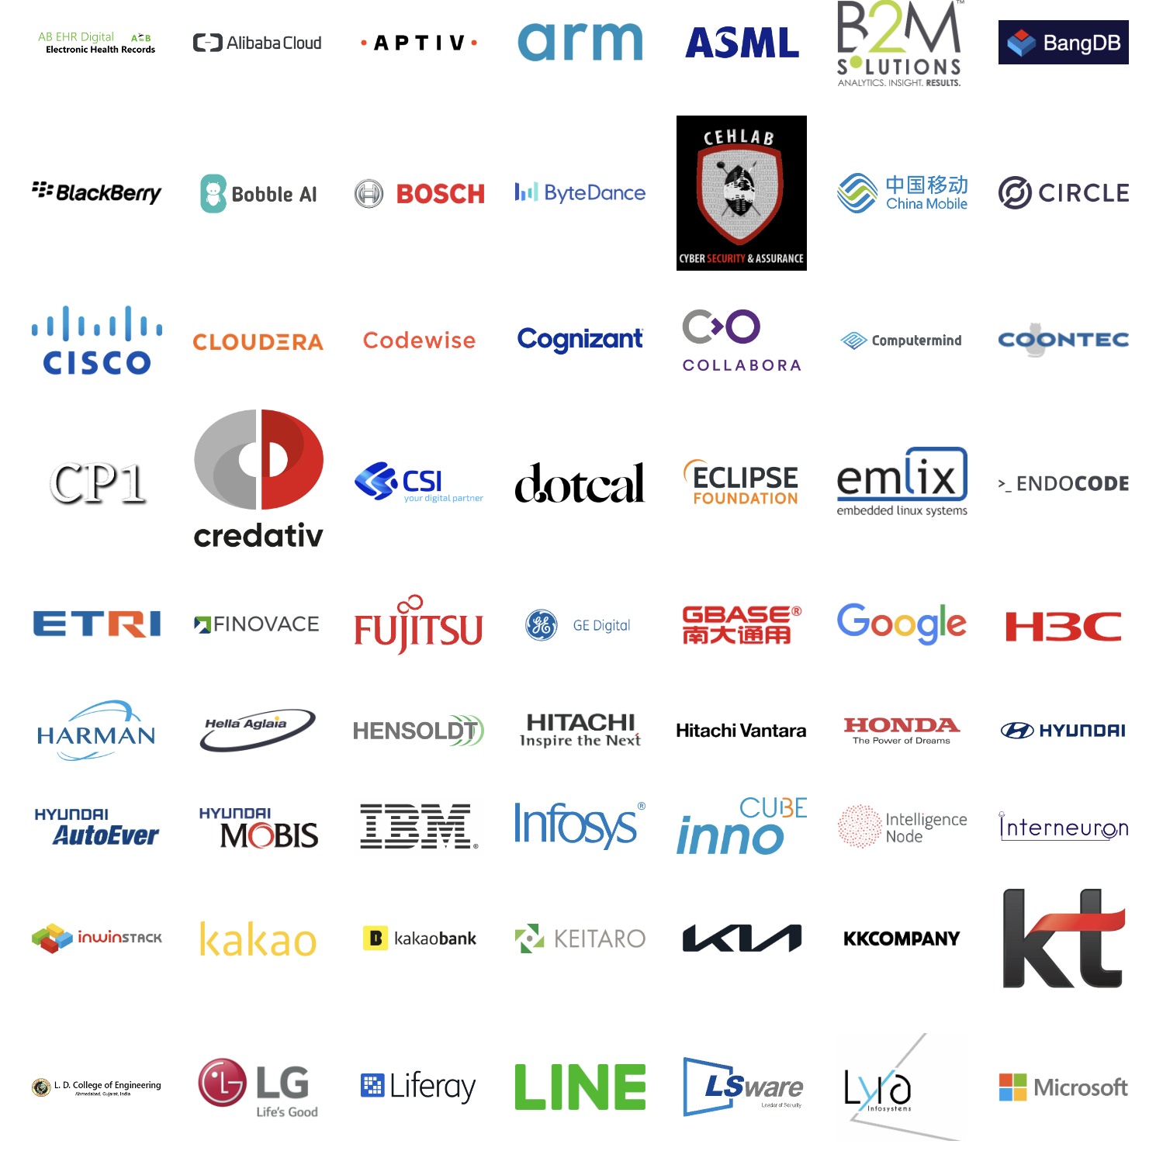
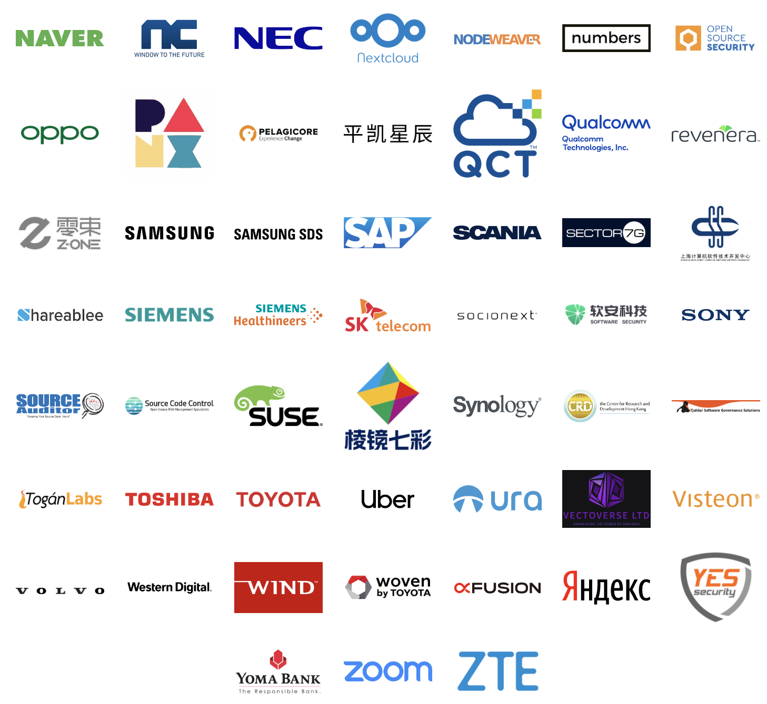
A Growing Public Community Of Conformance

Slide 7

31%
Data Point
of large German companies already use or plan to adopt OpenChain ISO/IEC 5230
Source PwC: https://tinyurl.com/openchain-germany-31

Slide 8
One utility of ISO standards is that they act as reputable shorthand in discussions, negotiations and contracts, allowing everything from “document format” to “quality program” to be communicated easily. The OpenChain standards are the international baseline for quality in open source license compliance or security assurance programs.

Slide 9
Procurement Negotiations
ISO/IEC 5230 and ISO/IEC 18974 provide a simple “ask” in procurement negotiations across all industry verticals.
In 2024 we expect:
Increased normalization of industry standards instead of bespoke approaches for open source procurement
More extensive use of OpenChain standards in procurement
The emergence of more support for legal professionals in this area

Slide 10
Mergers and Acquisitions
ISO/IEC 5230 and ISO/IEC 18974 provide a “floor” for understanding the governance approach of an M&A target with regards to open source.
In 2024 we expect:
More legal professionals using OpenChain standards in their default M&A toolkit
A rise in the quality of startup / small entity open source governance
More documentation or case studies around the use of OpenChain standards in this area

Slide 11
Supply Chain Management
ISO/IEC 5230 and ISO/IEC 18974 have been making it easy for customer companies to describe a baseline for open source license compliance and security assurance.
In 2024 we expect:
Increased supply chain requests for OpenChain conformant programs
Emergance of open source maturity models favoring OpenChain standards
More government policies referencing OpenChain standards

Slide 12
Addressing the CRA
Interestingly, given the amount of discussion around the Cyber Resiliency Act (CRA) and open source, it is pretty simple from the OpenChain optic.
In 2024:
The OpenChain standards to inherently support the fundamental concept of improved record-keeping around software, given the complementary requirements of ISO/IEC 5230 and ISO/IEC 18974 to create and archive verification materials related to open source license compliance and security assurance.

Slide 13
Working With SPDX ISO/IEC 5962 + Future SPDX
ISO/IEC 5230 and ISO/IEC 18974 require that organizations have a bill of materials for open source software passing through conformant programs. They inherently align with SPDX ISO/IEC 5962.
In 2024 we expect:
The SPDX Project to release SPDX 3.0, which provides the foundation for an updated version of SPDX ISO/IEC 5962:2021 (release TBD).
The SPDX 3.0 profile approach to provide enhanced integration with ISO/IEC 5230 and ISO/IEC 18974 for interested parties.

Slide 14
We are also compatible with all other SBOM formats

Slide 15

Existing Reference Material
The OpenChain Project has extensive reference material on GitHub:
Reference open source training slides
Policy template material
Supplier education material
Self-certification checklists and questionnaires
+ many, many more documents

Slide 16

80+
Data Point
Webinars covering all aspects of open source management and governance
https://openchainproject.org/webinars

Slide 17

Forthcoming Reference Material
The OpenChain Project is developing new reference material for 2024:
Updated training slides
Updated supplier education materials
SBOM quality guide
“Explainers” for different business roles
Maturity models

Slide 18

Community Support
Main Work Groups
Specification (Spring 2016~)
Education (Autumn 2020~)
Community Work Groups
Tooling (Summer 2019~)
Export Control (Winter 2022~)
Public Policy (Winter 2022~)
Community Study Groups
AI (January 2024~)
Industry-Specific Work Groups
Automotive (Summer 2019~)
Telecom (Spring 2021~)
Regional User Groups
Japan (Dec 2017~)
Korea (Jan 2019~)
India (Sept 2019~)
China (Sept 2019~)
Taiwan (Sept 2019~)
Germany (Jan 2020~)
UK (June 2020~)

Slide 19

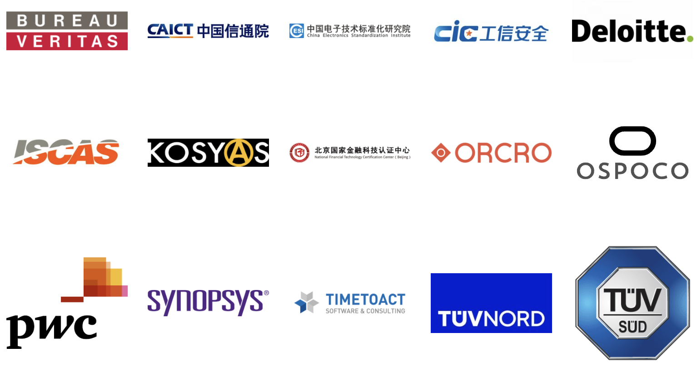
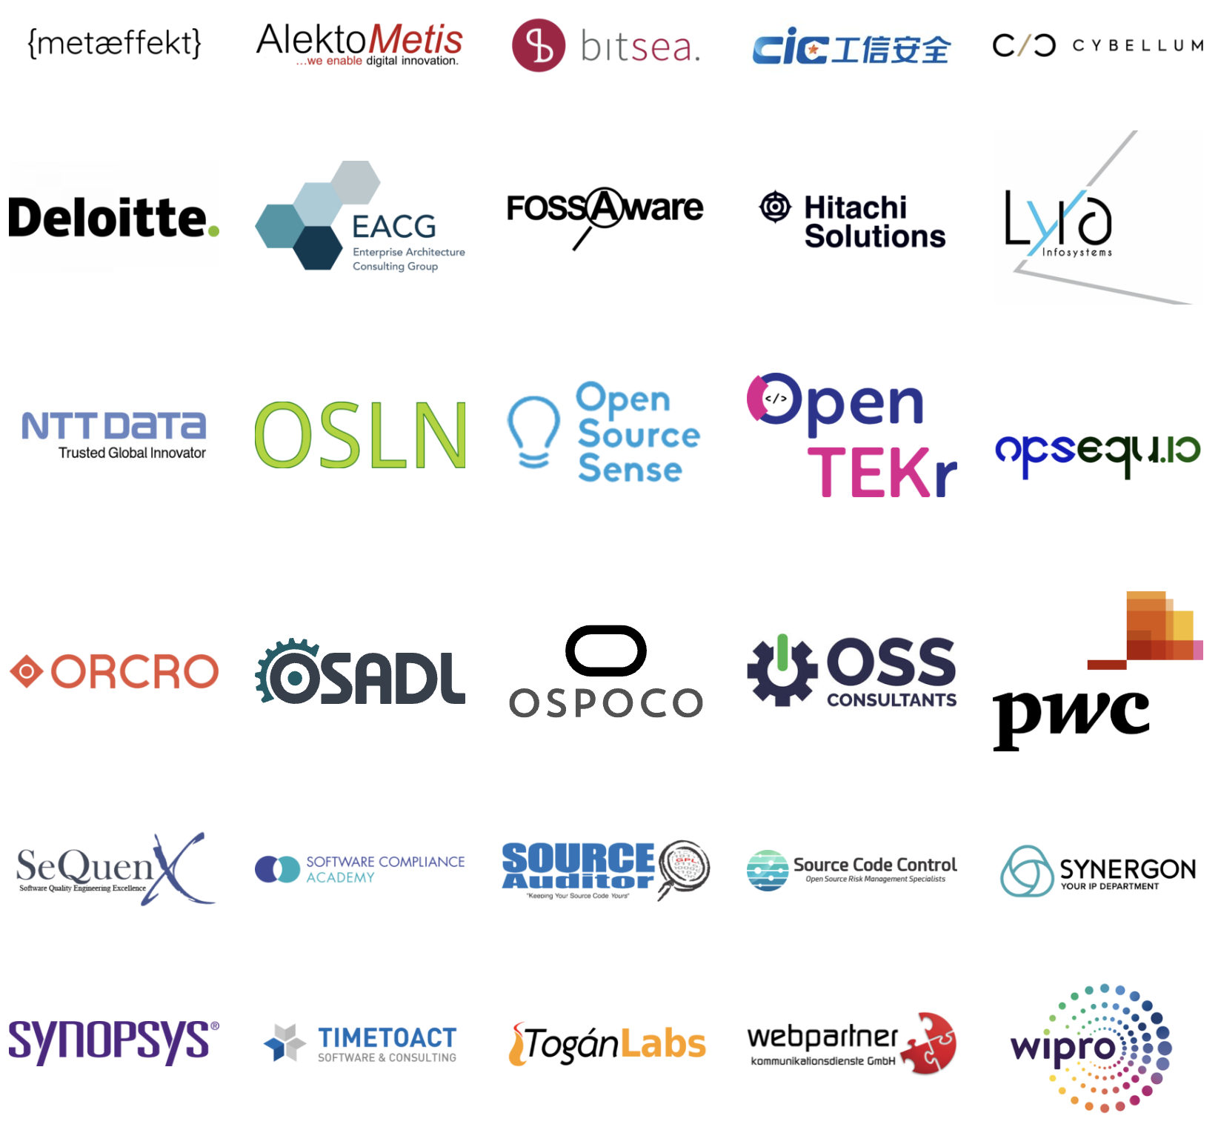

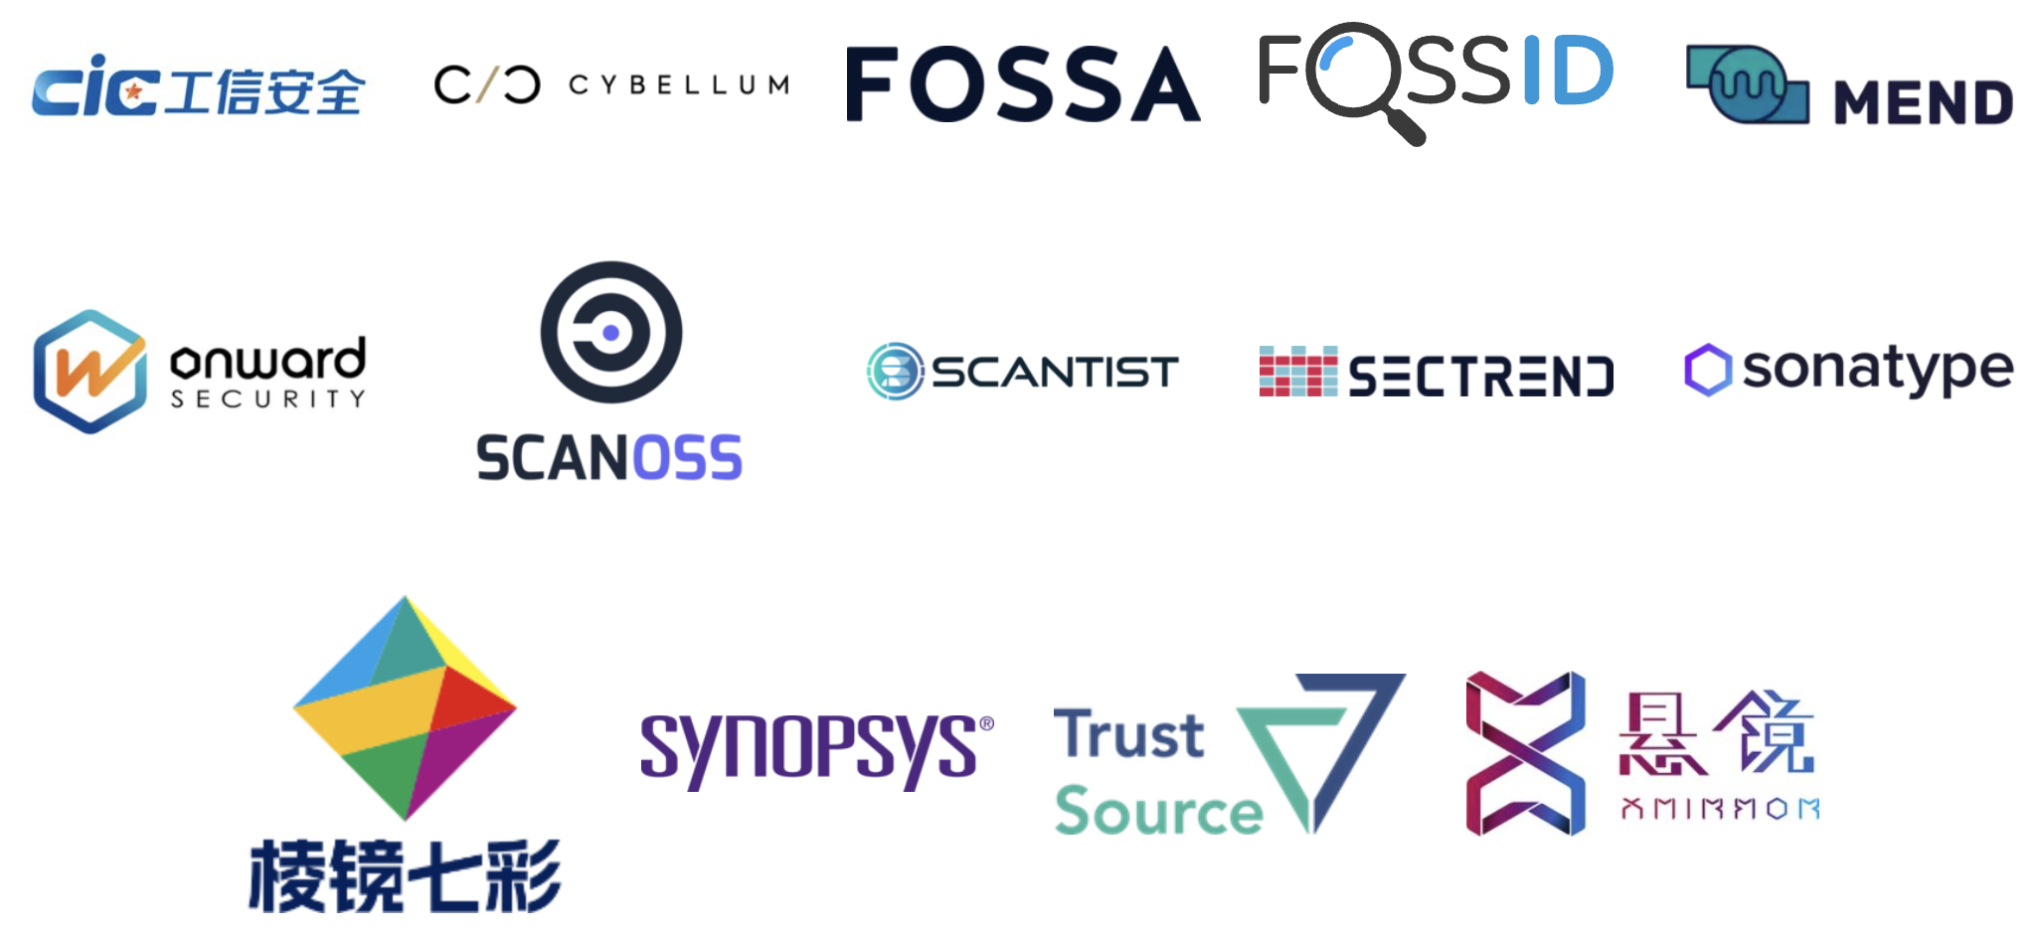
Commercial Support
Legal Providers
Third-Party Certification
Consultancies
Tooling / Automation

Slide 20
What Is Coming Next For The Market?
There has been a steady, inevitable trend for open source in the business domain:
Open source is becoming more professional
Open source is becoming more accountable
Open source is becoming more sustainable
In 2024 we expect this trend to bring open source closer to traditional Software Asset Management (SAM).

Slide 21
OpenChain will support the continued evolution of professional open source management

Slide 22
Current Versions of OpenChain Standards
Licensing Specification (CURRENT VERSION, 2nd Generation, ISO 5230): https://github.com/OpenChain-Project/License-Compliance-Specification/blob/master/2.1/en/openchainspec-2.1.md
Security Specification (CURRENT VERSION, 1st Generation, ISO 18974): https://github.com/OpenChain-Project/Security-Assurance-Specification/blob/main/Security-Assurance-Specification/1.1/en/openchain-security-specification-1.1.md

Slide 23
Draft Future Versions of Licensing / Security
Licensing Specification (3rd Generation Draft): https://github.com/OpenChain-Project/License-Compliance-Specification/blob/master/Official/en/3.0/openchain-license-compliance-3.0.md
Security Specification (2nd Generation Draft): https://github.com/OpenChain-Project/Security-Assurance-Specification/blob/main/Security-Assurance-Specification/2.0/en/openchain-security-specification-2.0.md

Slide 24
Next Steps: Licensing / Security
The draft next generation License Compliance specification and Security Assurance specification have open issues for review.
Licensing: https://github.com/OpenChain-Project/License-Compliance-Specification/issues/
Security: https://github.com/OpenChain-Project/Security-Assurance-Specification/issues/

Slide 25
Track This: Our Monthly Calls
Our current Specification Work Group Chair is Chris Wood, Fellow at Lockheed Martin.
Chris and the rest of the Work Group host:
One call for North America / Europe per month
One call for North America / Asia per month
Everyone is welcome to join, welcome to contribute

Slide 26
OpenChain will also support conversations around new areas of open collaboration and governance

Slide 27

Introducing Our AI Compliance Study Group
Since January 2024 the OpenChain Project has facilitated an AI Compliance Study Group.
They are focused on:
Determining commonalities in AI Compliance in the Supply Chain
Assessing whether these commonalities are suitable for development into reference material
And ensuring all voices are heard

Slide 28
Let’s Wrap Up: Global Impact 2023

Slide 29
100%
Data Point
Increase in standards maintained

Slide 30
100%
Data Point
Increase in third-party certifiers

Slide 31

Massively Improved Self-Certification
And…

Slide 32
This is just a taste of developments… Every other metric increased positively as well

Slide 33
In 2024…
ISO/IEC 5230 and ISO/IEC 18974 will continue to assist in the professionalization of the supply chain
There will be specific impact in procurement, M&A and supply chain management
There will be a growing corpus of material to assist with all adoptors, including specific items useful for legal professionals

Slide 34

Let’s Talk More
Shane Coughlan
scoughlan@linuxfoundation.org +81 80 4035 8083

