Slide 1

Apache Hadoop
Large scale data processing
Speaker: Isabel Drost
TM

Slide 2
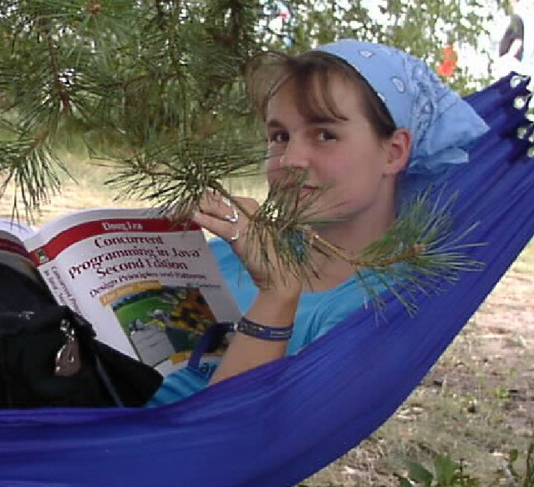
Isabel Drost
Nighttime:
Co-Founder Apache Mahout.
Organiser of Berlin Hadoop Get Together.
Organiser Berlin Buzzwords.
Daytime:
Software developer

Slide 3
Agenda
Collecting and storing data.
Tour of Hadoop.
Analysing data.
Hadoop ecosystem.

Slide 4
Collecting and storing data.

Slide 5
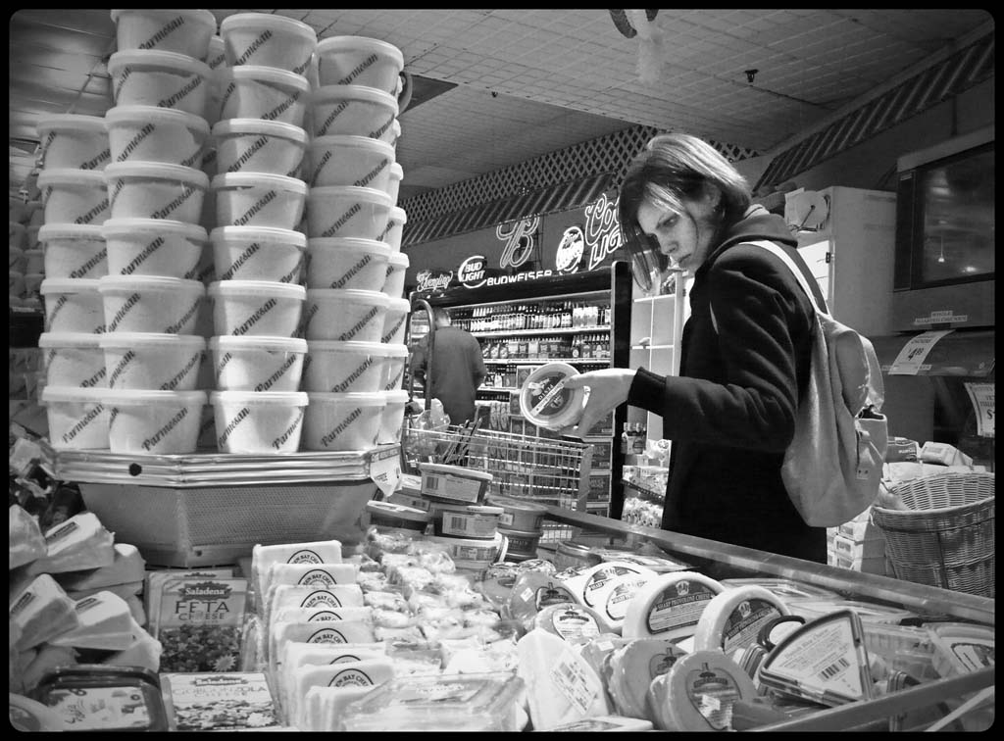
By Lab2112, http://www.flickr.com/photos/lab2112/462388595/

Slide 6



Data storage options
Data storage options
Structured, relational.
  Customer data.
  Bug database.

Slide 7

By bareform, http://www.flickr.com/photos/bareform/2483573213/

Slide 8

January 8, 2008 by Pink Sherbet Photography
http://www.flickr.com/photos/pinksherbet/2177961471/
Massive data as in:
Cannot be stored on single machine.
Takes too long to process in serial.
Idea: Use multiple machines.

Slide 9
Challenges when scaling out.

Slide 10

Single machines tend to fail:
Hard disk.
Power supply.
...

Slide 11
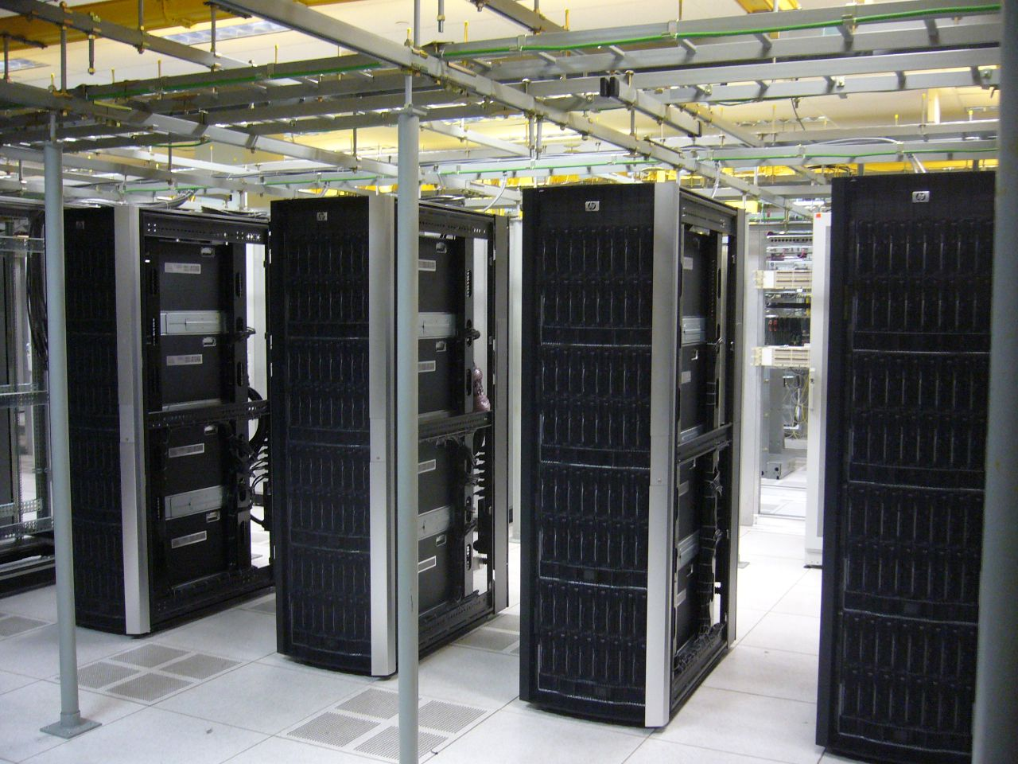
More machines – increased
failure probability.
January 11, 2007, skreuzer
http://www.flickr.com/photos/skreuzer/354316053/

Slide 12
Requirements
Built-in backup.
Built-in failover.

Slide 13
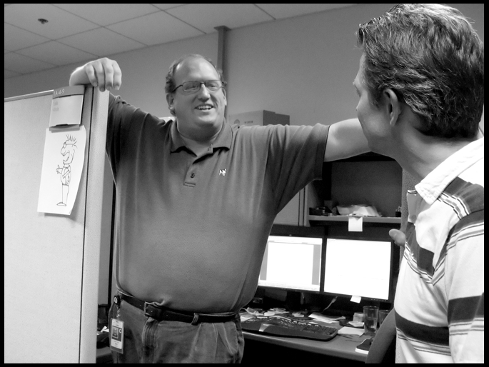
Typical developer
Has never dealt with large (petabytes) amount of data.
Has no thorough understanding of parallel programming.
Has no time to make software production ready.
September 10, 2007 by .sanden.
http://www.flickr.com/photos/daphid/1354523220/

Slide 14
Requirements
Built-in backup.
Built-in failover.
Easy to use.
Parallel on rails.

Slide 15

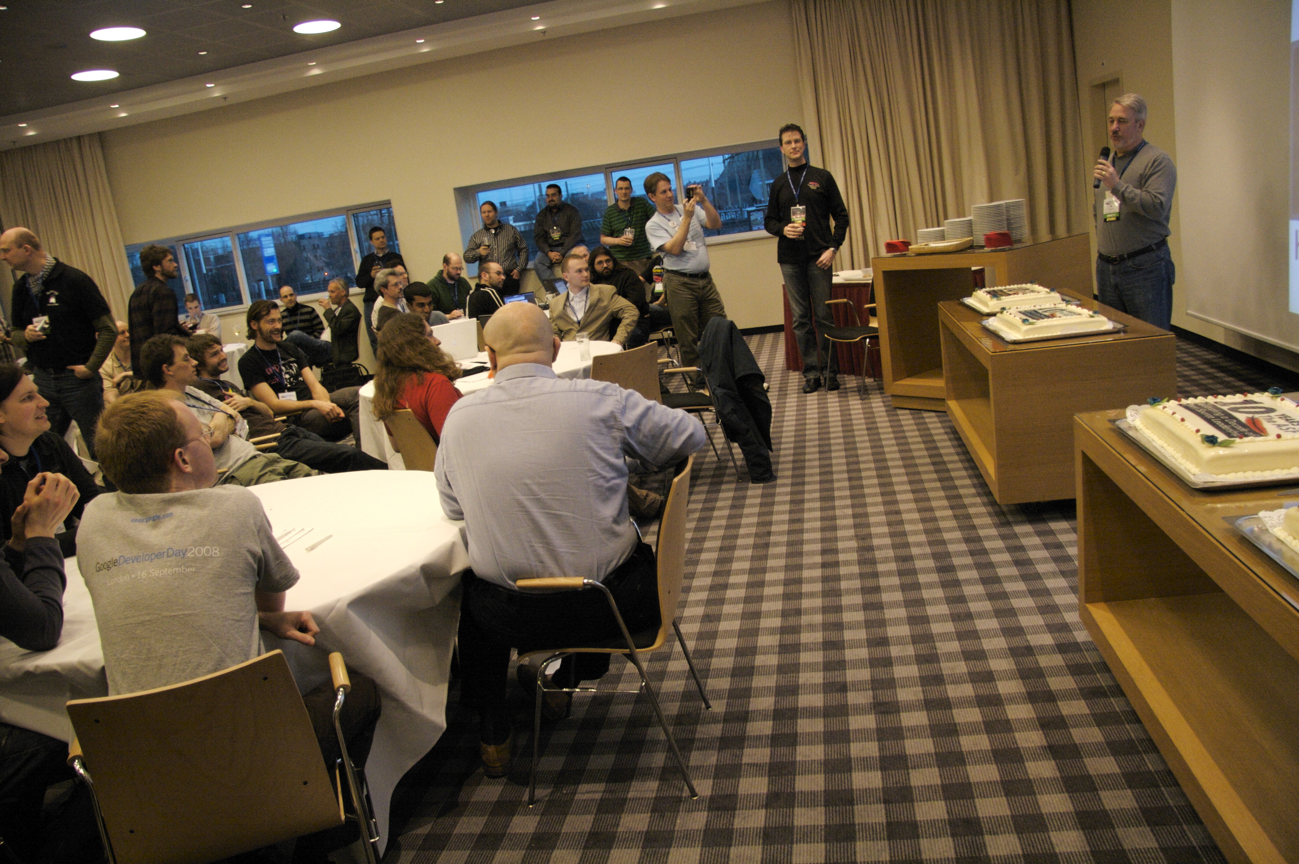
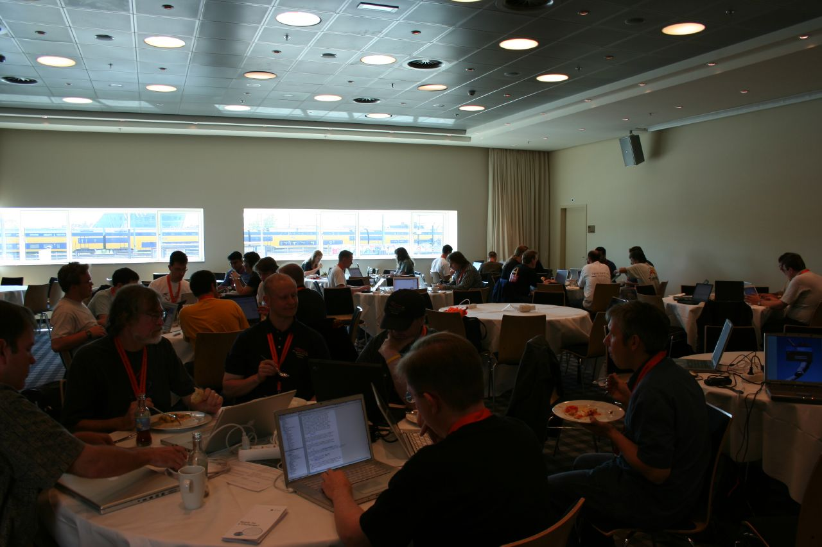
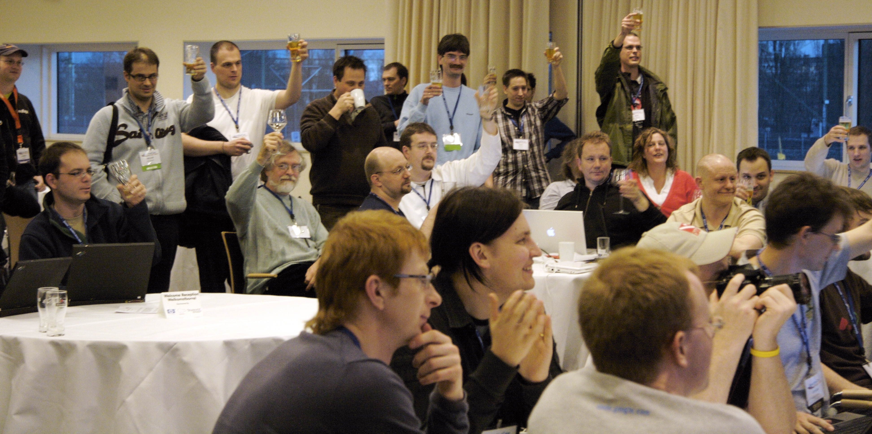
http://www.flickr.com/photos/jaaronfarr/3384940437/
March 25, 2009 by jaaron
Picture of developers / community
February 29, 2008 by Thomas Claveirole
http://www.flickr.com/photos/thomasclaveirole/2300932656/
http://www.flickr.com/photos
/jaaronfarr/3385756482/
March 25, 2009 by jaaron
May 1, 2007 by danny angus
http://www.flickr.com/photos/killerbees/479864437/

Slide 16
Requirements
Built-in backup.
Built-in failover.
Easy to use.
Parallel on rails.
Active development.

Slide 17

http://www.flickr.com/photos/cspowers/282944734/ by cspowers on October 29, 2006

Slide 18
Requirements
Built-in backup.
Built-in failover.
Easy to administrate.
Single system.
Easy to use.
Parallel on rails.
Active development.

Slide 19
Easy distributed programming.
Well known in industry and research.
Scales well beyond 1000 nodes.
TM

Slide 20
Some history.

Slide 21
Feb '03 first Map Reduce library @ Google
Oct '03 GFS Paper
Dec '04 Map Reduce paper
Dec '05 Doug reports that nutch uses map reduce
Feb '06 Hadoop moves out of nutch
Apr '07 Y! running Hadoop on 1000 node cluster
Jan '08 Hadoop made an Apache Top Level Project

Slide 22
Apache Hadoop assumptions

Slide 23

Assumptions:
Data to process does not fit on one node.
Each node is commodity hardware.
Failure happens.
Ideas:
Distribute filesystem.
Built in replication.
Automatic failover in case of failure.
January 16, 2005 by JohnSeb
http://www.flickr.com/photos/johnseb/3425464/

Slide 24
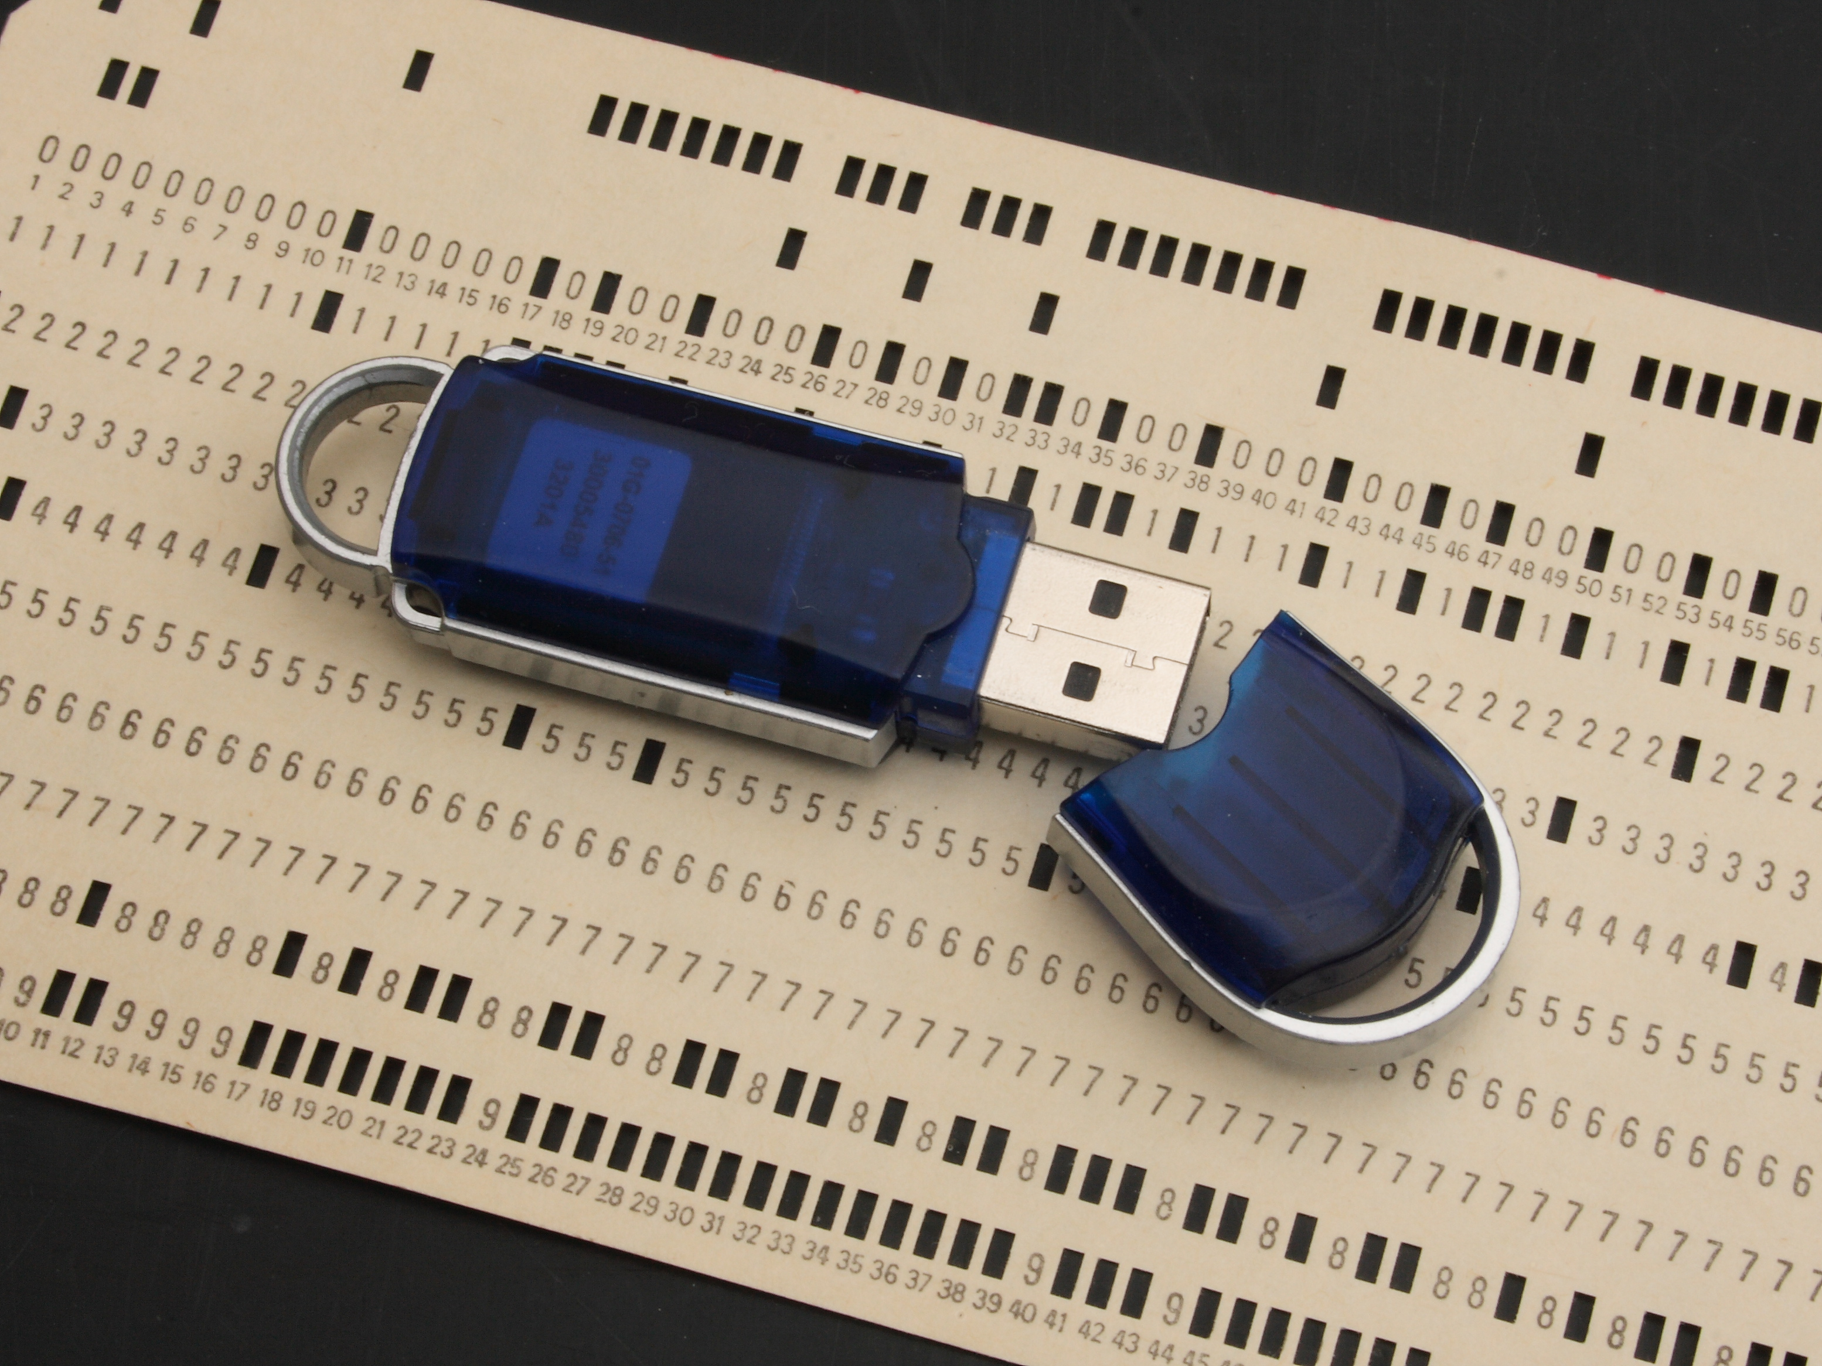
Assumptions:
Distributed computation is easy.
Moving computation is cheap.
Moving data is expensive.
Ideas:
Move computation to data.
Write software that is easy to distribute.
December 31, 2007 by Ian-S
http://www.flickr.com/photos/ian-s/2152798588/

Slide 25

Assumptions:
Systems run on spinning hard disks.
Disk seek >> disk scan.
Ideas:
Improve support for large files.
File system API makes scanning easy.
August 27, 2007 by Stuart Bryant
http://www.flickr.com/photos/stuartbryant/1249649001/

Slide 26


TM
TM

Slide 27
HDFS building blocks
TM

Slide 28
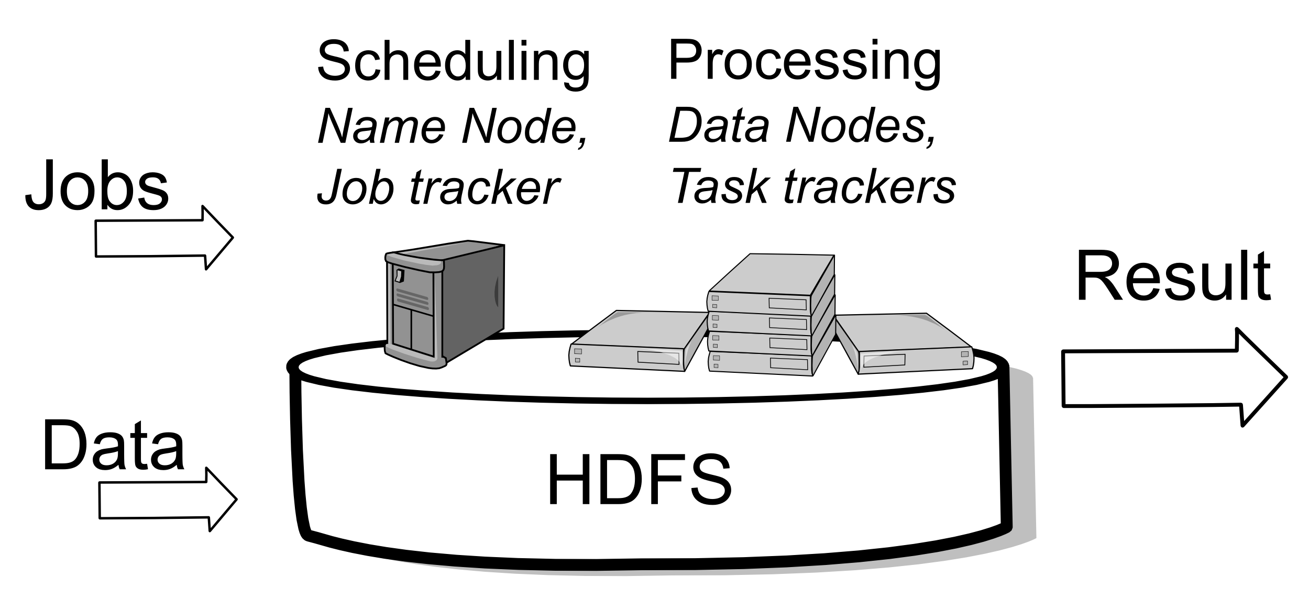
(Graphics: Thanks to Thilo.)

Slide 29
NameNode
  Stores file meta data.
  In memory.
  Block-node mapping.
DataNode
  Stores file contents.
  On disk.
  Block-Id to disk.

Slide 30
Anatomy of a file write
HDFS client
Client node
Slide inspired by: “Hadoop – The definitive guide”, Tom White, O'Reilly

Slide 31
Anatomy of a file write
HDFS client
Name Node
Create file
Close file
Client node
Slide inspired by: “Hadoop – The definitive guide”, Tom White, O'Reilly

Slide 32
Anatomy of a file write
HDFS client
Name Node
Create file
Close file
Client node
Write packet
Ack packet
Data Node
Slide inspired by: “Hadoop – The definitive guide”, Tom White, O'Reilly

Slide 33
Anatomy of a file write
HDFS client
Name Node
Create file
Close file
Client node
Write packet
Ack packet
Data Node
Data Node
Data Node
Slide inspired by: “Hadoop – The definitive guide”, Tom White, O'Reilly

Slide 34
HDFS Replication Strategy
Rack
Rack
Datacenter
Slide inspired by: “Hadoop – The definitive guide”, Tom White, O'Reilly

Slide 35
Anatomy of a file read
HDFS client
Client node
Slide inspired by: “Hadoop – The definitive guide”, Tom White, O'Reilly

Slide 36
Anatomy of a file read
HDFS client
Name Node
Open file
Close file
Client node
Slide inspired by: “Hadoop – The definitive guide”, Tom White, O'Reilly

Slide 37
Anatomy of a file read
HDFS client
Name Node
Open file
Close file
Client node
Read blocks
Data Node
Read blocks
Data Node
Read blocks
Data Node
Slide inspired by: “Hadoop – The definitive guide”, Tom White, O'Reilly

Slide 38
Analyse and understand your data.

Slide 39
Map/Reduce by example
TM

Slide 40
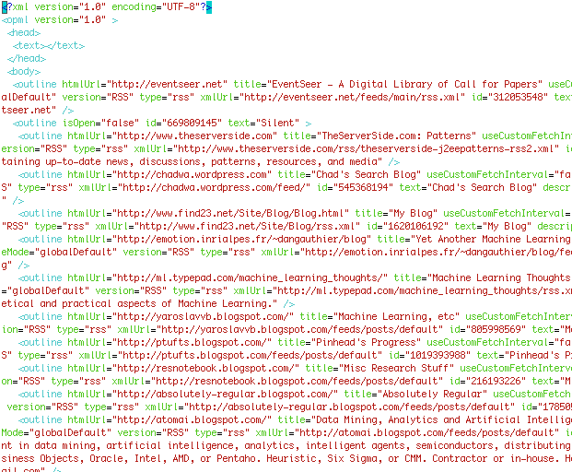

Slide 41
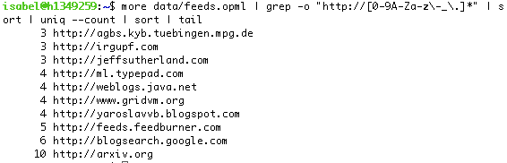

Slide 42
pattern=”http://[0-9A-Za-z\-_\.]*”
grep -o "$pattern" feeds.opml
| sort
| uniq --count
TM

Slide 43
pattern=”http://[0-9A-Za-z\-_\.]*”
grep -o "$pattern" feeds.opml
| sort
| uniq --count
M A P
| SHUFFLE
| R E D U C E
TM

Slide 44
Input
Map
Map
Map
Map
Map

Slide 45
Input
Map
Map
Map
Map
Map
k2:v1, k1:v3
Intermediate Output
k1:v1, k2:v1, k1:v2
k2:v1, k1:v2

Slide 46
Input
Map
Map
Map
Map
Map
k2:v1, k1:v3
Intermediate Output
k1:v1, k2:v1, k1:v2
k2:v1, k1:v2
Shuffle
Groups by key
Intermediate Output

Slide 47
Input
Map
Map
Map
Map
Map
k2:v1, k1:v3
Intermediate Output
k1:v1, k2:v1, k1:v2
k2:v1, k1:v2
Shuffle
Groups by key
Intermediate Output
k1:v1, k1:v2, k1:v3
k2:v1, k2:v1, k2:v1
Reduce
Reduce
Output

Slide 48
private IntWritable one = new IntWritable(1);
private Text hostname = new Text();
public void map(K key, V value, Context context) {
String line = value.toString();
StringTokenizer tokenizer = new StringTokenizer(line);
while (tokenizer.hasMoreTokens()) {
hostname.set(getHostname(tokenizer.nextToken()));
context.write(hostname, one);
}
}
public void reduce(K2 key, Iterable<V2> values,
OutputCollector<K3, V2> output) {
int sum = 0;
while (values.hasNext()) {
sum += values.next().get();
}
output.collect(key, new IntWritable(sum));
}

Slide 49
Job Configuration

Slide 50
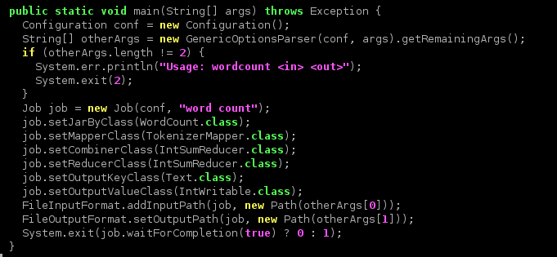

Slide 51
(Graphics: Thanks to Thilo.)

Slide 52
Anatomy of a map/reduce job
Client app
Client node
Slide inspired by: “Hadoop – The definitive guide”, Tom White, O'Reilly

Slide 53
Anatomy of a map/reduce job
Client app
Job Tracker
Submit Job
Client node
Slide inspired by: “Hadoop – The definitive guide”, Tom White, O'Reilly

Slide 54
Anatomy of a map/reduce job
Client app
Job Tracker
Submit Job
Client node
TaskTracker
Slide inspired by: “Hadoop – The definitive guide”, Tom White, O'Reilly

Slide 55
Anatomy of a map/reduce job
Client app
Job Tracker
Submit Job
Client node
TaskTracker
Map Job or
Reduce
Job
JobJVM
Slide inspired by: “Hadoop – The definitive guide”, Tom White, O'Reilly

Slide 56
Anatomy of a map/reduce job
Client app
Job Tracker
Submit Job
Client node
TaskTracker
TaskTracker
TaskTracker
Map Job or
Reduce
Job
Map Job or
Reduce
Job
Map Job or
Reduce
Job
JobJVM
JobJVM
JobJVM
Slide inspired by: “Hadoop – The definitive guide”, Tom White, O'Reilly

Slide 57
Map Reduce Optimisations

Slide 58
Input
Map
Map
Map
Map
Map
k2:v1, k1:v3
Intermediate Output
k1:v1, k2:v1, k1:v2
k2:v1, k1:v2
Shuffle
Groups by key
Intermediate Output
k1:v1, k1:v2, k1:v3
k2:v1, k2:v1, k2:v1
Reduce
Reduce
Output

Slide 59
Input
Map
Map
Map
Map
Map
k2:v1, k1:v3
Intermediate Output
k1:v1, k2:v1, k1:v2
k2:v1, k1:v2
Shuffle
Groups by key
Intermediate Output
k1:v1, k1:v2, k1:v3
k2:v1, k2:v1, k2:v1
Reduce
Reduce
Output

Slide 60
Input
Map
Map
Map
Map
Map
Local Combiners
k2:v1, k1:v3
Intermediate Output
k1:v1, k2:v1, k1:v2
k2:v1, k1:v2
Shuffle
Groups by key
Intermediate Output
k1:v1, k1:v2, k1:v3
k2:v1, k2:v1, k2:v1
Reduce
Reduce
Output

Slide 61
Customise me

Slide 62
FileInputFormat
Input

Slide 63
Custom Writeable
k2:v1, k1:v3
Intermediate Output
k1:v1, k2:v1, k1:v2
k2:v1, k1:v2
Shuffle
Groups by key

Slide 64
FileOutputFormat
Output

Slide 65
Counters

Slide 66
ToolRunner

Slide 67
configure()/ close()

Slide 68
Custom Partitioner
Shuffle
Groups by key

Slide 69
Distributed Cache

Slide 70

Requirements to get started
March 14, 2009 by Artful Magpie
http://www.flickr.com/photos/kmtucker/3355551036/

Slide 71
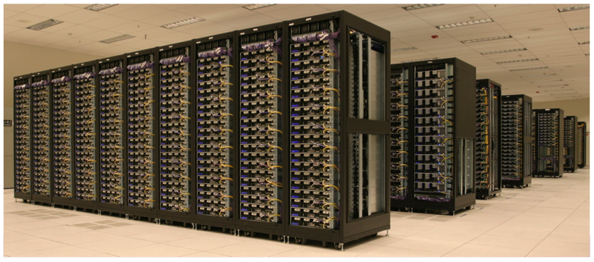

Slide 72
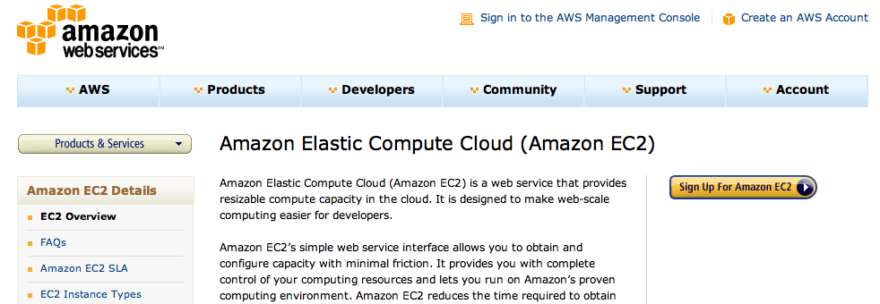

Slide 73
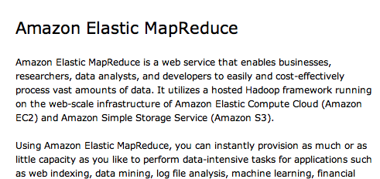

Slide 74
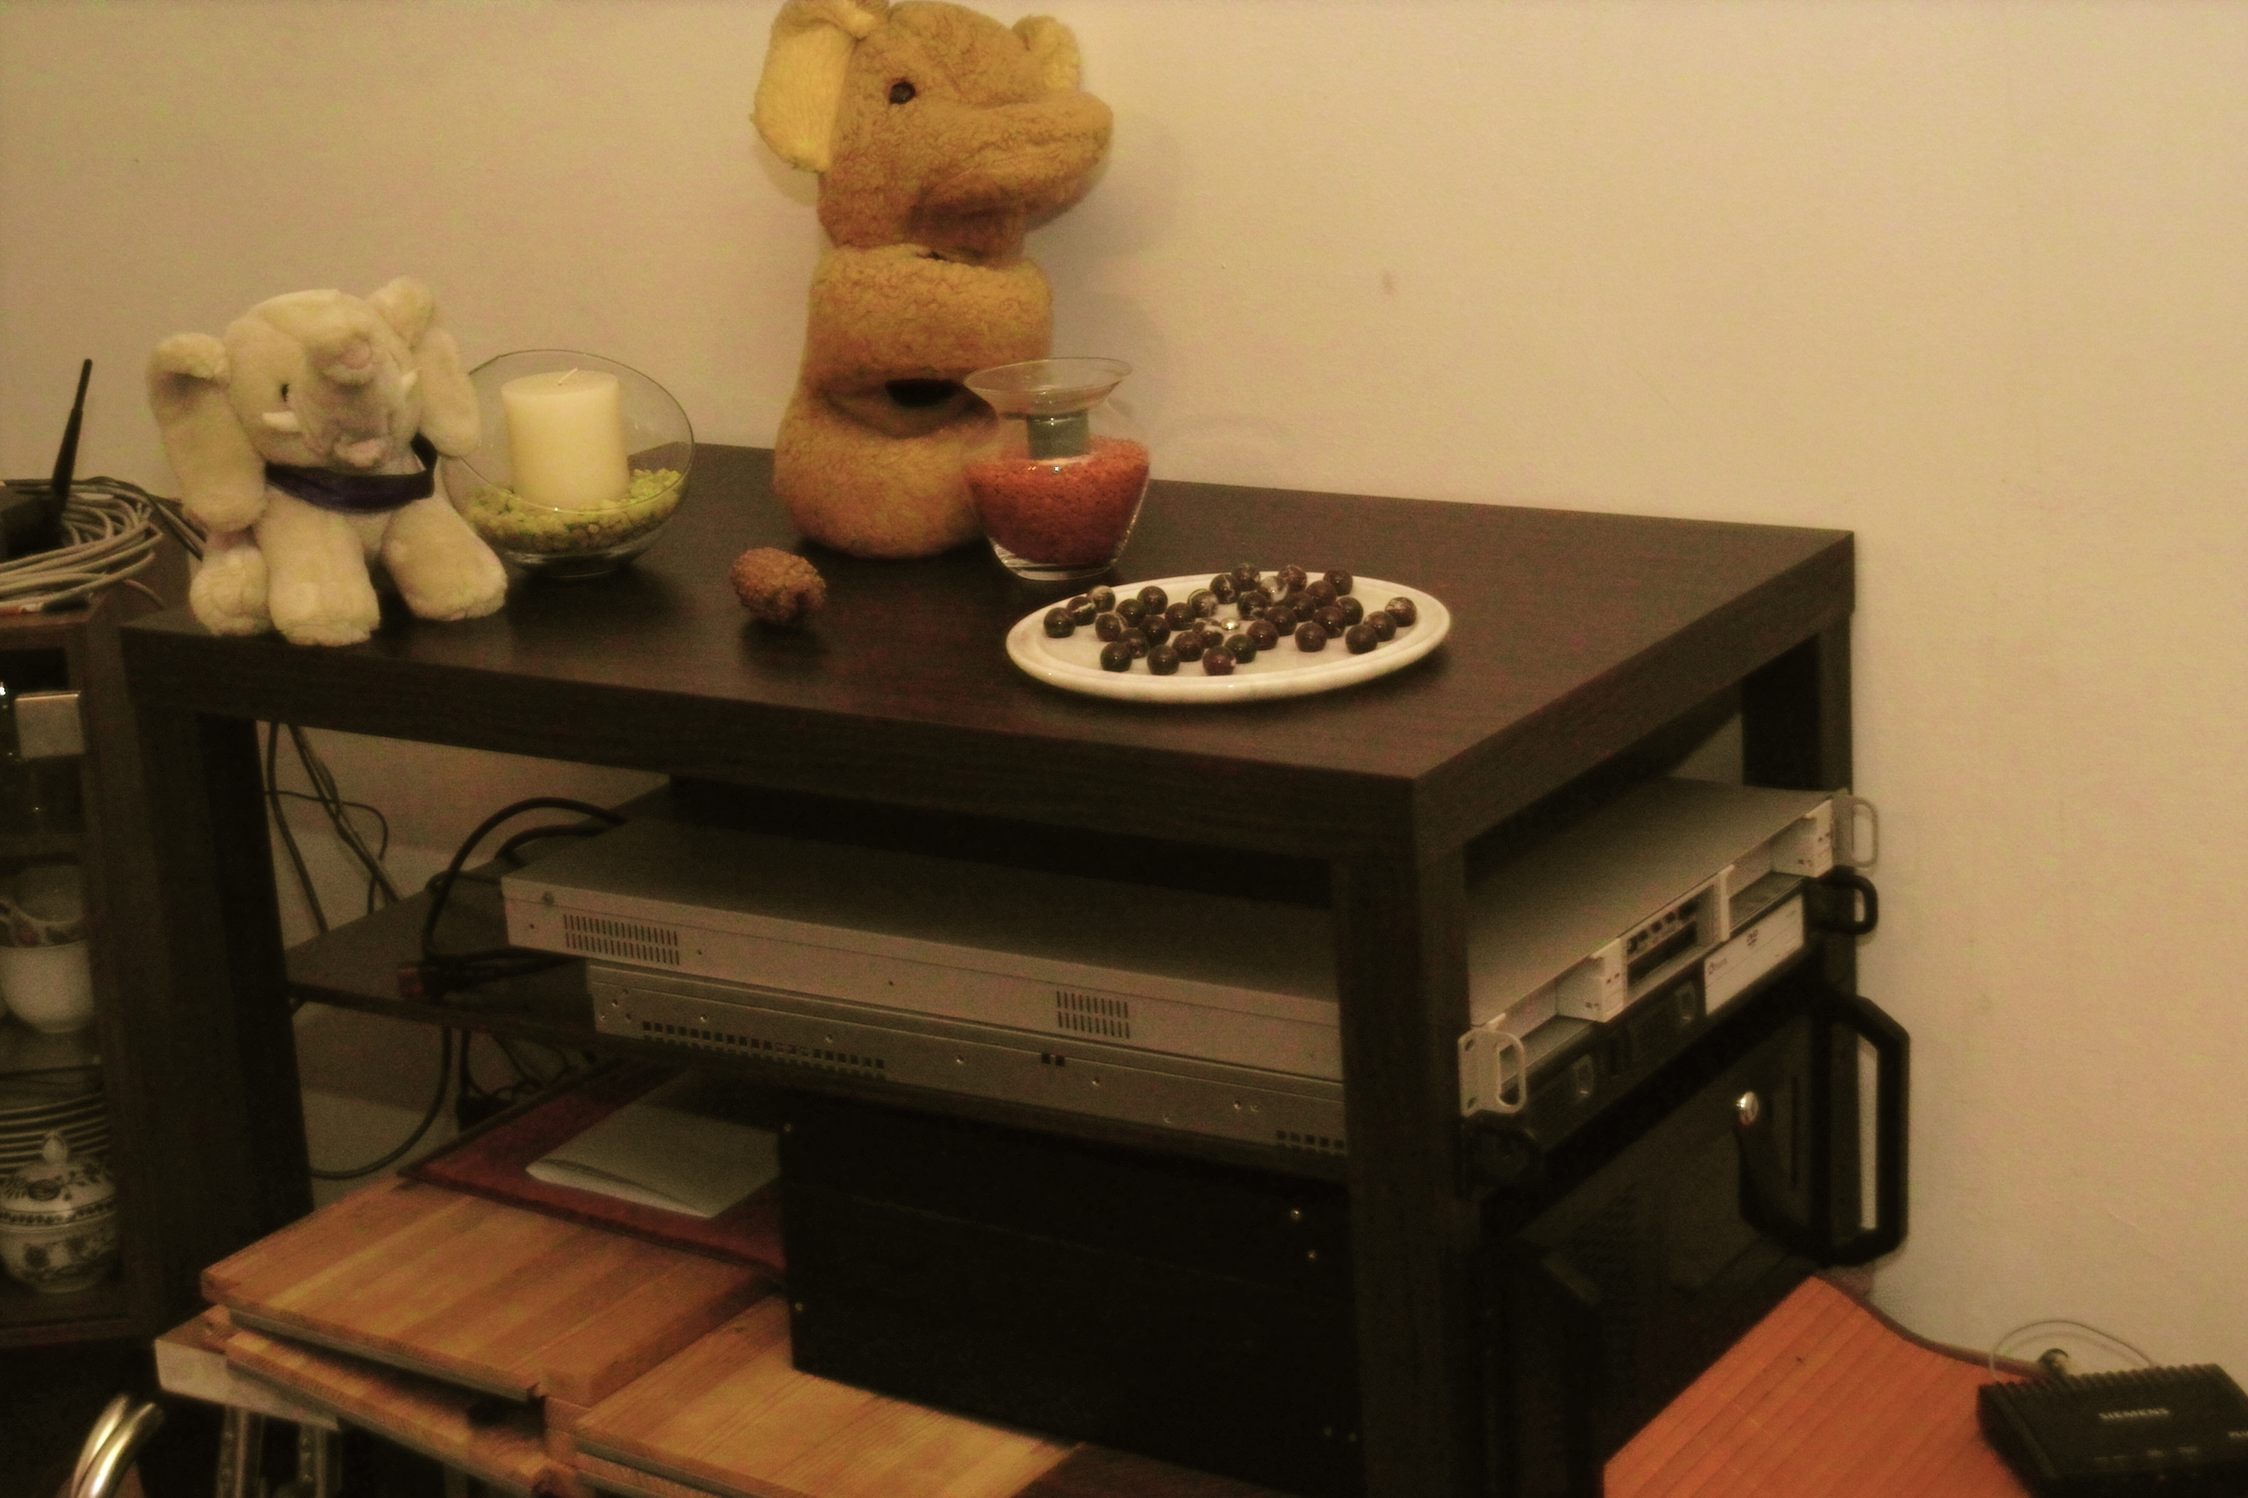
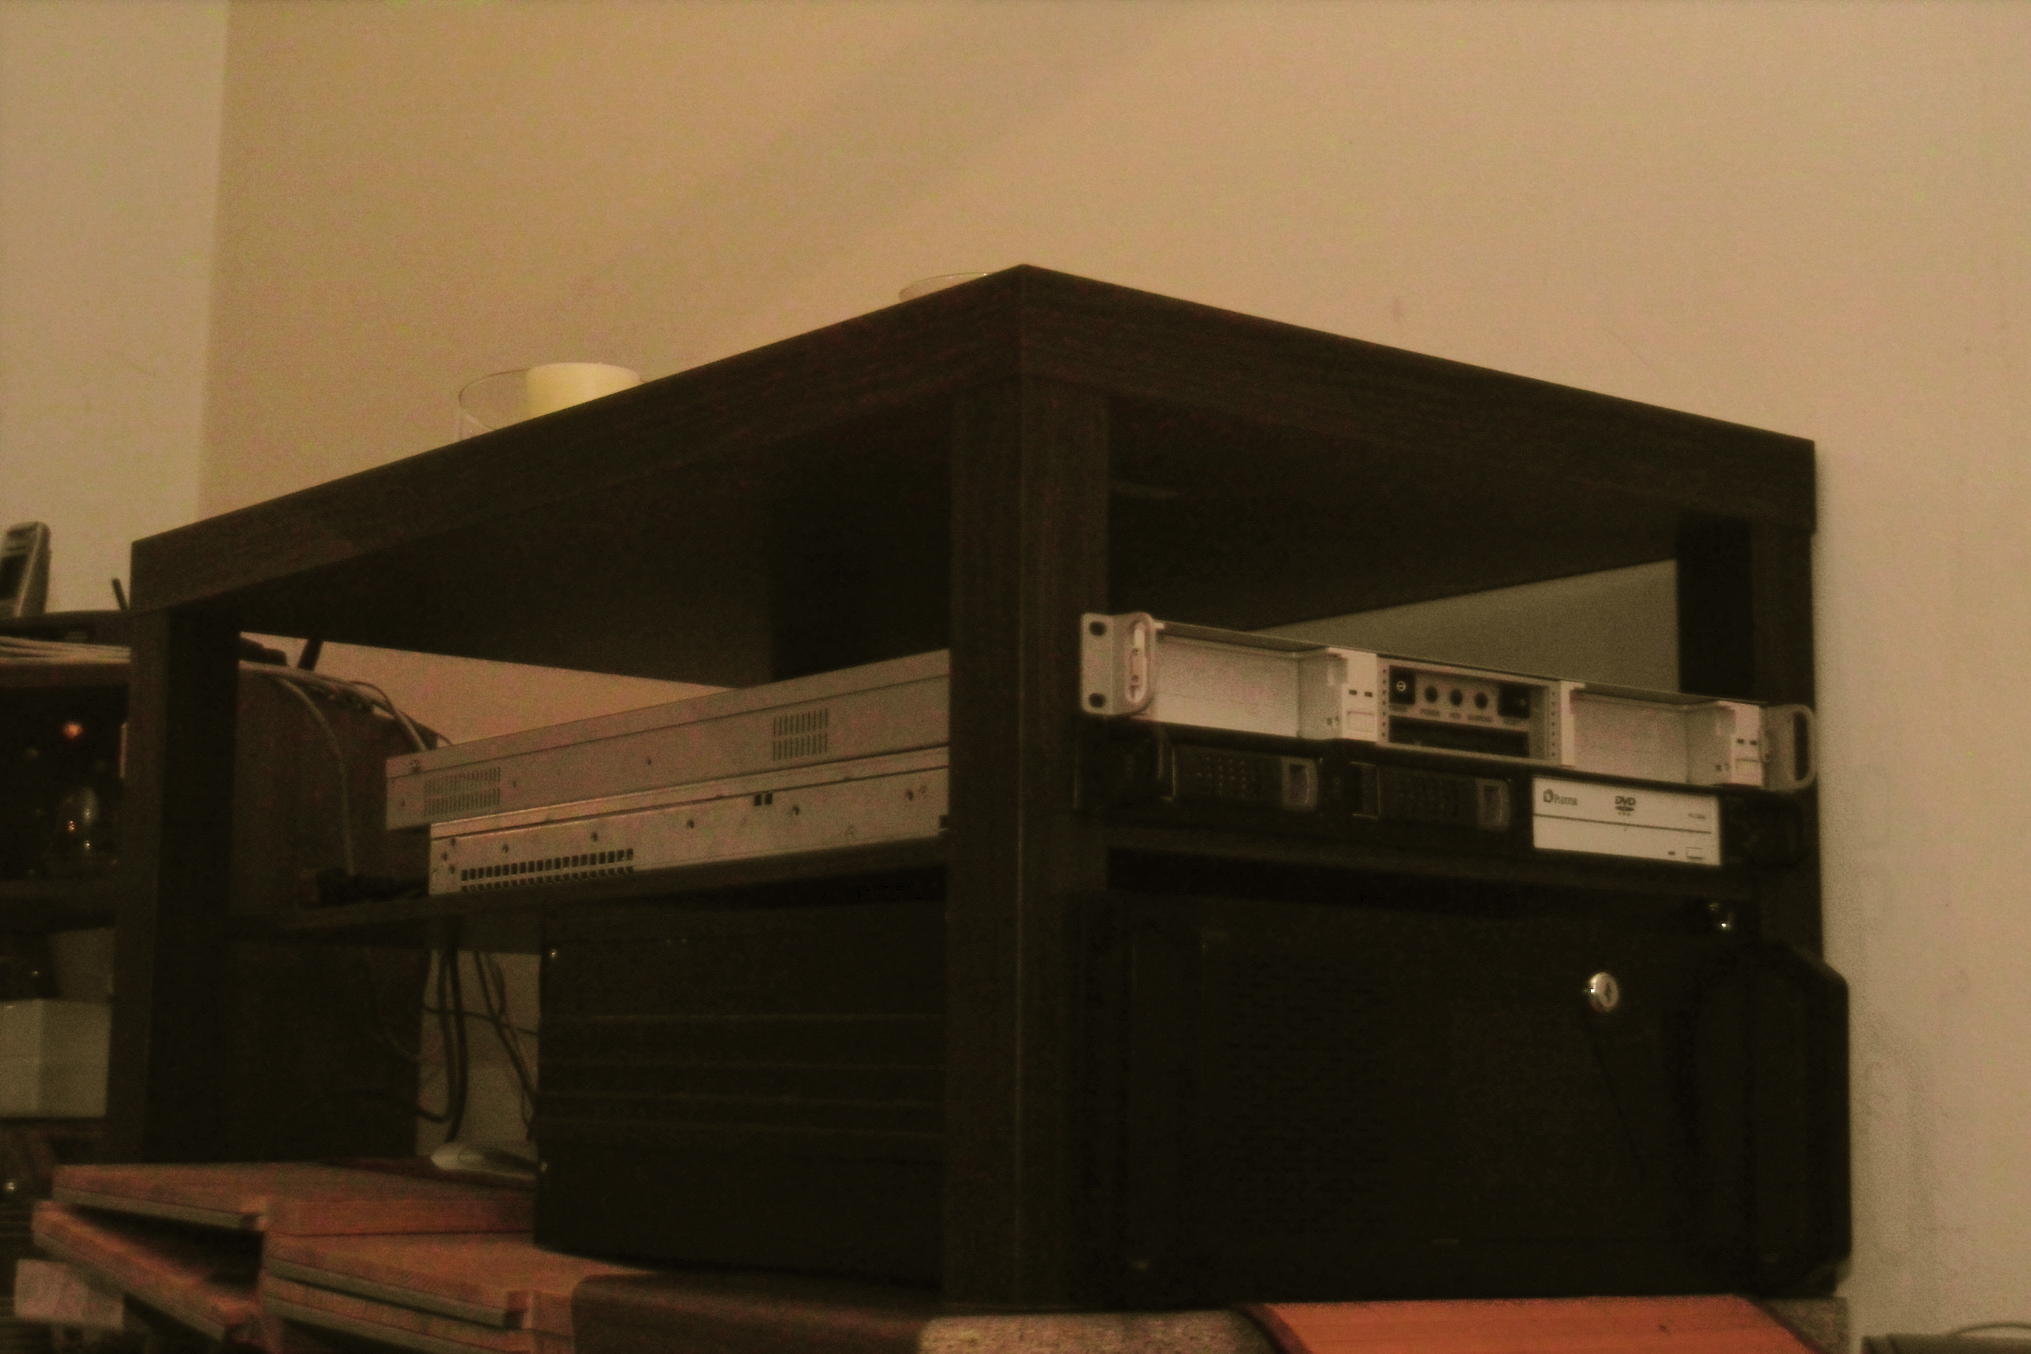
(Thanks to Thilo for helping set up the
cluster, Thanks to packet and masq
for two of the three machines.)

Slide 75
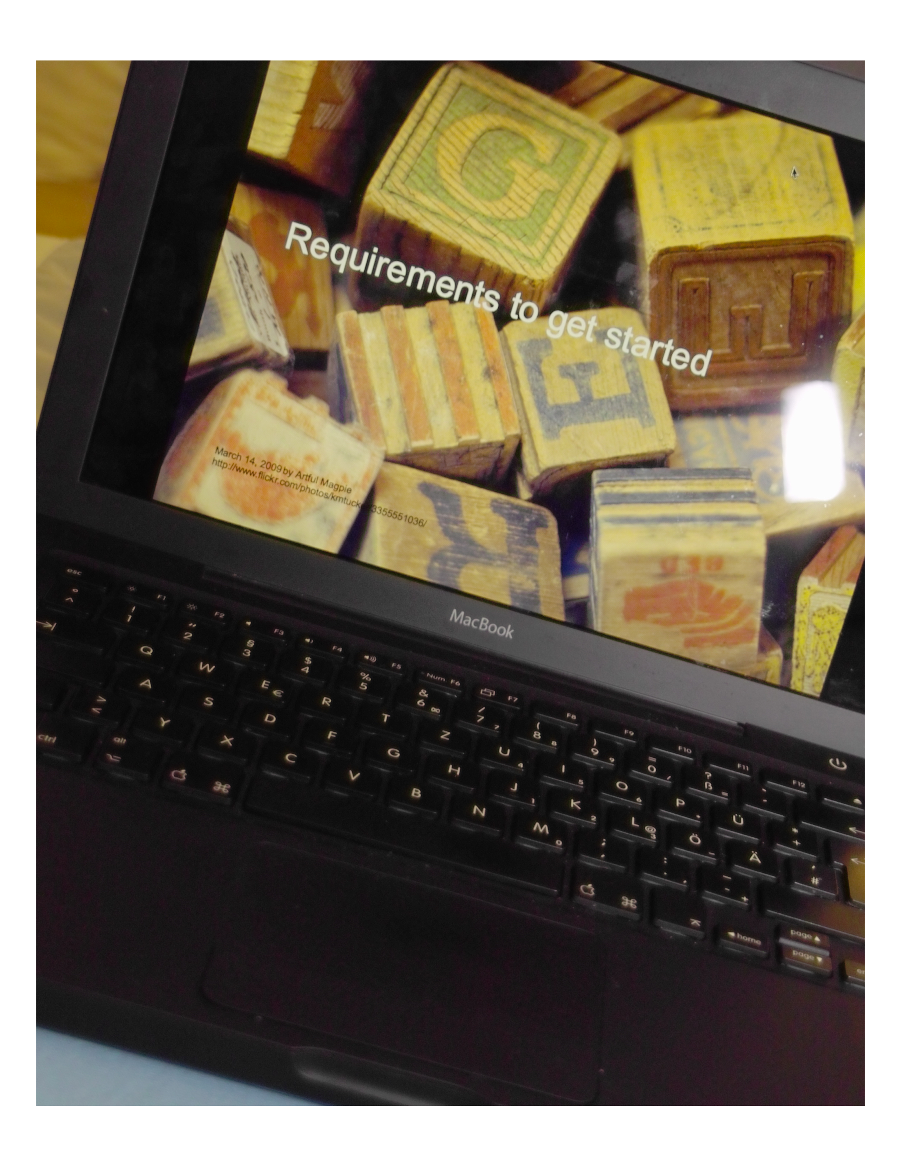

Slide 76

Up next.
http://www.flickr.com/photos/87106931@N00/3835231300/
By mhobl

Slide 77
Up next.
In 0.2*:
  Continued bug fixing,
  Security support.
MapReduce Next Gen:

Slide 78
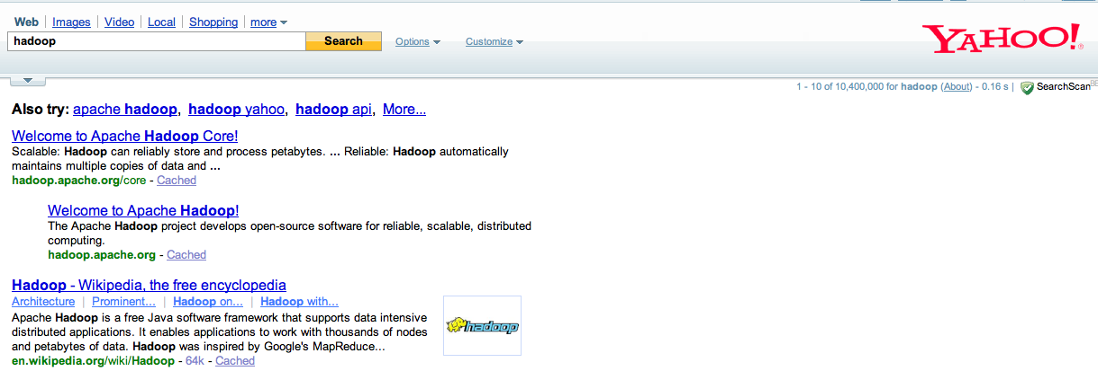

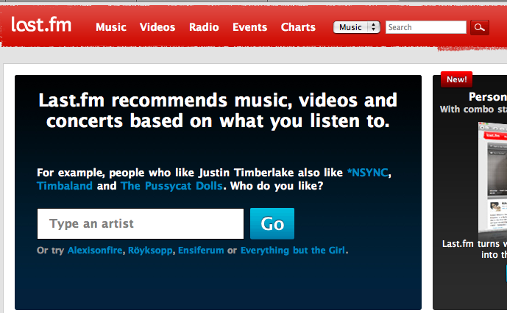

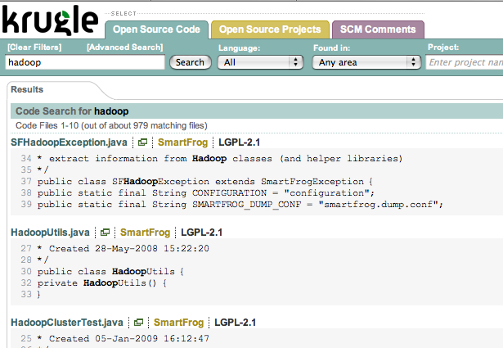
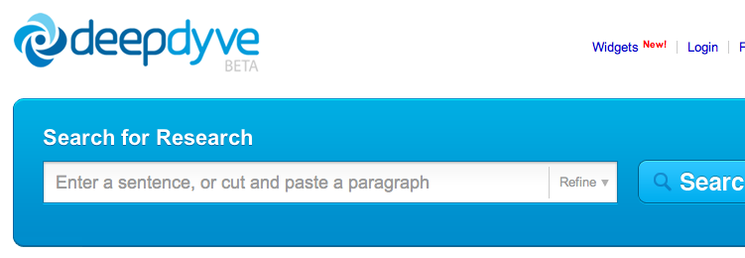


Slide 79
Apache Hadoop ecosystem.

Slide 80
Higher level languages.

Slide 81



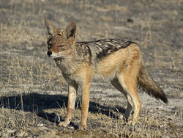
TM
TM

Slide 82
TM

Slide 83
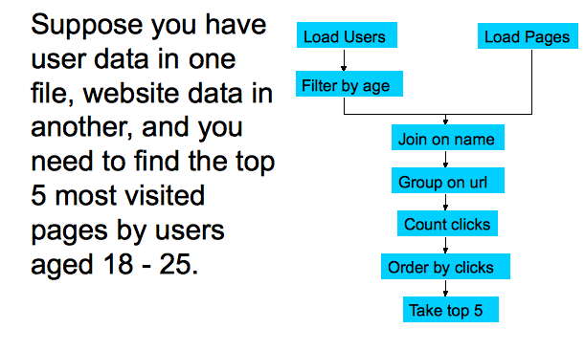
TM
Example from PIG presentation at Apache Con EU 2009

Slide 84
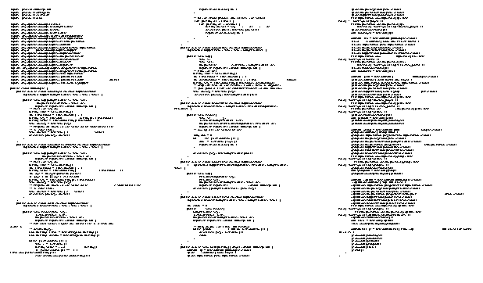
TM
Example from PIG presentation at Apache Con EU 2009

Slide 85
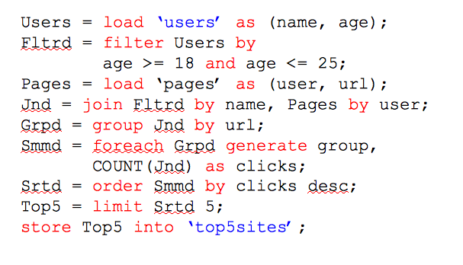
TM
Example from PIG presentation at Apache Con EU 2009

Slide 86
(Distributed) storage.

Slide 87


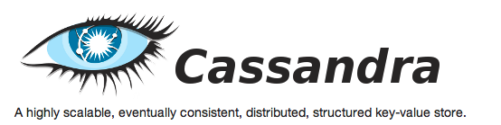
TM
TM
TM

Slide 88
Libraries built on top.

Slide 89



TM
TM

Slide 90





TM
TM
TM
TM
TM
TM

Slide 91

Jumpstart your project with proven code.
January 8, 2008 by dreizehn28
http://www.flickr.com/photos/1328/2176949559

Slide 92

Discuss ideas and problems online.
November 16, 2005 [phil h]
http://www.flickr.com/photos/hi-phi/64055296

Slide 93
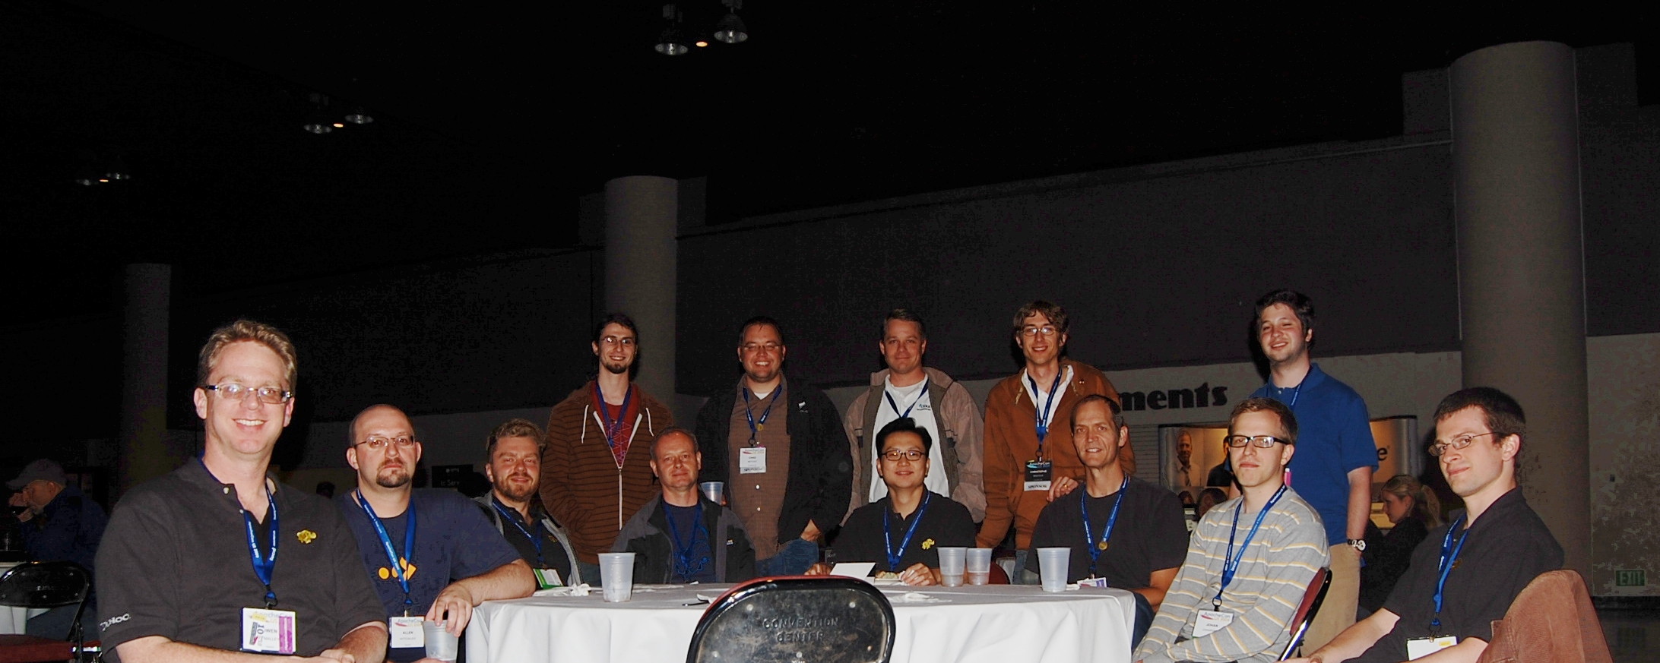

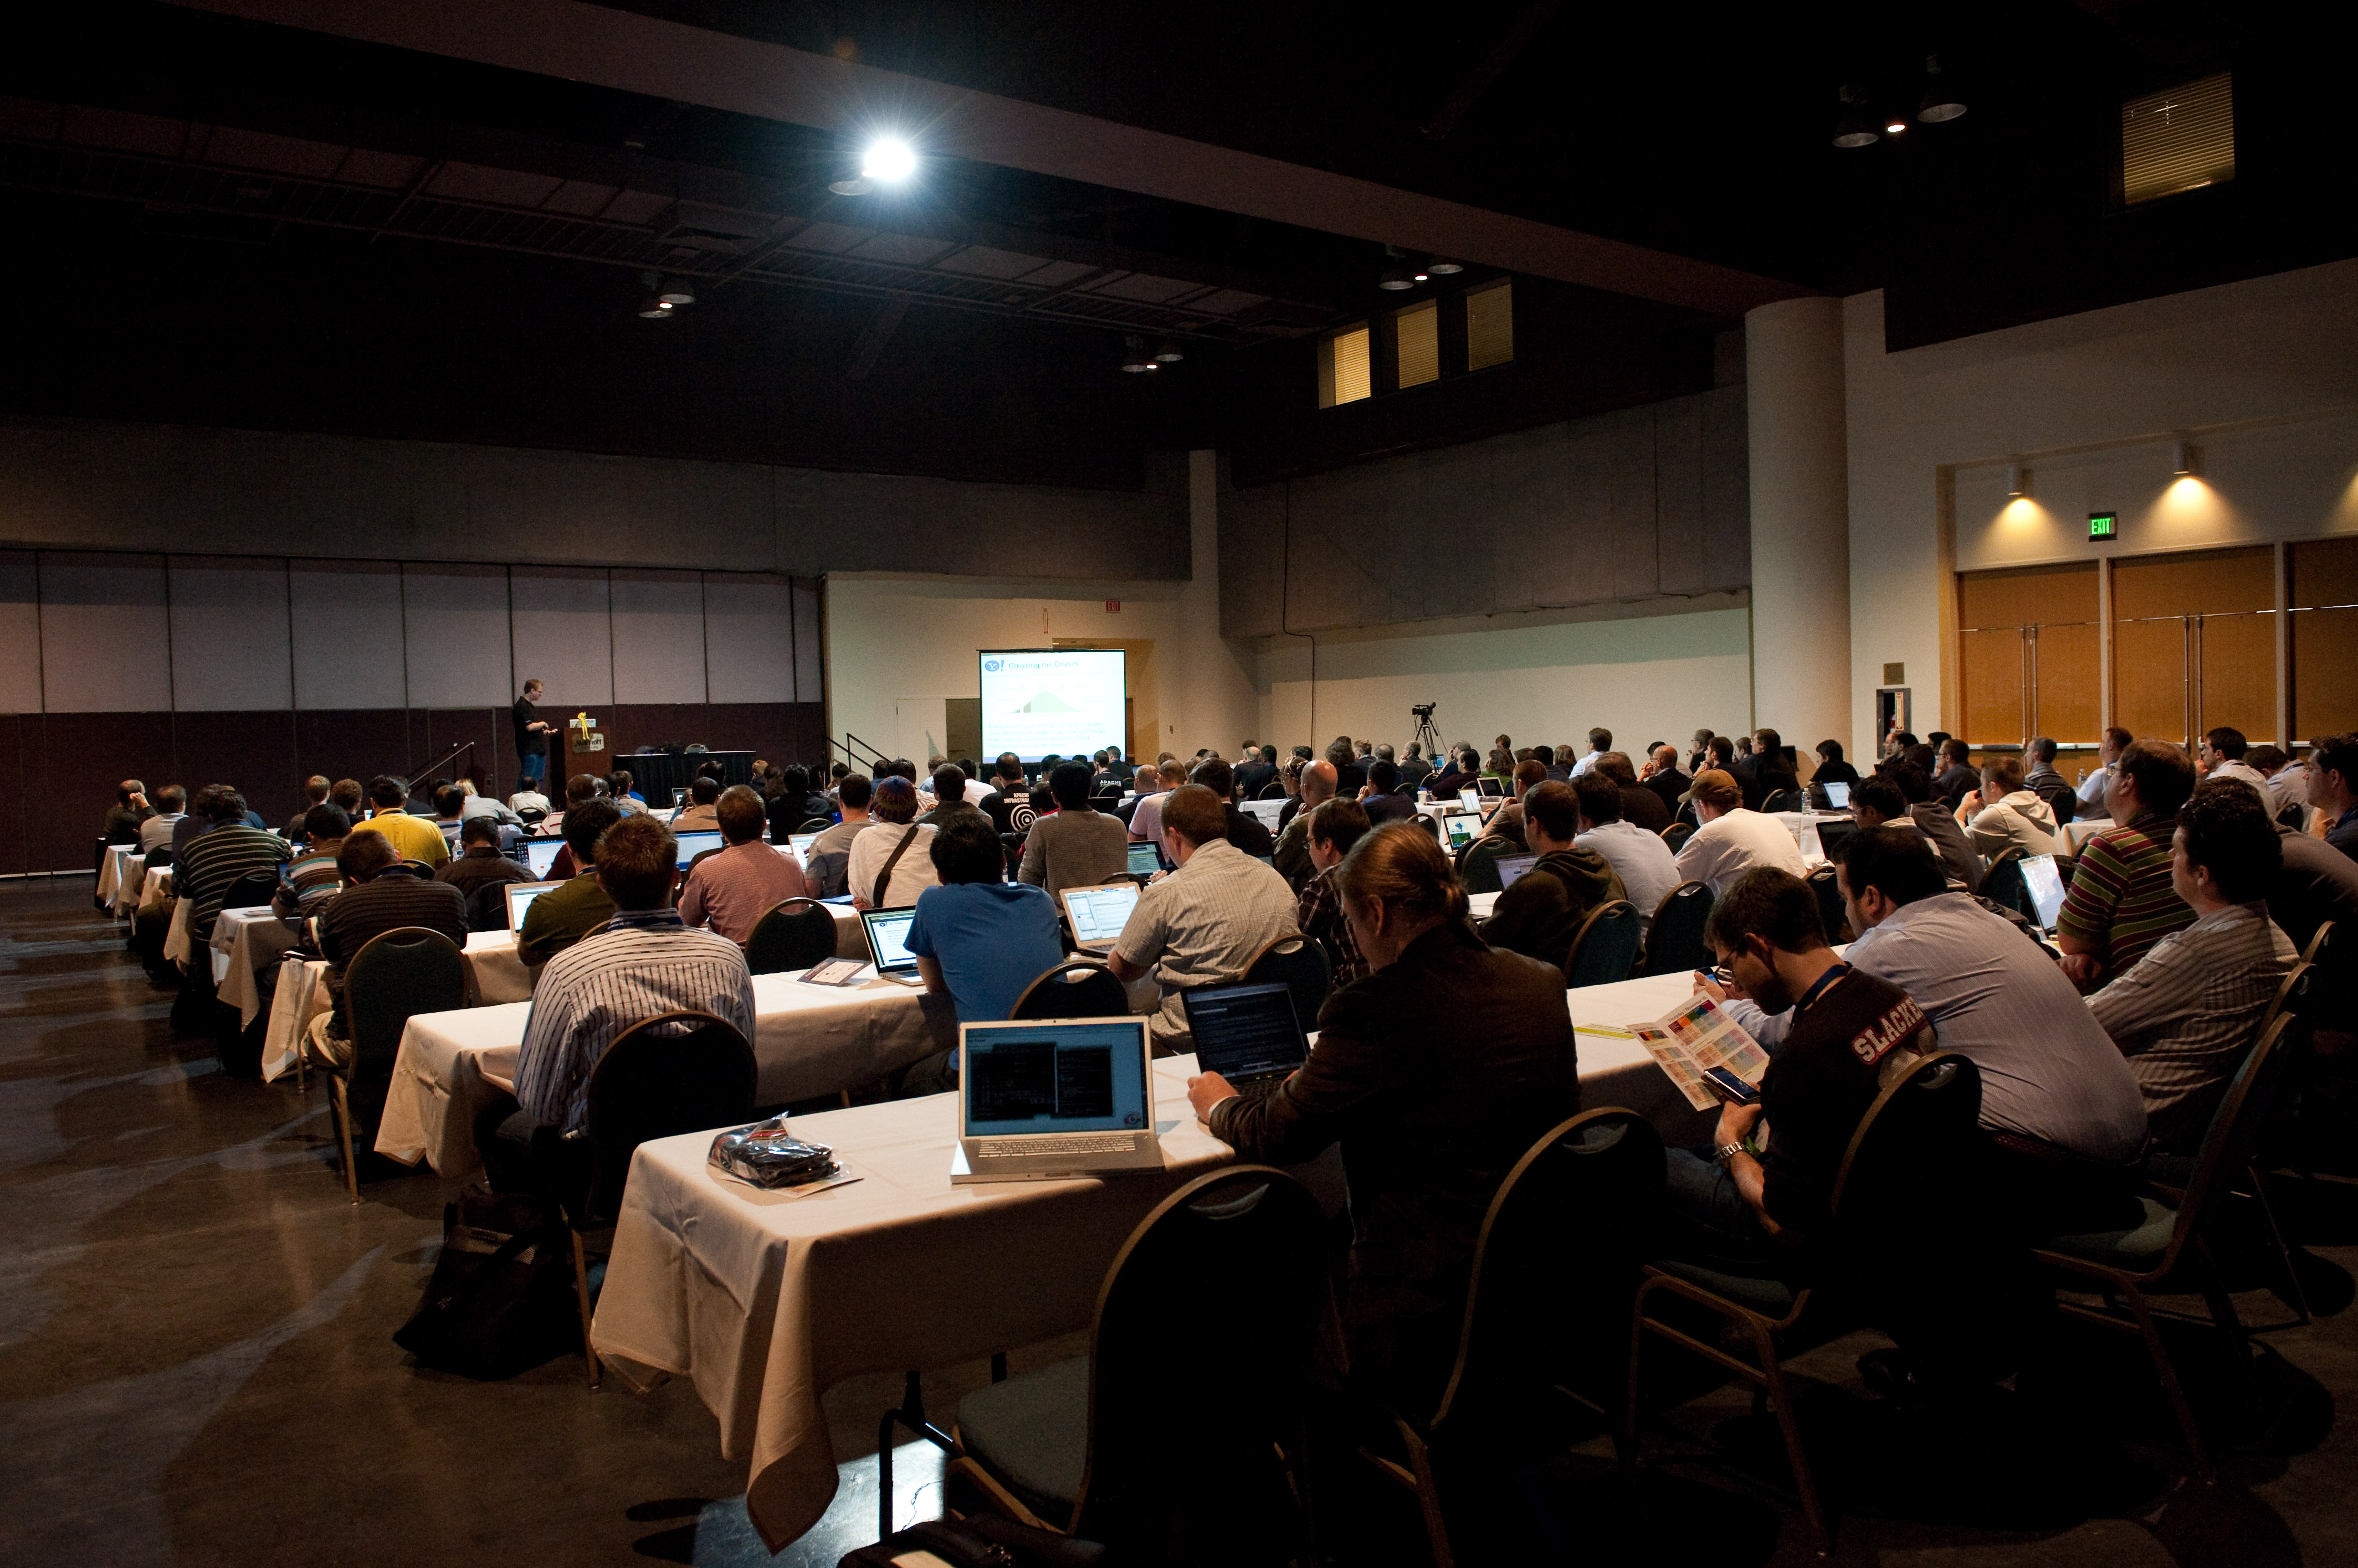
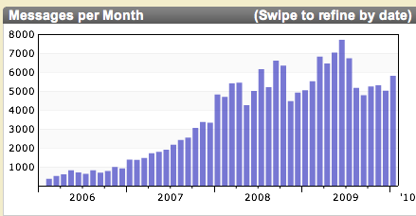
http://www.flickr.com/photos/vonguard/4076391191
By: VonGuard
Become part of the community.
http://flickr.com/photos/iamdietrich/4075363845/
By: Iam Dietrich
http://www.flickr.com/photos/twleung/4110005817/
By: Ted Leung

Slide 94

*-user@hadoop.apache.org
*-dev@hadoop.apache.org
Interest in solving hard problems.
Being part of lively community.
Engineering best practices.
Bug reports, patches, features.
Documentation, code, examples.
Image by: Patrick McEvoy

Slide 95

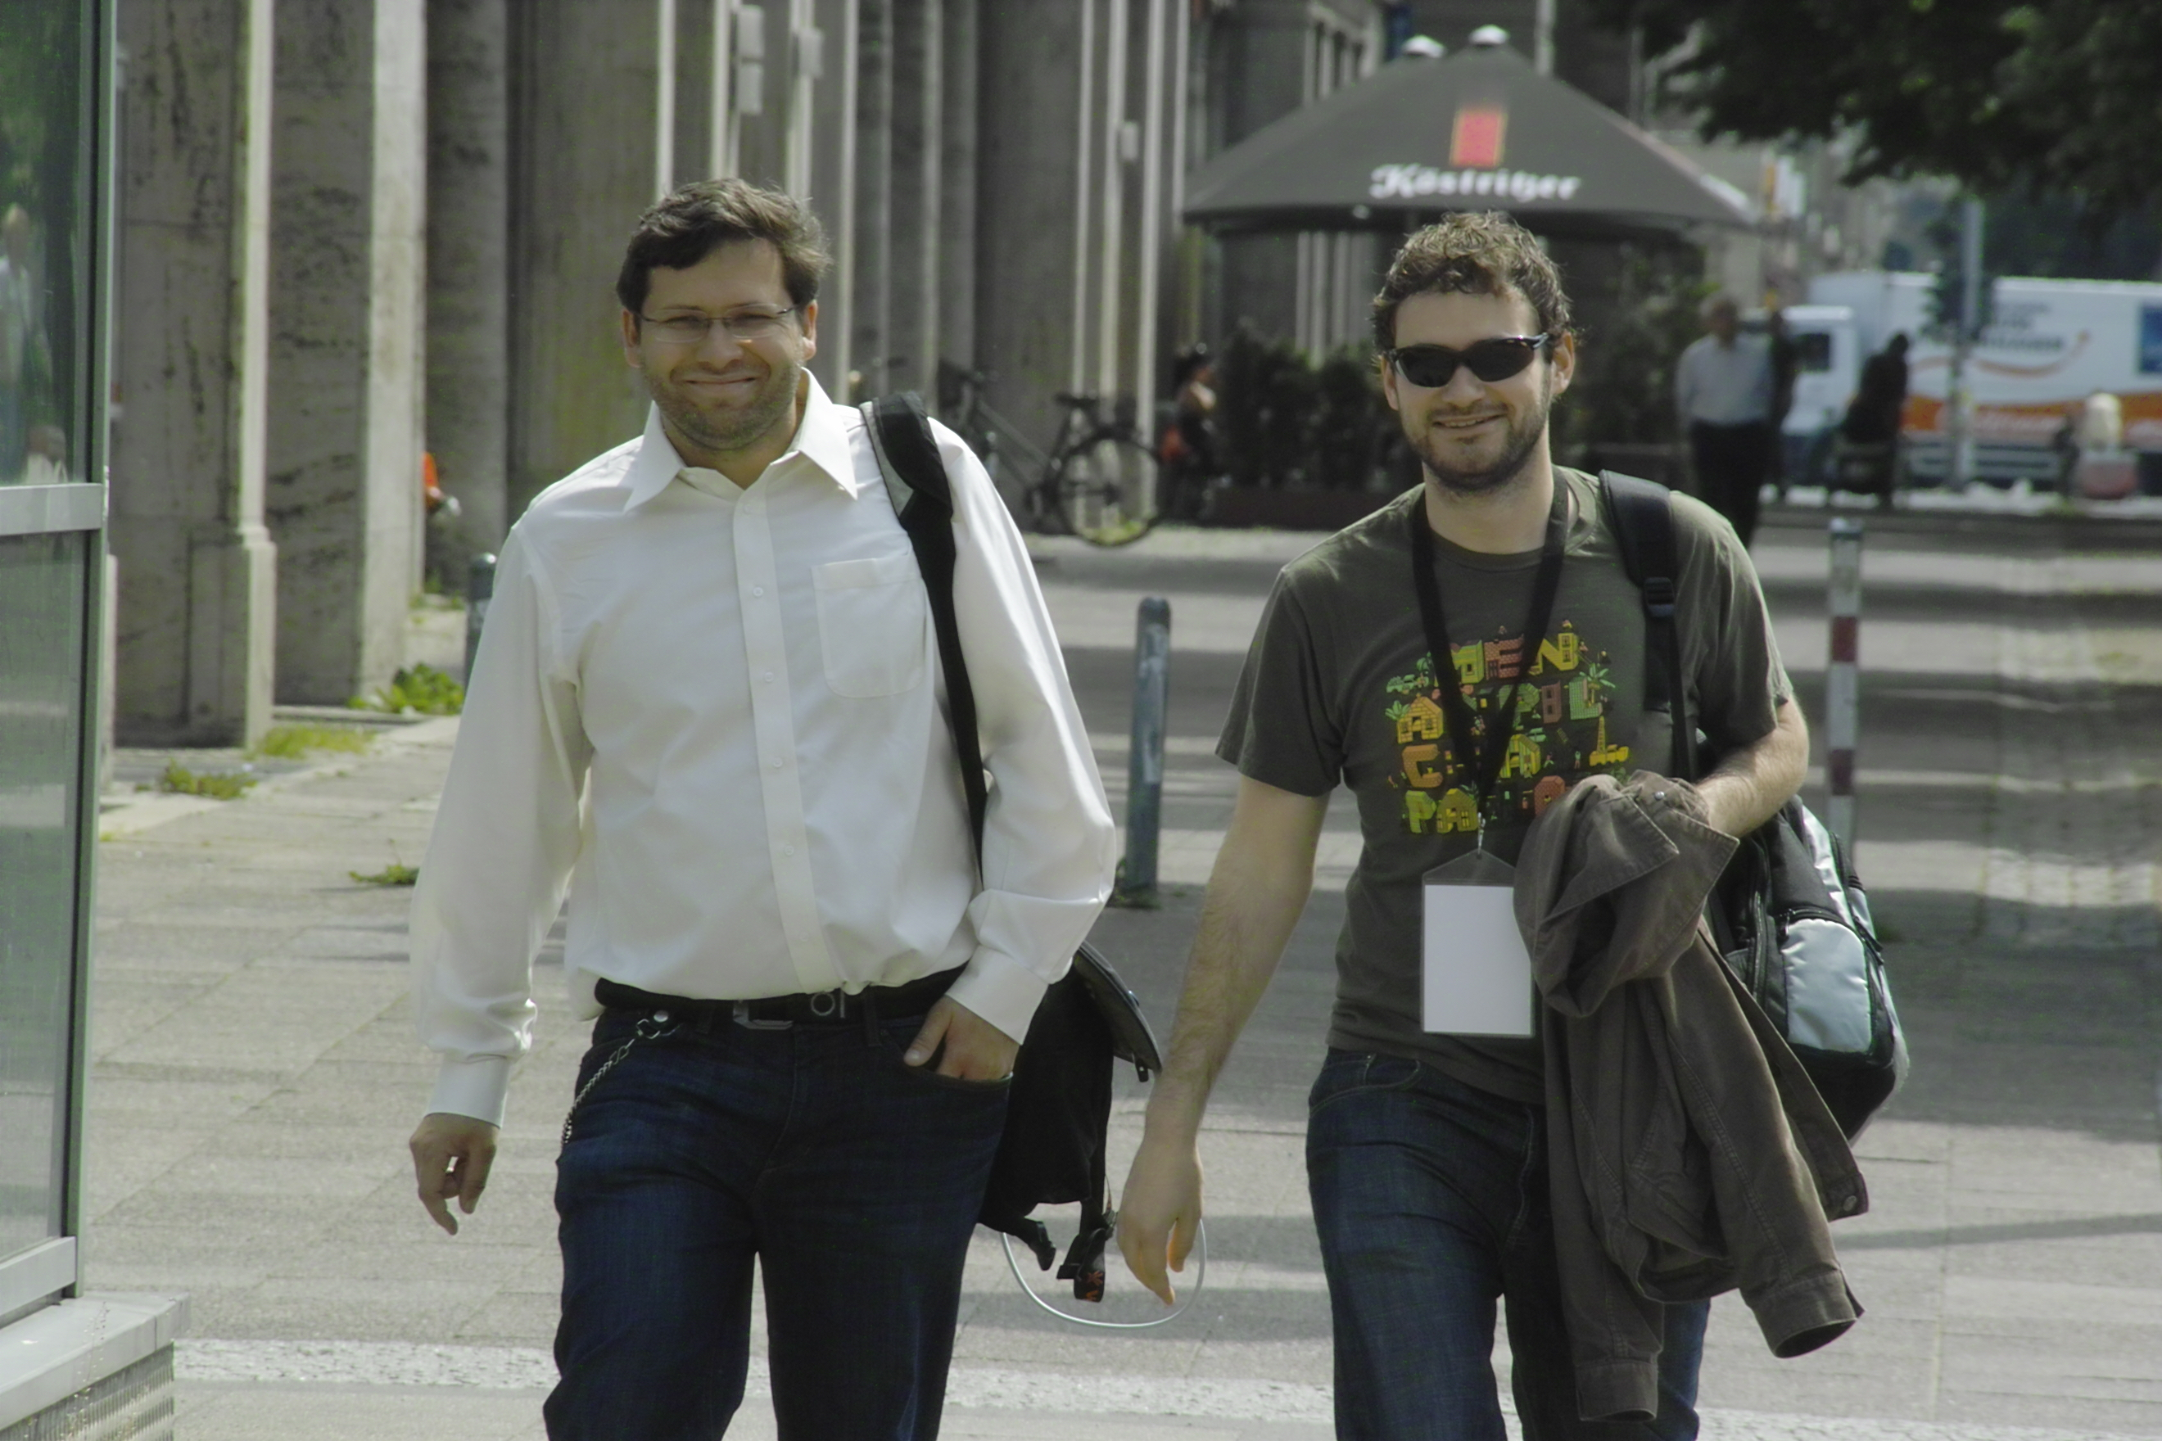
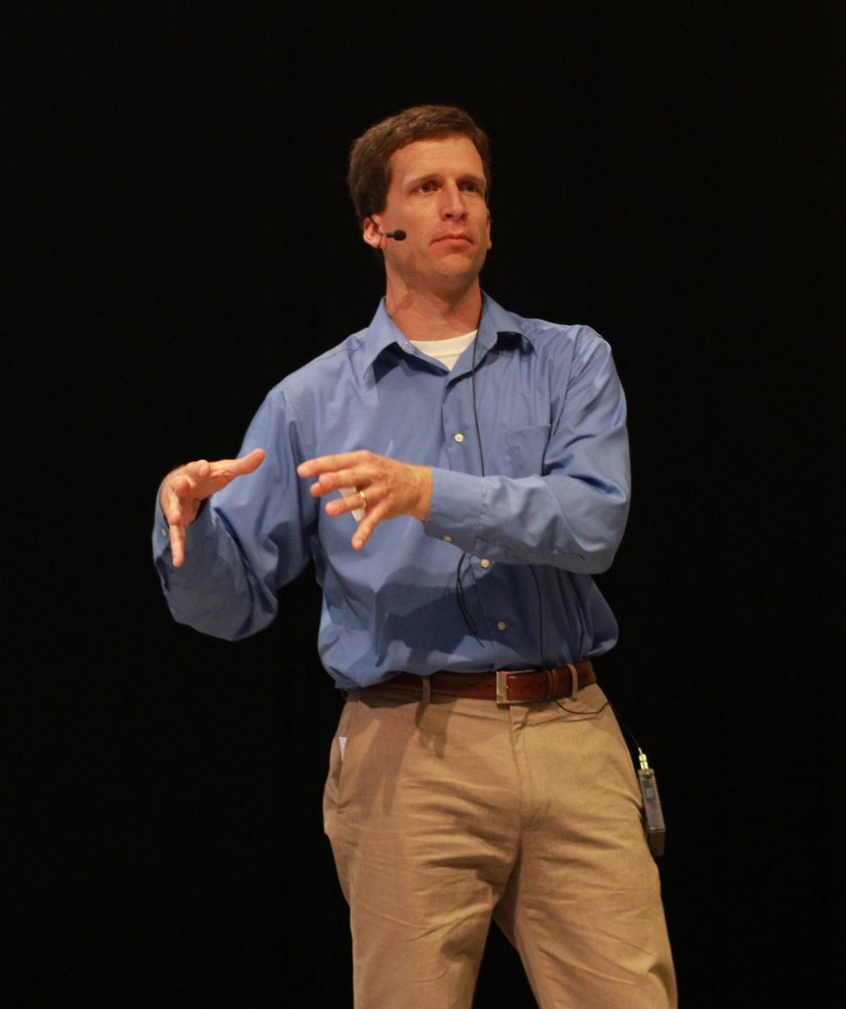
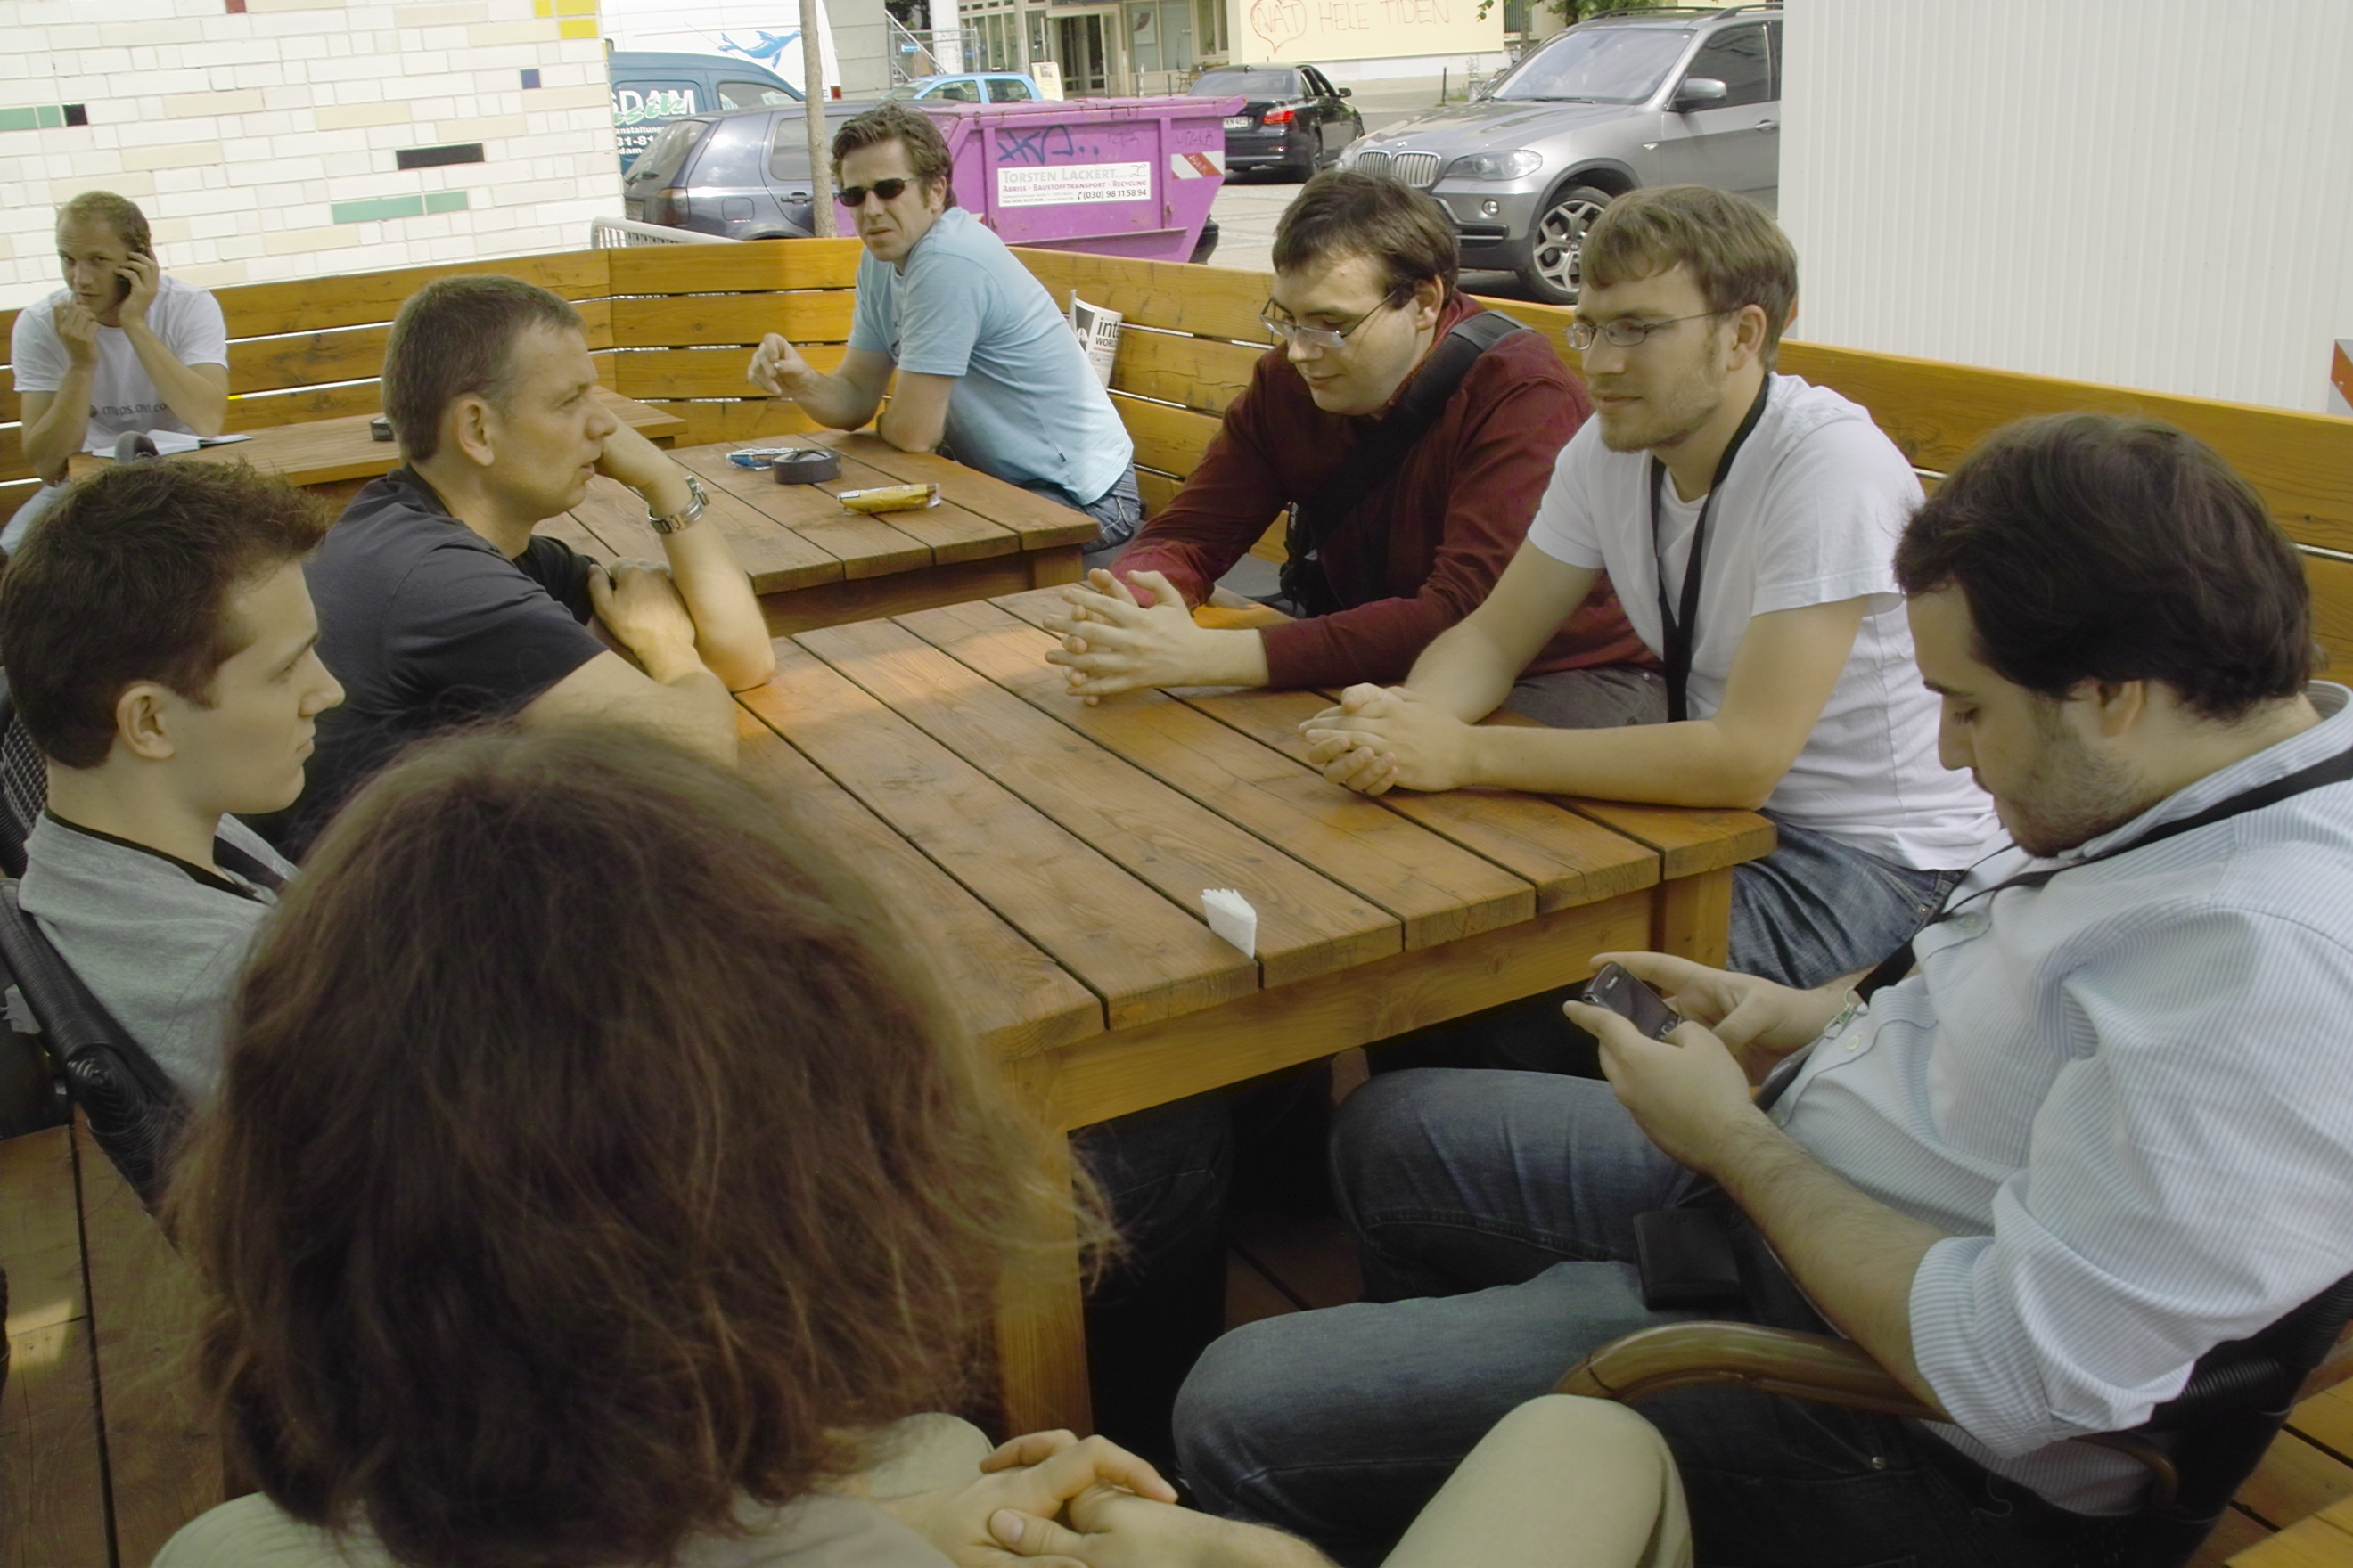
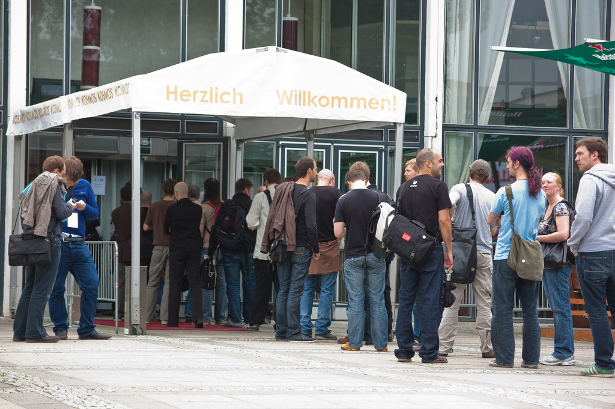

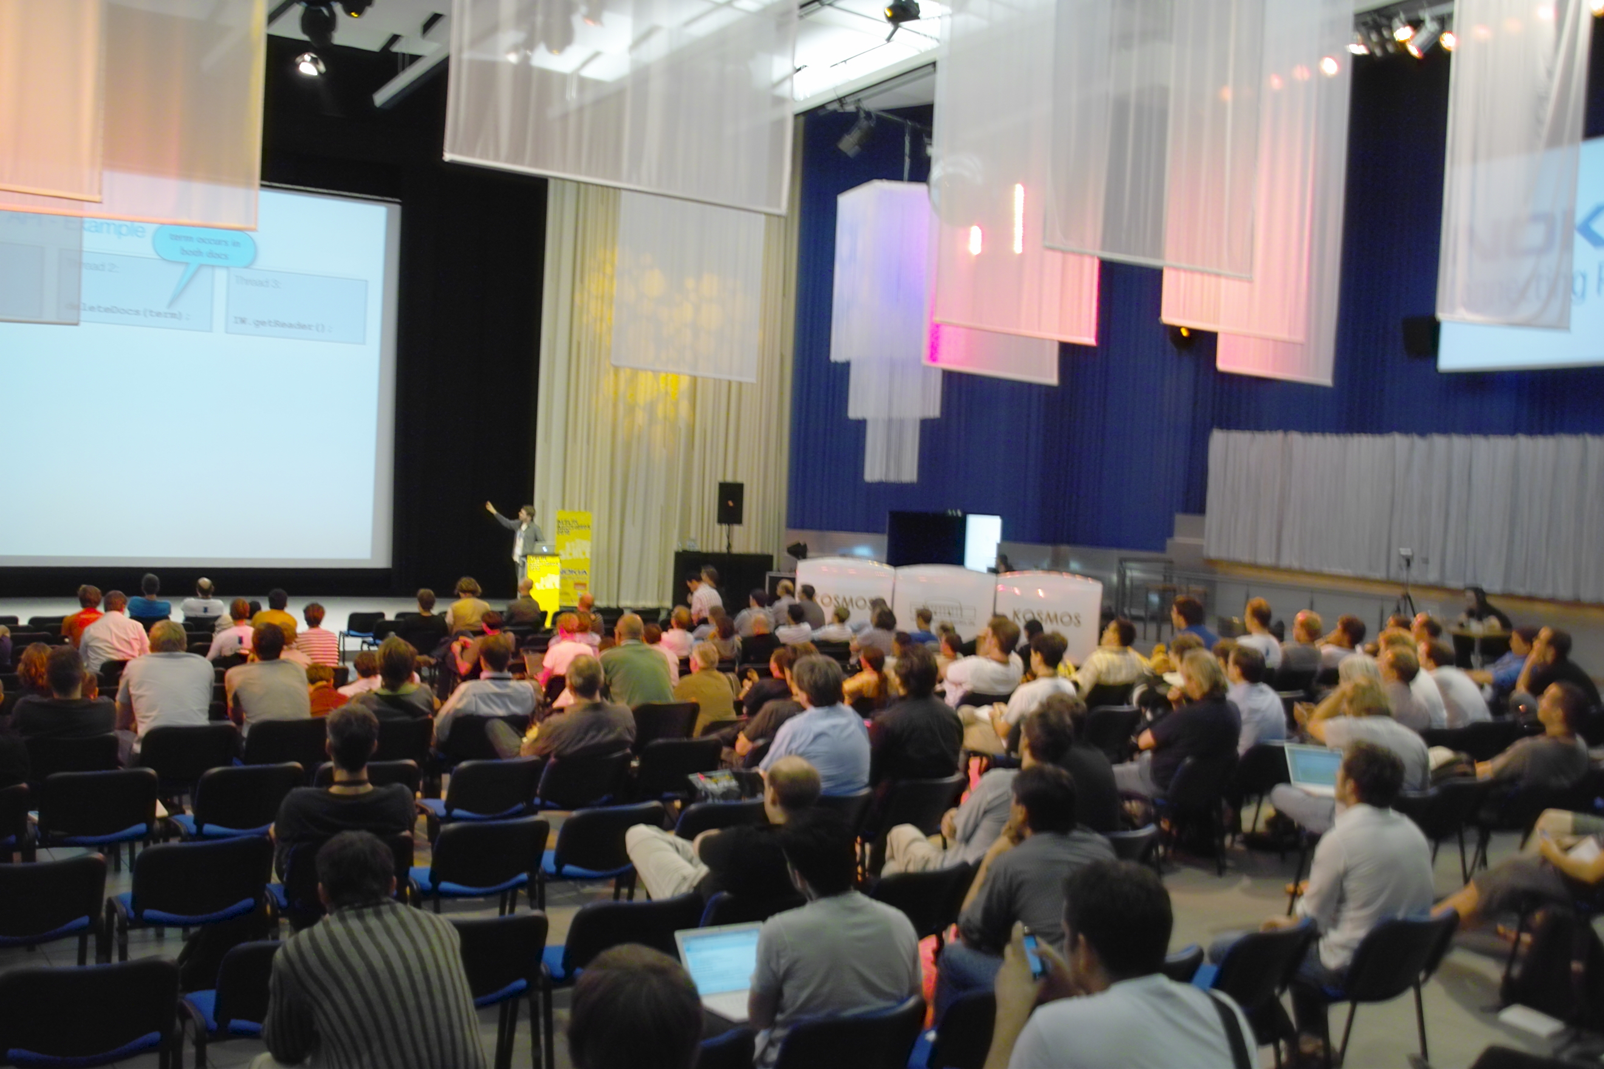
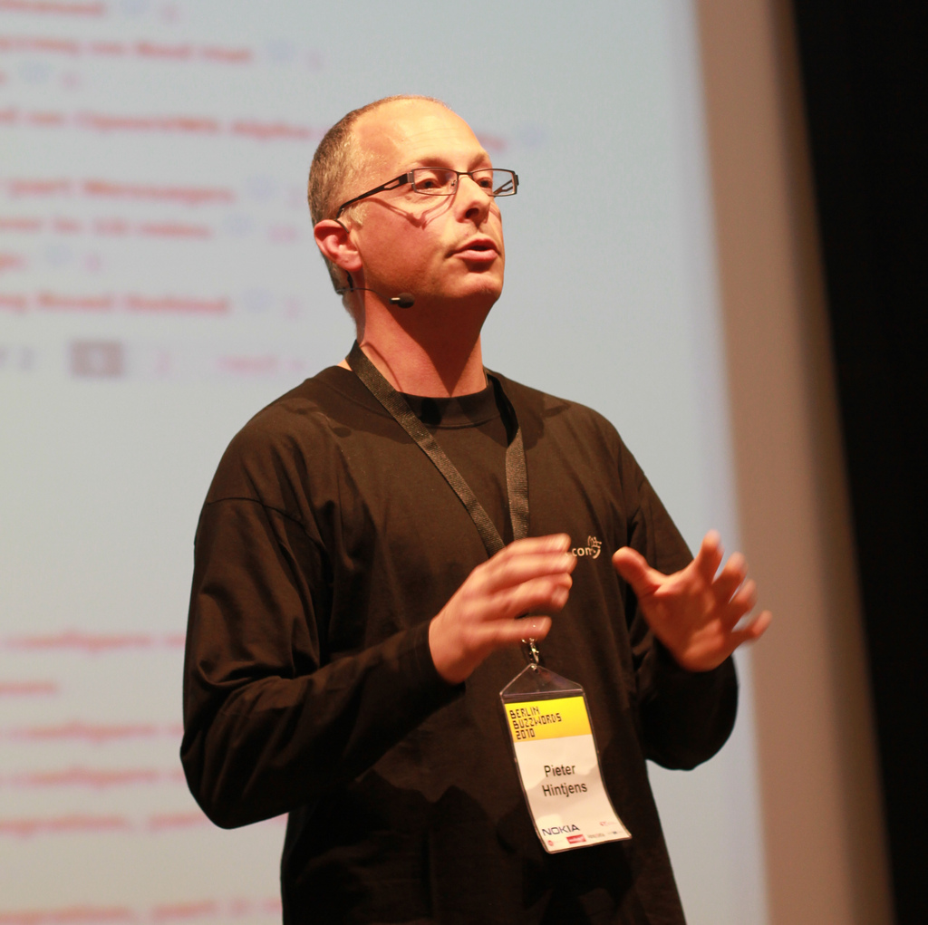
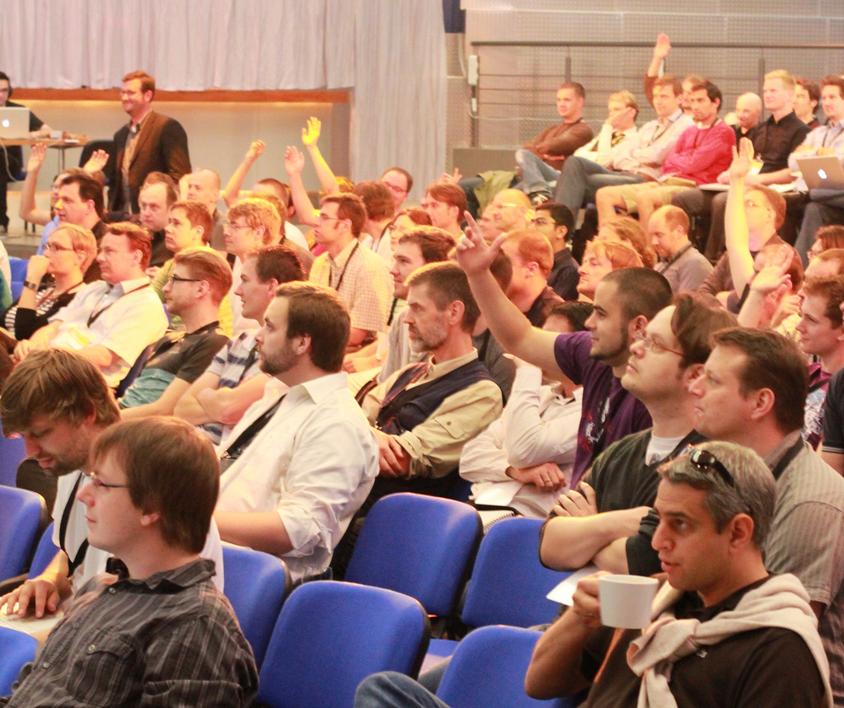
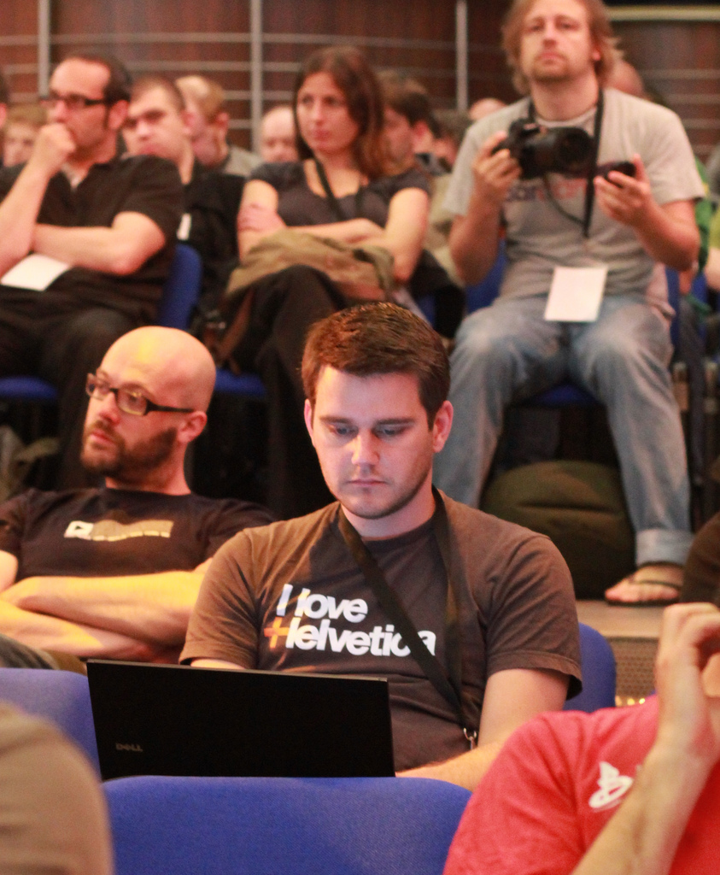
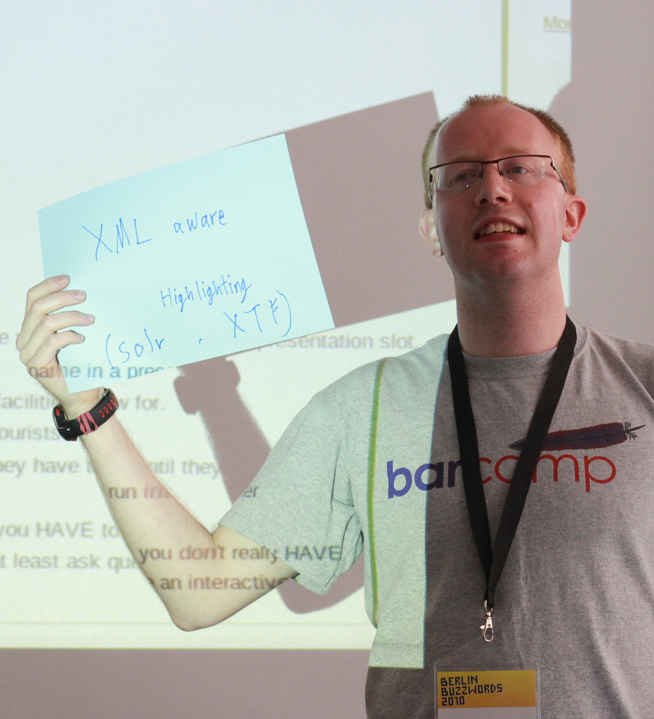
Berlin Buzzwords 2011
Search/ Store/ Scale
June 6/7th 2011
Thanks to Tim Lossen et. al for taking amazing pictures of the conf.

Slide 96
*-user@hadoop.apache.org
*-dev@hadoop.apache.org
Interest in solving hard problems.
Being part of lively community.
Engineering best practices.
Bug reports, patches, features.
Documentation, code, examples.
Image by: Patrick McEvoy

Slide 100
M A P
| SHUFFLE
| R E D U C E
Local to data.

Slide 101
M A P
| SHUFFLE
| R E D U C E
output
Local to data.
Outputs a lot less data.
Output can cheaply move.

Slide 102
M A P
| SHUFFLE
| R E D U C E
output
Local to data.
Outputs a lot less data.
Output can cheaply move.

Slide 103
M A P
| SHUFFLE
| R E D U C E
output
input
result
result
Local to data.
Outputs a lot less data.
Output can cheaply move.
Shuffle sorts input by key.
Reduces output significantly.

