Slide 1
Apache Hadoop
Implementation patterns

Slide 2
Agenda
Performance metrics
General patterns
Map/Reduce patterns
Implementing Joins

Slide 3
Performance metrics

Slide 4
Throughput
Response time
Running time

Slide 5
Example: Finding similar documents.

Slide 6
If we looked at two words only:
Sunny weather
High performance computing

Slide 7
Aaron
Zuse

Slide 8
Binary bag of words
Imagine a n-dimensional space.
Each dimension = one possible word in texts.
Entry in vector is one, if word occurs in text.
Problem:
  Number of word occurrences not accounted for.

Slide 9
Term Frequency
Imagine a n-dimensional space.
Each dimension = one possible word in texts.
Entry in vector equal to the words frequency.

Slide 10
Possible performance metrics
Documents parsed/ second
Gigabyte parsed/ second
What if we were to:
  Add more machines?
  Compare an inherently sequential algorithm to a parallel one?

Slide 11
Sequential vs. parallel
Speed-Up Ratio:
  T(n) = time of best sequential algorithm to solve problem of size n.
  T_p(n) = time for parallel algoirthm to solve same problem using p > 1 processors.
  Sp > 1 if the algorithm is any good.

Slide 12
Sequential vs. parallel
Efficiency: 0 < Ep <= 1
More than p times faster on p processors impossible with same algorithm.
Ep > 1: Using different algorithm in parallel case.

Slide 13
Sequential vs. parallel
Good Speed-Up != Great efficiency.
Bad Speed-Up != Bad efficiency.
Remember: Good serial algorithms are optimised for sequential machines.
Cheap and simple sequential algorithms can make great parallel algorithms.

Slide 14
Sequential vs. parallel
Optimal:
  1 <= Sp <= p
  0 <= Ep <= 1
Optimal: Algorithms approaching upper bound as p approaches infinity.

Slide 15
Speed-Up Graphs
Fixed n
Fixed p
Sp
super-
linear
ideal
Sp
Different algorithm
expected
usual
p
poor
p
n

Slide 16
Amdahl's law
Algorithms have sequential parts.
  a – serial cost of parallelisable part
  b – serial cost of inherently sequential part
Fraction of serial work.
Fraction of parellel work.
Amdahl's law.
Speed-up achieved dpends on serial fraction.

Slide 17
Gustafson's Law
Amdahl's law overly pessimistic:
  Sequential fraction depends on problem size.
  For large class of problems

Slide 18
General parallelisation patterns

Slide 19
Dependencies
Data flow dependency:
  Output used as Input in next step.
  Output written to same output target.
  Input read from same input source.
Control dependency.

Slide 20
Map/Reduce patterns

Slide 21
Input
Map
Shuffle
Reduce
Output

Slide 22
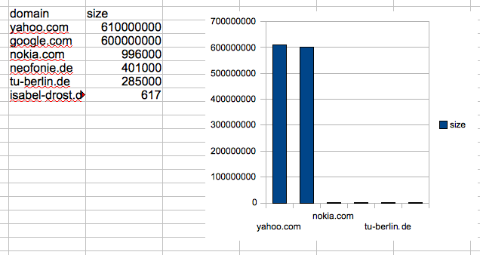
Blocking mapper
Problem: Data distribution
  Different split criteria
  Outlier handling
  Sampling of larger site

Slide 23
Network overhead
Use combiners.
Implement combiner as part of mapper.
  Memory/ emit frequency trade-off.
Pairs and Stribes.

Slide 24
Word Co-Occurrence Example
Count n-grams in a document corpus.
Naive:
  Create co-occurrence matrix.
  Fill it's entries when scanning texts.
  Size of matrix is O(n^2) where n = vocabulary.

Slide 25
Pairs
Plain Map Reduce does not work:
  Key = first word; Value = second word.
  Reducer: No guarantee on ordering of values.
Pairs: Key = first and second word.
  Reducer: Guarantee that we see all same n-grams at once.

Slide 26
Stribes
Still quite some (de-)serialisation overhead for pair keys.
Stribes: Key = first word; Value = associative array of counts of all co-occuring words.
Optimise by regularly emitting partial results.

Slide 27
Secondary sorting
Hadoop provides no sorting by value.
Solution:
  Convert value to be part of the key.
  Write a custom sorting function.
  Potentially write a custom partitioner.

Slide 28
Joins

Slide 29
Reduce-Side Join
One to One:
  Map over both data sets separately.
  Use join key as key.
  Merge results in reducer now easy.
One to many:
  Use join key and source as key.
  Custom sorting to pay attention to source as well.
  Custom partitioner to pay attention only to join key.
Many to many left as excercise.

Slide 30
Map Side Join
Scan over two datasets that are both ordered by join key already.
Do filtering in mapper.

Slide 31
Memory backed join
One dataset fits in memory.
Blocks of one dataset fit in memory.
  Needs to stream over larger dataset n = block number times.
Use a distributed key value store.

Slide 32
Alternative approaches
Use more versatile operators.
  Next Friday.
Streaming processing.
Bulk synchronous parallel.
More freedom and setup overhead:
  PVM.
  MPI.
  Others.

Slide 33
References
Course material “Parallel algorithms”, Prof. G.M.Megson, University of Reading.
Data-Intensive Text Processing with MapReduce, Jimmy Lin and Chris Dyer, University of Maryland, College Park.

