Slide 1
Advanced Information
Management III
Large Scale Data Analysis
and Data Mining

Slide 2
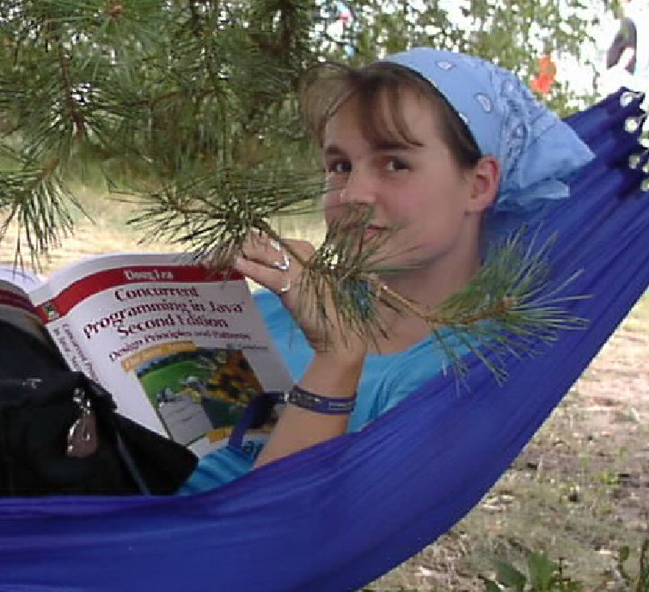
Isabel Drost
Nighttime:
Member Apache Software Foundation.
Co-Founder Apache Mahout.
Daytime:
Software developer @ Berlin.
Organizer of Berlin Hadoop Get Together.
Organizer Berlin Buzzwords.

Slide 3
Sebastian Schelter
Nighttime:
Committer Apache Mahout.
Daytime:
PhD. student DIMA TU Berlin.

Slide 4
Hello TU Students

Slide 5

January 8, 2008 by Pink Sherbet Photography
http://www.flickr.com/photos/pinksherbet/2177961471/
Massive data as in:
Cannot be stored on single machine.
Takes too long to process in serial.
Idea: Use multiple machines.

Slide 6

SW-Engineering.
Improving projects.
Scaling software.
Communication.
International projects.
Machine learning.
Project Management.

Slide 7
Credits for the project.
20 - Community interaction.
20 - Code discussion.
20 - Interaction with issue tracker.
20 - Design discussion.
20 - Coding skills.
20 - Project leadership.
30 - Theoretical understanding.
Total: 150
100 = 100%

Slide 8
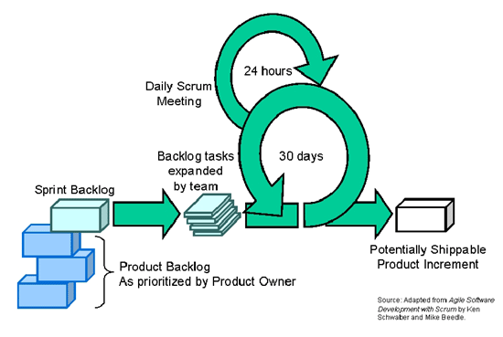
Organisation
10
http://github.com/MaineC/Playground/blob/master/projekt/backlog

Slide 9
Organisation

Slide 10
Topics

Slide 11
Comparison M/R - PACT
Take an algorithm availalbe in Mahout and
re-implement that with PACT for performance
comparison.

Slide 12
Performance benchmark

Slide 13
Yahoo! collaborative challenge

Slide 14
???

Slide 15
Topics until next Friday
Agile development.
Build management.
Version control.
Issuetracking.
Apache Hadoop.

