Slide 1
PROJECT title: ONLINE BUS TICKET BOOKING SYSTEM
GROUP NO: 31 STREAM B
MEMBERS:
1. 1062811- JULIUS MAINGI NJUGUNA
2. 1062793- NJENGA KENDI
3. 1046045- SHARON CHEPKORIR
4. 1045121- LUCY MWONGELI
5. 1049060- PETER KILUNDA

Slide 2
introduction
An online bus ticket booking system is an online platform that simplifies the process of purchasing bus tickets .it allows users to search for routes, compare prices and book tickets conveniently.

Slide 3
OBJECTIVES:
Main objective- to provide a convenient ,efficient, and user-friendly platform for customers to easily search, book, and pay for bus ticket online.
ii) To enable customers to check the availability of buses online.
iii) To enable customers to choose their seats online.
iv) To enable customers to pay for their bus ticket online.

Slide 4
Tables
Users seat_reservation
Booking tickets user_cancellation
Payment option feedback table
Routes table Audit logs
Buses table Admin table
Drivers Booked_trips
User_booking_history

Slide 5
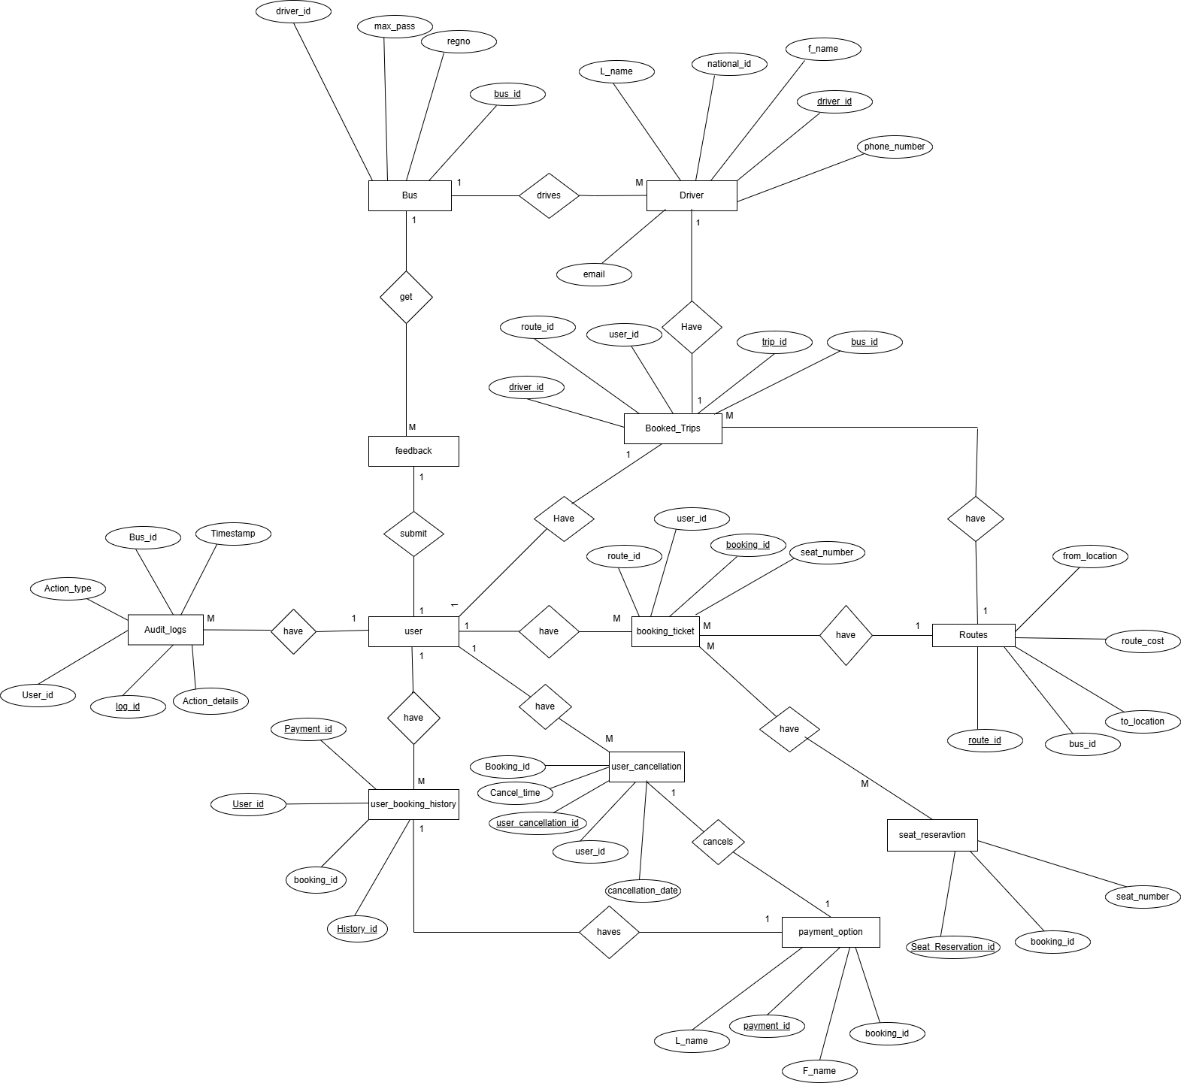
(i) ER- DIAGRAMS

Slide 6
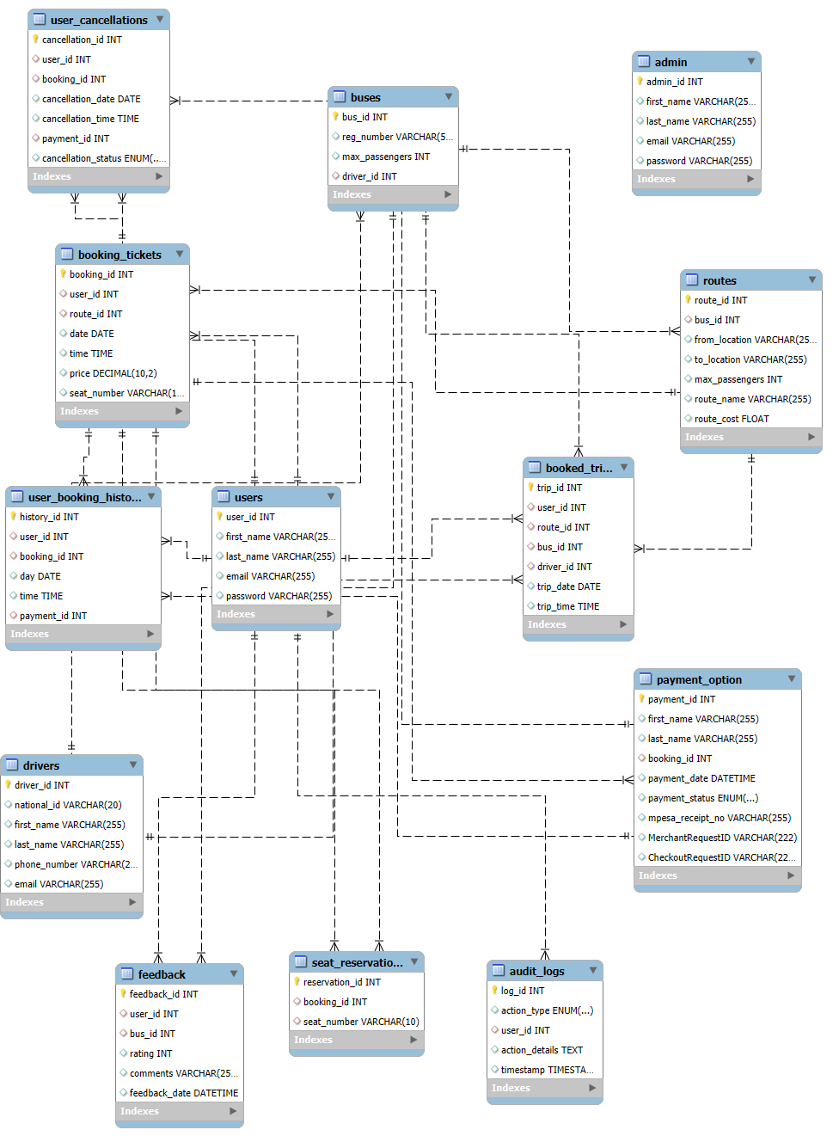
(iii) SQL SCHEMA

Slide 7
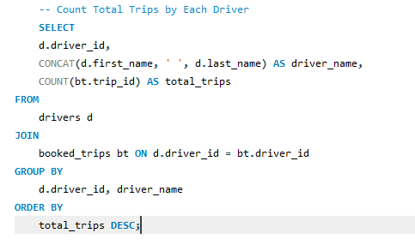
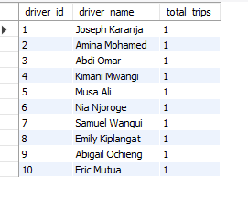
Advanced queries

Slide 8
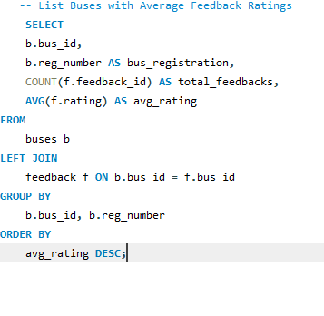
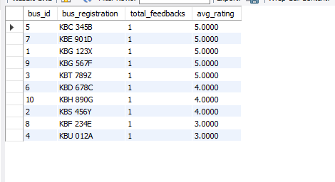
Advanced queries

Slide 9
TESTING AND VALIDATION:
Unit testing-Test inserting a user record to verify constraints like UNIQUE(email).Insert succeeds for unique email and fail for duplicate emails.
Integration Testing-Testing relationships between tables(e.g. Foreign Keys).Only existing users can make a booking.
Load Testing- Simulate a high number of operations to check database performance.(e.g. Generate 10,000 bookings records to test if the database can handle high transaction volumes)

Slide 10
CONCLUSIONS AND RECOMMENDATIONS:
Conclusions:
This online ticket booking system will:
Enhance customer satisfaction with convenient and reliable services.
Improve operational efficiency and reduce errors.
Optimize resource management using real-time data.
Strengthen market competitiveness by meeting modern needs.
Boost revenue through a user-friendly experience.

Slide 11
Future Recommendations:
Offer more Integrated Payment Options: such as credit cards, mobile wallets, and bank transfers, to cater to varied customer preferences.
Real-Time Notifications: Implement notification systems that update customers on booking confirmations, trip reminders, and any changes or delays in schedules.
Offer Promotions: Offer promotional discounts on different seasons to encourage more bookings in the future.
Incorporate Data Analytics: This will enable admins to track and understand the booking trends, popular routes.

