Slide 1




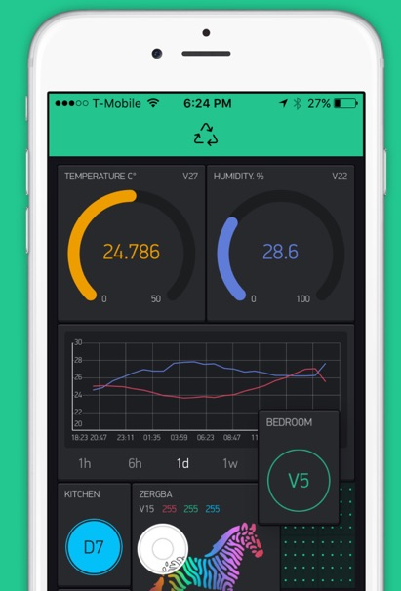




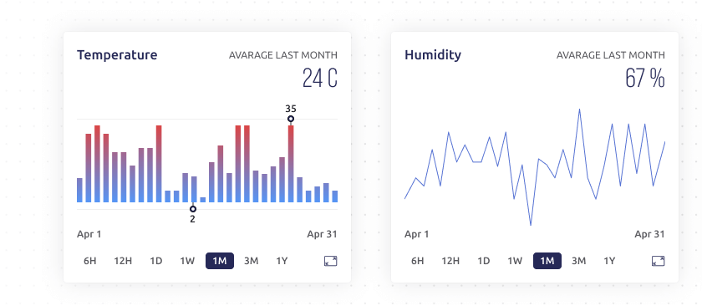

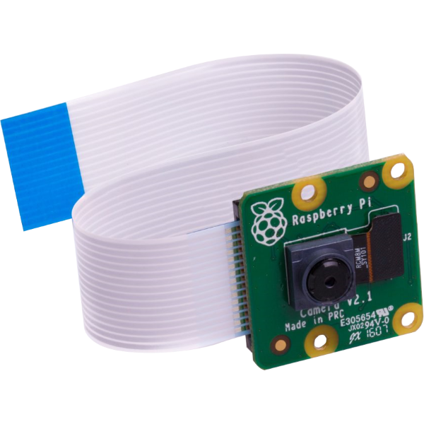
BrewBuddy
RaspberryPi in fermentation fridge
RaspberryPi with
SenseHat placed
inside fermentation
fridge
Blynk is used to visualise
the data from the RaspberryPi
and send push notification to
the mobile app when
temperature falls outside
the optimum range
Blynk console used to analyse temperature and humidity data (max., min. and average)
Python Script publishes Temperature and humidity readings at 30 minute intervals
Use SMTP in Python Script
to send an email
with a picture when
fridge is opened
RaspberryPi to
send alert to
speaker via
Bluetooth when
temperature falls
outside optimum
range

