Slide 1
Analysis of staffing levels for nursing and adult inpatient care
Mairead Bermingham

Slide 2
Markdown Elements (1)
italic, bold, –strikeout–, _{subscript}, ^{superscript}, small caps, verbatim
Ordered list item 1
Ordered list item 2
Unordered list item 1
Unordered list item 2

Slide 3

Image
Image 1 - A dog

Slide 4
Table
species | sepal.length | sepal.width
setosa | 5.1 | 3.5
virginica | 7.4 | 2.8
versicolor | 6.4 | 3.2

Slide 5
Multi-column Layout
This is the first column
List item 1
List item 2
And this is the second column
Item
Item

Slide 6
Elavator Pitch
Context Proble How we are gong to olve it
This is an R Markdown presentation. Markdown is a simple formatting syntax for authoring HTML, PDF, and MS Word documents. For more details on using R Markdown see http://rmarkdown.rstudio.com.
When you click the Knit button a document will be generated that includes both content as well as the output of any embedded R code chunks within the document.
#Som EDAs

Slide 7
Slide with Bullets
Bullet 1
Bullet 2
Bullet 3

Slide 8
Loading the libraries
## ── Attaching core tidyverse packages ──────────────────────── tidyverse 2.0.0 ── ## ✔ dplyr 1.1.2 ✔ readr 2.1.4 ## ✔ forcats 1.0.0 ✔ stringr 1.5.0 ## ✔ ggplot2 3.4.2 ✔ tibble 3.2.1 ## ✔ lubridate 1.9.2 ✔ tidyr 1.3.0 ## ✔ purrr 1.0.1 ## ── Conflicts ────────────────────────────────────────── tidyverse_conflicts() ── ## ✖ dplyr::filter() masks stats::filter() ## ✖ dplyr::lag() masks stats::lag() ## ℹ Use the conflicted package (<http://conflicted.r-lib.org/>) to force all conflicts to become errors
Meta
## Rows: 32 ## Columns: 11 ## $ mpg <dbl> 21.0, 21.0, 22.8, 21.4, 18.7, 18.1, 14.3, 24.4, 22.8, 19.2, 17.8,… ## $ cyl <dbl> 6, 6, 4, 6, 8, 6, 8, 4, 4, 6, 6, 8, 8, 8, 8, 8, 8, 4, 4, 4, 4, 8,… ## $ disp <dbl> 160.0, 160.0, 108.0, 258.0, 360.0, 225.0, 360.0, 146.7, 140.8, 16… ## $ hp <dbl> 110, 110, 93, 110, 175, 105, 245, 62, 95, 123, 123, 180, 180, 180… ## $ drat <dbl> 3.90, 3.90, 3.85, 3.08, 3.15, 2.76, 3.21, 3.69, 3.92, 3.92, 3.92,… ## $ wt <dbl> 2.620, 2.875, 2.320, 3.215, 3.440, 3.460, 3.570, 3.190, 3.150, 3.… ## $ qsec <dbl> 16.46, 17.02, 18.61, 19.44, 17.02, 20.22, 15.84, 20.00, 22.90, 18… ## $ vs <dbl> 0, 0, 1, 1, 0, 1, 0, 1, 1, 1, 1, 0, 0, 0, 0, 0, 0, 1, 1, 1, 1, 0,… ## $ am <dbl> 1, 1, 1, 0, 0, 0, 0, 0, 0, 0, 0, 0, 0, 0, 0, 0, 0, 1, 1, 1, 0, 0,… ## $ gear <dbl> 4, 4, 4, 3, 3, 3, 3, 4, 4, 4, 4, 3, 3, 3, 3, 3, 3, 4, 4, 4, 3, 3,… ## $ carb <dbl> 4, 4, 1, 1, 2, 1, 4, 2, 2, 4, 4, 3, 3, 3, 4, 4, 4, 1, 2, 1, 1, 2,…

Slide 9
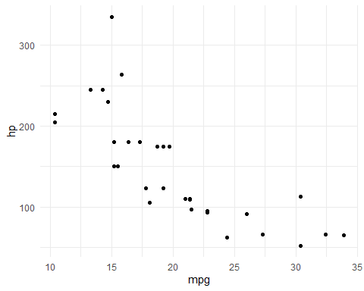
Some EDAs
This is the most critical part

Slide 10
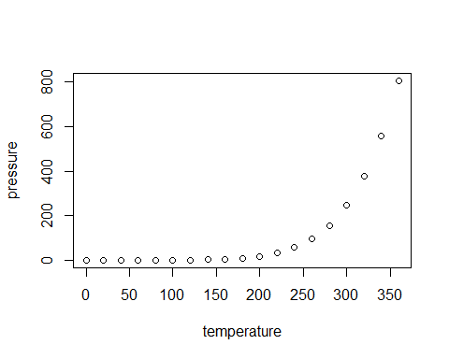
Slide with Plot

