Slide 1

Name: MAISA BASHER
Major: Computer Science
Freshman

Slide 2

Name: Quyen Pham
Major: Computer Science
Sophomore

Slide 3

14 th Annual Georgia state Undergraduate Research Conference
CRYPTOGRAPHY From CAESAR CIPHER to RSA
Quyen Pham & Maisa Basher
Advisor: professor Muiny Somaya

Slide 4
CRYPTOGRAPHY
Objectives:
1. Confidentiality
2. Integrity
3. Non-repudiation
4. Authentication

Slide 5





CRYPTOGRAPHY
CEASER CIPHER OPERATION
CYPHER TEXT
PLAIN TEXT
PLAIN TEXT
Encryption
Decryption

Slide 6
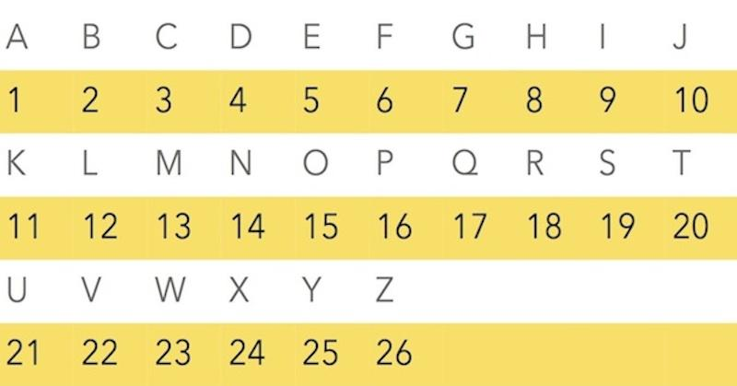
CRYPTOGRAPHY
CEASER CIPHER SETTING-UP:

Slide 7
CRYPTOGRAPHY
CEASER CIPHER OPERATION
Let’s send the message “HI”
H (8)
I (9)
Encyption
C=(M+3)mod26
C=(8+3)mod26
L (12)
K (11)
Decryption
M=(C-3)mod26
M=(11-3)mod26
H (8)
I (9)

Slide 8
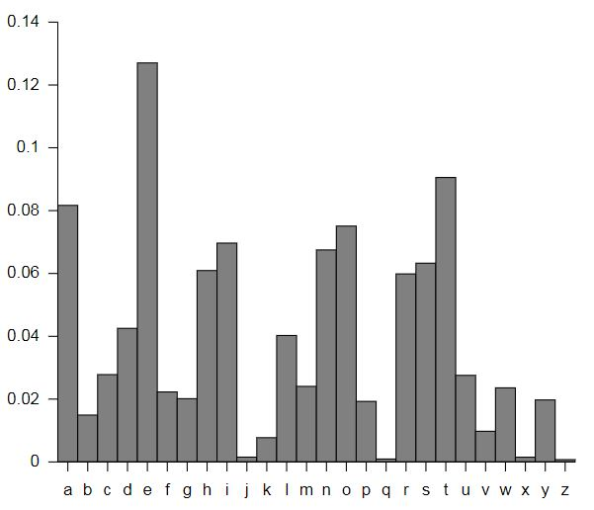
CRYPTOGRAPHY
Frequency
(%)
DISADVANTAGES
1. Symmetry of the encrypted and decrypted functions
2. Letter of frequency
Letter of Frequency Table
letters

Slide 9
CRYPTOGRAPHY THE RSA CIPHER

Slide 10
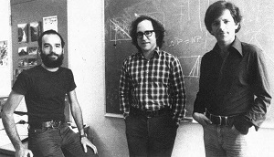
CRYPTOGRAPHY

Slide 11
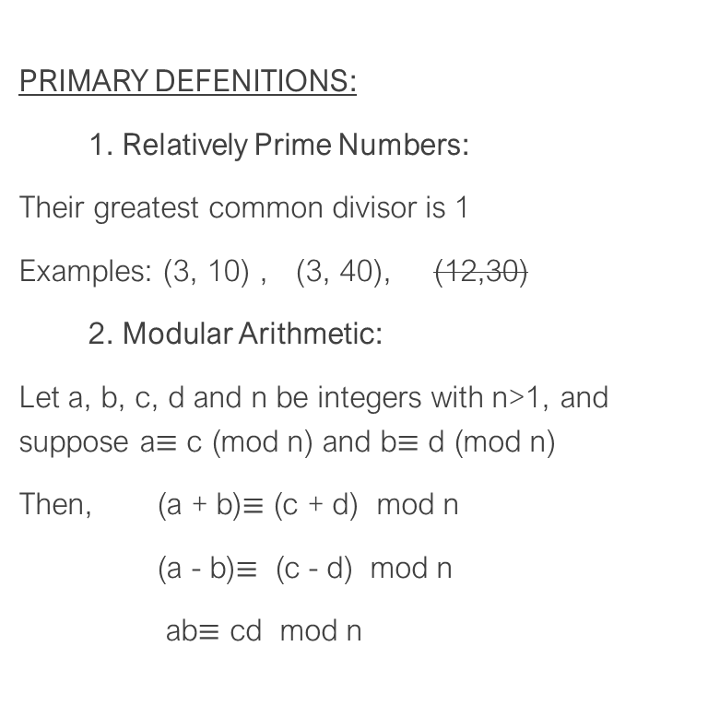
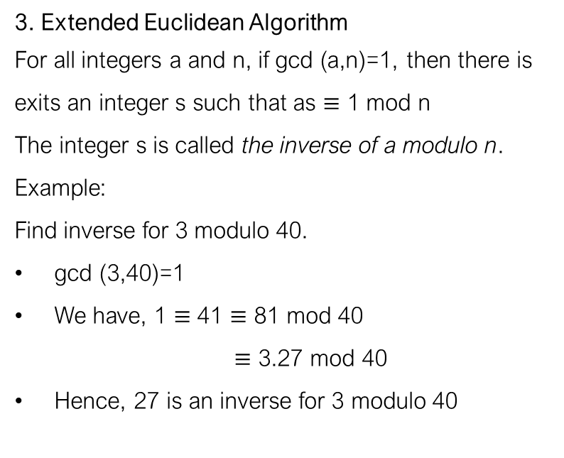
CRYPTOGRAPHY

Slide 12
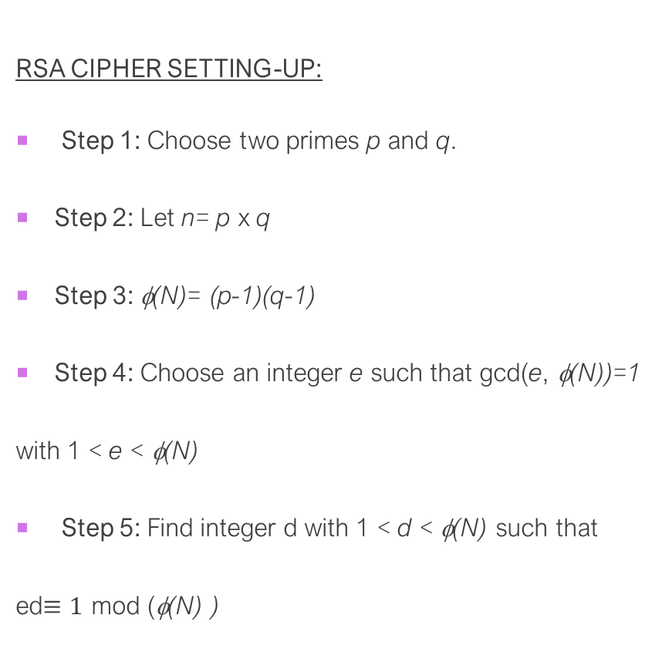
CRYPTOGRAPHY
🡺 p = 5 and q = 11
🡺 n= 5 x 11= 55
🡺 φ(N)= (5-1)(11-1)=40
🡺 e = 3
🡺 d = 27

Slide 13
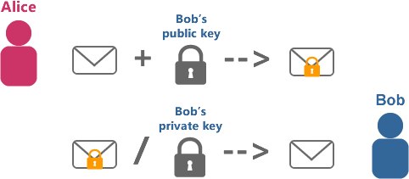
CRYPTOGRAPHY
RSA CIPHER OPERATION
Let’s send the message “HI” again!
Public key (e, n) = (3, 55)
Private key (p, q) = (5, 11)

Slide 14
CRYPTOGRAPHY
RSA CIPHER OPERATION
H and I are encoded since they are the eighth and ninth letters in the alphabet corresponding
H:
C = 8³ mod 55 = 512 mod 55 =17
I:
C= 9³ mod 55 = 729 mod 55= 14
8 and 9
Accordingly Alice sends Bob the message: 17 14
Encryption
C = Me mod n

Slide 15
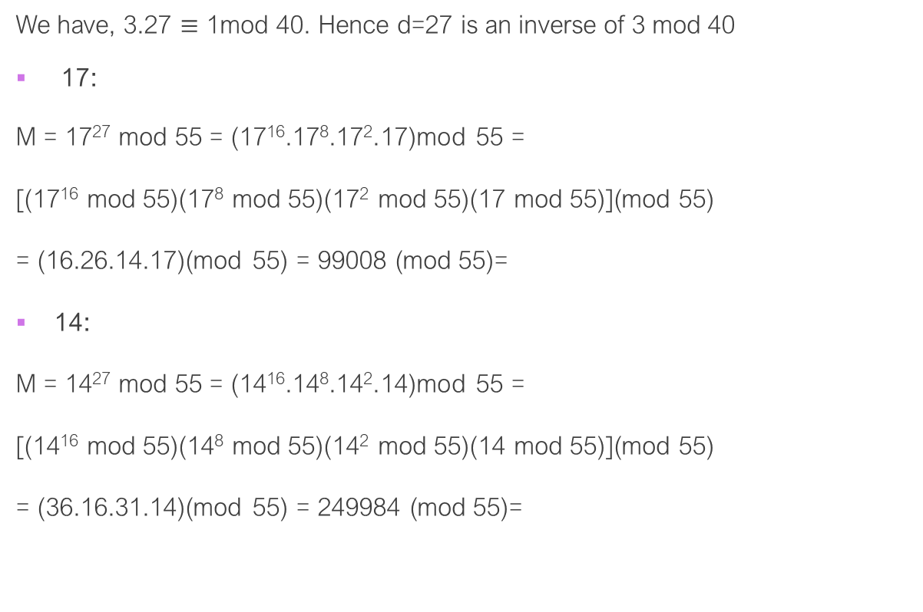
CRYPTOGRAPHY
RSA CIPHER OPERATION
Accordingly Bobs sends Alice the message: 8 9, which corresponds to the letters “HI”
Decryption
M = C^{d} mod n
8 mod 5
9 mod 5

Slide 16
CRYPTOGRAPHY
WORKS CITED:
Cryptography Defined/Brief History. https://www.laits.utexas.edu/~anorman/BUS.FOR/course.mat/SSim/history.html. Accessed 31 Jan. 2020.
“Frequency Analysis.” Privacy Canada, https://privacycanada.net/attack-vectors/frequency-analysis/. Accessed 31 Jan. 2020.
Susanna S. Epp. Discrete Mathematics with Applications 4th Edition. Cengage Learning; 004 edition (August 4, 2010)

