Slide 1

Supervisor
PhD. Moshe Sulamy
MosheSu@braude.ac.il
Students
Seren Hanany seren.hanany@e.braude.ac.il
Maisalon Safory maisalon.safory@e.braude.ac.il
Software Engineering Department ORT Braude College
Capstone Project Phase B – 61998
House of Riddles using ML
24-1-D-42

Slide 2

House of Riddles using ML
Dynamic 3D environment
Quiz-solving
Constantly evolving world based on player actions

Slide 3
Problem

Slide 4

Widespread Smartphone Use
Perception of Casual Games
Lack of Educational Value
Missed Opportunity
Notes:
Nowadays, it's common for everyone to spend their free time using smartphones and playing video games, which are often games of little importance to adults, seen as a waste of time without a clear goal, and contribute to a lack of knowledge in many fields.

Slide 5

Gap between Phase A and Phase B
Model Training Limitations and Future Enhancements:
Additional training is required to enhance the model's ability to provide more personalized quiz-solving strategies
Multiplayer Mode: Challenges and Planned Improvements:
Multiplayer mode implementation was postponed in Phase B due to time and resource constraints.

Slide 6
Solution

Slide 7




House of Riddles
A game using ML to develops player’s information.
ML-Driven Player Behavior Analysis
Educational Value
Purposeful Gaming
Adaptive Learning Experience
Notes:
house of riddles integrates a reinforcement learning model designed to analyze the players' answers. By learning patterns from previous game sessions, the model adapts tips to choose the correct answer. This ML feature acts as a support system, pushing players unfamiliar with the game and rewarding those who demonstrate consistent skill.

Slide 8
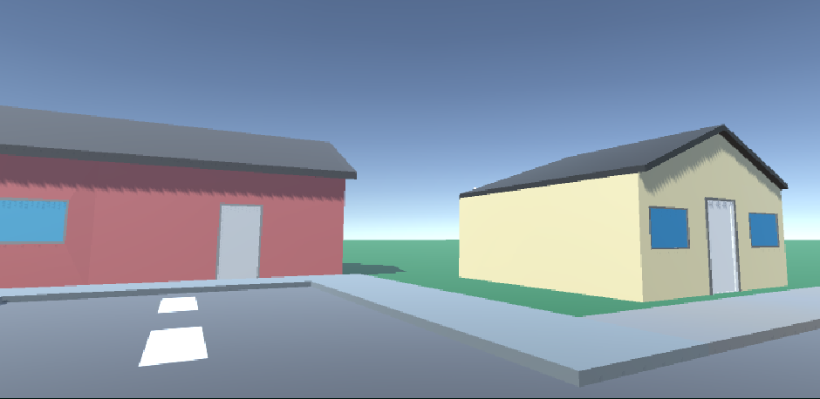
Developing the solution

Slide 9
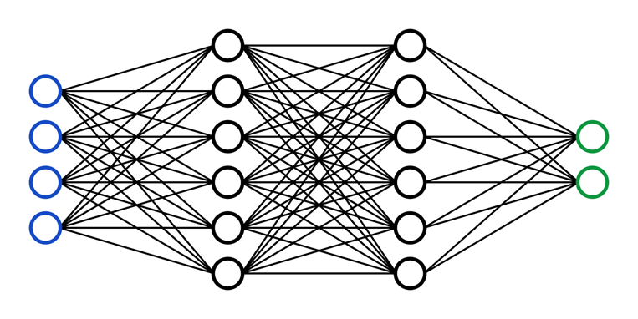



Reinforcement Learning Integration:
Applied to dynamically adjust quiz difficulty based on player performance.

Slide 10
Player Behavior Analysis
ML system analyzes player behavior to offer personalized hints and challenges.

Slide 11
3D Environment Development
Built using Unity to create a visually immersive and interactive world.

Slide 12
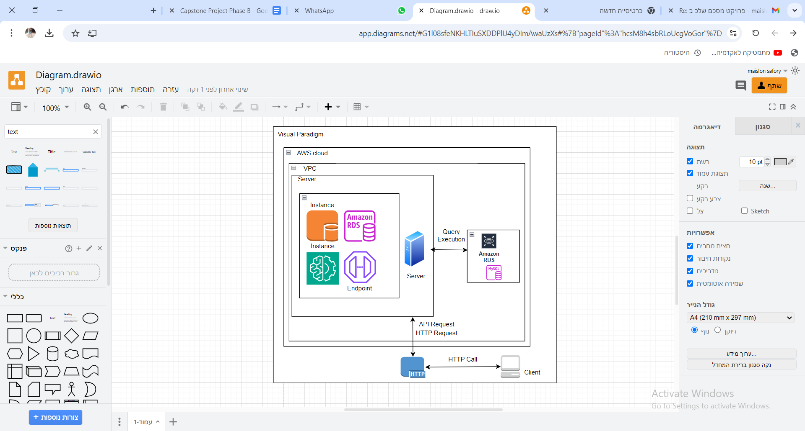
AWS Architecture Diagram
Server-Client Infrastructure:
Data stored securely using AWS RDS MySQL, ensuring progress is preserved.
REST API Integration:
Seamless communication between client and server for real-time updates.

Slide 13
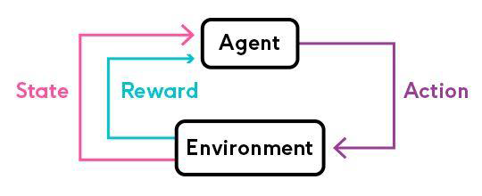
Training
Reward: +0.1
Penalty: -0.1

Slide 14
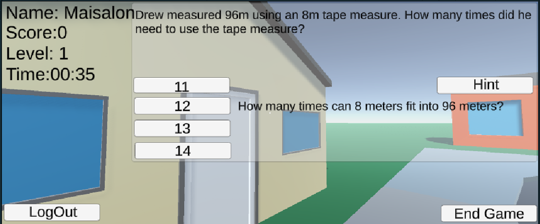
Examples of RL results
Example 1:
Notes:
In this example, the player named "Seren" is not new to the game, as indicated by their level being 5. Since Seren has progressed to a higher level, the reinforcement learning (RL) model recognizes their experience and provides a more challenging hint: "The process starts with 'photo,' which means light, and ends with a term related to making something." This hint requires the player to connect more advanced concepts, making it suitable for someone at a higher skill level.
The RL system adjusts the difficulty of hints based on the player's level, performance, and history. It also takes into account the time taken (in this case, 1 minute and 41 seconds) and the number of attempts to decide on the next hint's complexity. Additionally, the RL model understands that this hint might be considered hard for Seren, but it could be easy for another player at a different skill level. This dynamic adjustment ensures that hints are tailored not just to the player's current level but also to their individual learning pace and ability.

Slide 15
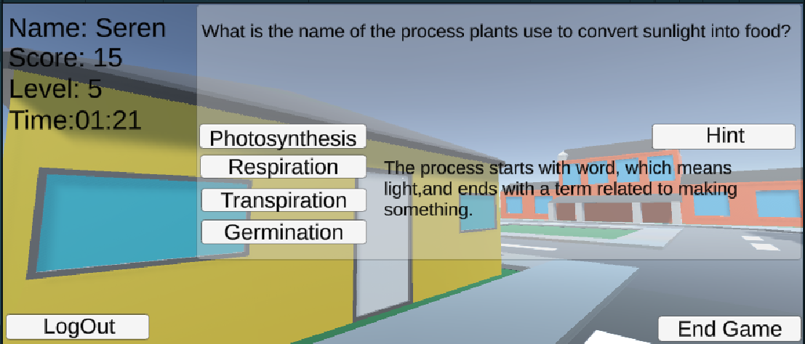
Example 2:
Notes:
In the text displayed at the bottom, it congratulates the player, "Seren," for successfully solving the current challenge: "Well done! You've won a house! Keep going to conquer even more!" This message serves as motivation for the player to continue progressing through the game.
The subsequent line, "Number of your houses: 3," indicates that Seren has already solved three houses in total. Each house represents a set of challenges or quizzes that the player has successfully completed. This running count serves as a way for the player to track their progress and achievements in the game, providing a sense of accomplishment and encouraging them to keep pushing forward to conquer additional houses.

Slide 16
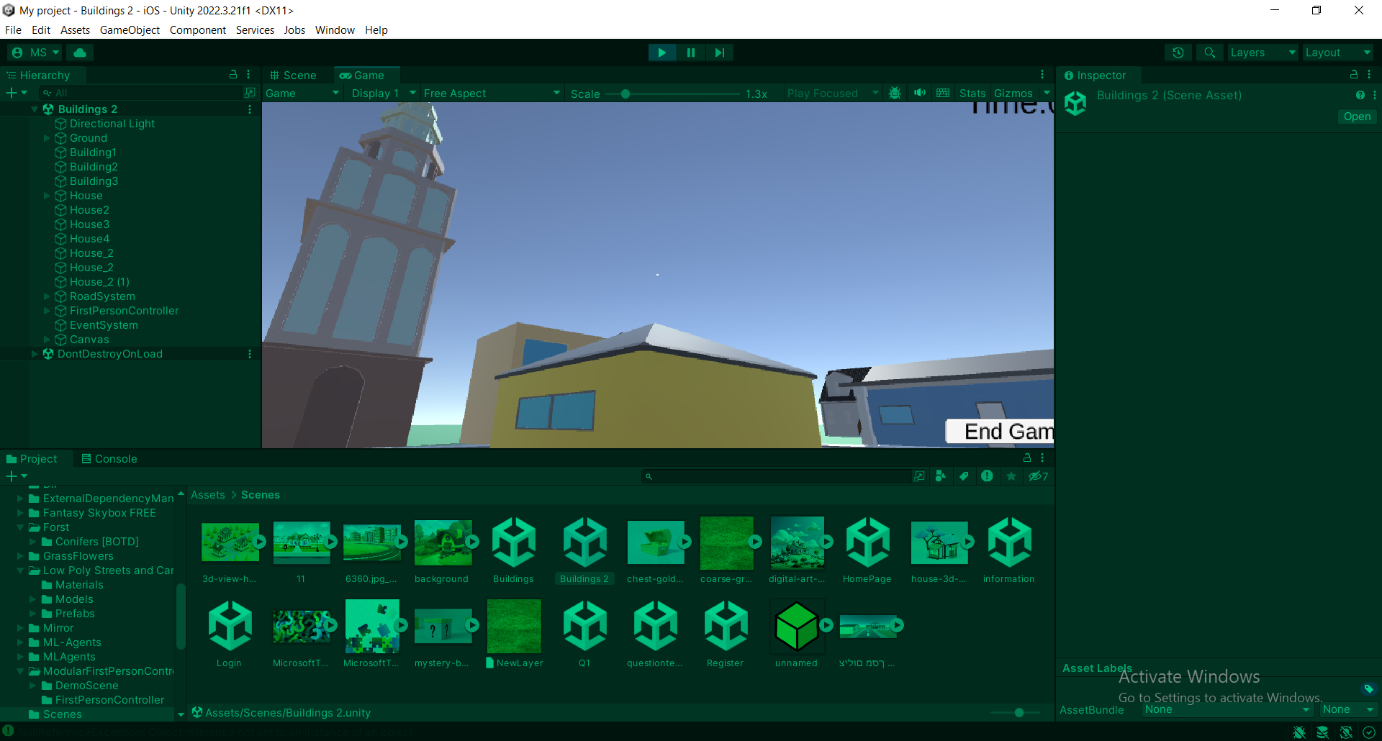
Scenes and Flow

Slide 17
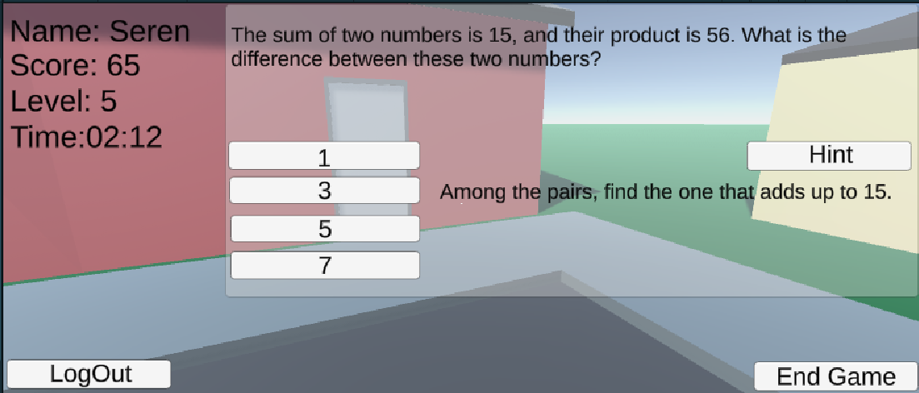

Slide 18
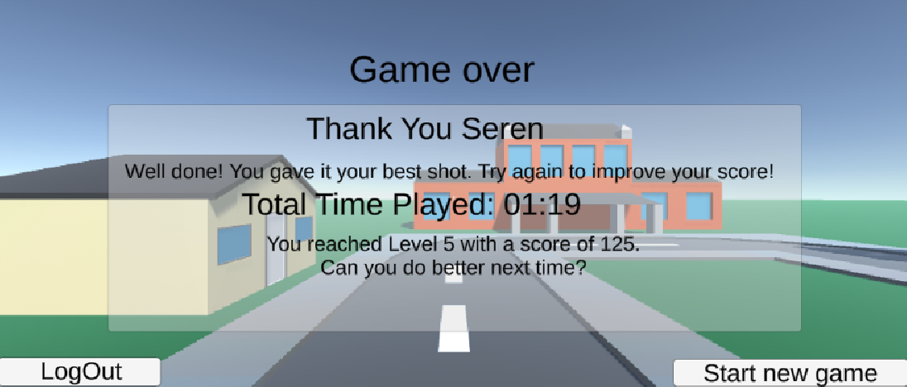

Slide 19





Tools we used

Slide 20
Further Improvements
Adding Multiplayer Mode
Adding music & sound effects
More training helps the RL agent learn from experience, improving its performance.

Slide 21
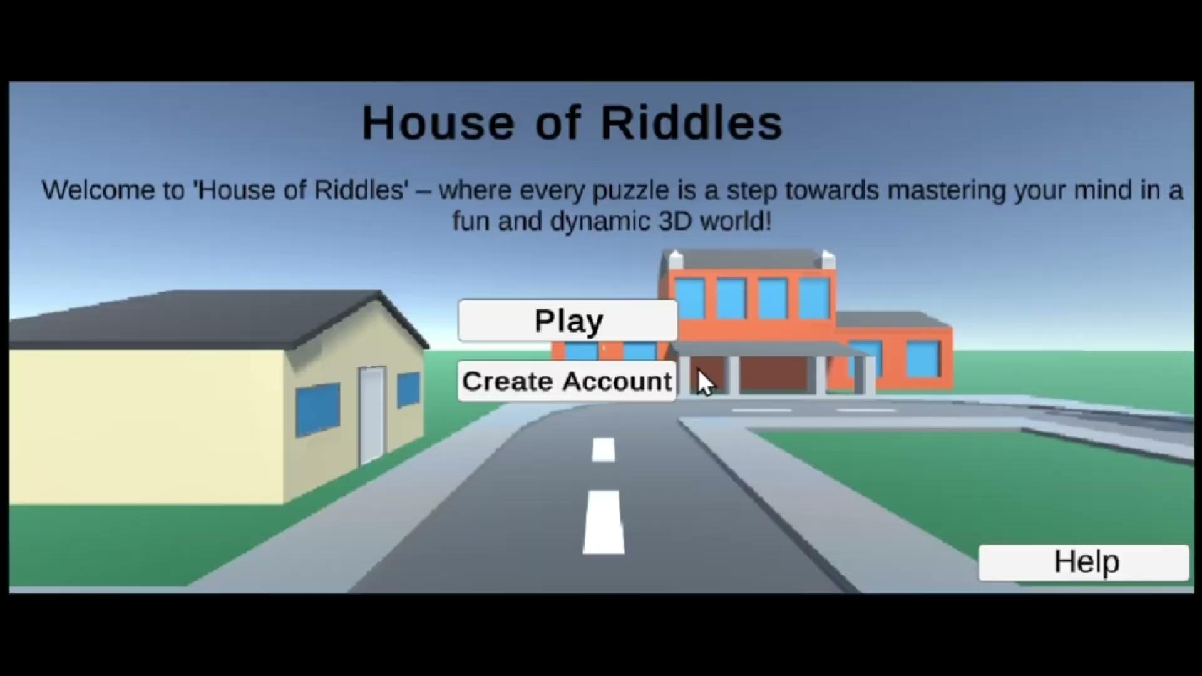

Slide 22

Thank You

