Slide 1

DIGITAL INTEGRATED CIRCUITS
Design and Analysis of a Low Power Conditional Capture Flip-Flop in 32 nm CMOS
Done by:
Maysam AbuJaber 1220014
Khadija Absi 1220458
Date: 27 Jan 2026

Slide 2

The Outline
1. Introduction & Motivation
2. Problem Statement
3. Proposed CCFF Architecture
4. Pre-Layout Simulation Results
5. Physical Layout Design
6. Post-Layout Simulation Results
7. Comparative Analysis
8. Innovation & Results Summary
9. Conclusion & Future Work

Slide 3

Table of contents
Introduction & Motivation
Power Crisis in Modern VLSI:
- Clock power: 30-45% of total chip power
- Flip-flops: Critical for power optimization
- Problem: Redundant switching when D=Q
Statistical Opportunity:
- Flip-flops unchanged 50-70% of cycles
- Target: Low-activity applications
- Control logic
- Configuration registers

Slide 4

Conventional FF Problem
Continuous internal switching
Power waste even when D = Q
No data-dependent control
Our Goal: Optimal power-timing-area balance
Design | Power Reduction | Limitation
Kang 2008 | 35% | Timing OH
Mahmood (2004) | 40% | Area +43%
Roy (2014) | 29% | PVT issues

Slide 5
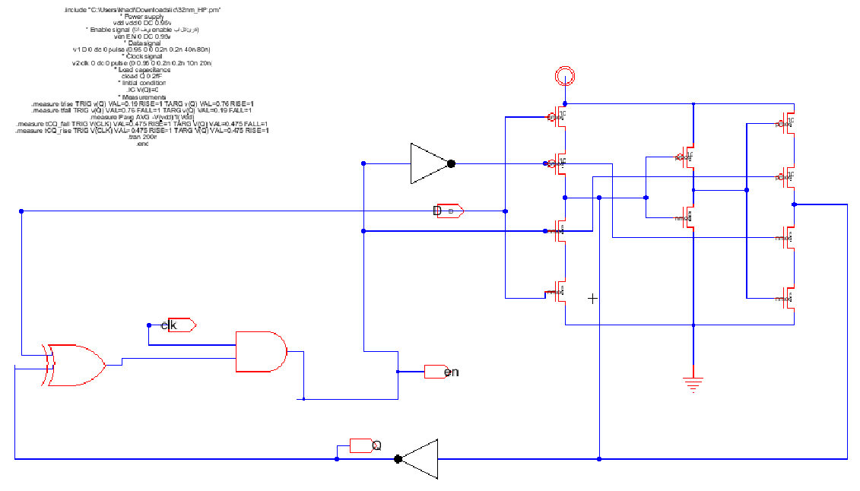
Three Main Blocks:
1. Data Comparison Unit (XOR)
• Compares D and Q
• Lightweight: 2-transistor TG
2. Conditional Clock Gating
• Generates CLK_int
• Blocks when D = Q
3. Master-Slave Latch
• Static CMOS design
• Robust data retention
Specifications:
- 28 transistors (vs. 24 conventional)
- 18% area overhead
- 32 nm CMOS technology

Slide 6
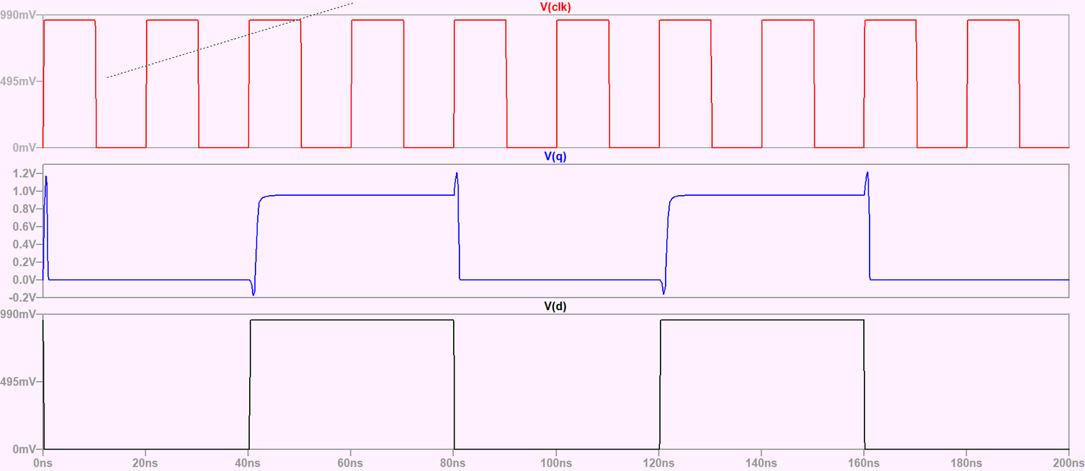
When the input data differs from the stored value (D ≠ Q), the comparison logic activates the internal clock, allowing normal flip-flop operation and enabling data transfer from the master to the slave stage. In contrast, when no data transition occurs (D = Q), the internal clock is blocked, freezing the internal nodes and completely eliminating unnecessary switching activity, which results in significant power savings. From a timing perspective, the comparison operation must be completed before the active clock edge, introducing a minor setup time penalty of approximately 7 ps, while ensuring fully glitch-free and reliable operation.

Slide 7
pre-Layout Result
Parameter | Conventional FF | Proposed CCFF
avg Power | 3.77*10-7 | 2.3*10-7
CLK Power(W) | 3.77*10-7 | 3.77*10-7
Setup Time (ps) | 35 | 42
Hold Time (ps) | 8 | 10
CLK to Q (ps) | 37.8 | 38.5
Power Reduction |  | 39%
CLK Power Reduction |  | 48.6

Slide 8
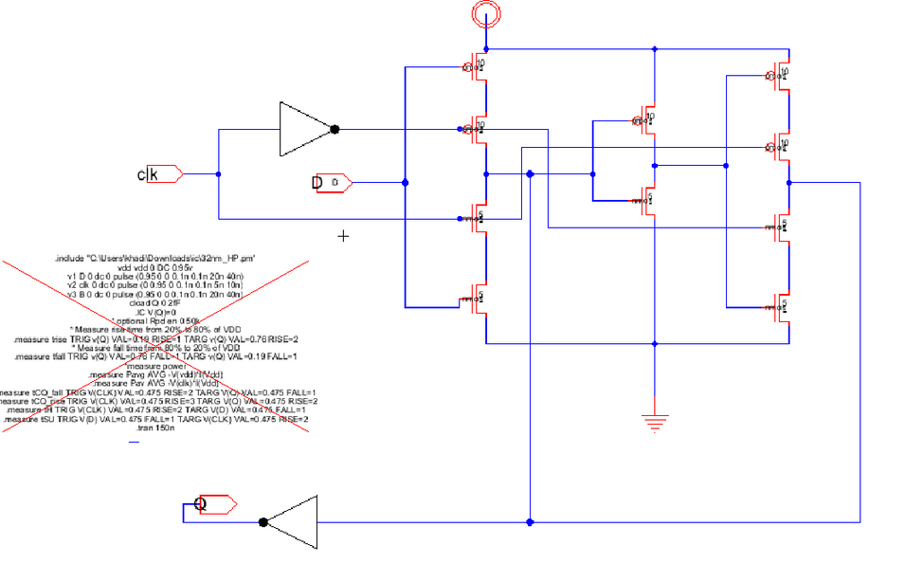
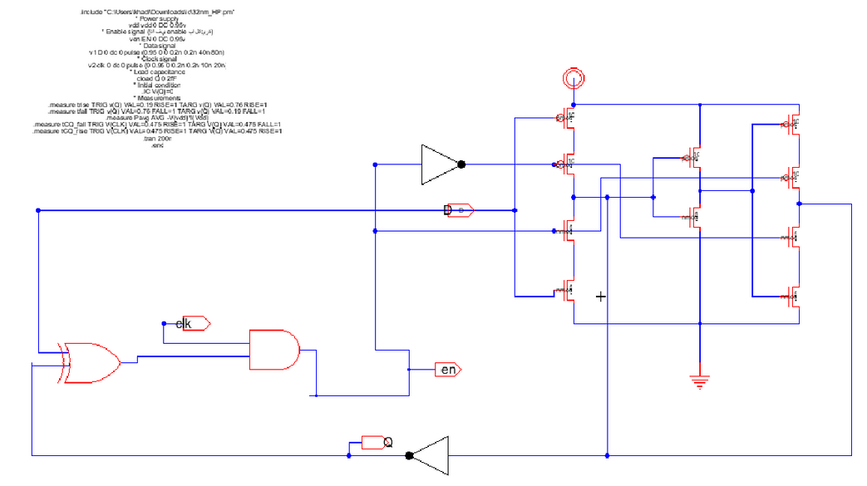
Right (CCFF): Internal clock stops toggling when D = Q,
eliminating unnecessary switching and saving power.
left (Conventional FF): Internal signals continuously
toggle every cycle, wasting power even when data is stable.
Result: 39% power reduction in CCFF vs. conventional design.

Slide 9
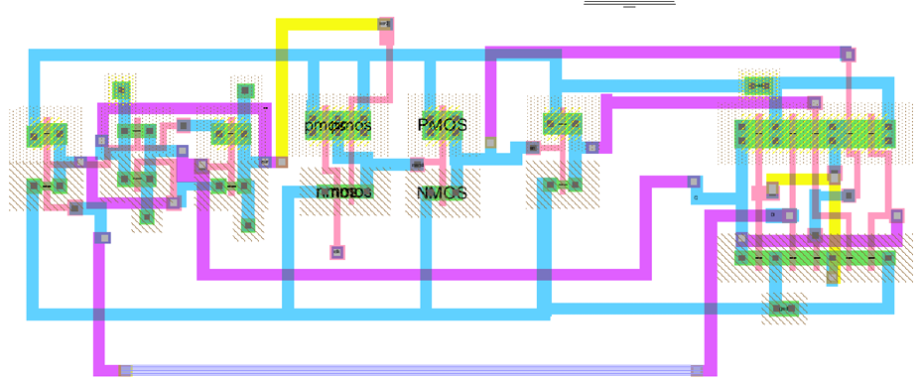
Physical Layout Design

Slide 10
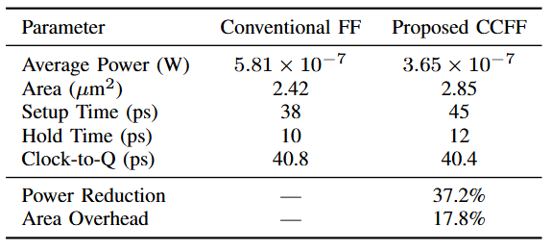
post-Layout Result

Slide 11
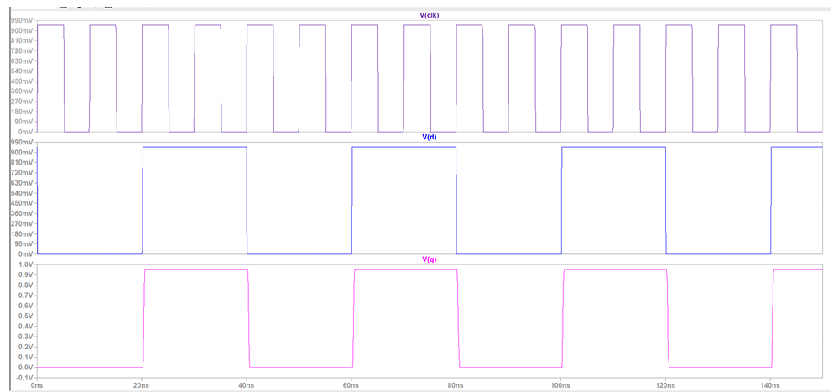
Post-Layout Results

Slide 12
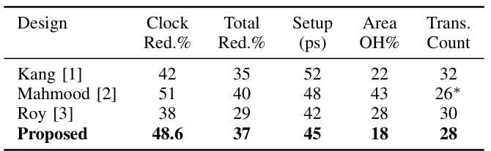
Comparison with References

Slide 13






Key Achievements
Area Innovation
Low area overhead compared to reference designs
Compact and efficient flip-flop structure
Optimized layout implementation
Power Innovation
Significant reduction in clock power
Reduced total power consumption
Power saving improves when data activity is low
Speed Innovation
Competitive clock-to-Q delay
Small setup time penalty
Stable timing across operating conditions
Project Goals
Target: 20–30% clock power reduction
Achieved: Exceeded the target clock power reduction

Slide 14
Conclusion & Future Work
Conclusion
Designed a low power CCFF in 32 nm CMOS
Reduced clock power compared to conventional flip-flop
Maintained acceptable timing performance
Verified through pre- and post-layout simulations
Future Work
Extend the design to advanced technology nodes
Design multi-bit CCFF structures
Further optimize power consumption
Integrate into larger digital systems

