Slide 1



Hospital
Management
System

Slide 2


at a normal doctor’s chamber or hospital , in a chaotic day
Receptionist usually manage all the patients and their matters manually
Which leads to:
Unable to document
Emergency system mismanagement
Mentally laborious job
Untraceable information

Slide 3
at a normal doctor’s chamber or hospital , in a chaotic day
Receptionist usually manage all the patients and their matters manually
Which leads to:
Emergency system mismanagement
Unable to document
Mentally laborious job
Untraceable information

Slide 4
at a normal doctor’s chamber or hospital , in a chaotic day
Receptionist usually manage all the patients and their matters manually
Which leads to:
Unable to document
Emergency system mismanagement
Mentally laborious job
Untraceable information

Slide 5
at a normal doctor’s chamber or hospital , in a chaotic day
Receptionist usually manage all the patients and their matters manually
Which leads to:
Unable to document
Emergency system mismanagement
Mentally laborious job
Untraceable information

Slide 6

Serial management
Creating database
Searching and sorting patients information
Backed up by DATA STRUCTURE

Slide 7
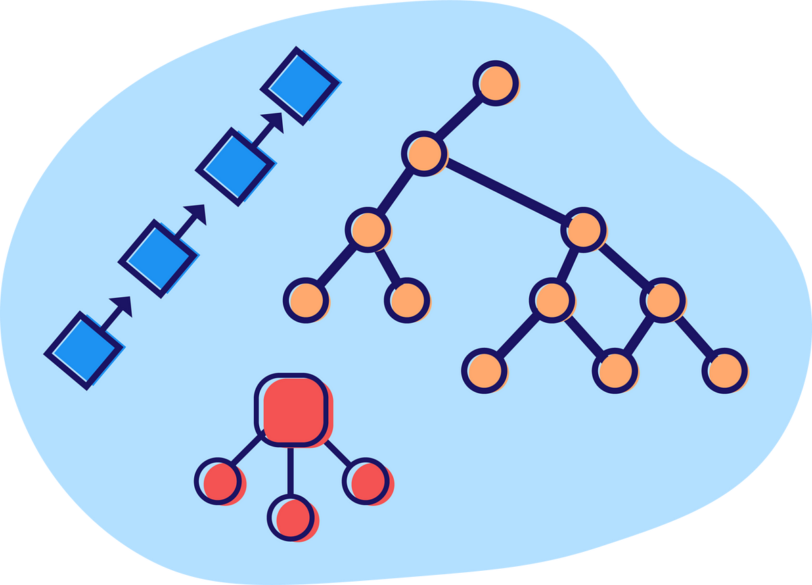
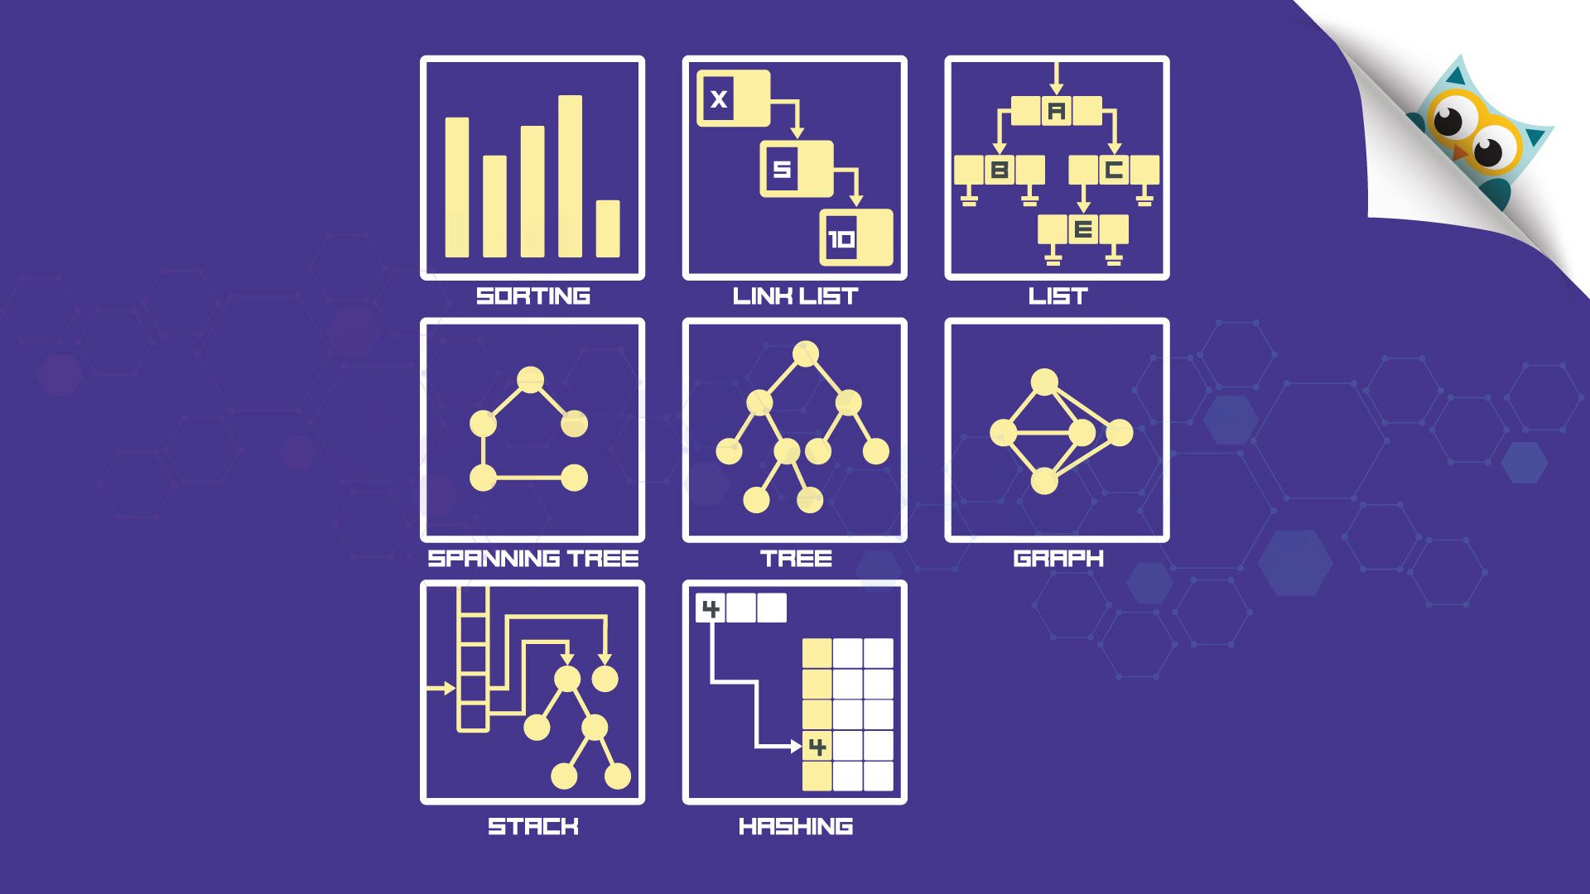

Data Structure
Linked list: A linear data structure that stores a collection of data elements dynamically.
Queue: a linear data structure that is open at both ends and the operations are done in (FIFO) order
Sorting: a sorting technique that swaps the smallest element with the current index

Slide 8

`
Patient 1
FRONT
REAR

Slide 9
`
Patient 1
FRONT
Patient 2
REAR

Slide 10
`
Patient 1
FRONT
Patient 2
Patient 3
REAR

Slide 11
`
Patient 1
FRONT
Patient 2
Patient 3
REAR
EMERGENCY CASE

Slide 12
`
Patient 1
FRONT
Patient 2
Patient 3
REAR
EMERGENCY CASE

Slide 13
`
EMERGENCY CASE
FRONT
Patient 1
Patient 2
Patient 3
REAR

Slide 14
`
Pseudo Code
function enqueue(name1, age1, gender1, bgroup1, emergency1):
newNode = create Node with attributes (name1, age1, gender1, bgroup1, emergency1)
if size is 0:
set front and rear as newNode
else:
if emergency1 is not equal to 0:
newNode.next = front
set front as newNode
else:
rear.next = newNode
set rear as newNode
increment size by 1

Slide 15
View Patient at the front of the Queue
===== Options =====
1. Add Patient to Serial
2. Remove Patient from Serial
3. View Current Patient
4. View Whole Serial list
5. Database Options
6. Exit system
====================
Enter your choice: 3
Current Patient is :
Name Age Gender Blood Group Emergency Status
MASHRAFI 22 Male O+ 0
Press any key to go back.......
.

Slide 16
Psuedo Code
function peek():
if size is 0:
output "Serial is empty"
else:
output formatted data:
output "Name Age Gender Blood Group Emergency Status"
output front node's data in formatted columns:
output front.name, front.age, front.gender, front.bgroup, front.emergency
.

Slide 17

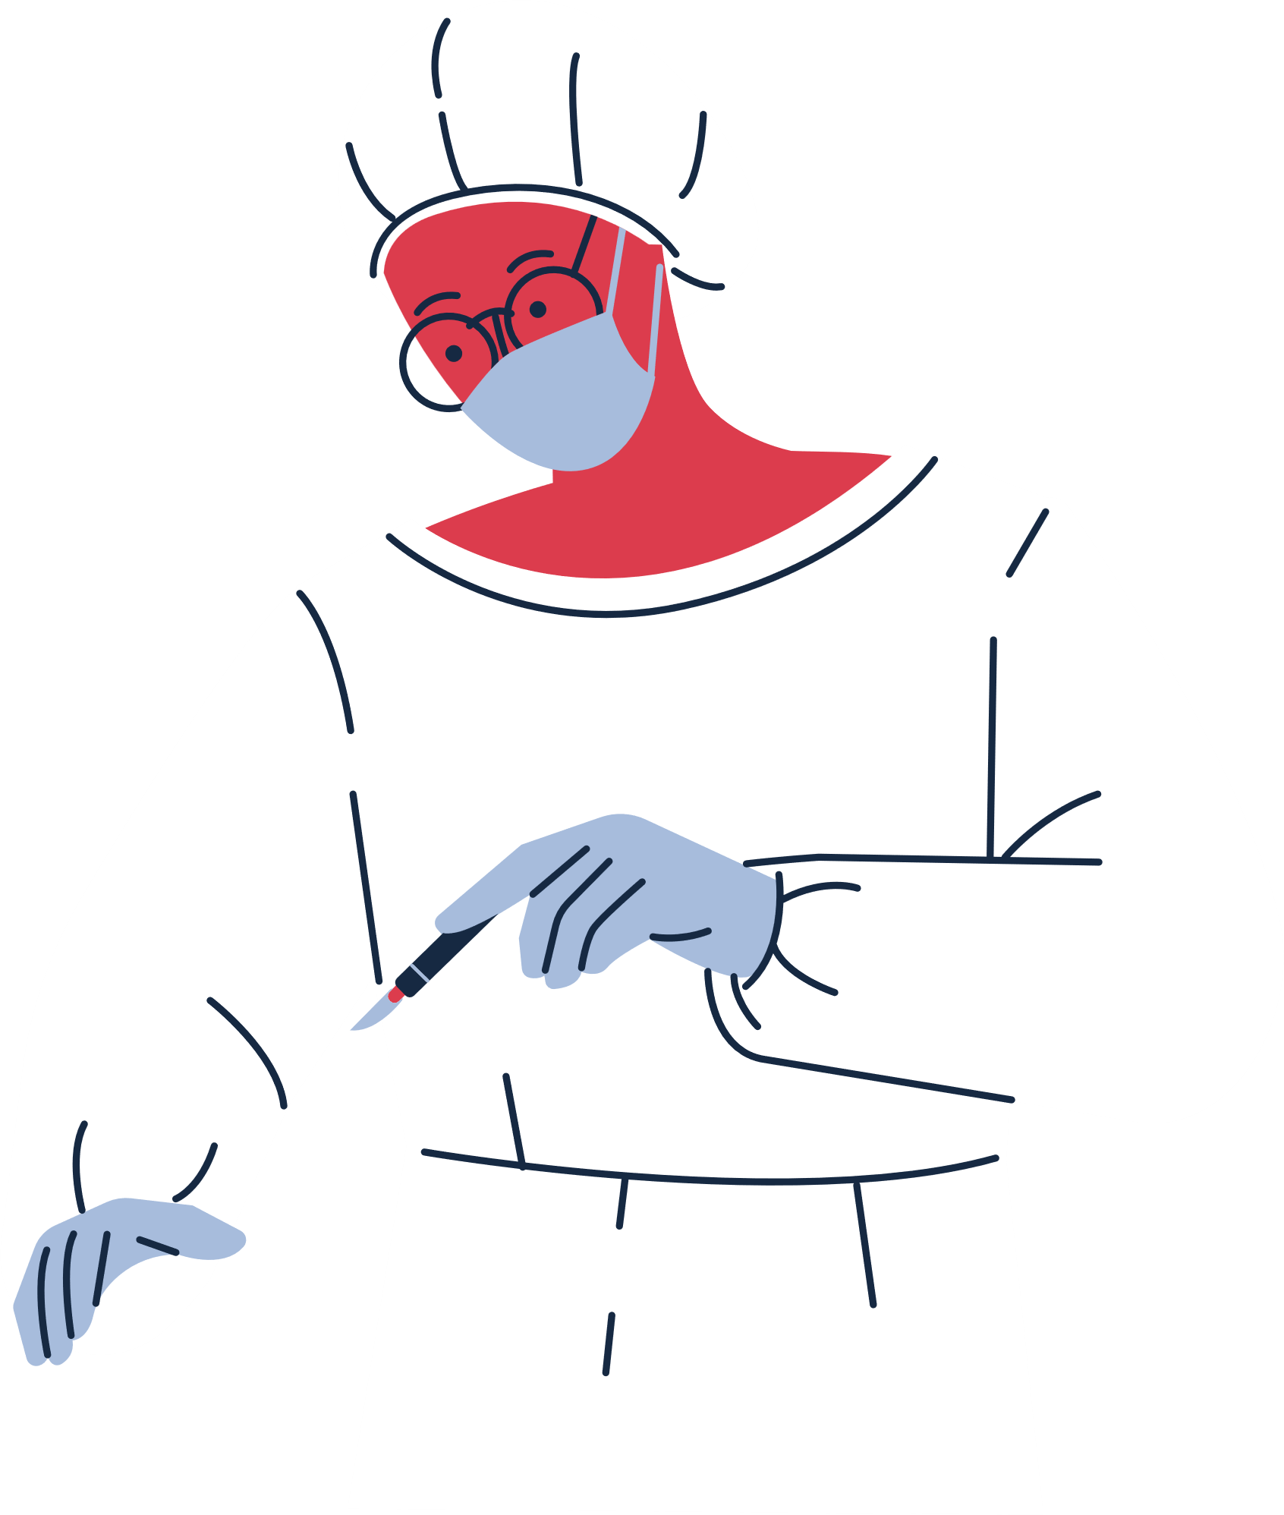
NAME AGE GENDER BLOOD GROUP
DATABASE
NAME: MAISHA
AGE:20
GENDER:Female
BLOOD GROUP:A+
MAISHA 20 Female A+
NAME: MASHRAFI
AGE:20
GENDER:Male
BLOOD GROUP:B+
MAISHA 20 Female A+
NAME: Nipun
AGE:22
GENDER:Male
BLOOD GROUP:O+
REMOVED BUT NOT SAVED IN DATABASE

Slide 18
Pseudo Code
function dequeueAdd():
if size is 0:
output "Serial is empty"
return
temp = front
set front as front.next
add data (name, age, gender, bgroup, emergency) to database at the end
delete temp
decrease size by 1
output "Patient successfully removed and added to database"

Slide 19





SUB MENU OF DATA BASE
SEARCH DATABASE
BY NAME & BLOOD GROUP
DELETE ENTRY BY NAME
SORT BY NAME,
AGE, GENDER & BLOOD GROUP
VIEW WHOLE DATA BASE
EXPORT TO TEXT FILE

Slide 20
Search Database
( B y N a m e )
Found
Not Found
===== Database Options =====
1. View Database
2. Search Database by Name
3. Search Database by Blood Group
4. Delete Entry
====================
Enter your choice: 2
Enter name to search
Mehnaz Aurpa
Patient found:
Name Age Gender Blood Group Emergency Status
Mehnaz Aurpa 19 Female AB+ 0
Press any key to go back.......
===== Database Options =====
1. View Database
2. Search Database by Name
3. Search Database by Blood Group
4. Delete Entry
====================
Enter your choice: 2
Enter name to search
Musabbir Hasan
Patient not found.
Press any key to go back.......
.

Slide 21
Pseudo Code
Linear Search
function searchByName(nameToSearch):
current = head
while current is not equal to nullptr:
if current.name is equal to nameToSearch:
return current
set current as current.next
return nullptr
.

Slide 22
SUB MENU OF DATA BASE
SEARCH DATABASE
BY NAME & BLOOD GROUP
DELETE ENTRY BY NAME
SORT BY NAME,
AGE, GENDER & BLOOD GROUP
VIEW WHOLE DATA BASE
EXPORT TO TEXT FILE

Slide 23
SUB MENU OF DATA BASE
SEARCH DATABASE
BY NAME & BLOOD GROUP
DELETE ENTRY BY NAME
SORT BY NAME,
AGE, GENDER & BLOOD GROUP
VIEW WHOLE DATA BASE
EXPORT TO TEXT FILE

Slide 24
Viewing whole data base
NAME AGE GENDER BLOOD GROUP
MAISHA 20 Female A+
JERRY 22 Female O+
.
MASHRAFI 21 Male AB+
NIPUN 21 Male B+

Slide 25
SUB MENU OF DATA BASE
SEARCH DATABASE
BY NAME & BLOOD GROUP
DELETE ENTRY BY NAME
SORT BY NAME,
AGE, GENDER & BLOOD GROUP
VIEW WHOLE DATA BASE
EXPORT TO TEXT FILE

Slide 26
SUB MENU OF DATA BASE
SEARCH DATABASE
BY NAME & BLOOD GROUP
DELETE ENTRY BY NAME
SORT BY NAME,
AGE, GENDER & BLOOD GROUP
VIEW WHOLE DATA BASE
EXPORT TO TEXT FILE

Slide 27
Sorting whole data base by blood group
===== Database Options =====
5. Sort by Name
6. Sort by Age
7. Sort by Gender
Sort by Blood Group
Enter your choice:
8
Showing Database:
Name Age Gender Blood Group
Sazin 23 Male A+
Fazle 22 Male A-
Rumo 21 Male B+
NAME AGE GENDER BLOOD GROUP
RUMO 21 male B+
FAZLE 22 male A-
.
SAZIN 23 male A+

Slide 28
Pseudo Code
Selection Sort
function sortByBGroup():
current = head
while current is not equal to nullptr:
minNode = current
nextNode = current.next
while nextNode is not equal to nullptr:
if nextNode.bgroup is less than minNode.bgroup:
set minNode as nextNode
set nextNode as nextNode.next
if minNode is not equal to current:
swapData(current, minNode)
set current as current.next
.

Slide 29
SUB MENU OF DATA BASE
SEARCH DATABASE
BY NAME & BLOOD GROUP
DELETE ENTRY BY NAME
SORT BY NAME,
AGE, GENDER & BLOOD GROUP
VIEW WHOLE DATA BASE
EXPORT TO TEXT FILE

Slide 30
SUB MENU OF DATA BASE
SEARCH DATABASE
BY NAME & BLOOD GROUP
DELETE ENTRY BY NAME
SORT BY NAME,
AGE, GENDER & BLOOD GROUP
VIEW WHOLE DATA BASE
EXPORT TO TEXT FILE

Slide 31
SUB MENU OF DATA BASE
SEARCH DATABASE
BY NAME & BLOOD GROUP
DELETE ENTRY BY NAME
SORT BY NAME,
AGE, GENDER & BLOOD GROUP
VIEW WHOLE DATA BASE
EXPORT TO TEXT FILE

Slide 32


Export in Database file
Terminal
===== Database Options =====
5. Sort by Name
6. Sort by Age
7. Sort by Gender
Sort by Blood Group
Enter your choice:
8
Showing Database:
Name Age Gender Blood Group Emergency Status
Sazin 23 Male A+ 0
Fazle 22 Male A- 0
Rumo 21 Male B+ 0
shipon 20 Male B- 0
Mash 25 Male O+ 0
Database.txt
Name Age Gender Blood Group Emergency Status
Sazin 23 Male A+ 0
Fazle 22 Male A- 0
Rumo 21 Male B+ 0
shipon 20 Male B- 0
Mash 25 Male O+ 0

Slide 33


Improvements
Count disease
Doctor allotment
Storage Medical
Ambulence services
Room vacancy
Priotaritizing Child cases

Slide 34
THANK YOU
Md. Mashrafi Zaman
Roll : 2009005
Maisha Mehnaz
Roll : 2009018
Fazle rabbi nipun
Roll : 2009014
.
.
.

