Slide 1
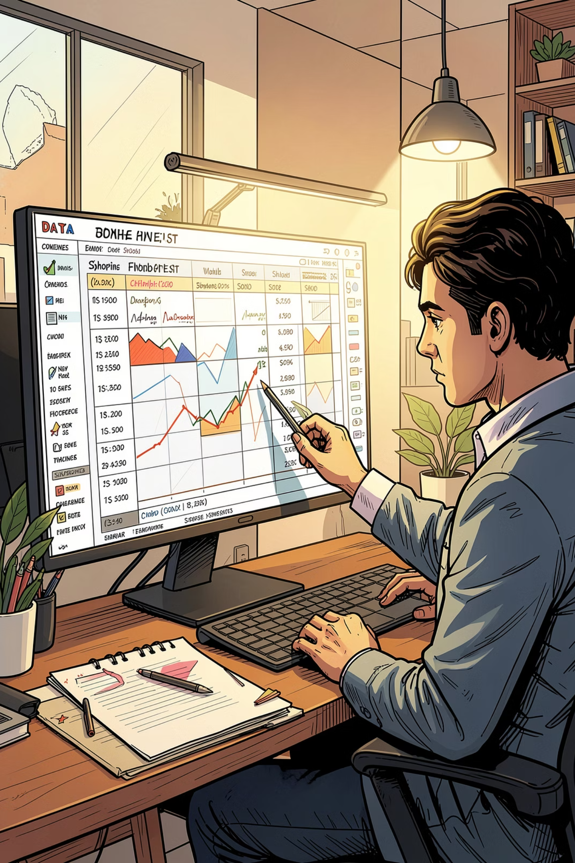
Customer Shopping Behavior Analysis
Uncovering spending patterns, customer segments, and product preferences from 3,900 transactions to guide strategic decisions.

Slide 2
Dataset at a Glance
3,900
18
Transactions
Features
$59.76
3.75
Avg Purchase
Avg Rating
Demographics · Purchase details · Shipping · Discounts · Subscription status

Slide 3


Data Preparation in Python
Load & Explore
pandas · df.info() · .describe()
Clean & Standardize
Imputed missing ratings · renamed to snake_case
Feature Engineering
age_group · purchase_frequency_days
Database Export
Loaded cleaned data into PostgreSQL

Slide 4
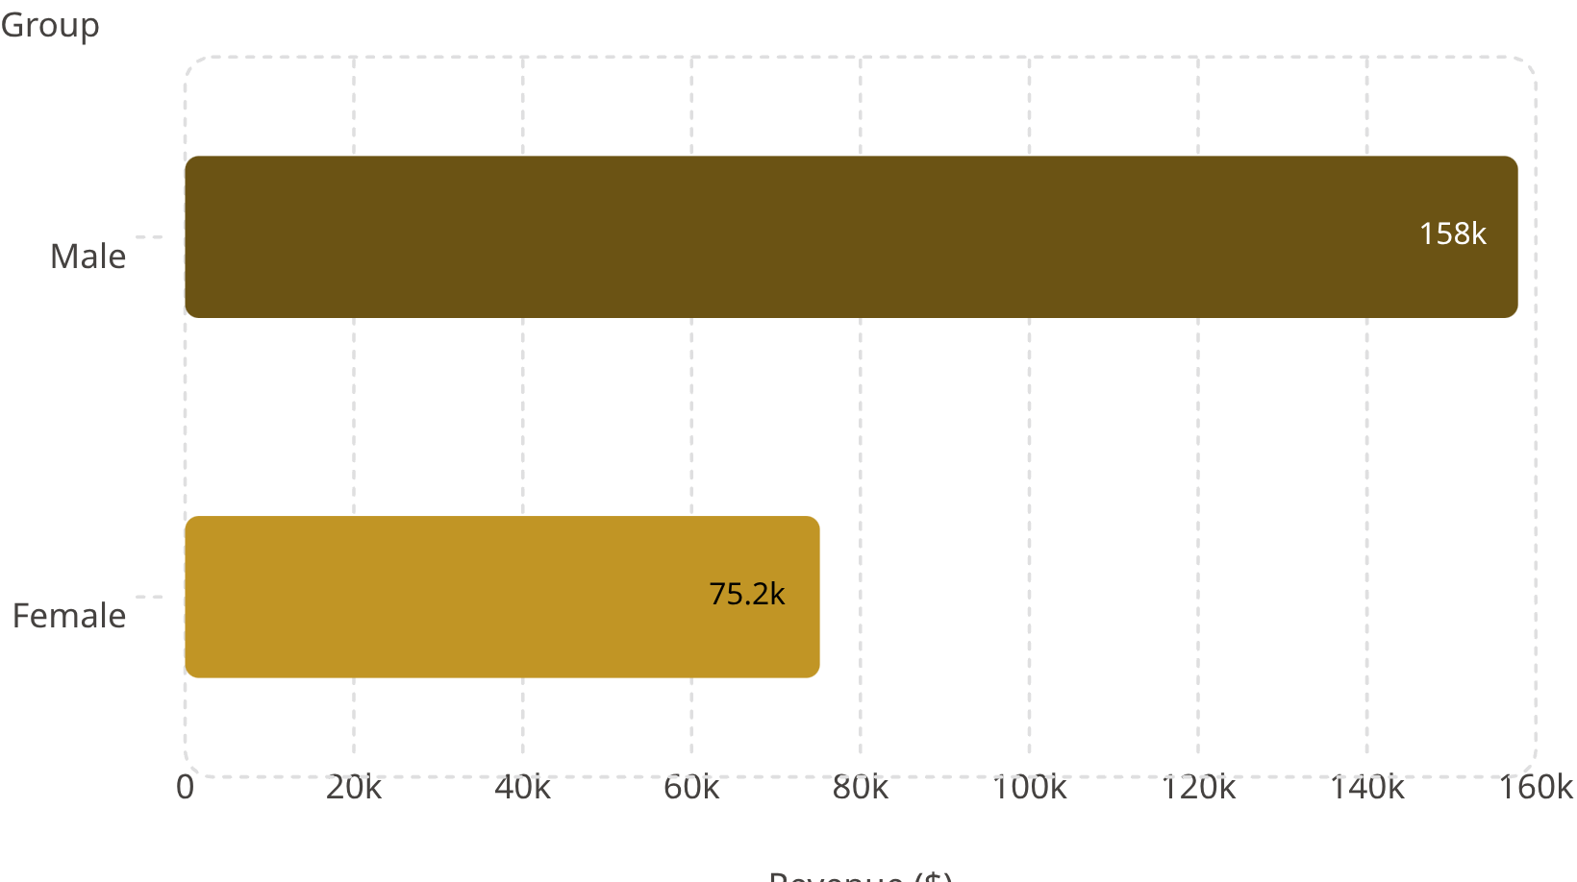
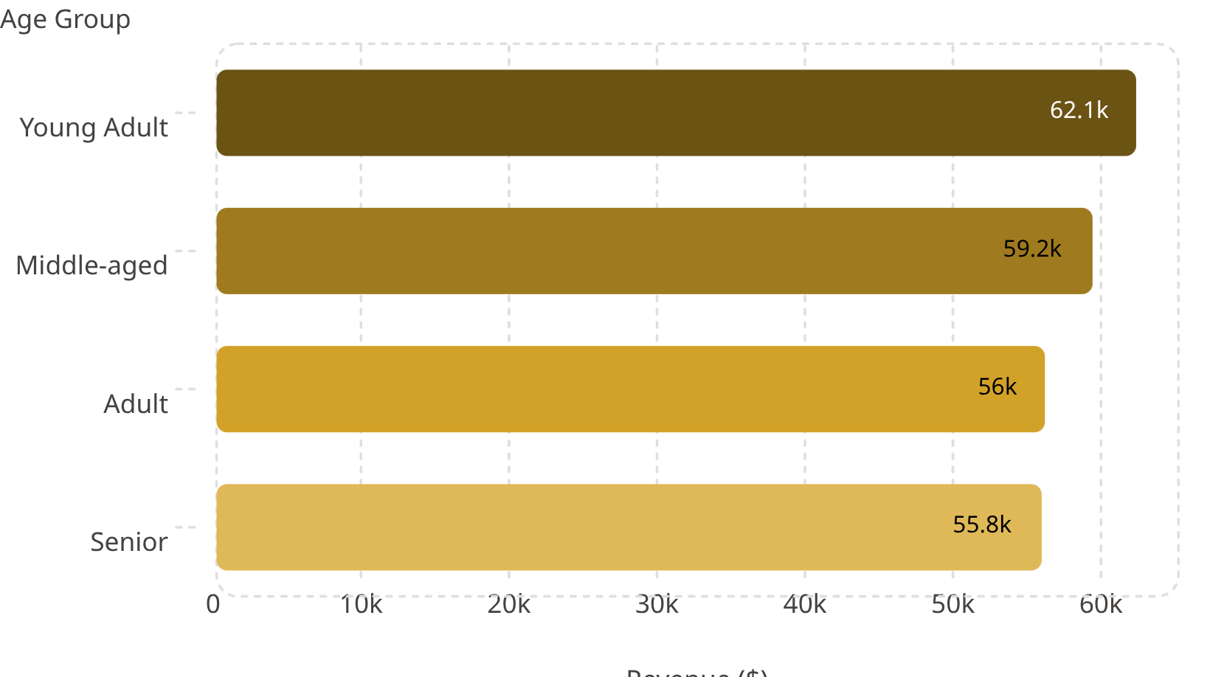
Revenue by Gender & Age Group
Male customers drive 2× more revenue than female. Young Adults lead across age groups.

Slide 5
Top Products & Discount Dependency
Top 5 by Rating
Most Discount-Dependent
Product
Avg Rating
Product
Discount Rate
Gloves
3.86
Hat
50.00%
Sandals
3.84
Sneakers
49.66%
Boots
3.82
Coat
49.07%
Hat
3.80
Sweater
48.17%
Skirt
3.78
Pants
47.37%

Slide 6
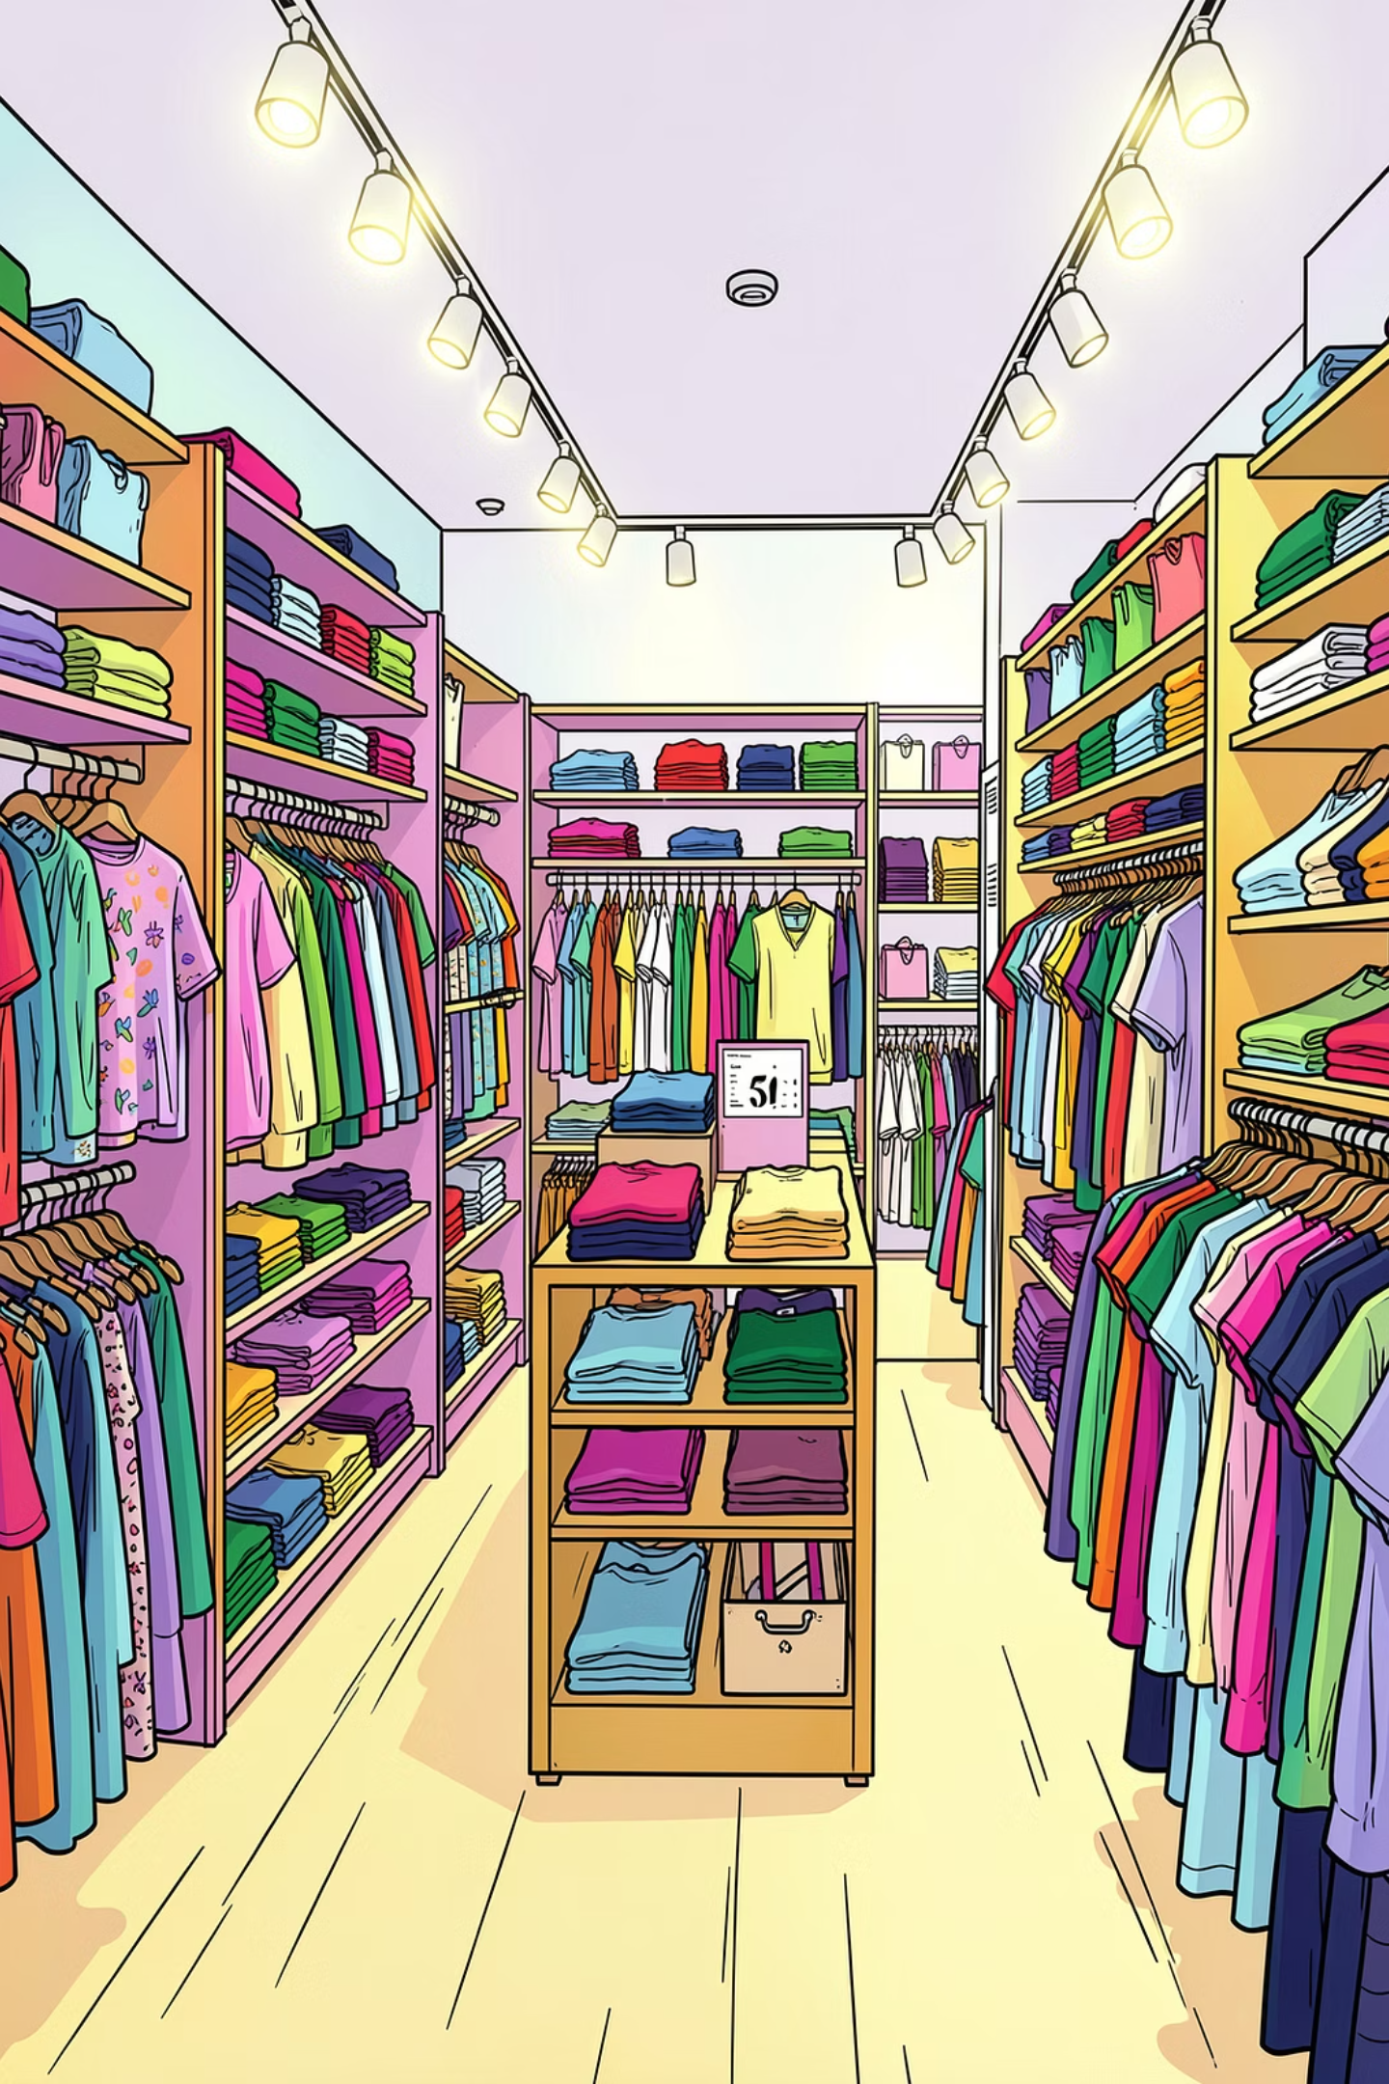
Top Products by Category
Accessories
Jewelry · Sunglasses · Belt
Clothing
Blouse · Pants · Shirt
Footwear
Sandals · Shoes · Sneakers
Outerwear
Jacket · Coat

Slide 7
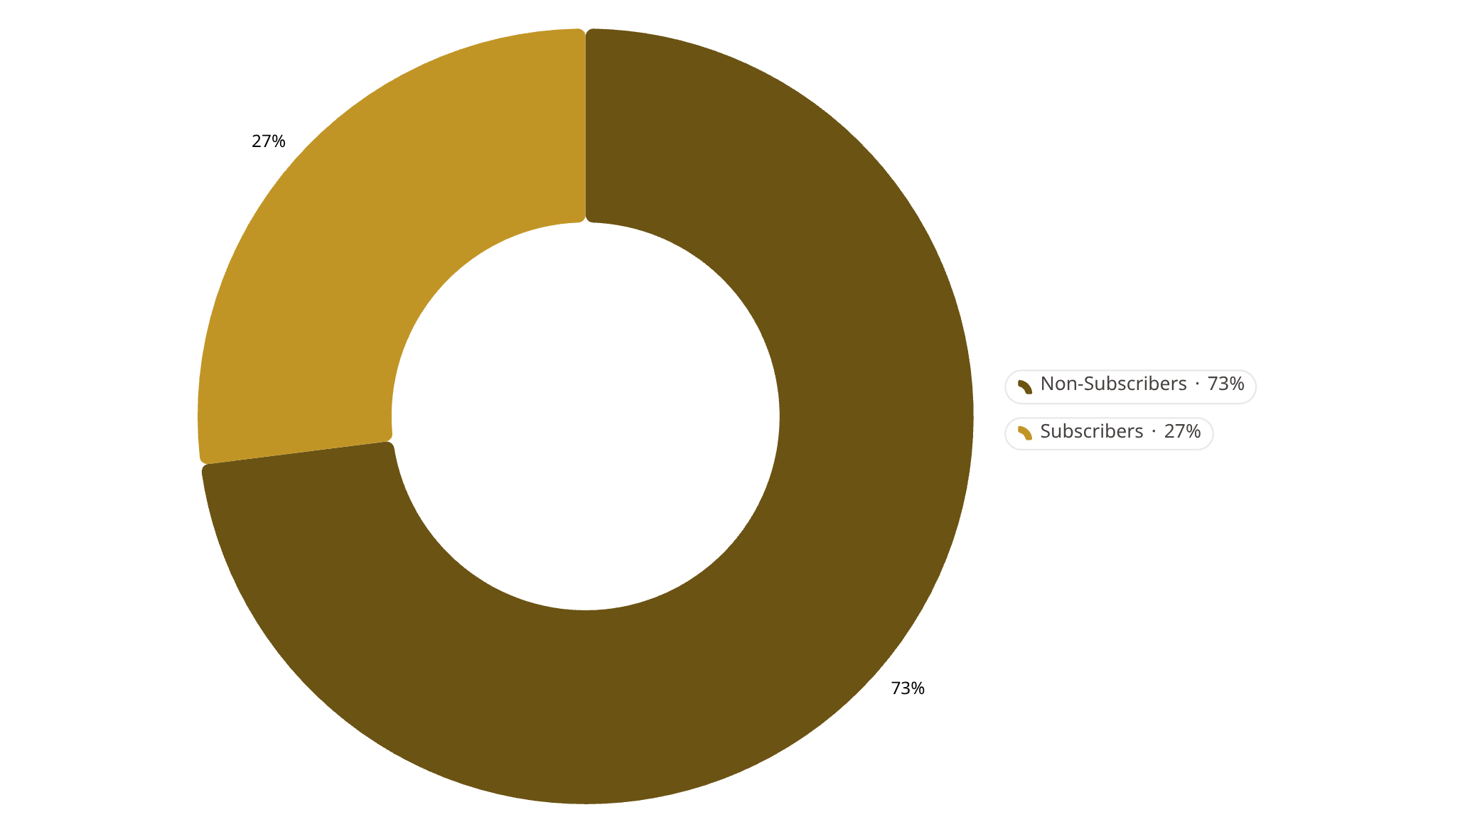
Subscriptions & Customer Segments
Customer Segments
3,116
701
83
Loyal
Returning
New
Repeat buyers (>5 purchases): 958 subscribers vs. 2,518 non-subscribers

Slide 8
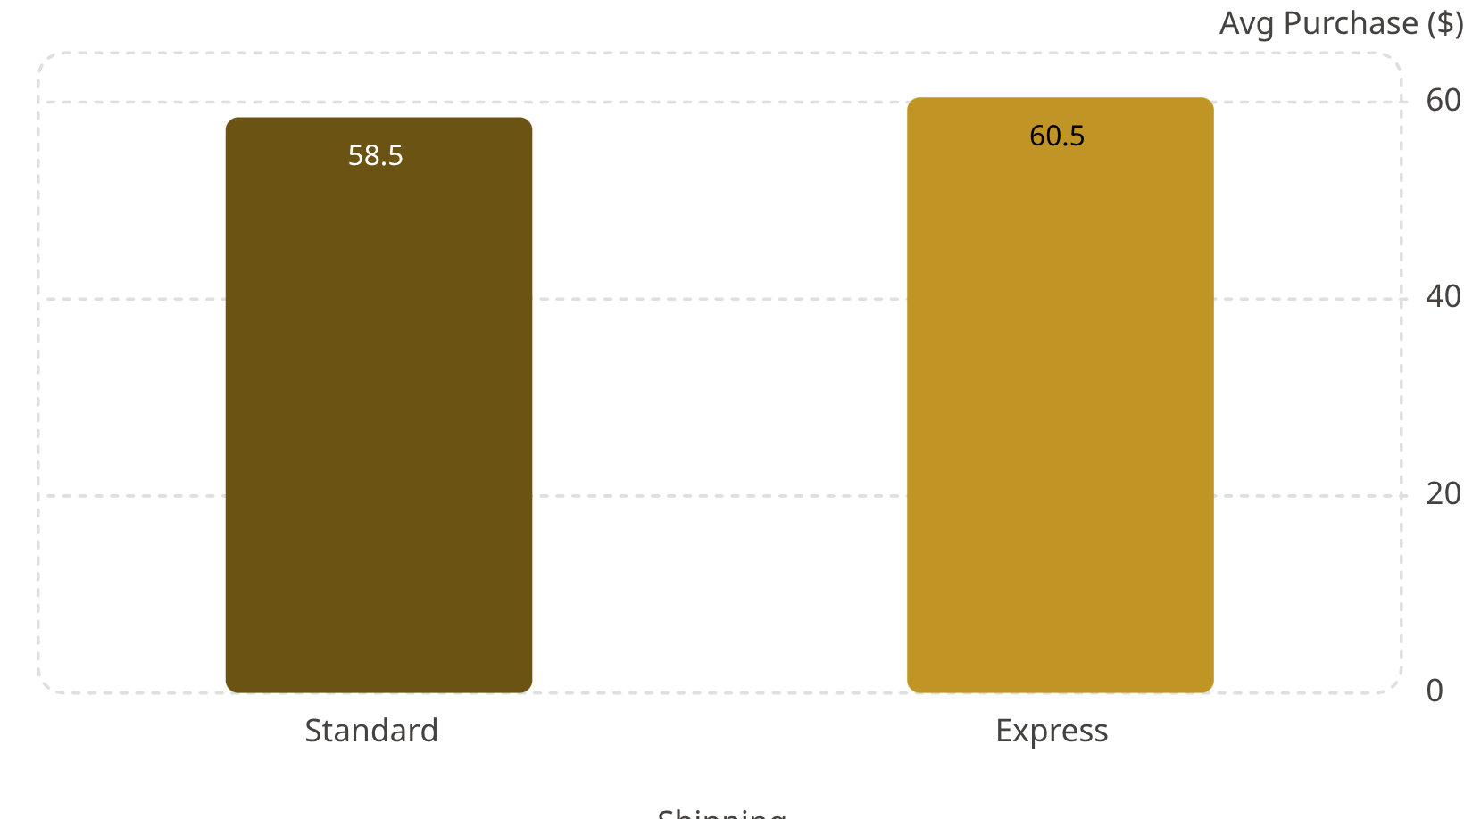

Shipping & Discount Insights
Avg Spend by Shipping Type
High-Spend Discount Users
839 customers used discounts yet spent above average — discounts don't always erode value.
Opportunity: reward high-spend discount users with loyalty perks

Slide 9
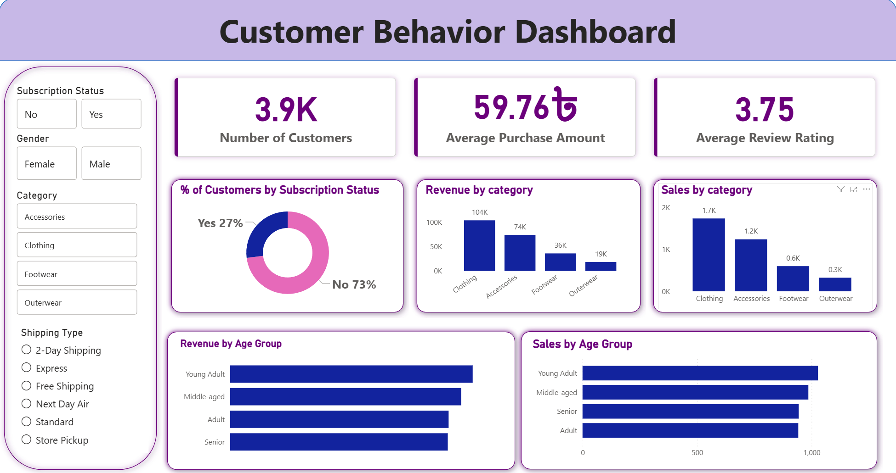
Power BI Dashboard
Interactive filters by subscription status, gender, category, and shipping type — enabling real-time business exploration.

Slide 10
Business Recommendations
Boost Subscriptions
Loyalty Programs
Review Discount Policy
Promote exclusive subscriber benefits
Reward repeat buyers → move to "Loyal" segment
Balance sales boosts with margin control
Product Positioning
Targeted Marketing
Highlight top-rated & best-selling items in campaigns
Focus on high-revenue age groups & express-shipping users

