Slide 1
DiaSense Diabetes Detection Expert System
Assalamu Alaikum

Slide 2
Team Members
DEPARTMENT OF COMPUTER SCIENCE & ENGINEERING
Group: E
C201206 | Asma Akter Mukta
C201207 | Tahsin Huda
C201214 | Sadia Binte Amir
C201233 | Sadia Elias
C201238 | Maisha Alam
Course Title: Artificial Intelligence Sessional
Course Code: CSE-3636
Submitted to:
Nazmun Nahar, Guest Faculty.

Slide 3
TABLE OF CONTENTS
01
02
03
05
06
07
04
Introduction
Motivation
Objectives
Methodology
08
Flow Chart
Result
Discussion
Conclusion

Slide 4
INTRODUCTION
Diabetes detection is a crucial task in the field of healthcare,
aimed at identifying individuals at risk of developing diabetes or those already diagnosed with the disease. The advancements in artificial intelligence and expert systems have paved the way for the development of Diabetic Detection Expert Systems, which employ sophisticated algorithms and medical knowledge to assist in the early detection and management of diabetes.

Slide 5
Motivation
Rising Prevalence of Diabetes
Complex Diagnostic Process
Need for Standardization
Handling Large Amounts of Data
Support for Healthcare Professionals
Continuous Learning and Improvement

Slide 6
Objectives
Early Detection
Accurate Diagnosis
Risk Assessment
Personalized Treatment Recommendations:
Decision Support for Healthcare Professionals
Continuous Learning and Improvement

Slide 7
Methodology
Knowledge Representation
Data Input
Inference Engine
Querying and Output
Knowledge Base Updates

Slide 8
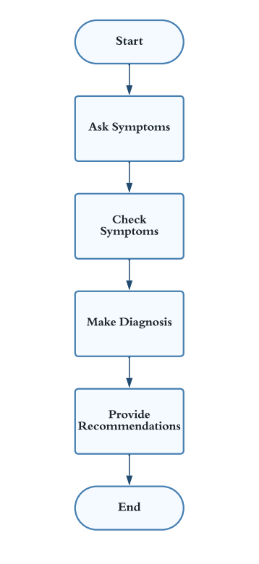
Flowchart:

Slide 9
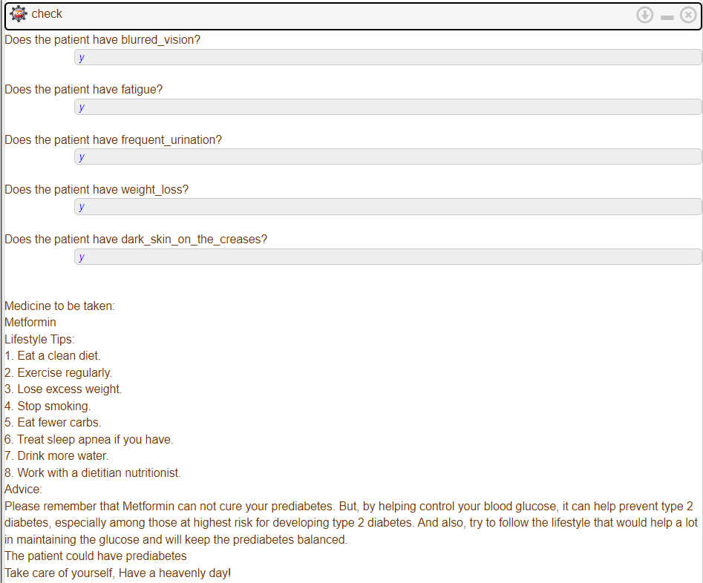
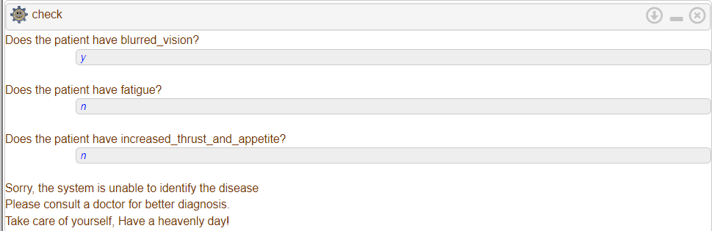
Result(output):
Fig: When the system
Cannot detect the diabetes type.
Fig: When the system detects prediabetes.

Slide 10
Future Scopes
Integration of Advanced Technologies: Diabetic Detection Systems can benefit from the integration of advanced technologies such as machine learning, deep learning, and natural language processing. These technologies can enhance the system's ability to analyze complex and diverse patient data, leading to more accurate and personalized diagnoses.
Big Data Analytics: With the growing availability of large-scale healthcare data, there is an opportunity to leverage big data analytics in Diabetic Detection Systems. Analyzing extensive datasets from diverse sources can provide valuable insights into patterns, risk factors, and disease progression, enabling better detection and management of diabetes.
Remote Monitoring and Wearable Devices: The use of wearable devices and remote monitoring technologies presents exciting opportunities for diabetic detection. Continuous glucose monitoring devices, smart insulin pumps, and other wearables can provide real-time data that can be integrated into the detection system, offering more comprehensive and up-to-date information for analysis.

Slide 11

Conclusion
Diabetic Detection Expert Systems aid in identifying individuals at an early stage who are at risk of developing diabetes or those who may require further diagnostic testing. Early detection allows for timely interventions and preventive measures, leading to better management and improved patient outcomes. By analyzing various risk factors, symptoms, and medical data, these systems provide accurate and reliable diagnoses of diabetes. They leverage established medical guidelines and rules to ensure consistency and accuracy in the diagnostic process.

Slide 12

Thank you!!

