Slide 1

“Improving Mental Health Mortality Prediction: A Machine Learning Approach for Risk Assessment and Clinical Guidance”
Presented By:
Presented To:
Zaima Sartaj Taheri
Lecturer,
Department Of CSE,
University Of Asia Pacific
Shuhurat Fariha(22201252)
Maisha Sameha(22201266)

Slide 2
Contents
CONTENTS
Introduction
Motivation
Objectives
Literature Review
Dataset Development Steps
Proposed Methodology
Conclusion

Slide 3
Introduction
CONTENTS
Mental health disorders cause significant morbidity and early death worldwide.
Severe mental illness (SMI) shortens life expectancy by 10–20 years.
Current risk assessment tools are limited.
Electronic Health Records (EHRs) offer new opportunities..
Machine Learning (ML) can improve mortality prediction.
Mental health mortality prediction using ML is underexplored.
This study proposes an ML-based framework for mortality prediction.
Goal: Help clinicians detect high-risk patients early.

Slide 4
Motivation
CONTENTS
People with mental illness face 2–3× higher death risk.
Heart disease from antipsychotics
Substance abuse and overdose
Smoking-related diseases
Underdiagnosed physical illnesses
Current prediction tools lack:
Subgroup precision
Clear explanations for clinicians
Consistent performance across populations
Our study addresses these gaps using MIMIC-III data and ML.

Slide 5
Objectives
CONTENTS
Test multiple ML models for mortality prediction.
(XGBoost, Cox PH, Logistic Regression, Autoencoder + RF, Multivariable Model).
Compare model accuracy and interpretability.
Improve risk assessment for mental health mortality.
Create tools to support clinical decision-making.
Use survival analysis to track risk over time.
Identify key risk factors through feature analysis.
Check if models work well in different settings.
Suggest future improvements and research areas.

Slide 6
Literature Review
CONTENTS
1. Automatic prediction of mortality in patients with mental illness (Nature, 2016)
Proposed model was Logistic Regression, Random Forest, SVM, KNN
RF & SVM achieved 91.1% accuracy
Severity variations affect mortality rates, broad category usage
2. Development of ML Model for Mortality in First-Episode Psychosis (Sweden, 2021)
Proposed model was XGBoost
80.7% accuracy for substance-related deaths
False positives in 2-year follow-up, lacks some treatments data

Slide 7
Literature Review
CONTENTS
3. Mortality in Qatari Individuals with Mental Illness: A Retrospective Cohort Study(2021)
Proposed model was SPSS v26, linear regression model, Bonferroni’smethod
No significant increase in mortality with mental illness.
No future work mentioned
4. The Risk of All-Cause Mortality Associated with Anxiety: A Retrospective Cohort Study Using 'The Health Improvement Network' Database
Proposed model was Cox Regression, DExtER Tool.
14% higher risk of mortality with anxiety
Limited by diagnostic recording accuracy, mostly unspecified types

Slide 8
Literature Review
CONTENTS
5. Machine learning-based mortality risk assessment infirst-episode bipolar disorder: a transdiagnostic external validation study(Sweden/Finland, 2020)
Proposed model was MIRACLE-FEP, XGBoost, R(R Project for StatisticalComputing)
AUROC = 0.77 for 2-year mortality prediction in Swedenand 0.71 in Finland.
No clinician-assessed risks, lacks causal interpretation
6. Mortality in people with mental disorders in Poland: A nationwide, register-based cohort study(2009–2018)
Proposed model was statistical analysis using SMR(Standardized mortality Ratios)
SMR: 1.54 overall, 3.04 for substance use
Missing data, no cause-specific mortality rates

Slide 9
Literature Review
CONTENTS
7. Excess mortality in a cohort of Brazilian patients with a median follow‑up of 11 years after the first psychiatric hospital admission()
Proposed model was SMR, YLL Calculation, Cox Proportional Hazards.
SMR: 2.90, Average 27.64 years life lost .
Excludes deaths outside São Paulo, lacks socioeconomic data.
8. Association of stress-related disorders with subsequent risk of all-cause and cause-specific mortality: A population-based and sibling-controlled cohort study
Proposed model was Cox proportional hazards; population-based matched cohort and the sibling cohort comparison.
Increased risk of all-cause as well as multiple cause-specific mortality .
Misclassification of stress-related disorders, Lacks outpatient details in the National Patient Register.

Slide 10
Literature Review
CONTENTS
9. A human-interpretable machine learning approach to predict mortality in severe mental illness
Proposed model was Logistic Regression, Autoencoder + RF, Cox PH, Interpretability Models.
SMR: 7.4 for schizophrenia, risk factors identified.
Counterintuitive predictions due to imbalanced data

Slide 11
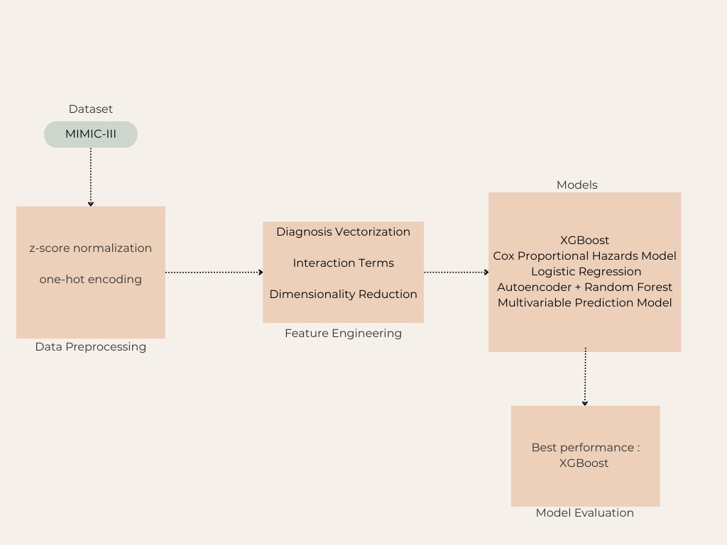
Proposed Methodology
CONTENTS

Slide 12
Conclusion
CONTENTS
A multi-model ML framework was developed.
XGBoost showed highest accuracy; Cox model helped with survival analysis.
Feature engineering and hybrid models improved results.
Created a clinical risk scoring system for early detection.
Bridges ML and real clinical care for mental health.
Future steps: Validate with diverse patient groups and real hospital settings.

Slide 13
References
CONTENTS
1. Automatic prediction of mortality in patients with mental illness using electronic health records
2. Development and Validation of a Machine Learning–Based Model of Mortality Risk in First-Episode Psychosis
3. Mortality in Qatari Individuals with Mental Illness: A Retrospective Cohort Study
4. The Risk of All-Cause Mortality Associated with Anxiety: A Retrospective Cohort Study Using 'The Health Improvement Network' Database
5. Machine learning-based mortality risk assessment in first-episode bipolar disorder: a transdiagnostic external validation study

Slide 14
References
CONTENTS
6. Mortality in people with mental disorders in Poland: A nationwide, register-based cohort study
7. Excess mortality in a cohort of Brazilian patients with a median follow‑up of 11 years after the first psychiatric hospital admission
8. Association of stress-related disorders with subsequent risk of all-cause and cause-specific mortality: A population-based and sibling-controlled cohort study
9. A human-interpretable machine learning approach to predict mortality in severe mental illness

Slide 15



Slide 16


