Slide 1
Cutting Costs & Raising Revenue
By Maisie Jaramillo

Slide 2
Current Situation
50 branches
4000 cars
55 cars are unprofitable

Slide 3
Notes:
Top 5 Cars
GMC Savanna 2018
Isuzu Ascender 2017
Pontiac Firebird 2016
Chevrolet Beretta 2018
Mitsubishi Eclipse 2017
Bottom 5 Cars
Jaguar XJ Series 2016
Mercedes-Benz CL-Class 2017
Jaguar XJ Series 2018
Oldsmobile Tornado 2017
Volkswagen Type 2 2016

Slide 4
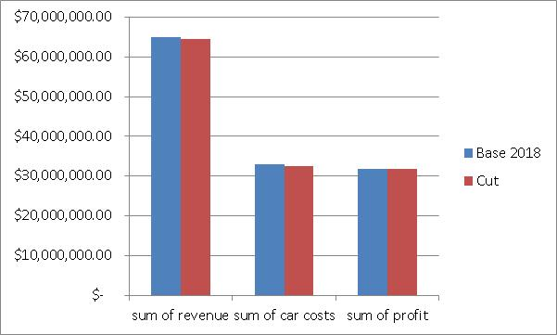
Strategy 1 Cut
Notes:
Lose 450k in revenue
Save 500k in costs
Gain 50k in profit
Sell the cut cars

Slide 5

Strategy 2 Replace
Notes:
Replacing the unprofitable 55 cars with similar cars of our top 5 earners we
Gain over 1.5mil in revenue
Lose 400k in costs
Gain over a million in profits

Slide 6
Future Data
4 Door vs 2 Door
Styles (luxury, sedan, sports car, etc.)
Who is our customer?
Notes:
Surveys could help us figure out if our cars are being used for business travel or personal travel. We could break that down further by seeing if the business is sales or consulting and we could see if the personal is broken down into individual, couples, friends, or family. With that data we could tailor our fleet to our customers.

Slide 7
Conclusion
Cut
Replace
More Data
Notes:
More data will allow us to ask more questions and gain more insight into the fleet.

Slide 8
Thank You also Q&As

