Slide 1
Towards Sentiment analysis: A powerful technique for data analytics
CSE438
Name: Maisoon Tasnia
ID: 20301076
Section: 01
Course Instructor: Annajiat Alim Rasel
Unleashing the Potential of Sentiment Analysis in the Era of Big Data

Slide 2
Introduction
Opinion mining, or sentiment analysis, is a natural language processing (NLP) technique that identifies the sentiment or emotional tone that is communicated in a document. Understanding and classifying the subjective beliefs, emotions, and attitudes expressed in the text as neutral, negative, or positive is the aim of sentiment analysis.
It is now essential to recognize and use the feelings found in textual data in the ever-changing field of data analytics. Deciphering the feelings, attitudes, and opinions buried in large datasets is made possible in large part by sentiment analysis, sometimes referred to as opinion mining. In the age of big data and social media, textual information is becoming exponentially more abundant, making it crucial to draw valuable conclusions from this abundance of unstructured data.
I

Slide 3
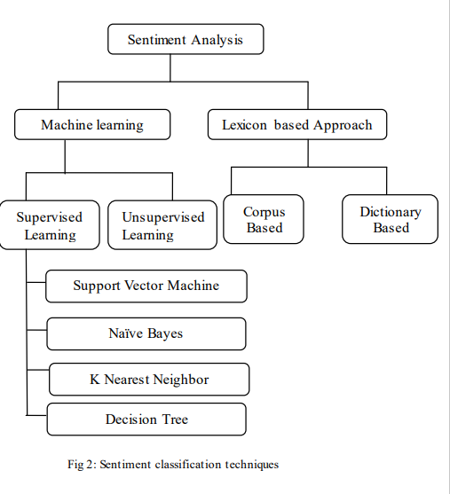
Classification
Techniques used for sentiment analysis

Slide 4
Hypothesis
Algorithmic Diversity: Performance is improved by using a range of algorithms.
Precision Enhancement: Various methods help to increase the accuracy of activities involving sentiment analysis.
Techniques Synergy: According to the theory, combining conventional and cutting-edge algorithms can work together to provide better outcomes.
Thorough Analysis: The goal of the paper is to validate the hypothesis by analyzing methods in detail and highlighting both their advantages and disadvantages.

Slide 5
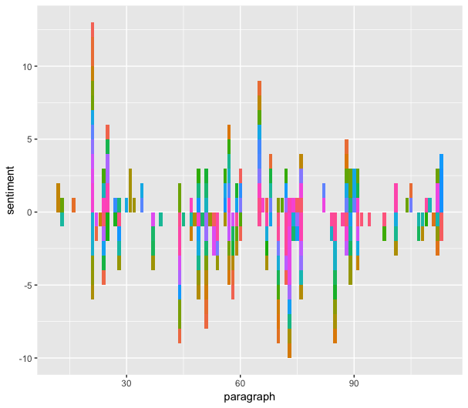
Significance of Sentiment analysis
Strategic Decision Making
Market insights
Social Trends Understanding
Diverse Applications

Slide 6
Reviews of Sentiment analysis methodologies
Conventional Methods: Investigating traditional machine learning techniques in sentiment analysis, such as Support Vector Machines and Naive Bayes.
Advanced Techniques: Learning about sentiment lexicons and rule-based systems, two examples of advanced natural language processing (NLP) techniques.
Examining the use of deep learning models, including transformer-based designs like BERT and recurrent neural networks (RNNs).
Performance Metrics: Discussing about the metrics that are used to assess performance, taking into account variables such as F1 score, accuracy, precision, and recall.

Slide 7
Limitations
Subjectivity and Sensitivity to Context:
Variability in Interpretation: Subjectivity is introduced by the fact that different people may interpret emotions differently.
Contextual Influence: A text's feeling is greatly impacted by its surroundings, which makes achieving universal correctness difficult.
Managing Ambiguity: The inability to effectively handle ambiguity and the various ways that emotions can be interpreted in various situations.

Slide 8
Limitations
2. Managing Texts in Many Languages:
Cross-Language Challenges: It may be difficult for current algorithms to accurately analyze sentiment in a variety of languages.
Nuances Lost in Translation: Challenges in accurately conveying linguistic subtleties and cultural differences in the presentation of sentiment.
Multilingual Models Are Necessary: demonstrating the need for specialized models to manage emotion across various linguistic contexts.

Slide 9
Synthesis
Diverse Challenges in Sentiment Analysis
Research Call to Action
Integrated approaches
Application centric innovation
Continuous Evolution

Slide 10
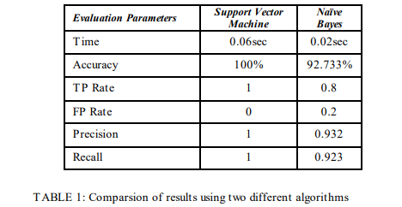
Comparison Results
of different algorithms

Slide 11
Future plans
Determine Research Gaps: Determine the weaknesses and difficulties in the current approaches, setting the stage for further sentiment analysis research.
Opportunities for Innovation: Point out areas that may use innovation and inspire scholars to investigate fresh methods and strategies for sentiment analysis.
Recognize the dynamic nature of sentiment analysis and offer suggestions for modifying techniques in response to new developments in language processing and textual data.

Slide 12
Conclusion
The report concludes by highlighting sentiment analysis enormous potential in data analytics. It highlights how crucial it is to keep up the research and innovation in the field in order to take advantage of fresh opportunities and solve new problems. The conclusion emphasizes how sentiment analysis can change a variety of fields and pushes for the inclusion of this method in standard data analytics procedures. The primary conclusions are also outlined, highlighting the importance of sentiment analysis, the necessity of continued research, and the incorporation of sentiment analysis into standard analytics procedures to support well-informed decision-making.

