Slide 1
Malware Analysis
CSE438
Name: Maisoon Tasnia
ID: 20301076
Section: 01
Course Instructor: Annajiat Alim Rasel
and Detection using machine
learning algorithms

Slide 2
Introduction
Any software that is intentionally created to damage, exploit, or compromise computer systems, networks, or user devices is referred to as malware, short for malicious software. The word "malware" is used to describe a wide range of malicious software varieties, each with unique features and goals.
The spread of malware in today's digital environment is a serious threat to people, companies, and entire countries. Understanding the nature and behavior of harmful software is essential for developing effective cybersecurity tactics, and malware analysis plays a key part in this process.

Slide 3
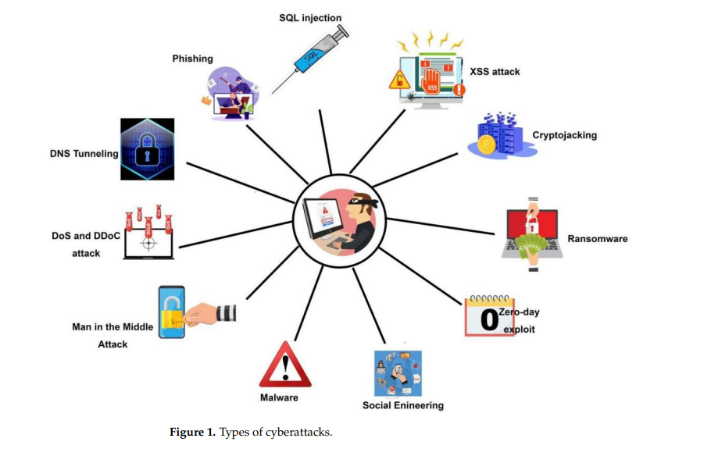
Types of cyber attacks

Slide 4
Hypothesis
By using machine learning algorithms for malware analysis and detection, cybersecurity measures become much more effective.
Traditional solutions struggle to keep pace with dynamic malware, demanding creative ways.
Machine learning provides precision, flexibility, and proactive protection against changing cyberthreats.
Enhanced capabilities to identify emerging and sophisticated malware types.

Slide 5
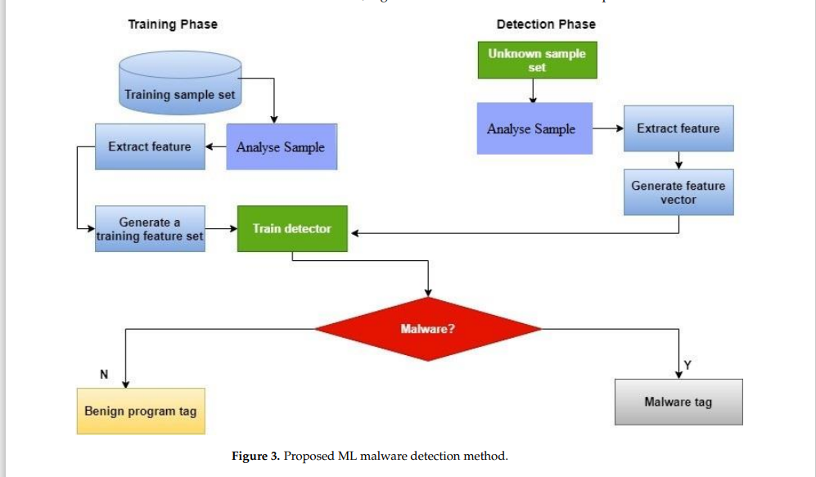
Detection Method

Slide 6
Significance of Malware Detection
Proactive threat mitigation
Protection of sensitive data
Maintaining operational continuity
Prevention of financial loss
Cybersecurity resilience
Strategic decision making
Global cybersecurity stability

Slide 7
Methodology
The approach entails a detailed investigation of machine learning methods used in malware analysis. This entails a thorough examination of the body of research, a comparison of the benefits and drawbacks of different algorithms, and the creation of a methodical malware detection process. To ensure reproducibility and transparency, the authors go into depth about the feature extraction procedure, model training, and assessment measures they employed in their research.

Slide 8
Limitations
Inconsistency in Labels:
Justification: Unbalances in labeled datasets could cause bias and affect how well the machine learning model detects malware types that are underrepresented. It is imperative to tackle this difficulty in order to guarantee an impartial and balanced model.

Slide 9
Limitations
2. Attacks by Adversaries:
Justification: Adversarial attacks can target machine learning models, which include those employed in malware detection. In order to trick the model and produce false negatives, malicious actors can alter features or input data, undermining the efficacy of the detection system. Strong safeguards against hostile attacks are necessary to ensure that the suggested methodology is reliable.

Slide 10
Synthesis
Advancements in malware detection
Improved accuracy and efficiency
Real world applicability
Ethical considerations
Overall impact on cybersecurity

Slide 11
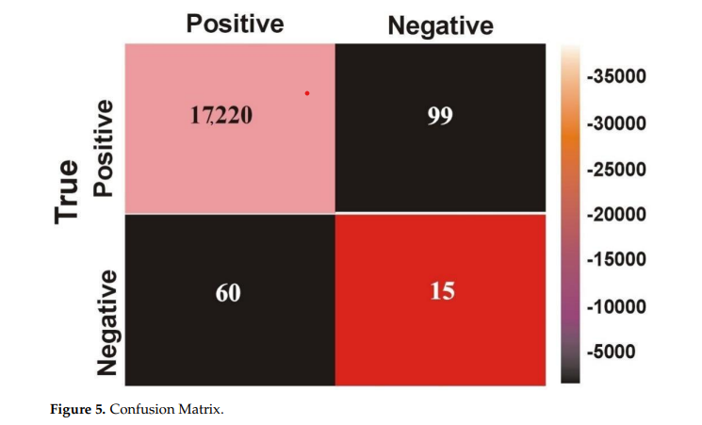
Result

Slide 12
Conclusion
The usefulness of machine learning techniques in the development of malware detection and analysis systems is highlighted in the report's conclusion. The authors summarize the key findings, highlighting the advantages of their recommended strategies and discussing potential implications for the cybersecurity sector. The discovery most likely encourages the application of machine learning techniques to improve the robustness of malware detection systems.

