Slide 1

TRUSTRAG: A Modular Framework for Detecting and Mitigating Hallucinations in Retrieval-Augmented Generation Systems
Team Members
23BD1A056A P.Varun Sai
23BD1A0572 S.Srishanth
23BD1A0573 S.Aakash
23BD1A057D V.Maithresh
Mentor
1. Mr.Challa Sundeep Babu

Slide 2
CONTENTS
Title Slide
Abstract
Introduction
Base Paper
Literature review
Existing Systems
Proposed System
Hardware Requirements
Software Requirements
Architecture Diagram
UML Diagrams
References

Slide 3
TRUSTRAG
A Modular Framework for Detecting and Mitigating Hallucinations in Retrieval-Augmented Generation Systems

Slide 4
ABSTRACT
Retrieval-Augmented Generation (RAG) improves the factual grounding of Large Language Models (LLMs) by providing external knowledge, but retrieved information alone does not guarantee that the generated response is supported by the evidence. TrustRAG addresses this limitation by introducing claim-level verification, evidence integrity checking, and bounded recovery into the RAG pipeline.The framework retrieves and reranks relevant evidence, generates a grounded response, decomposes the response into individual claims, and verifies each claim against the retrieved evidence using Natural Language Inference (NLI). It also maintains evidence provenance, checks document integrity and temporal validity, and performs bounded recovery when evidence is insufficient or conflicting. When a trustworthy response cannot be established, the system can abstain rather than return unsupported information.TrustRAG follows a local-first architecture using ONNX Runtime, Qdrant, MongoDB, and configurable local or external LLM runtimes. This design aims to improve the reliability, transparency, and auditability of RAG-based question answering.

Slide 5
INTRODUCTION
Large Language Models (LLMs) are widely used for question answering and document analysis, but they can generate incorrect, outdated, or unsupported information. Retrieval-Augmented Generation (RAG) reduces this problem by providing relevant external documents to the model; however, retrieval alone does not guarantee that the generated response is fully supported by the retrieved evidence.TrustRAG addresses this limitation by introducing verification and recovery into the RAG pipeline. The system retrieves relevant evidence, generates a grounded response, decomposes the response into individual claims, and verifies those claims against the retrieved evidence using Natural Language Inference (NLI).In addition, TrustRAG maintains evidence provenance, checks document integrity and temporal validity, and performs bounded recovery when verification fails. If sufficient trustworthy evidence cannot be established, the system can abstain instead of producing an unsupported response.Objective: To develop a modular RAG framework that improves answer reliability by explicitly verifying generated claims and providing evidence-backed responses.

Slide 6
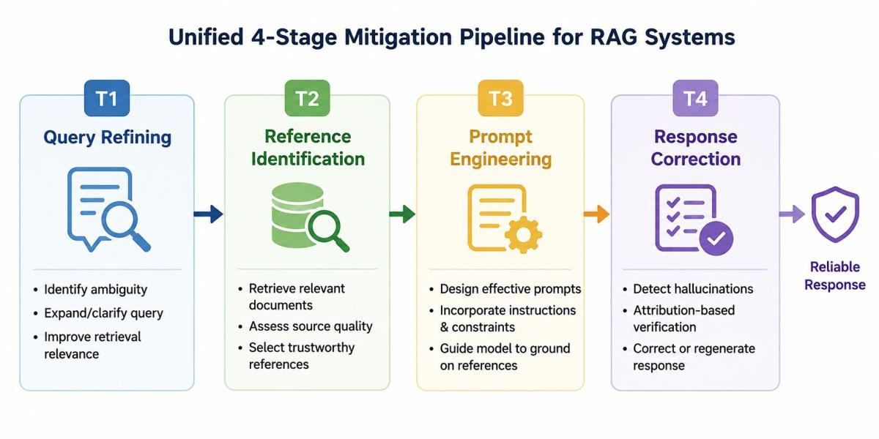
Base Paper
Paper : Zhao et al. (2026)
Title : Attribution Techniques for Mitigating Hallucinated Information in RAG Systems: A Survey
Key Contributions:
Presents a comprehensive survey of hallucination mitigation in RAG.
Proposes a unified 4-stage attribution pipeline.
Classifies 6 types of RAG hallucinations.
Maps hallucination types to effective techniques.
Primary Dataset : RAGTruth Dataset
Secondary Dataset : HaluEval
mitigation

Slide 7
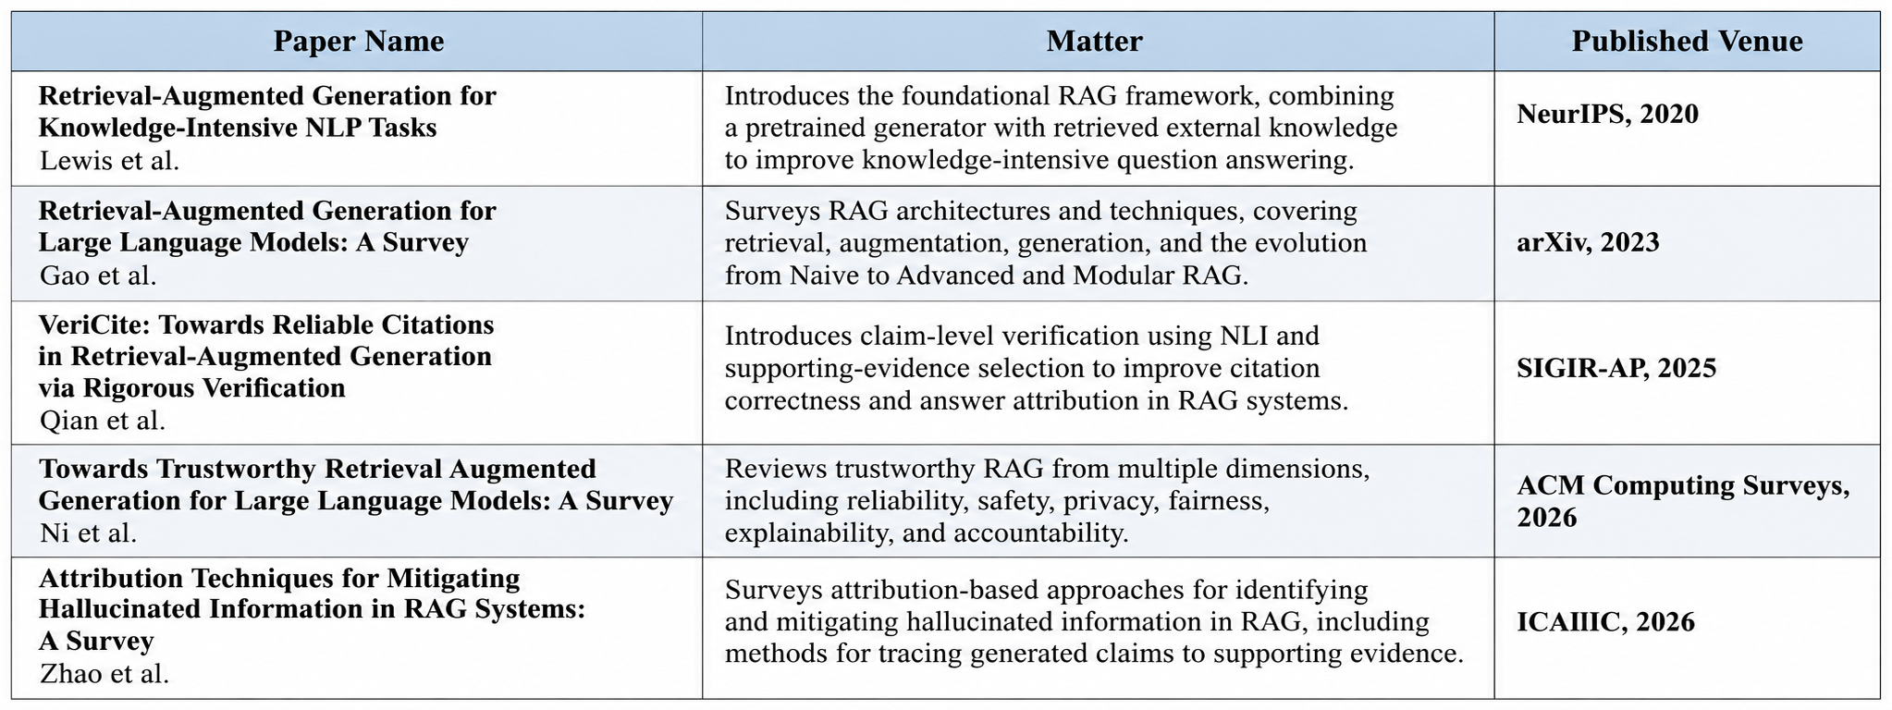
Literature Review

Slide 8

Existing Systems
Standard RAG Pipeline: User Query → Document Retrieval → LLM Generation
Retrieval Dependence: Final response quality depends heavily on the relevance and quality of retrieved documents.
Irrelevant or Conflicting Context: Retrieved documents may contain irrelevant, redundant, outdated, or conflicting information.
Limited Verification: Generated responses are not necessarily validated against source documents claim by claim.
Limited Source Validation: Source integrity and temporal validity may not be explicitly checked.
Unsupported Claims: The system may generate an answer even when sufficient supporting evidence is unavailable.
Limited Recovery: Conventional RAG may not provide a mechanism to recover from failed retrieval or verification.
Result: Retrieval noise and unverified generation can allow unsupported information to reach the final response

Slide 9
Proposed System
TrustRAG Framework: A modular pipeline designed to improve the reliability of Retrieval- Augmented Generation.
Stage 1 — Query Routing: Classifies the user query and selects the appropriate retrieval path.
Stage 2 — Hybrid Retrieval: Retrieves relevant evidence using dense embeddings and supports sparse BM25 retrieval with RRF-based fusion.
Stage 3 — Reranking: Uses a cross-encoder to rank retrieved candidates and select the most relevant evidence.
Stage 4 — Grounded Generation: Generates a response using the retrieved evidence as the grounding context.
Stage 5 — Claim Decomposition: Breaks the generated response into individual, verifiable claims.
Stage 6 — Claim Verification: Uses NLI to classify claims as SUPPORTED, CONTRADICTED, or NEUTRAL.
Stage 7 — Evidence Integrity Audit: Uses SHA-256 hashing to check whether retrieved evidence has been modified or corrupted.
Stage 8 — Recovery / Abstention: Performs bounded recovery when verification fails; if sufficient evidence cannot be established, the system abstains.
Key Outcome: Only sufficiently supported responses are presented as trustworthy; unsupported responses are withheld.

Slide 10


Hardware Requirements
Component | Specification
Processor | Intel Core i5 / AMD Ryzen 5 or higher
RAM | 8 GB minimum (16 GB recommended)
GPU | NVIDIA GPU with 8+ GB VRAM
Storage | 20-50 GB free disk space (SSD preferred)

Slide 11








Software Requirements
Component | Technology
Programming Language | Python 3.11-3.12
Framework | LangChain,LangGraph
Large Language Model Runtime | llama.cpp / Ollama / MLX_LM / Gemini
Embedding Model | BAAI/bge-small-en-v1.5
Vector Database | Qdrant
Operating System | Windows ,MAC,Linux
Frontend | React + Vite
Document Database | MongoDB

Slide 12
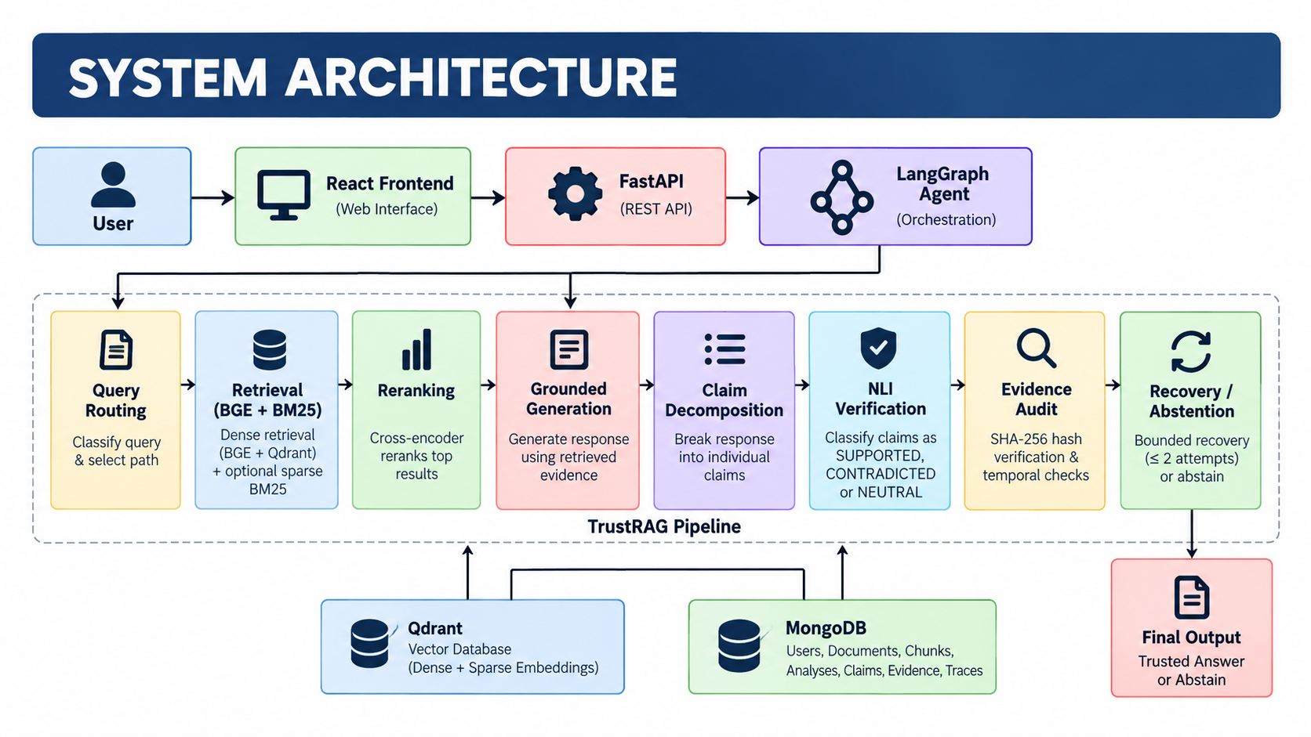
ARCHITECTURE DIAGRAM

Slide 13
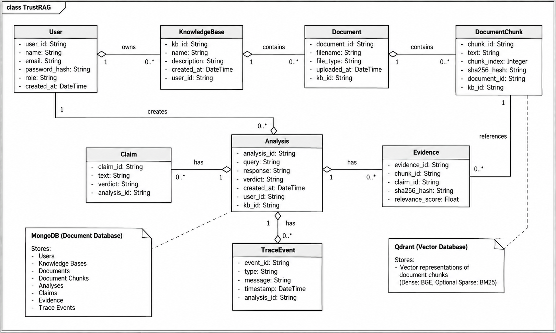
CLASS DIAGRAM

Slide 14
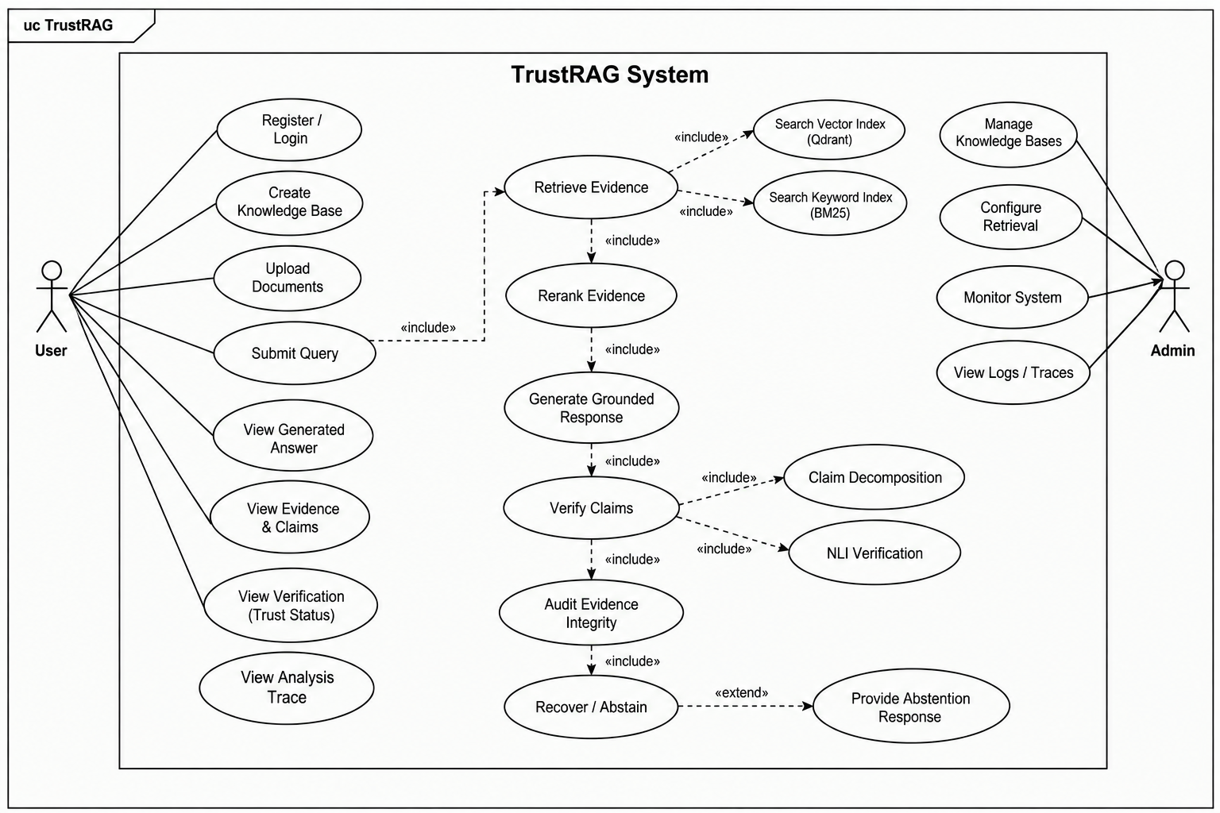
USE CASE DIAGRAM

Slide 15
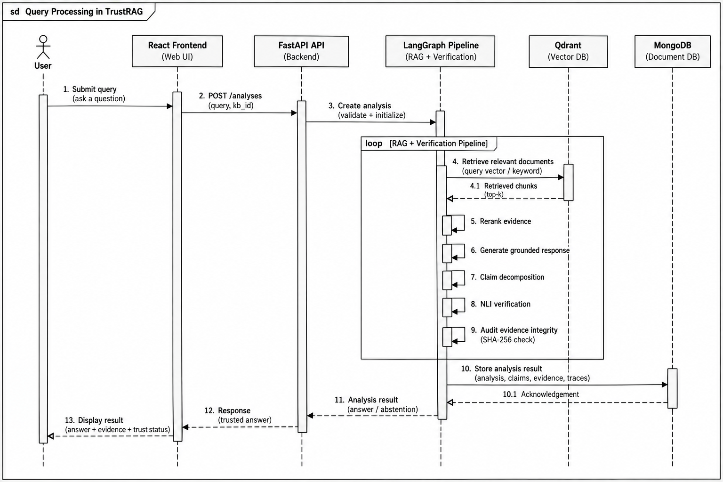
SEQUENCE DIAGRAM

Slide 16
REFERENCES
Y. Zhao, Z. Liu, Y. Zheng, and K.-Y. Lam, "Attribution Techniques for Mitigating Hallucinated Information in RAG Systems: A Survey," arXiv preprint arXiv:2601.19927, Jan. 2026.
A. Asai, Z. Wu, Y. Wang, A. Sil, and H. Hajishirzi, "Self-RAG: Learning to Retrieve, Generate, and Critique through Self-Reflection," arXiv preprint arXiv:2310.11511, Oct. 2023.
W. Shi, S. Min, M. Yasunaga, M. Seo, R. James, M. Lewis, L. Zettlemoyer, and W.-T. Yih, "REPLUG: Retrieval-Augmented Black-Box Language Models," arXiv preprint arXiv:2301.12652, Jan. 2023.
L. Gao, Z. Dai, P. Pasupat, A. Chen, A. T. Chaganty, Y. Fan, V. Y. Zhao, N. Lao, H. Lee, D.-C. Juan, and K. Guu, "RARR: Researching and Revising What Language Models Say, Using Language Models," arXiv preprint arXiv:2210.08726, Oct. 2022.
P. Lewis, E. Perez, A. Piktus, F. Petroni, V. Karpukhin, N. Goyal, H. Küttler, M. Lewis, W.-T. Yih, T. Rocktäschel, S. Riedel, and D. Kiela, "Retrieval-Augmented Generation for Knowledge-Intensive NLP Tasks," Advances in Neural Information Processing Systems (NeurIPS), vol. 33,
pp. 9459–9474, 2020.

Slide 17
Thank you!

