Slide 1
Banking application
Presented By
Maitrai Tumulury
Batch:2021-6708
Under the guidance of,
Pooja Mehta.

Slide 2
INTRODUCTION
A bank is a financial institution to receive deposits and withdraws. Banks provide a Safe place to Store extra cash and credit. They offer savings accounts, Certificates of Deposit, and checking accounts. Banking systems have been with us for as long as people have been using money. In this project the bank will perform some operations like deposit, withdraw, displaying account details .

Slide 3
LaNGUAGE & PLATFORM
Language :Core Java
(Loops, Methods, Statements)
IDE: Eclipse
Operating System: Windows

Slide 4
FUNCTIONS
1.Displaying details
2.Search by account number
3.Deposit
4.Withdrawl
5.Exit

Slide 5
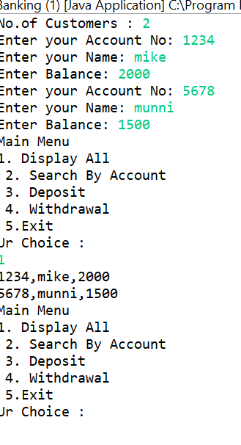
PROJECT SCREENSHOTS
Display all Details:

Slide 6
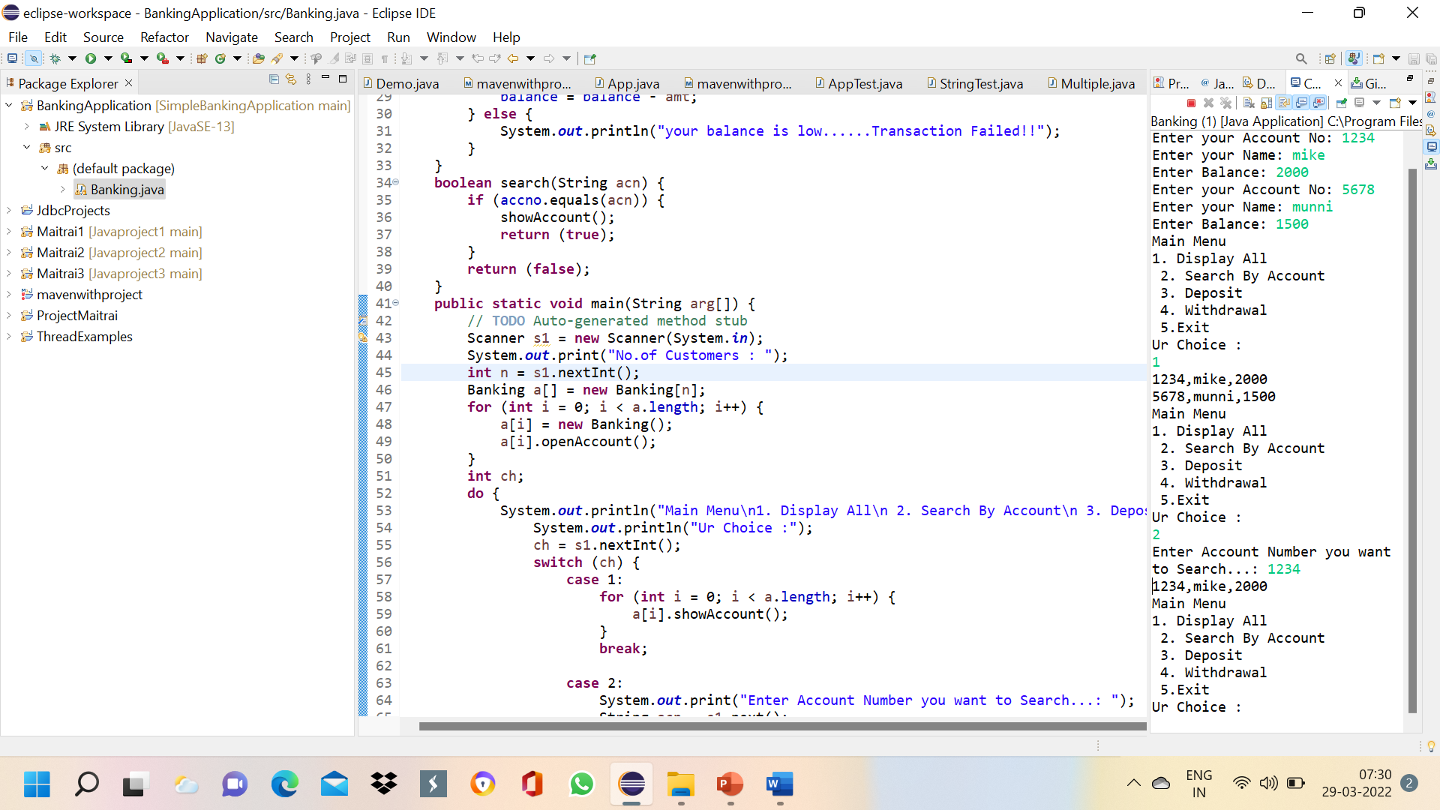
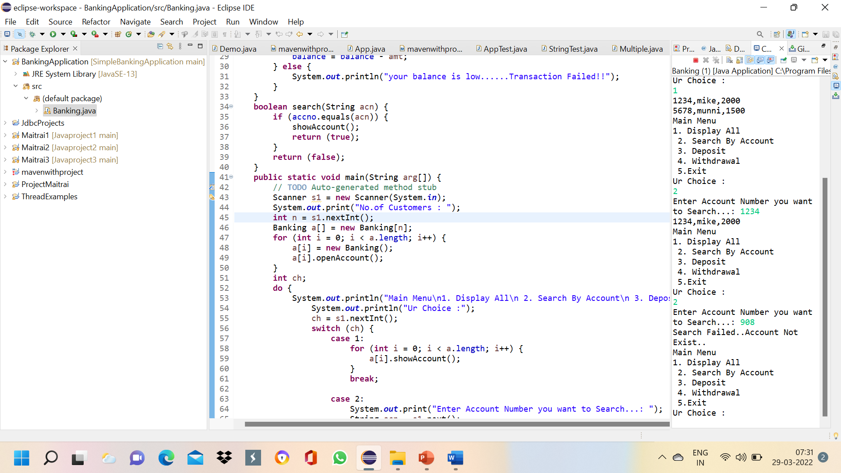
Search by Account:

Slide 7
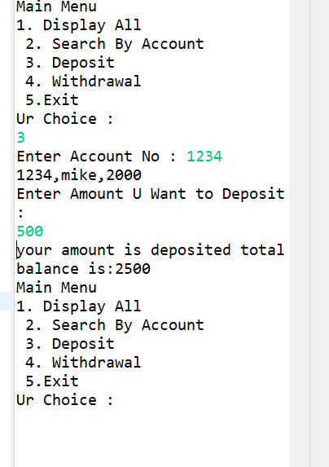
Deposit:

Slide 8
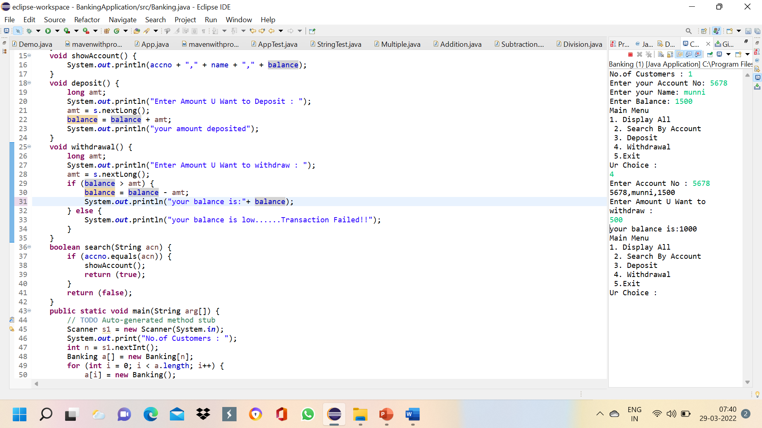
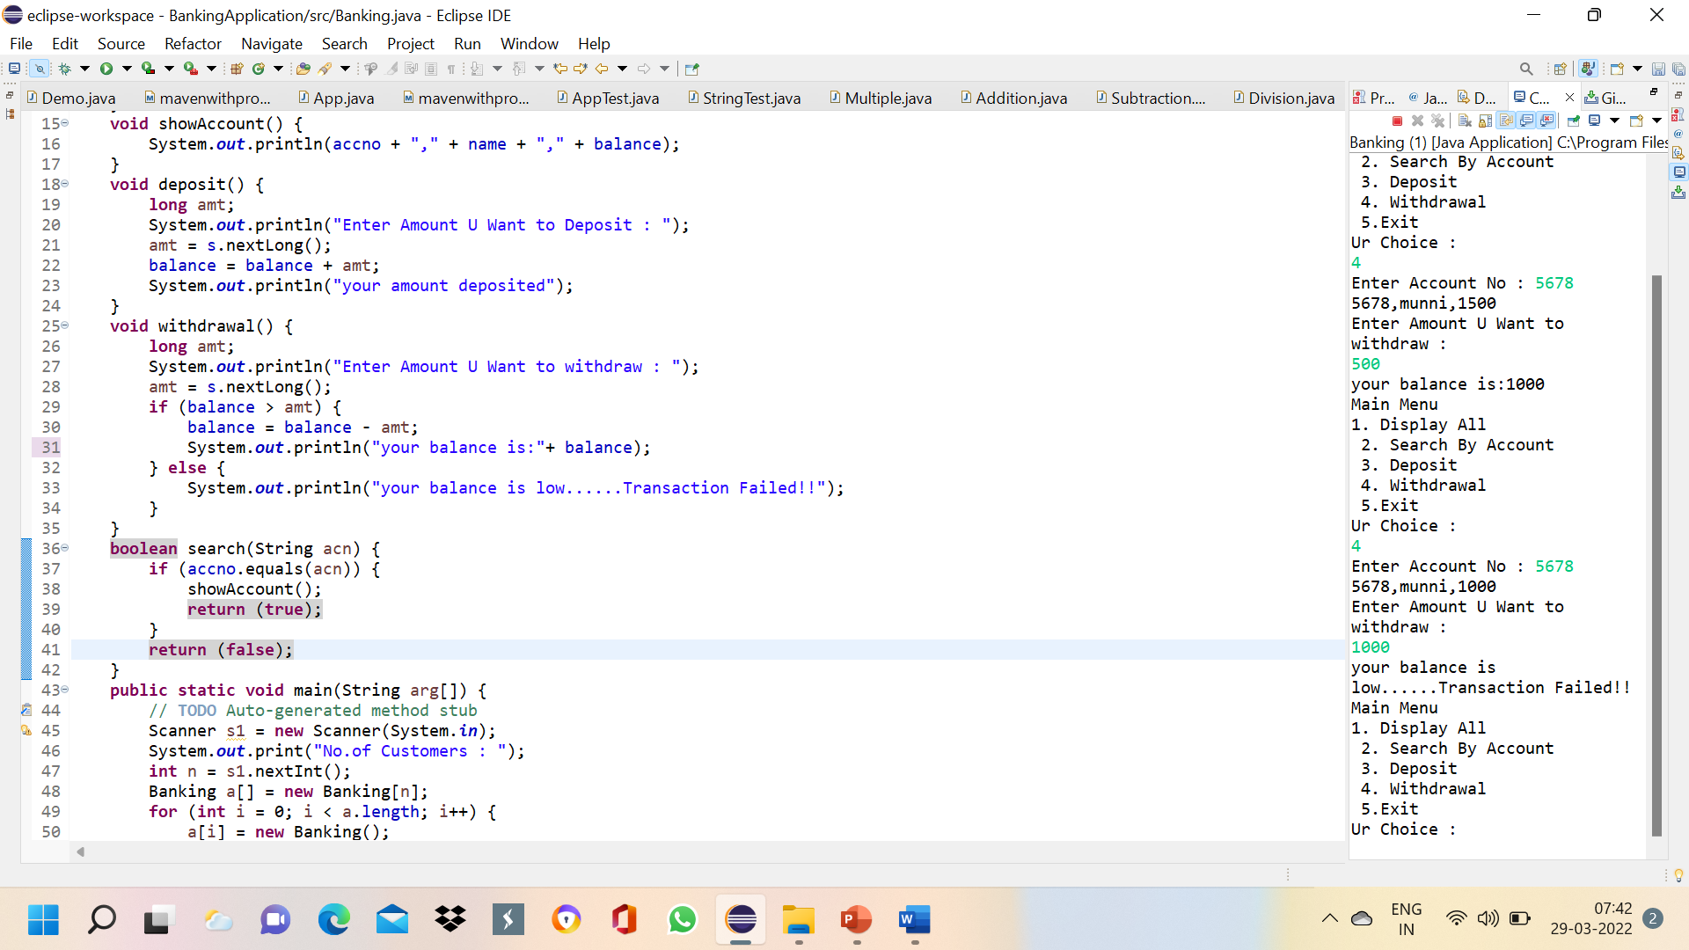
Withdraw:

Slide 9
THANK YOU

