Slide 1


Foreign Satellites Launched by ISRO
An Analytical Dashboard using Power BI

Slide 2

Understanding ISRO's Global Launch Footprint
The Need
Objective
ISRO has launched hundreds of satellites for foreign nations over two decades. Understanding this scale requires systematic analysis.
Build interactive insights to reveal:
Launch patterns and growth trends
Global reach and partnerships
Multiple nations, diverse payloads
Vehicle performance metrics
Complex launch vehicle portfolio
Data-driven strategic intelligence
Evolving commercial landscape

Slide 3

Dataset Overview
1
Source
Official ISRO foreign satellite launch records, validated and verified
2
Time Span
1999–2025: Over 26 years of launch history
3
Volume
434 total satellites analyzed across all missions
4
Attributes
Satellite names, Launch date, Country, Vehicle type, Payload mass

Slide 4

Data Preparation & Transformation
01
02
Standardization
Expansion
Unified country naming conventions across all records
Converted satellite count ranges into individual records
03
04
Normalization
Validation
Resolved mixed payload formats and managed null values systematically
Ensured data integrity with preserved satellite counts throughout

Slide 5

Performance at a Glance
434
37
101
Total Satellites
Countries Served
Record Launch
Launched for foreign clients
Global reach established
Max satellites in one day
38
54K
Launch Vehicles
Maximum Payload
Unique SLV configurations
Kilograms in single mission

Slide 6
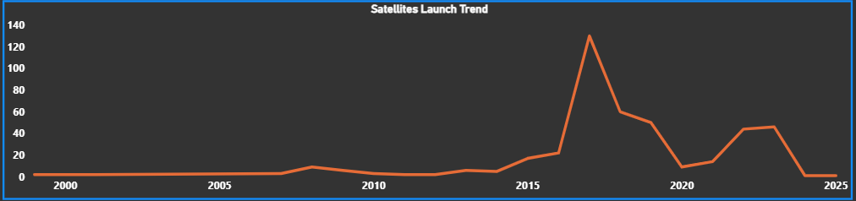
Launch Activity Over Time
Year-wise trends reveal ISRO's expanding commercial capabilities
2017 Peak
Post-2015 Growth
Record-breaking 158 satellites launched, showcasing unprecedented capacity
Dramatic acceleration in commercial missions reflects strategic expansion

Slide 7
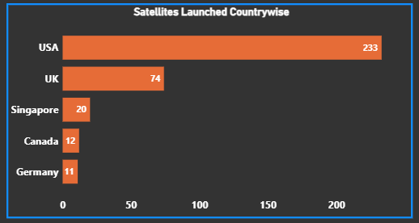
Global Client Distribution
Market Leadership
USA accounts for over 40% of all foreign satellites launched by ISRO
Diverse Portfolio
37 nations trust ISRO's launch capabilities, from North America to Europe and Asia
Strategic Partnerships
Strong presence in advanced space markets demonstrates technical credibility

Slide 8
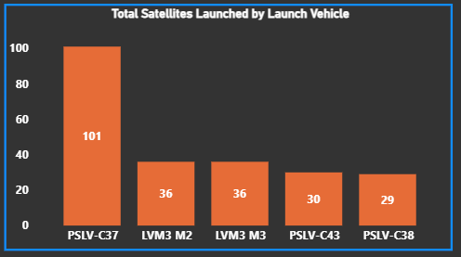
Launch Vehicle Performance
PSLV Dominance
Repeated Trust
Over 80% of foreign satellites launched on PSLV variants, proving reliability and cost-effectiveness
Multiple clients return for subsequent missions, indicating high satisfaction and mission success rates

Slide 9




Strategic Insights
Global Leadership
Vehicle Reliability
ISRO established as world leader in cost-effective small satellite launches
PSLV emerges as the most trusted workhorse for foreign payloads
37 nations served
Consistent performance
Diverse payload capabilities
Flexible configurations
Competitive pricing model
Proven track record
Commercial Expansion
Post-2015 surge signals strategic focus on commercial space services
400% growth rate
Market diversification
Revenue generation

Slide 10

Conclusion
ISRO has emerged as a global leader in foreign satellites launches, particularly in the small and medium satellite segment.
The record launch of 101 foreign satellites in a single day demonstrates ISRO’s technical excellence and operational efficiency.
Consistent use of PSLV variants highlights reliability and cost-effectiveness, making ISRO a preferred launch partner worldwide.

Slide 11

Future Scope
ISRO Perspective
Expand launch frequency to reduce customer waiting periods.
Develop reusable launch technologies to further reduce launch costs.
Strengthen private-sector collaboration under the Indian space ecosystem.
Analytical Perspective
Include revenue and cost analysis for commercial launches.
Compare ISRO vs other global launch providers.
Integrate real-time launch data for live dashboards.

Slide 12
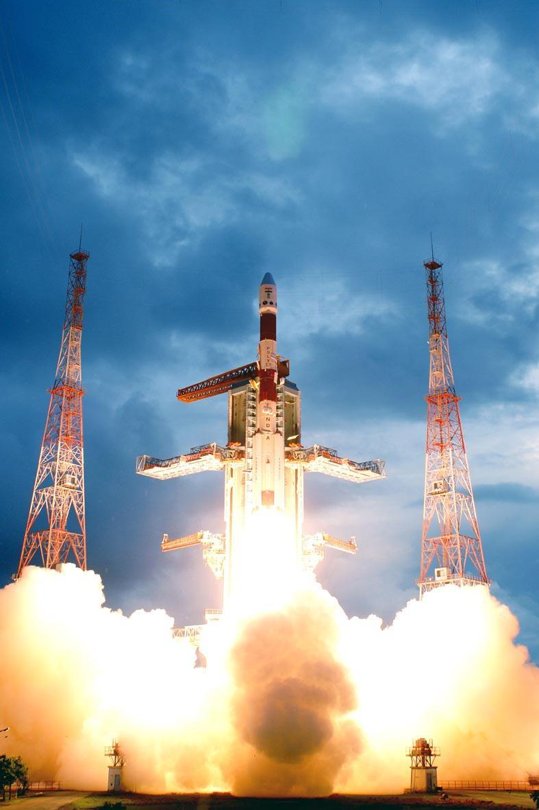
THANK YOU!

