Slide 1



Forest Fire Detection
Using Deep learning
Student name : Mr. Maitreya Kamble
AICTE ID : STU67d99a213c9721742314017
Internship ID : INTERNSHIP_174099535967c57b1f336c3

Slide 2

Learning Objectives
My goal was to understand Convolutional Neural Networks (CNNs) and apply them to image classification, specifically for detecting wildfires in forest images. I focused on training accurate deep learning models, preprocessing image data, preventing overfitting, evaluating performance, and using tools like TensorFlow, Keras, and OpenCV. I also explored real-time detection and transfer learning for improved accuracy.
Image Dataset Preparation: Learning effective techniques for preprocessing, organizing, and structuring image datasets to optimize model training.
Model Optimization: Exploring methods to mitigate overfitting, including the use of dropout layers and data augmentation strategies.
Model Evaluation: Practicing the evaluation of model performance using metrics such as accuracy, loss curves, and confusion matrices to assess classification effectiveness.
Tool Proficiency: Gaining practical experience with TensorFlow, Keras, and OpenCV for deep learning model development and image processing.
Prediction System Development: Building a system capable of making predictions on individual images and planning for real-time wildfire detection capabilities.
Advanced Techniques: Investigating the use of transfer learning to improve model accuracy and efficiency for deployment in real-world scenarios.
GOAL

Slide 3
Tool and Technology used
Python – My primary programming language for building and training the model.
Tensor Flow & Keras – Used to design, train, and evaluate the Convolutional Neural Network (CNN).
OpenCV – Helped me handle and process image data efficiently.
NumPy & Pandas – For data manipulation and preprocessing.
Matplotlib & Seaborn – To visualize training results, accuracy trends, and confusion matrices.
Scikit-learn – For model evaluation and performance metrics.
Google Colab/Jupyter Notebook – Used for code development, testing, and visualization in an interactive environment.
Kaggle – Source of the wildfire image dataset and a great platform for research inspiration.
Streamlit (Planned) – For building a web demo of the fire detection system.

Slide 4
Methodology
I began by collecting and organizing the wildfire dataset from Kaggle into training, validation, and test sets.
Then, I preprocessed the images by resizing and normalizing them to prepare for training. I also applied data augmentation techniques to make the model more robust.
I designed a Convolutional Neural Network (CNN) with Conv2D, MaxPooling, Dropout, and Dense layers to extract features and classify the images.
The model was trained on the training set and validated on the validation set to fine-tune hyperparameters and prevent overfitting.
After training, I evaluated the model’s performance on the test set, achieving around 80% accuracy.
I also created a prediction script to test the model on new images and analyze the output.

Slide 5
Problem Statement:
Wildfires pose a serious threat to our environment, wildlife, and human lives, often spreading rapidly before they are detected. I want to build an intelligent system that can automatically detect wildfires from images using deep learning. This system aims to provide early warning by accurately distinguishing between fire and non-fire images, helping in faster response and prevention efforts. The challenge lies in training a reliable model that can handle diverse forest conditions and varying fire appearances, minimizing false alarms and missed detections.

Slide 6
Solution:
To tackle this challenge, I developed a Convolutional Neural Network (CNN)-based image classification model that can accurately detect the presence of wildfire in forest images. Using The Wildfire Dataset from Kaggle, I trained the model to learn complex patterns and visual cues that differentiate fire from non-fire scenes. The architecture includes convolutional, pooling, dropout, and dense layers to ensure robust learning while minimizing overfitting. Once trained, the model can classify unseen images with around 80% accuracy, making it a promising step toward automated wildfire detection. This solution can serve as the foundation for real-time video surveillance, drone-based monitoring, or even mobile-based alert systems in the future.
GITHUB REPOSITORY : https://github.com/Maitreya5/Week-3

Slide 7
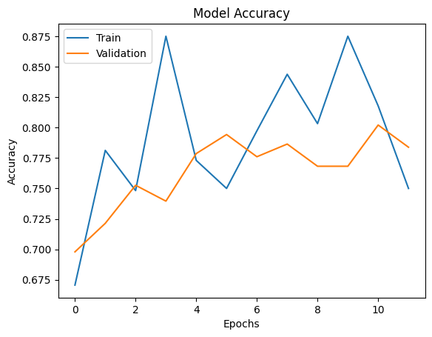
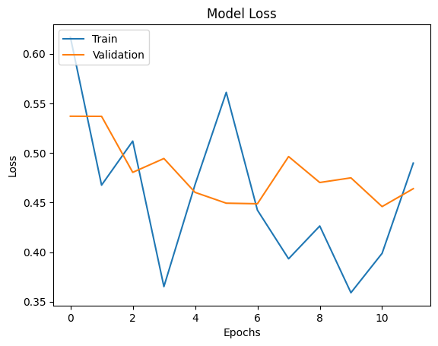
Screenshot of Output:
Graph : Model Accuracy and Loss

Slide 8
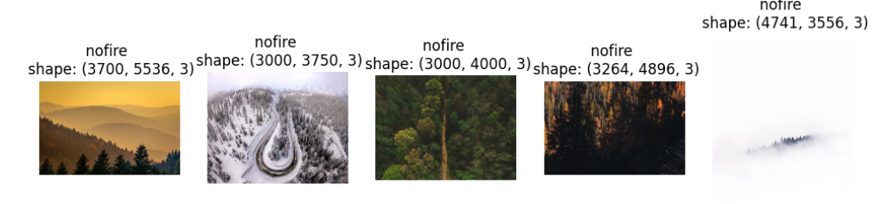
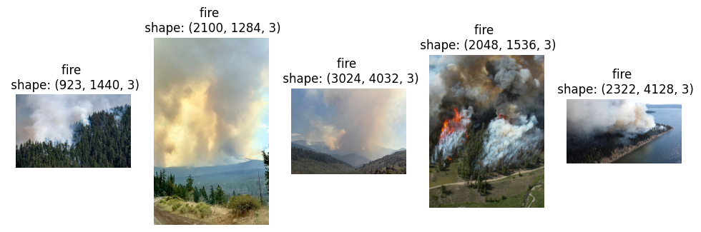
Training data image into two classes nofire and fire

Slide 9
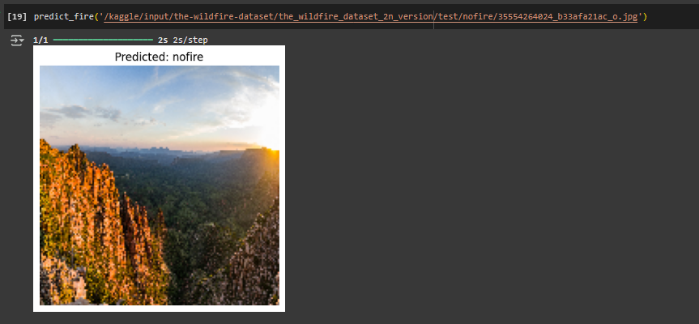
As we give path of image of forest to predict the fire or no fire , it will predict the output .

Slide 10
Conclusion:
This project demonstrated the potential of deep learning in addressing real-world environmental challenges. By training a Convolutional Neural Network on wildfire imagery, I developed a model capable of distinguishing fire from non-fire scenarios with promising accuracy. Beyond model development, the project highlighted the importance of early wildfire detection in protecting lives and ecosystems. Future directions include real-time video analysis, web deployment, and integration with drones or IoT systems. This experience reinforced my commitment to leveraging AI for meaningful impact. Thankyou.

