Slide 1
Clothing E-commerce SQL Database
Group 3
Krishna Yashwanth Tummala
Rituja Vishwanath Mahajan
Vinotha Subramaniyan
Maitreya Dayanand Babar

Slide 2
Project analysis slide 2
Project Objectives
Create a SQL database for multiple small business clothing vendors to offer their products
Provide a safe and secure platform for customers to browse and purchase clothes
Provide a platform for customers to give their feedback on purchased products
Provide a platform for vendors to connect with shipping contractors

Slide 3
Project analysis slide 3
Project Design
MARKET ANALYSIS
TECHNICAL ANALYSIS
FINANCIAL ANALYSIS
Gives an idea about the best-selling products and the view segments which showcases the growth of the business.
To maintain data integrity and derive unique insights from customer behavior for further analysis
The data shared between departments involves a deeper analysis than simple accounting work.

Slide 4
Project analysis slide 4
E-R Diagram

Slide 5
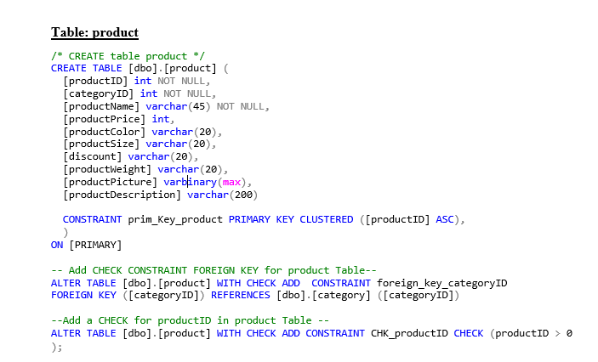
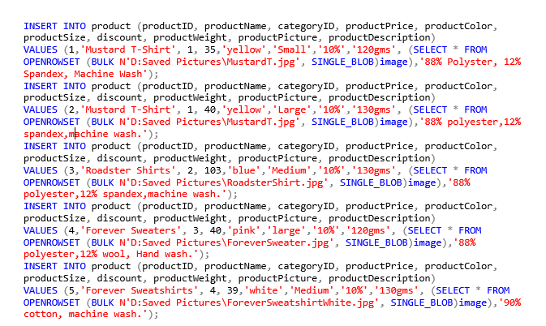
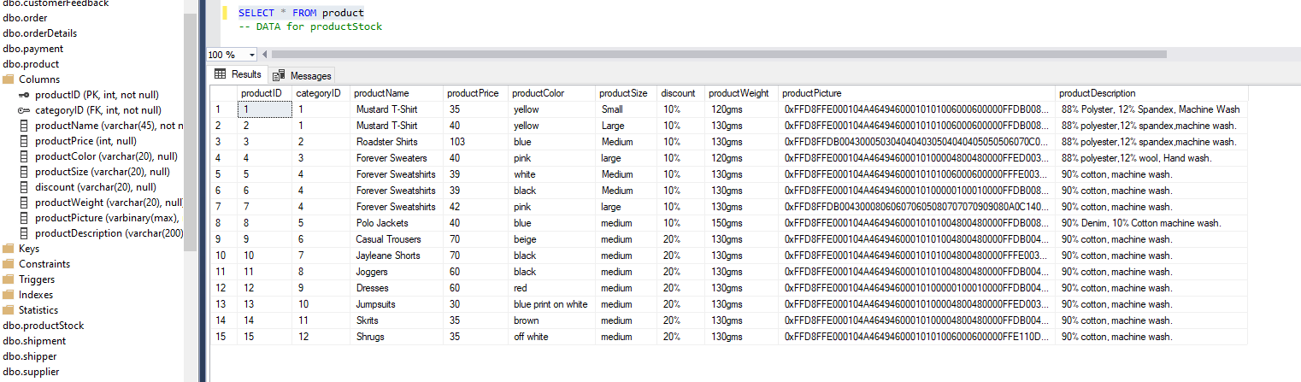
Project analysis slide 5
Database Objects
DDL for Product Table
Inserting data into Product Table

Slide 6
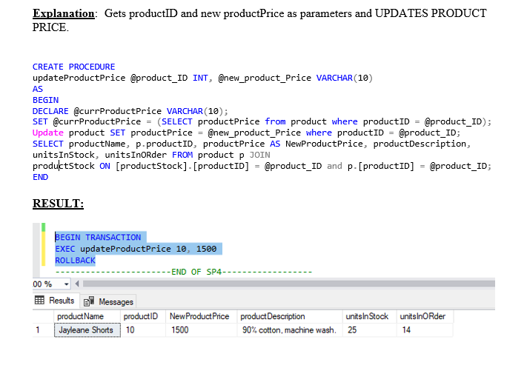
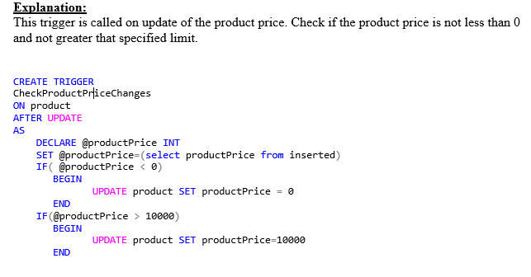
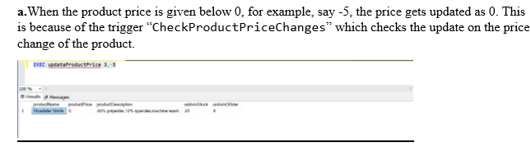
Project analysis slide 6
Database Objects
Stored Procedures
Triggers

Slide 7
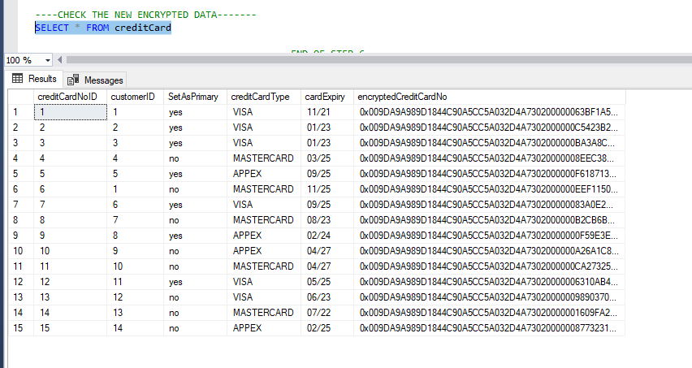
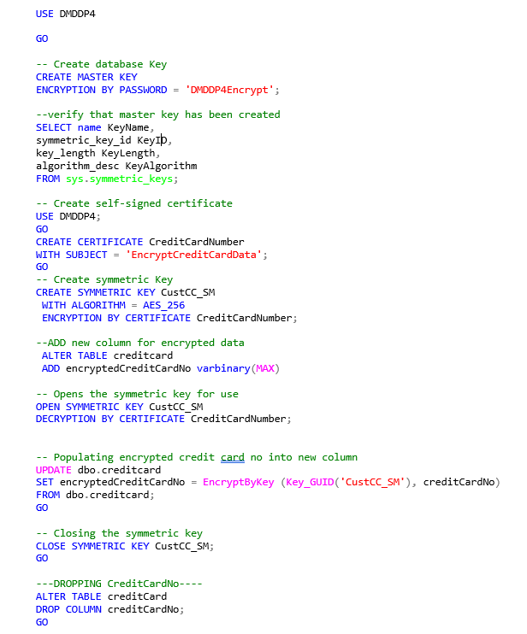
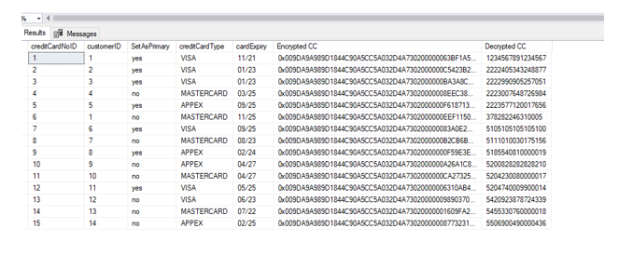
Project analysis slide 7
Database Objects
Encryption
---Decrypting Credit Card No-
OPEN SYMMETRIC KEY CustCC_SM
DECRYPTION BY CERTIFICATE CreditCardNumber;
SELECT creditCardNoID, customerID, SetAsPrimary, creditCardType, cardExpiry, encryptedCreditCardNo AS 'Encrypted CC', CONVERT(varchar(50), DecryptByKey(encryptedCreditCardNo)) AS 'Decrypted CC'
FROM creditcard

Slide 8
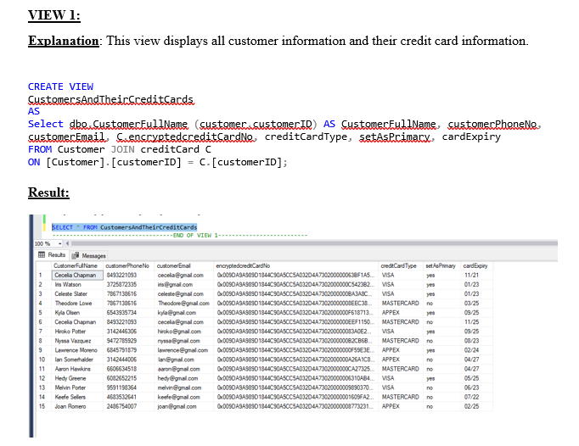
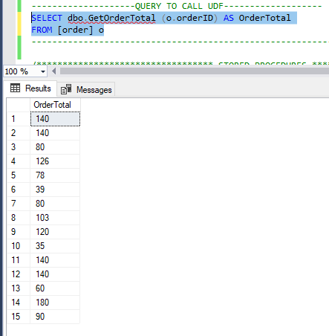
Project analysis slide 8
Database Objects
Views
User Defined Function

Slide 9
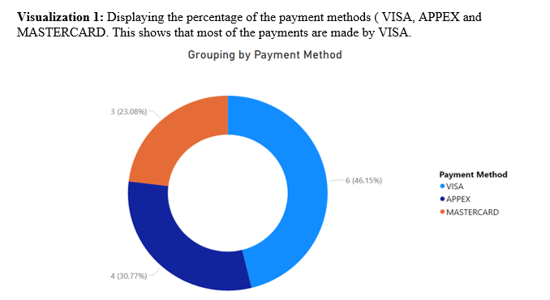
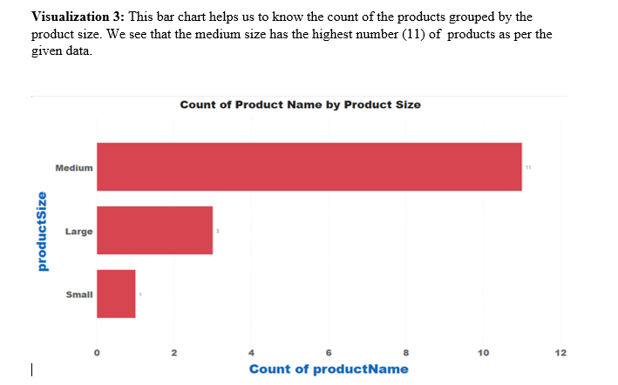
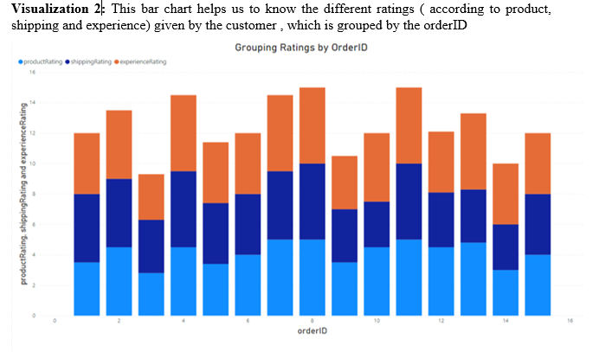
Project analysis slide 10
Project Analysis
Power BI analysis

Slide 10
Thank You

