Slide 1

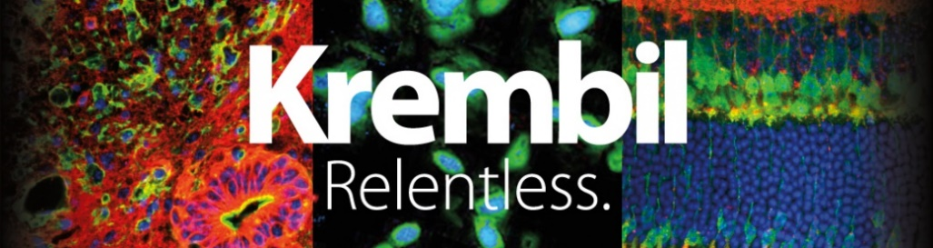

Mini- Symposium
May 5-August 28, 2020
Maitreyi Joshi
23/08/2020

Slide 2
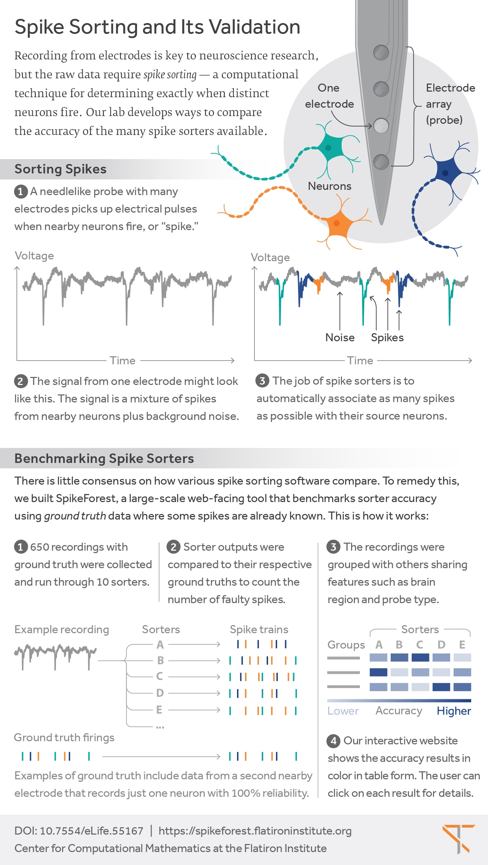
Introduction-Spike Sorting
https://www.simonsfoundation.org/flatiron/center-for-computational-mathematics/image-and-signal-processing/spikeforest/

Slide 3
Benchmarking Spike Sorters
Spike Forest and Spike Interface tools are used to benchmark various spike sorting algorithms like Mountain Sort ,Kilo Sort and SpykingCircus.
These tools provide an easy interface to preprocess, run the sorters (through wrappers) and validate the results with ground truth.

Slide 4
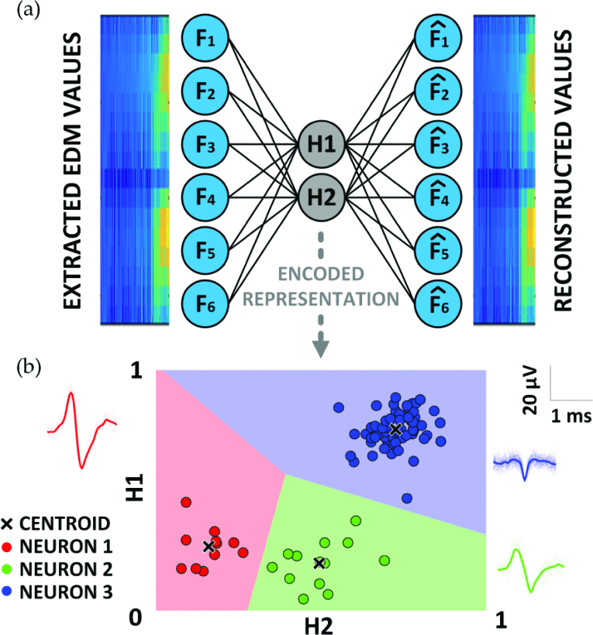
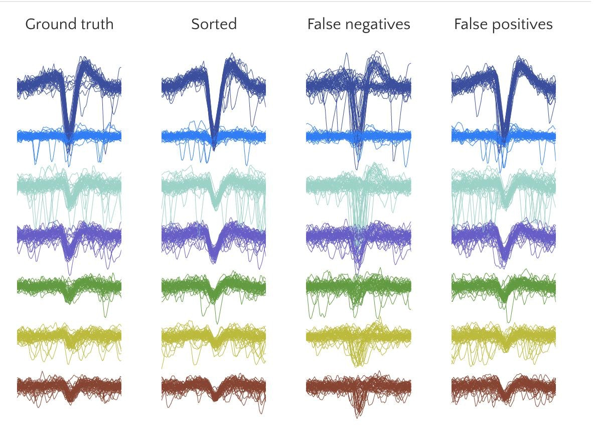
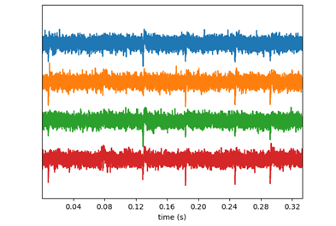
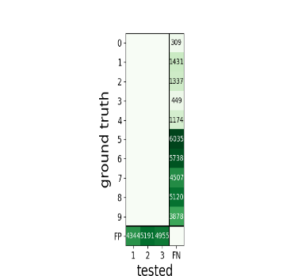
Steps in Benchmarking
G. O’Leary, A. Gierlach, R. Genov and T. A. Valiante, "Neural Interface System for Virtual High-Density Microelectrode Array Adaptive Neuromodulation," 2019 IEEE Biomedical Circuits and Systems Conference (BioCAS), Nara, Japan, 2019, pp. 1-4, doi: 10.1109/BIOCAS.2019.8918739.
https://www.simonsfoundation.org/flatiron/center-for-computational-mathematics/image-and-signal-processing/spikeforest/
Exponentially Decaying Memory Tree Algorithm from uNIT project
Spike Interface and Spike Forest Package
Visualise and Benchmark all 3 algorithms
Mountain Sort
SpykingCircus

Slide 5

Validation of Data
The sorting output is compared to the ground truth data using statistical tools like agreement matrix.
True Positives –spike found both in ground truth data and sorted output.
Accuracy is one such measure plotted in this matrix.

Slide 6
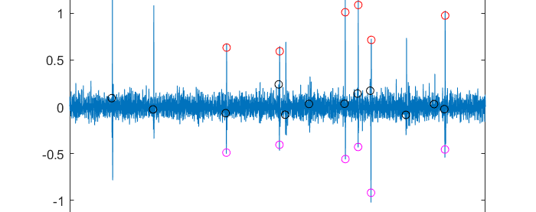
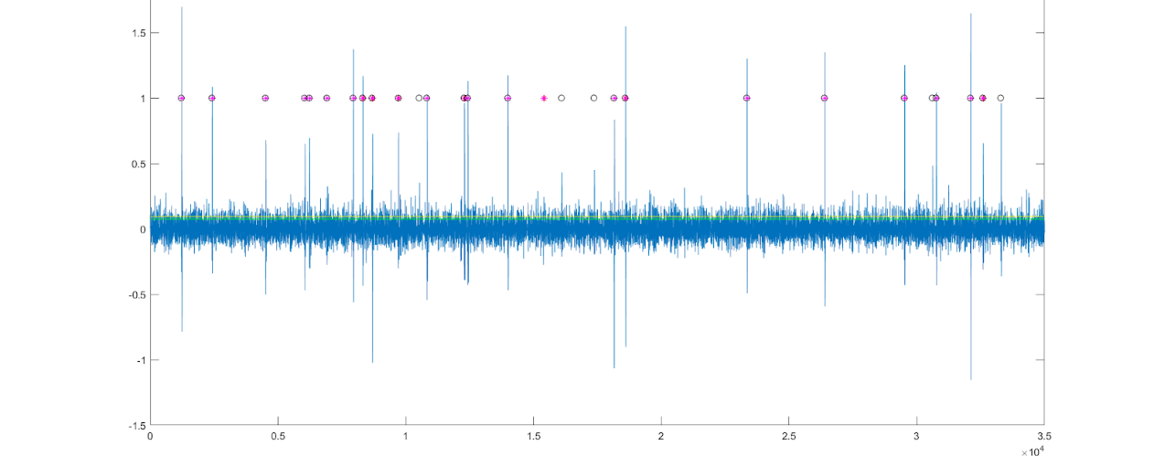
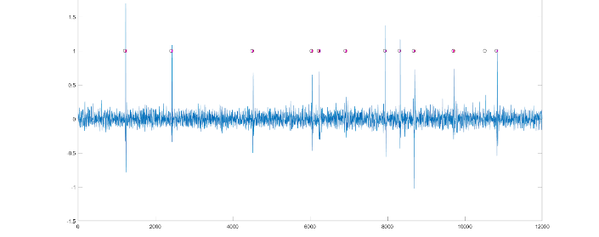
Experimenting with the MATLAB Algorithm
The data-set to be used for final benchmarking is SYNTH_MONOTRODE-single channel format, extracellular.
The plots on the right illustrate the spike events detected by the algorithm along with the spike events found in the ground truth.

Slide 7
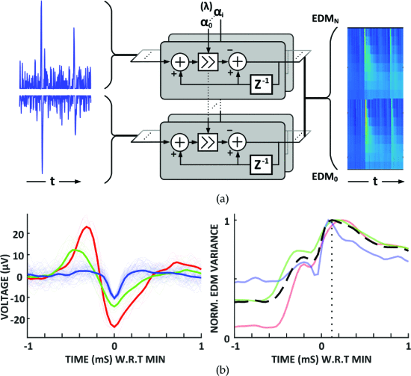
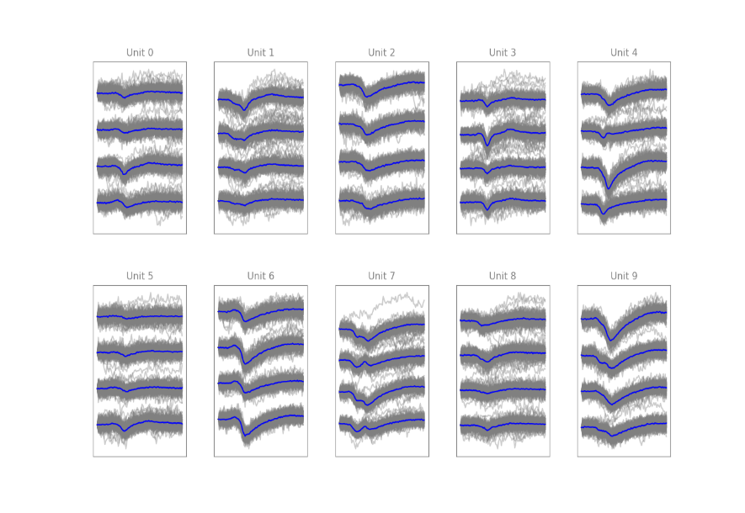
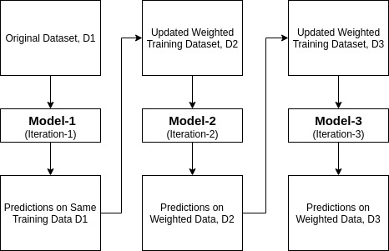
Ada-Boost Classifier
EDM Features and spike labels from ground truth
(training)
G. O’Leary, A. Gierlach, R. Genov and T. A. Valiante, "Neural Interface System for Virtual High-Density Microelectrode Array Adaptive Neuromodulation," 2019 IEEE Biomedical Circuits and Systems Conference (BioCAS), Nara, Japan, 2019, pp. 1-4, doi: 10.1109/BIOCAS.2019.8918739.
Iterative-ensemble boosting classifier.
AdaBoost classifier builds a strong classifier by combining multiple poorly performing classifiers to get high accuracy strong classifier.
Model learns to identify clusters

Slide 8
Going forward-Classifying brain states from neural data using ML
Electrophysiological data sets involving specific labelled “activity” of participants are hard to find.
Found 2 such data sets-recordings from Monkeys and Rodents where specific physical tasks are being performed by the animals.
Aim: Along with spike sorting, labelling each spike to a corresponding activity performed by the animal.
Approach: Machine Learning based Algorithm similar to Ada Boost Algorithm.

Slide 9
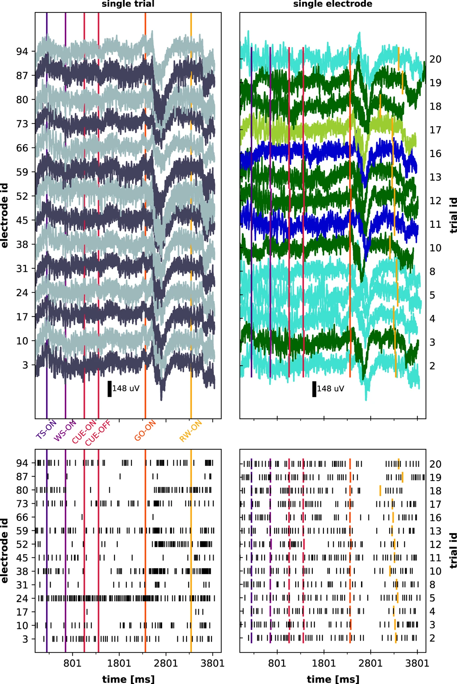
About the Data-set
recorded in motor cortex of two macaque monkeys
instructed delayed reach-to-grasp task
8 specific events: the precise timing of object touch (OT) and object release (OR) from the force traces, as well as the timing of displacement onset (DO) and object back to baseline (OBB) from the displacement trace.
Brochier, T., Zehl, L., Hao, Y. et al. Massively parallel recordings in macaque motor cortex during an instructed delayed reach-to-grasp task. Sci Data 5, 180055 (2018). https://doi.org/10.1038/sdata.2018.55

