Slide 1

ShipTriage
Supply Chain Disruption Decision Support
IBM BoB AI Innovation Hackathon 2026
Team: CargoMind
DISRUPTION
Unexpected supply chain interruption affecting shipments.
DECISION
Select mitigation actions and route recovery plans.
TRIAGE
Assess impact, prioritize issues, and allocate resources.

Slide 2
The Problem
When a disruption happens, the hard part is deciding what to do next.
Disruption
Impact Identification
Different Urgency
Rerouting Trade-offs
One disruption can affect multiple shipments.
Not every affected shipment has the same priority.
Managers need to identify which shipments are affected.
Rerouting decisions involve delay, cost, SLA, and feasibility trade-offs.
Managers need a structured decision process to move from disruption to action.

Slide 3
Our Solution
Disruption → Triage → Decision
ShipTriage helps a logistics operations manager move from a disruption event to a documented routing decision.
UNDERSTAND IMPACT
PRIORITIZE
DECIDE & LOG
Identify affected shipments and surface relevant shipment details.
Apply an explainable rule-based priority score.
Compare rerouting options, review a recommendation, approve or override it, and log the decision.
The manager remains in control of the final decision.

Slide 4







How It Works
1. Disruption
2. Affected Shipments
3. Priority Ranking
4. Rerouting Options
5. Recommendation
Event enters the workflow.
Identify shipments impacted by the disruption.
Rank shipments using explainable rules.
Compare simulated alternatives.
Surface the preferred option.
6. Approve / Override
7. Decision Log
Record the decision for traceability.
Manager makes the final decision.

Slide 5
Shipment Prioritization
Explainable Rule-Based Priority Scoring
40%
30%
20%
10%
SLA Urgency
Customer Importance
Cargo Criticality
Shipment Value
Priority Tiers
CRITICAL
HIGH
NORMAL
No ML model is used for this scoring.

Slide 6
Rerouting & Recommendation
Compare options using the information that matters to the decision.
Estimated delay
Estimated cost
SLA met / not met
Feasibility
Shipment priority
 | Route A | Route B | Route C
Delay | Moderate | High | Low
Cost | $$ | $$$ | $
SLA | Met | Missed | Met
Feasible | High | Medium | Low
Compare Options
Recommendation
Manager Review
Approve / Override
The recommendation supports the manager; it does not replace the manager.

Slide 7
Demo / User Journey
Disruption
Analyse Impact
Affected Shipments
Priority
Shipment Details
TRIAGE
TRIAGE
TRIAGE
DECISION
DECISION
Rerouting Options
Recommendation
Approve / Override
Decision Log
DECISION
DECISION
CONTROL
CONTROL

Slide 8
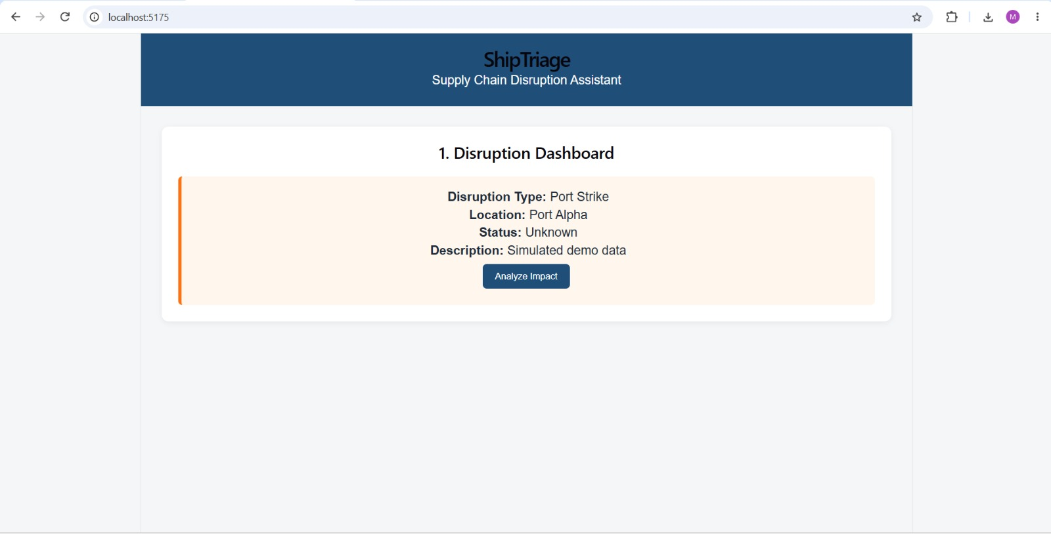
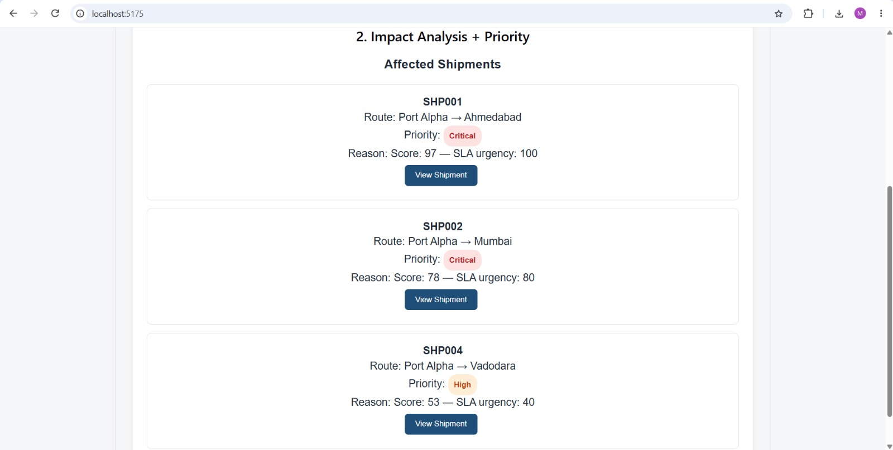

Slide 9
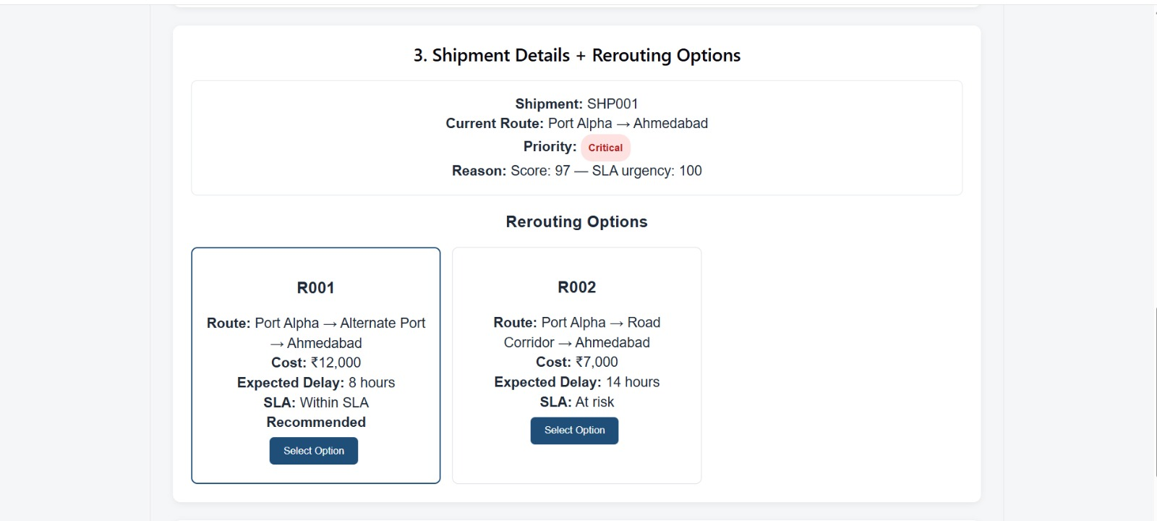
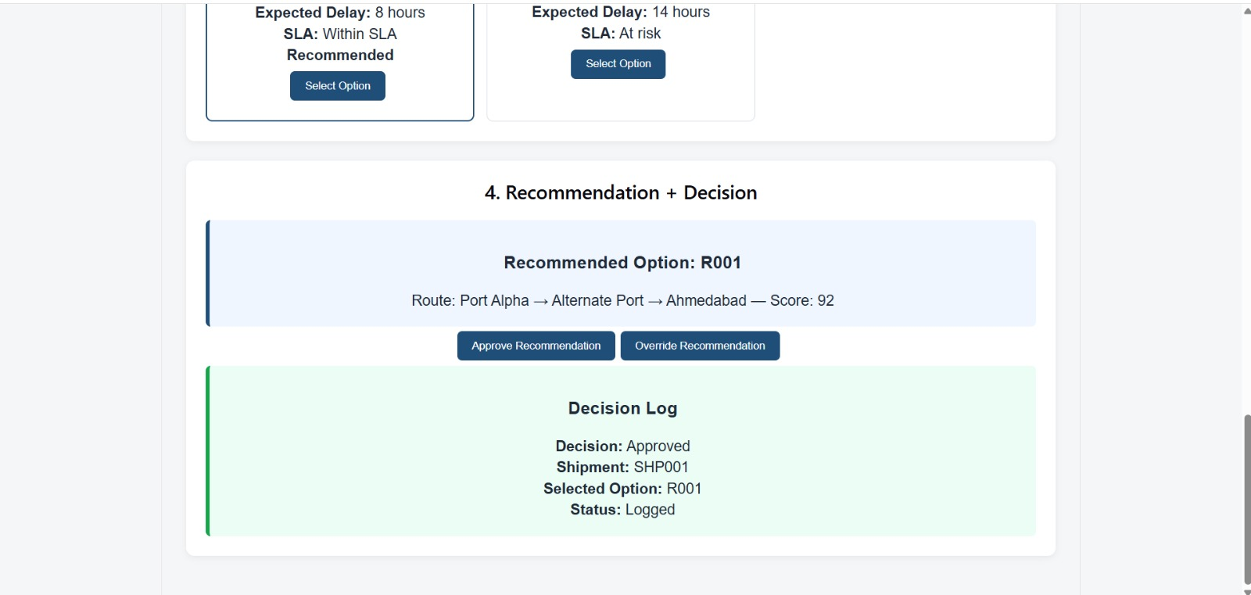

Slide 10


Slide 11
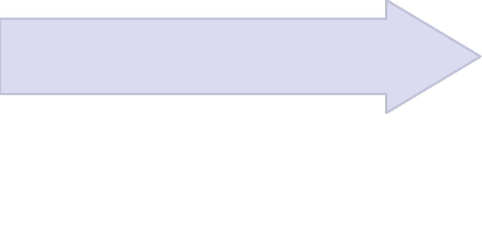
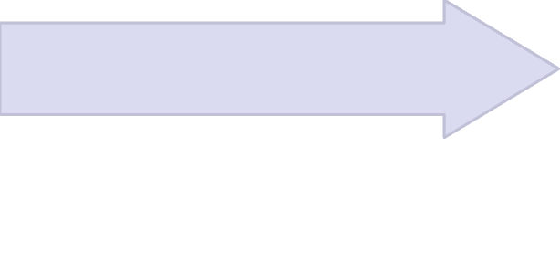


System Architecture
Clear separation between the runtime stack and development support.
Runtime Stack
Development Support
IBM BoB supports development and SDLC tasks only.
Node.js + Express API
React Frontend
Development / SDLC Support
Logistics Operations Manager
IBM BoB
IBM BoB is NOT the runtime decision engine.
SQLite Database
Rule-Based Decision Engine

Slide 12
Impact / Value
Practical value for disruption decision-making
Faster Understanding
Clear Prioritization
Structured Comparison
Explainable Recommendation
Human Control
Managers can approve or override recommendations.
Quickly see disruption impact and affected shipments.
Use consistent, explainable rules to surface urgency.
Compare rerouting options using relevant trade-offs.
Understand why an option is suggested.
Traceability
Decisions are recorded for later review.
ShipTriage turns disruption response into a structured, explainable decision workflow.

Slide 13
Limitations & Future Scope
CURRENT LIMITATIONS
FUTURE SCOPE
Demo uses simulated shipment and disruption data.
No live carrier or logistics-data integrations.
No real-time GPS tracking.
No ML-based disruption prediction.
Current routing support is a structured comparison, not advanced route optimization.
Fleet-level optimization and IoT/cold-chain monitoring are not part of the current MVP.
Integrate real-time logistics data.
Connect real carrier APIs.
Add live GPS / tracking feeds.
Explore ML-based disruption prediction.
Add more advanced route optimization.
Extend to fleet-level optimization.
Add IoT / cold-chain monitoring and excursion severity support.
Current MVP ≠ Future Scope

Slide 14
SHIPTRIAGE
Turns a supply-chain disruption into a structured, explainable decision workflow.
Disruption → Triage → Decision → Logged
Thank You
CargoMind
IBM BoB AI Innovation Hackathon 2026

