Slide 1

- Maitri Chande

Slide 2

Introduction
Goal: To develop a multiclass sentiment analysis model to accurately classify abusive tweets into different categories of sentiments.
Sentiment analysis is a process of analyzing and understanding people's opinions, attitudes, emotions, and feelings towards a particular topic, product, service, or event. It involves using NLP techniques and machine learning algorithms to automatically identify, extract, and classify the sentiment expressed in a text, such as a tweet, review, comment, or article.
Abusive tweets are those that contain offensive, derogatory, or harmful language, which can cause emotional distress, harm, or discrimination towards individuals or groups.

Slide 3

Techniques
Stopwords
common words
Punctuation
special char
Tokenization
smaller unit
Stemming
Lemmatization
numbers
root form
base form

Slide 4
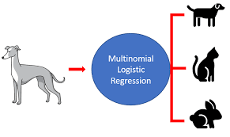
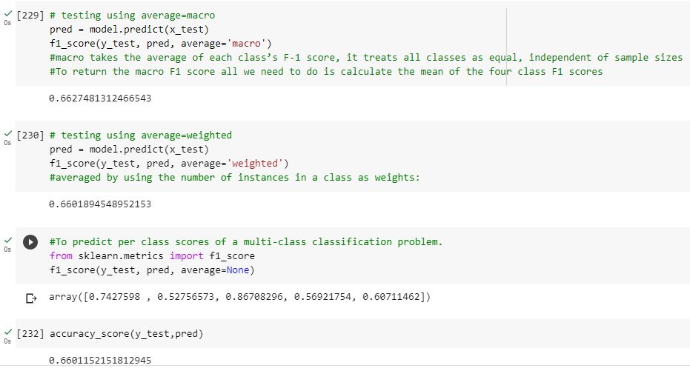
model
Multinomial Logistic Regression

Slide 5
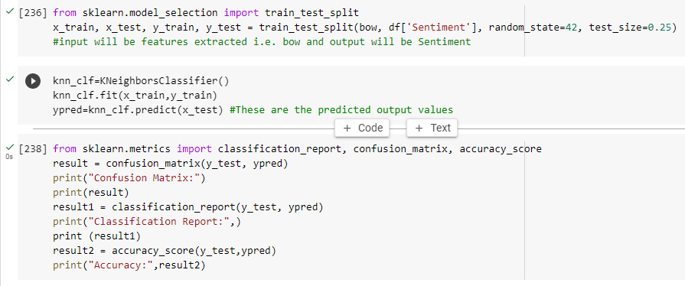
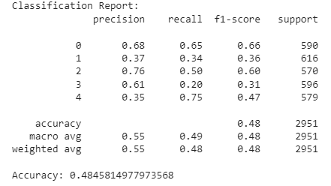
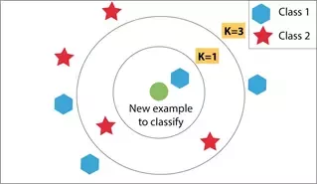
model
K-Nearest Neighbor (KNN)

Slide 6
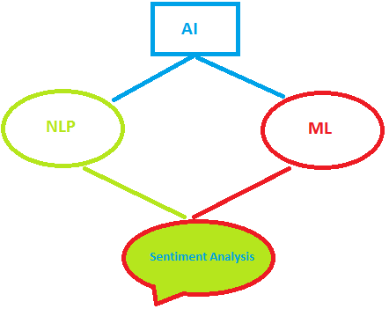
conclusion
The conclusion of a sentiment analysis of abusive tweets using Multinomial Logistic Regression and KNN model depends on the specific dataset and analysis conducted.
In our case, accuracy of Multinomial Logistic Regression is more as compared to KNN indicating that the data is more suited for linear modeling rather than clustering
Overall, the choice of the most suitable model for sentiment analysis of abusive tweets depends on various factors such as the characteristics of the dataset, the goals of the analysis, and the resources available.

